Slide 1
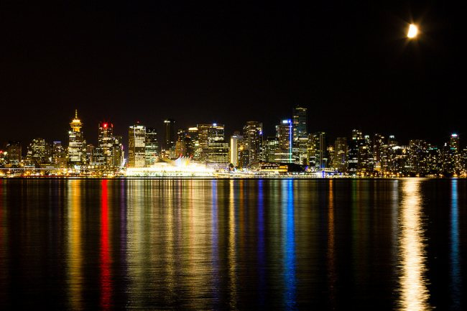
Canadian Geography 1202
Unit 1.2: Human Systems

Slide 2
Characteristics of Human Systems
Human Systems
Are connected in a complicated network of relationships
Depend on natural systems
Can be affected by outside influences and events
Are not well understood by humans
Have shorter timelines than natural systems
Often has harmful waste
Display Synergy

Slide 3
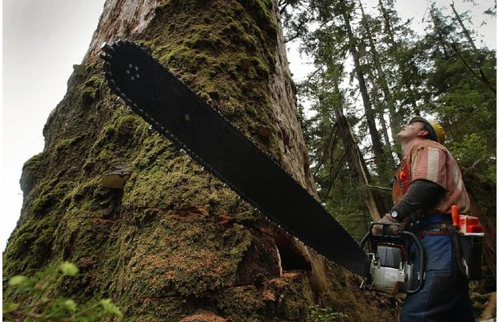
Human Systems
Human systems are developed as a means to fulfill peoples’ individual and collective needs and wants.
With technology we are able to manipulate our environment to make it easier to live in
Human systems use the resources provided by natural systems to change our environment.

Slide 4
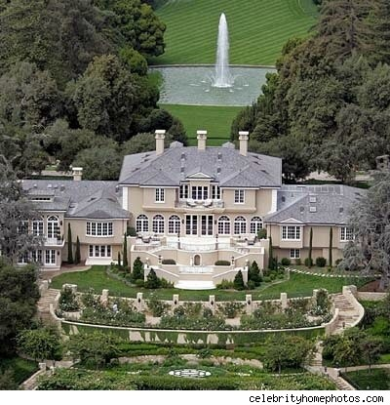
Needs and Wants
Needs: Something that is essential for normal human life to continue.
Wants: Something that can improve quality of life but is not essential for life
Oprah’s House

Slide 5
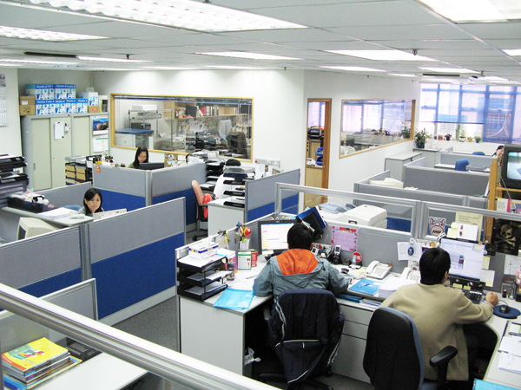
Types of Human Systems
Communication
Energy
Infrastructure
Transportation
Economic

Slide 6
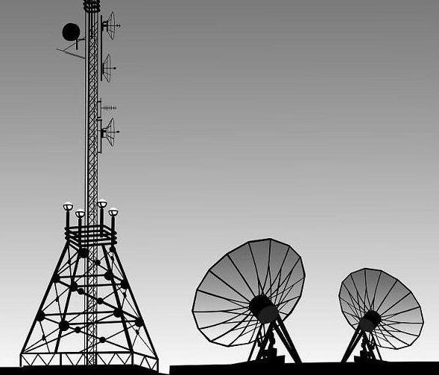
Communication Systems
Purpose: To fulfill the human need to communicate with each other over vast distances.
Allows for business to be conducted
Allows for a person in one are to instruct people in others
Allows humans to keep in contact with each other
Elements: Communication systems all have
Input
Transmitted signal
Received signal
Output

Slide 7
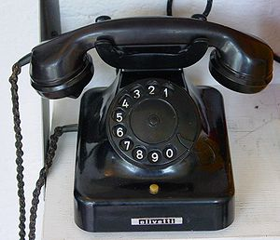
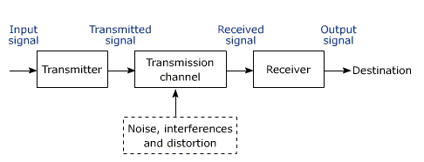
Communication Systems
To get from the source to the destination communication must go through transmitter, transmission channels and then a receiver.

Slide 8
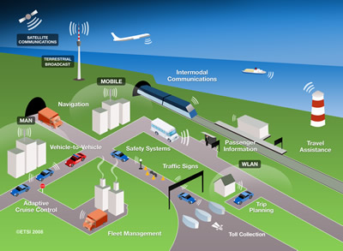
Types of Communication Systems
Mobile (Cell Phone)
GPS Navigation
Television
E-mail
Telephone
Radio

Slide 9
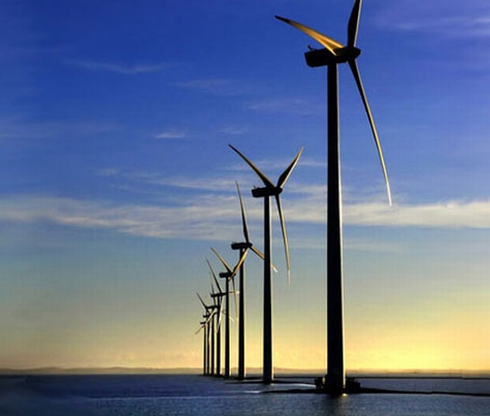
Energy Systems
Purpose: To fulfill the human need for energy in the form of electricity, combustible fuels, or mechanical energy
Elements: There are three elements in an energy system
1. Input (solar, wind, water, gas)
2. Process that allows us to harvest the energy
(turning a turbine, pushing a piston)
3. Output: Some useable form of energy
(Electricity, mechanical motion, heat)

Slide 10
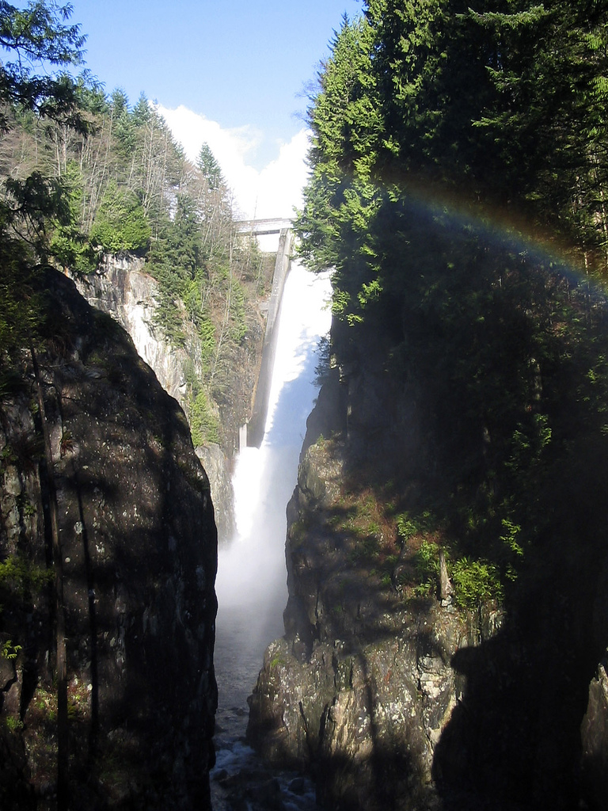
Types of Energy Systems
Hydro Electric
Gasoline
Propane
Wind

Slide 11
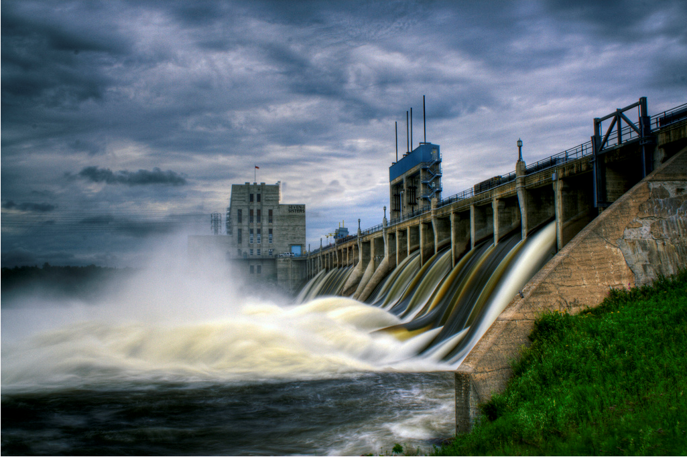
Hydro-Electricity
Uses the power of rivers to generate electricity
The river turns turbines as it passes through a dam
Construction of the dam destroys ecosystems
Once completed the dam provides a clean source of renewable energy

Slide 12
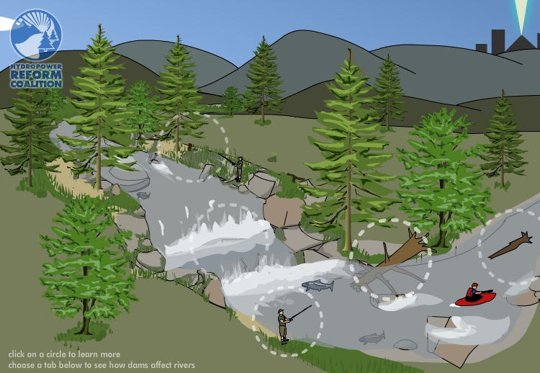

Slide 13
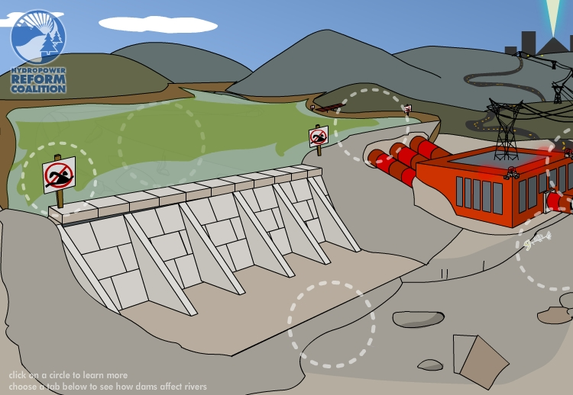

Slide 14
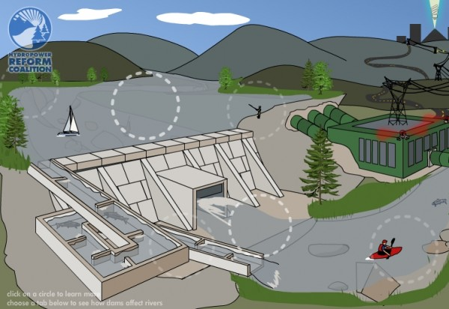

Slide 15
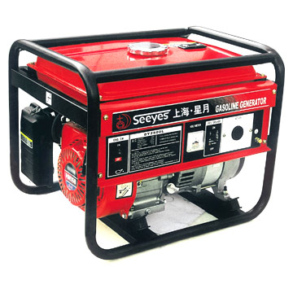
Gasoline
Gas powered generators create electricity by burning gasoline
Gasoline is fed into a combustion chamber and then ignited
The resulting force pushes a piston and turns the motor generating electricity
Burning gasoline generates many toxic fumes that damage the environment

Slide 16
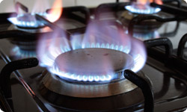
Propane
Propane is a non renewable gas that can be burned to cook over, or to generate other forms of energy
Like gasoline propane is a non renewable resource, once it is burned it cannot be recovered
Propane is a dangerous explosive gas, and much care must be taken in handling it
Many cities in Canada have natural gas systems that provide gas services through lines that run much like the sewers.

Slide 17
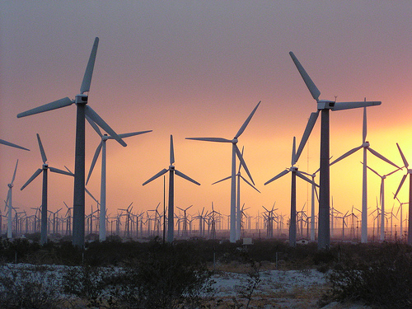
Wind Power
Wind turbines harvest the power of the wind to generate electricity
Large wind farms like the one above generate massive amounts of power
While expensive to start and maintain wind turbines offer a clean solution to todays energy needs
Recently Health Canada has begun an inquiry into the possible health effects of living near these wind turbines

Slide 18
Economic Systems
Economic System: A system of different people and agencies that allow for goods or money to be exchanged for goods and services
Purpose: To allow people to trade one thing for another to fulfill needs and wants.
Elements:
Goods, services, or money to trade
A place of trade
Goods and or services that fulfill needs or wants

Slide 19
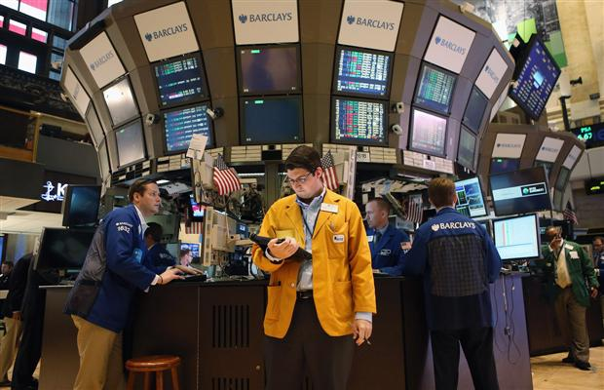
Examples of Economic Systems
Banks
Trade
Money
Shopping

Slide 20
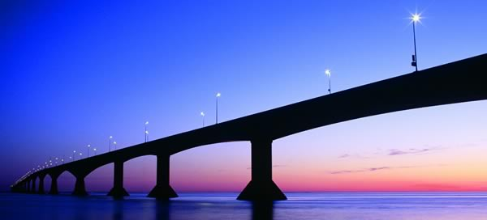
Infrastructure Systems
Infrastructure: is basic physical and organizational structures needed for the operation of a society
Purpose: The purpose of infrastructure is to allow for society to function.
The Confederation Bridge, which joins Prince Edward Island and New Brunswick, is the longest bridge over ice-covered waters in the world at 12.9 kilometers.

Slide 21
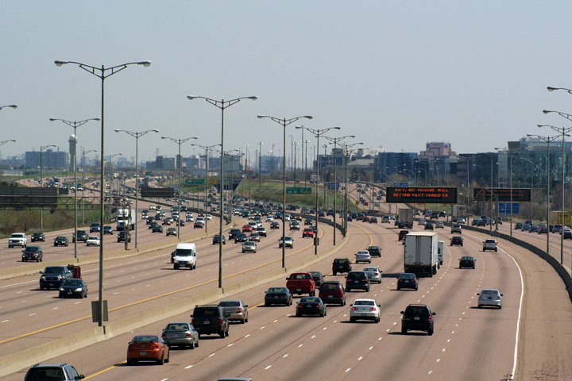
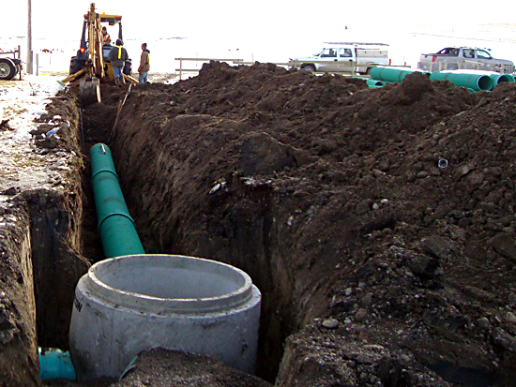
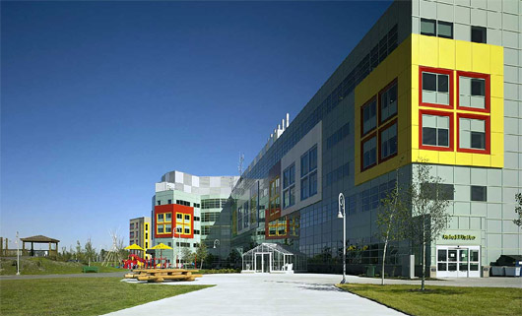
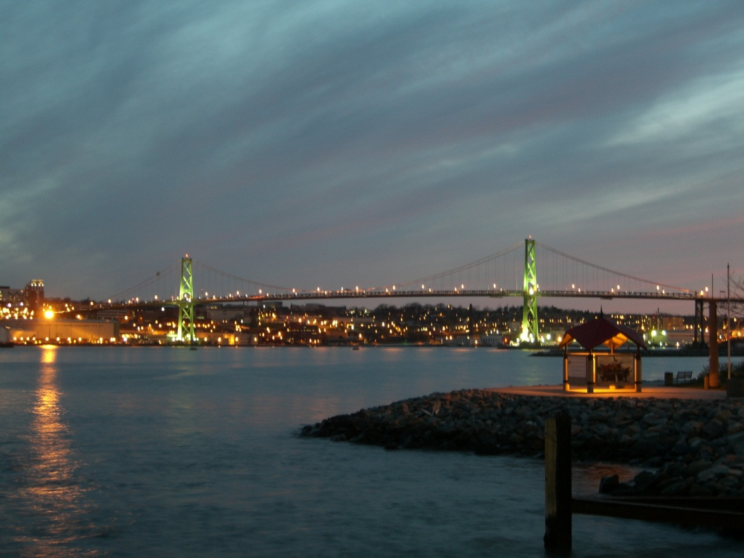
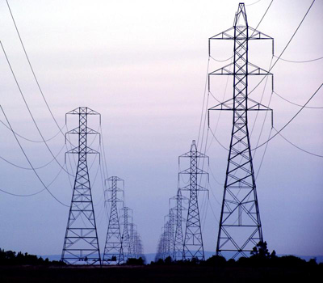
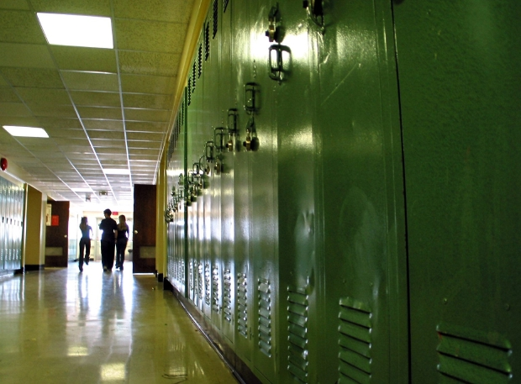
Examples of Infrastructure
Water & sewer systems
Roads
Hospitals
Power Lines
Schools
Bridges
, , ,

Slide 22
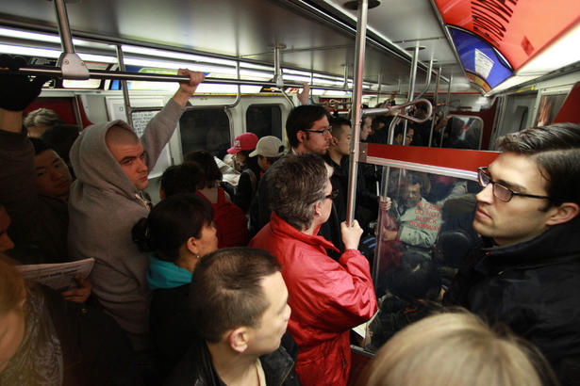
Transportation Systems
Transportation Systems: Systems that move people or goods from one place to another
Purpose: To allow people to move from one place to another, or to move goods from one area to another
Subway cars are an essential system to bring people in and out of Canada’s major cities. Like this crowded subway car of Toronto’s TTC.

Slide 23
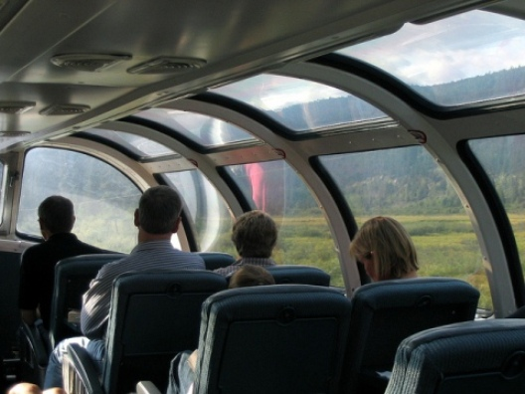
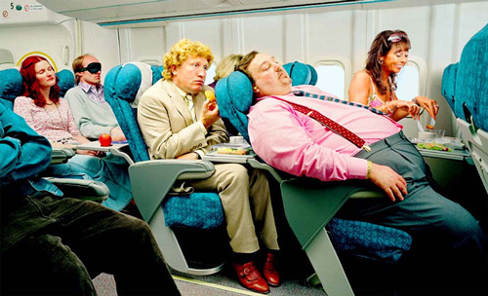
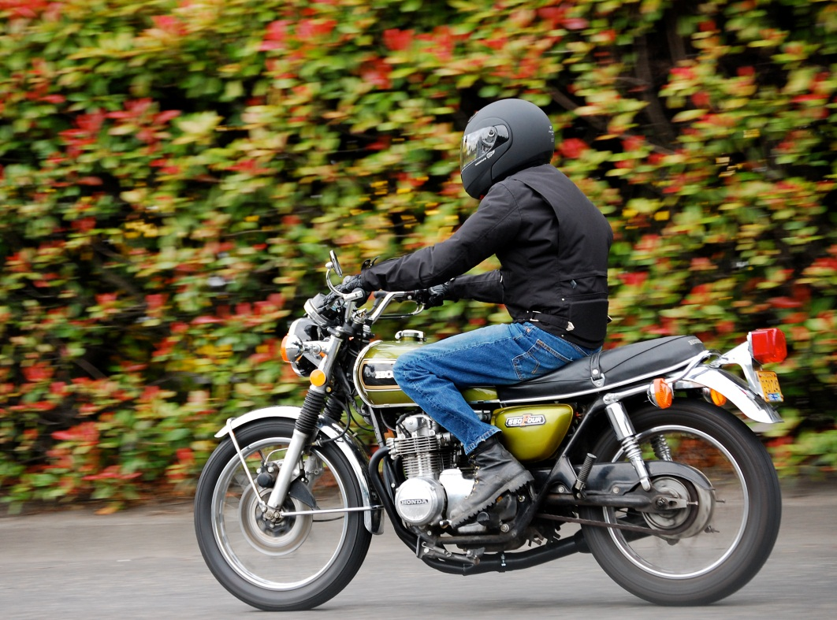
Examples of Transportation Systems
Trains
Ships
Airplanes
Motorcycles

Slide 24
Create a visual to demonstrate your knowledge of the purpose of human systems and how they interact (i.e., poster, powerpoint, video, collage, diorama, etc.). Be sure to highlight any interactions between these systems.

