Slide 1
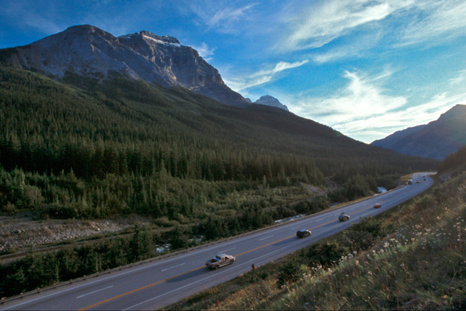
Unit 1.3: Understanding Interactions Between Natural and Human Systems

Slide 2
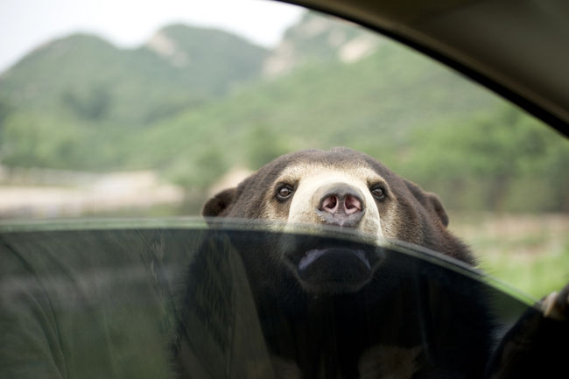
Natural and Human Systems Interact
Human systems rely on natural systems
Human systems often have negative effects on natural systems
To understand these effects we must look at how the systems interact
When we understand the causes and effects then we can work on sustainability

Slide 3
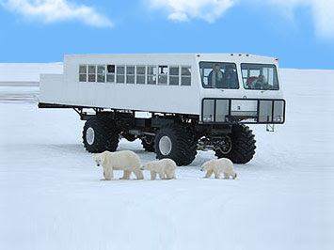
Natural and Human Systems Interact
Systems Thinking: Thinking about how all of the little pieces from each system fit together as a whole
Looks at how people interact with their environment
Systems thinking helps manage resources in a sustainable way

Slide 5
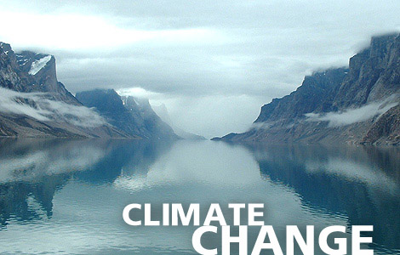
Climate
Weather: The temperature, precipitation, and wind conditions that are experienced daily in an area.
Weather changes daily.
Climate: The average conditions of temperature and precipitation that an area experiences over time.
Climate stays the same for long periods of time

Slide 6
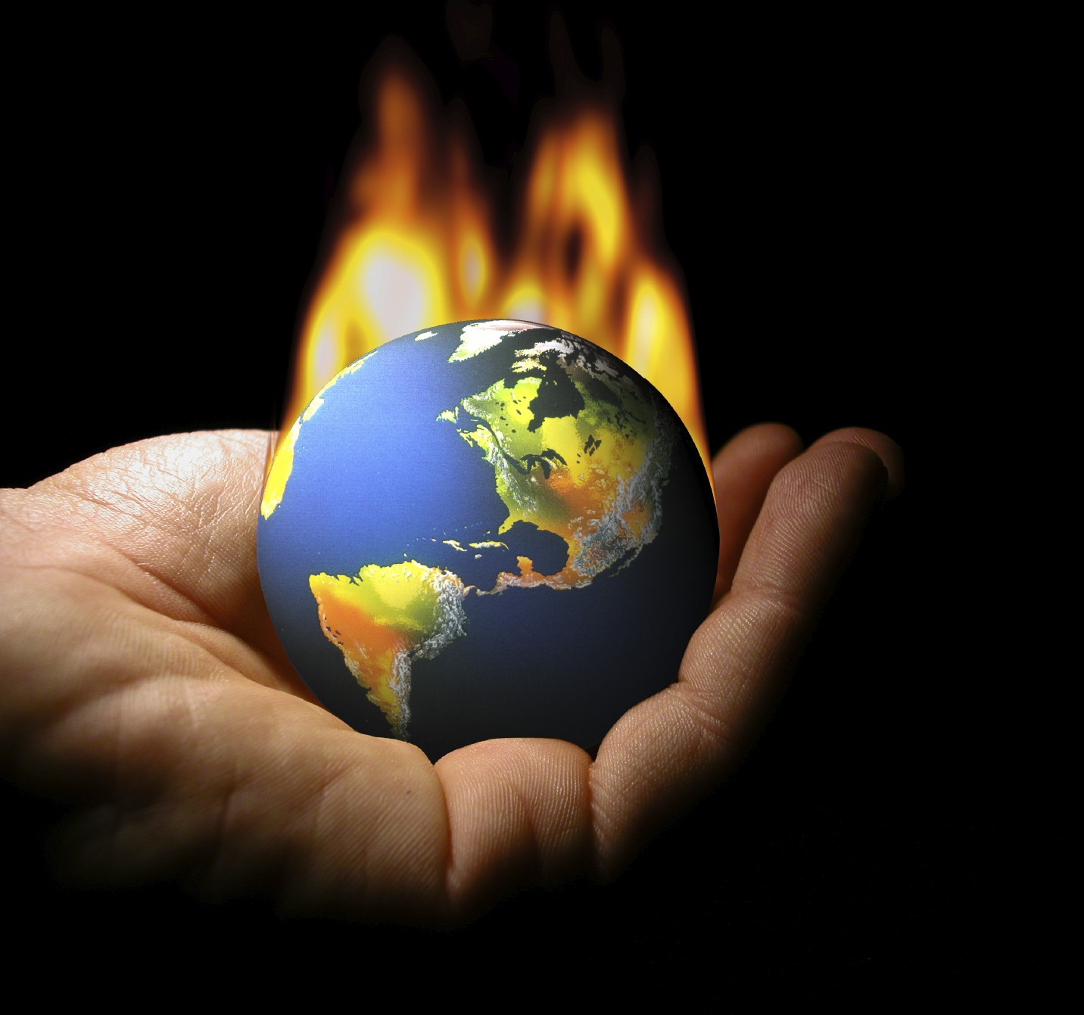
Influences on Climate
There are 7 factors that impact climate in Canada
Their names form the anagram J. Blower
1. Jet Stream
2. Bodies of Water
3. Latitude
4. Ocean Currents
5. Winds and Air Masses
6. Elevation
7. Relief

Slide 7
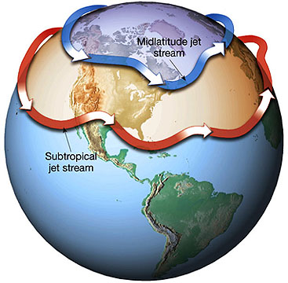
The Polar Jet Stream
Jet Stream: A layer of fast moving air that forms an ever changing boundary between cold and warm air masses
The Polar Jet stream directs weather systems, pushing
them over the country
The position of the jet stream helps determine what the
Climate is like in a place at that time

Slide 8
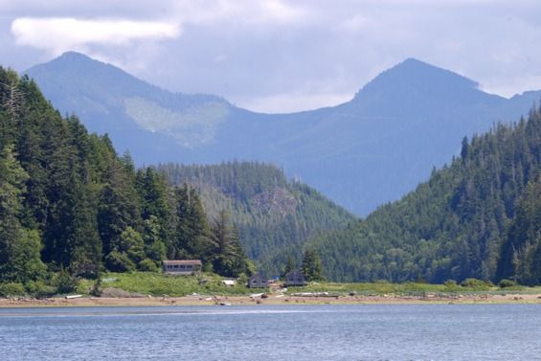
Bodies of Water
Bodies of water heat up and cool down more
slowly than land masses
They have a moderating effect on climate
Places nearer to large bodies of water experience
cooler summers and warmer winters
Places along the ocean coasts have a maritime climate (cool and wet)
Places in the middle of the country have a
continental climate ( Extreme cold and warm)

Slide 9
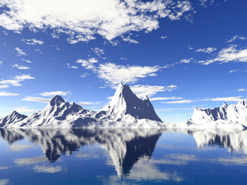
Latitude
Canada is a northern country, located closer to the
pole than the equator
The further north you are the colder and drier the climate
Cooler Air does not hold as much water
The Subarctic is Canada’s largest climate region
Most of Canada has short cool summers and long cold winters

Slide 10
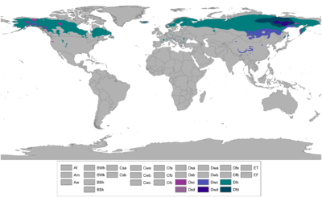
Subarctic climate region

Slide 11
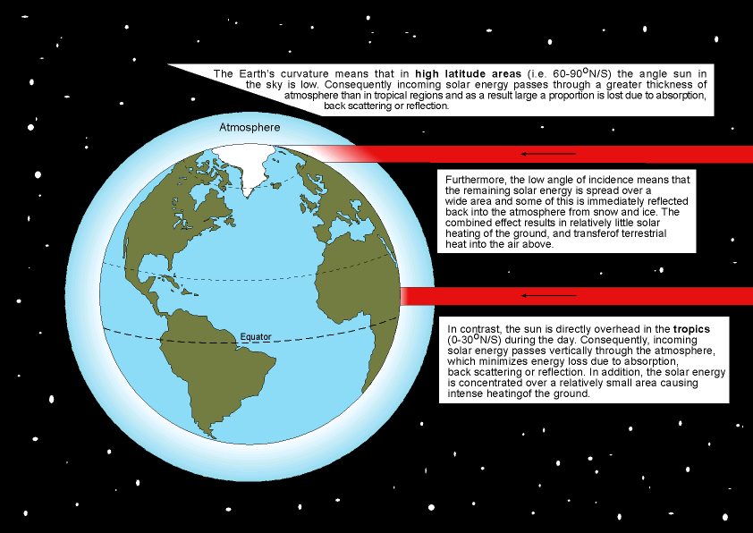
Why Does Latitude Influence Temperature?
In the north the suns rays are less direct and must cover a larger area. This reduces the amount of energy any one area gets.
The sun is directly over head at the tropics. The light is direct and covers a smaller area.

Slide 12
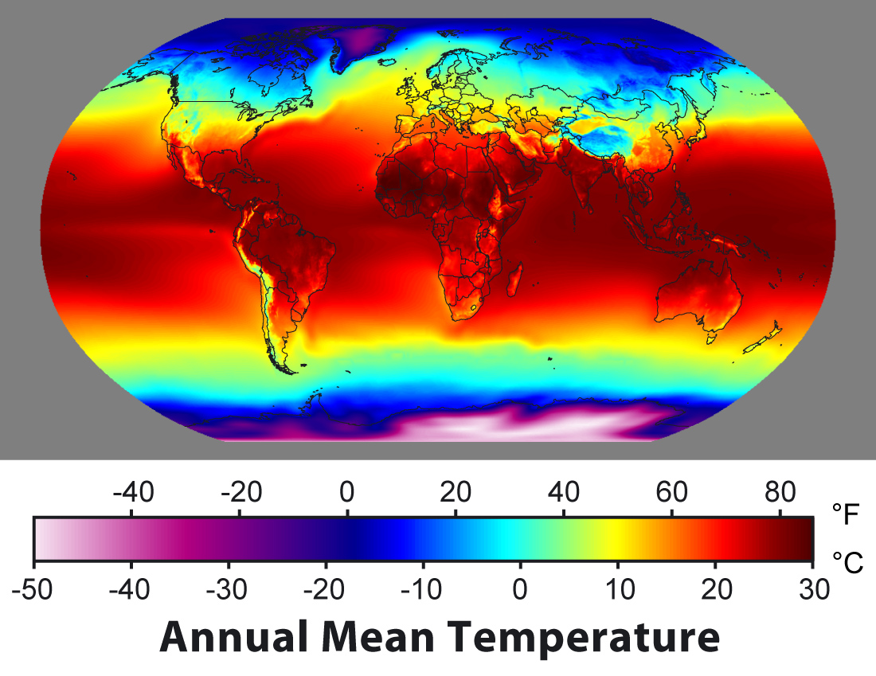
Temperature and Latitude

Slide 13
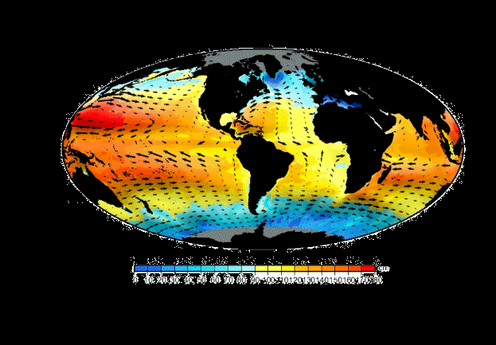
Ocean Currents
Warm and cold ocean currents flow along
Canada’s coastlines
Warm ocean currents make places warmer than normal for that latitude
Cool ocean currents make places colder
than normal for that latitude

Slide 14
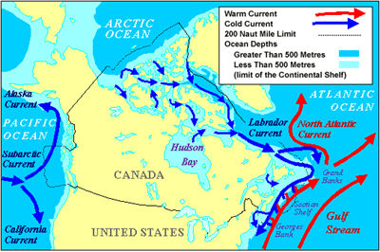
Canada’s Ocean Currents
Labrador Current: A cold ocean current that brings cold arctic water down giving Newfoundland and Labrador a cooler climate than that of the rest of Atlantic Canada
The Gulf Stream: A warm ocean current that brings water
up from the tropics to warm Atlantic Canada. Gives
wetter warmer summers
Subarctic Current: Cool ocean current that influences the climate
of Western Canada

Slide 15
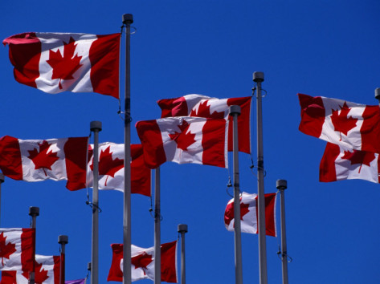
Winds and Air Masses
Winds blow from areas of high pressure to areas of lower pressure
Air mass: a huge body of air with the same temperature and
moisture conditions throughout
Winds carry air masses around the country
Under low pressure skies are cloudy and precipitation occurs
High pressure means sunny skies
Where air masses meet you get precipitation and storms

Slide 16
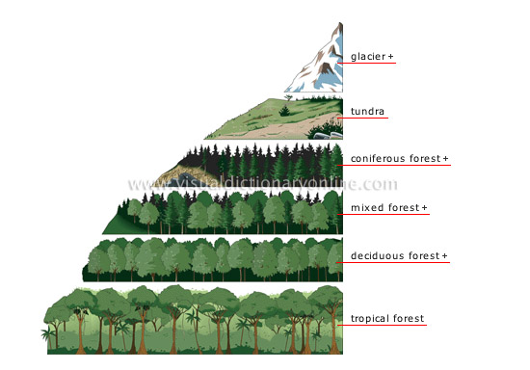
Elevation
Elevation: The high a place is above sea level
As elevation increases temperature decreases
This means that the higher up a mountain
you go the colder and dryer it will get
This is why you see treeless mountain tops

Slide 17
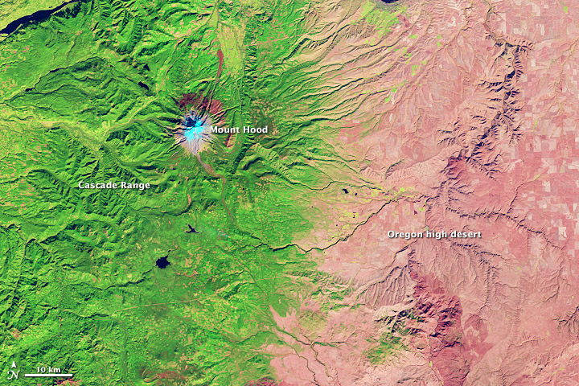
Relief
Relief: The difference in height between the
highest and lowest points in an area
Areas of high relief cause precipitation
As warm air is forced up over a mountain it cools, as
it cools it begins to drop its moisture
The moisture falls on the windward slopes of mountains
The leeward side often has an area of low
precipitation known as a rain shadow

Slide 18
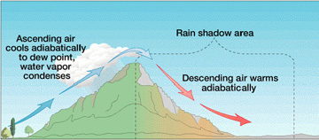
Air is Cold and Dry
Cools, drops moisture as precipitation
As dry air descends it warms rapidly
Warm Moist Air

Slide 20
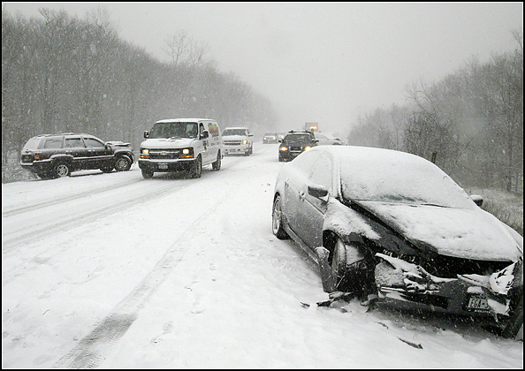
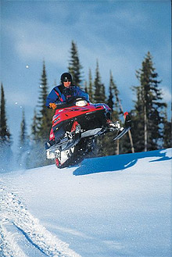
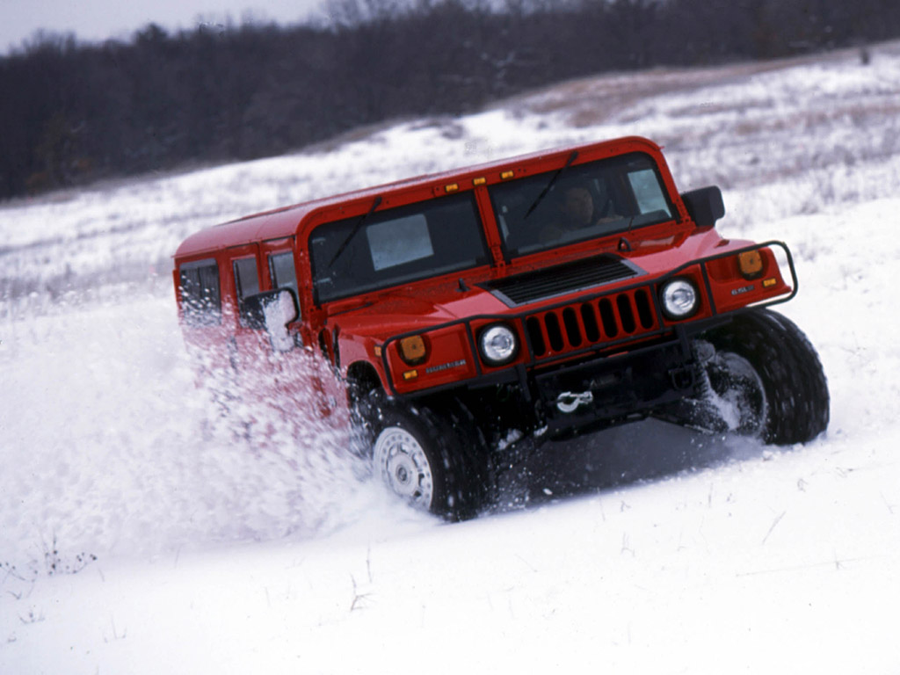
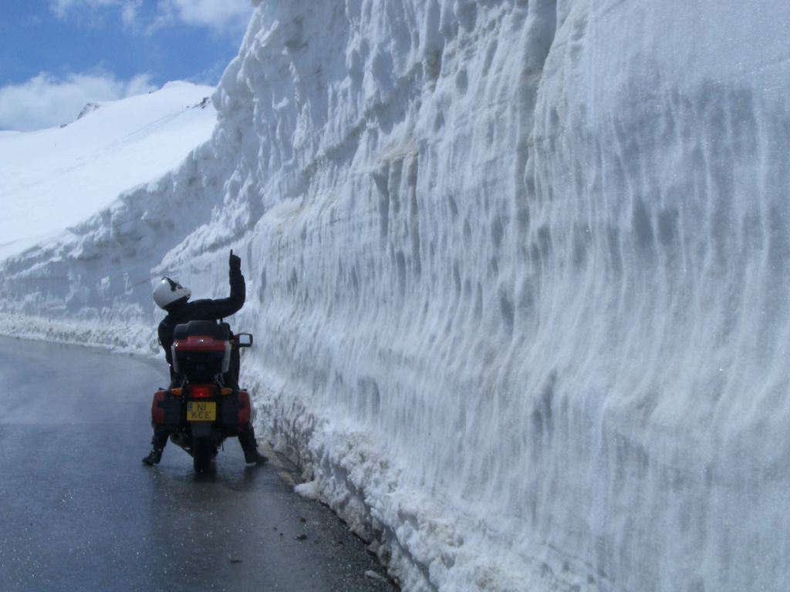
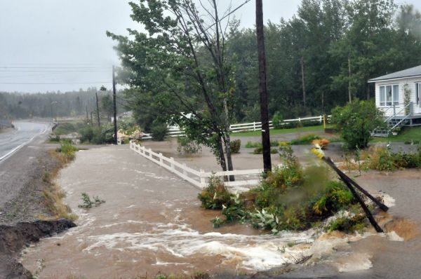
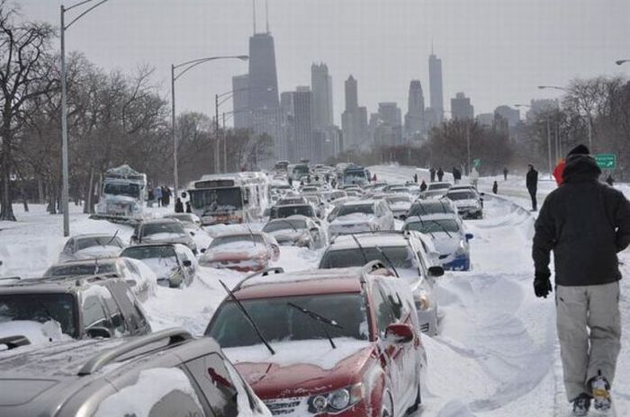
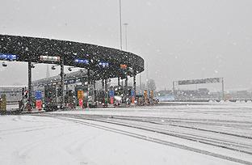
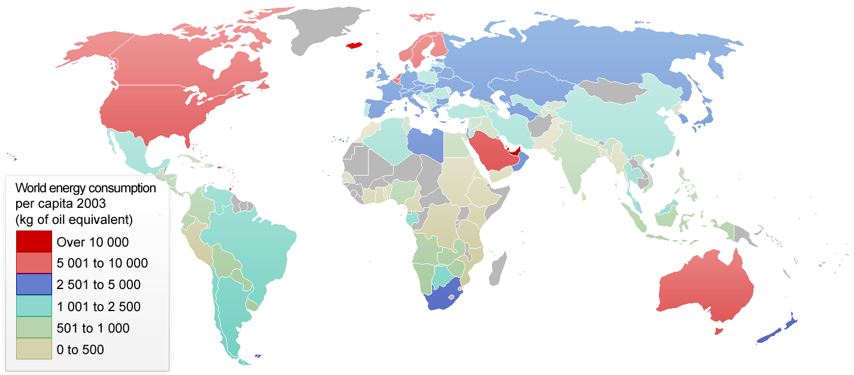
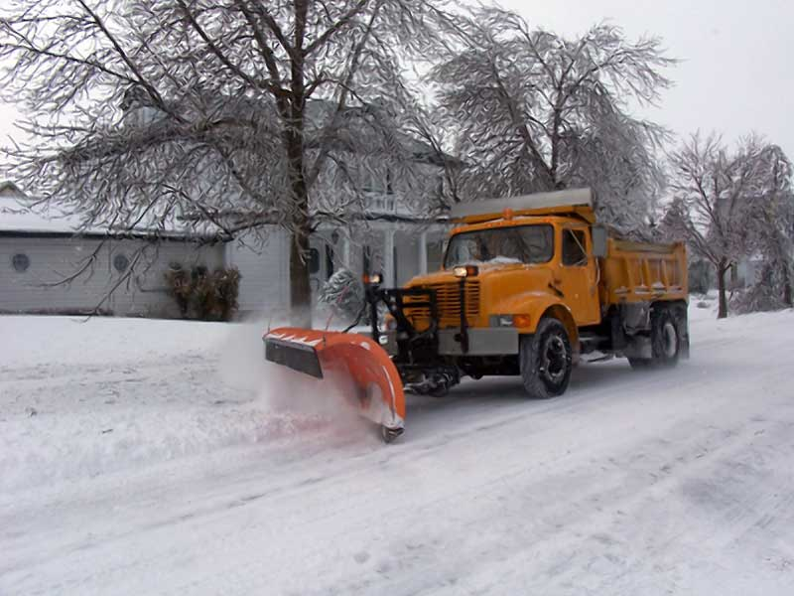
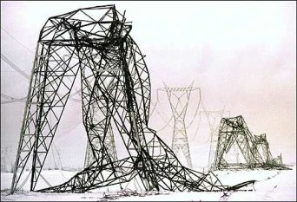
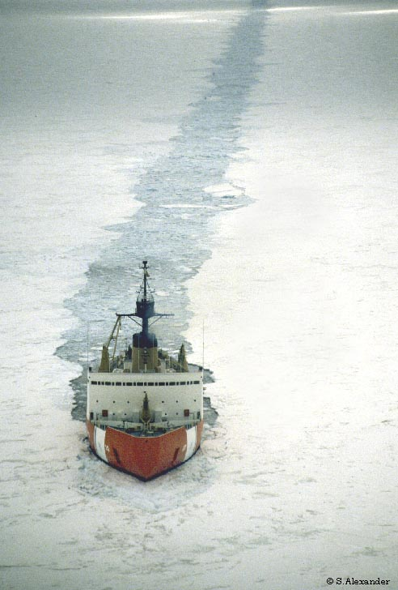
How Does Climate Influence Human Systems?
Transportation: Cold climates influence our modes of transportation
Infrastructure: To deal with the long winter special measures must be taken to keep people safe, and productive
Energy: To live in our cold climate people must spend
more energy to stay warm.
Economy: Our climate influences our economy in many ways
Encourages use of
Tracks for snow
Promotes Larger
Heavier Vehicles
Restricts Some Types of Transportation
Roads need plowing
Power lines need to be fortified
Ice needs to be broken
We have to pay for damages caused by storms
Snow Storms Shut down traffic systems causing stopping people from working
Weather closes banks, trading markets, and many other economic institutions stopping trade
Avalanches need to be triggered

Slide 21
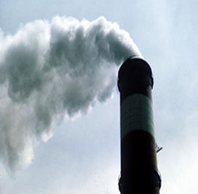
How Humans Influence Climate?
The Earth is getting warmer at an alarming rate
Data indicates that humans have had a dramatic influence on the climate
The main cause is the increase of greenhouse gasses which include:
Carbon Dioxide
Methane
Ozone
Water Vapor
Nitrous Oxide

Slide 22
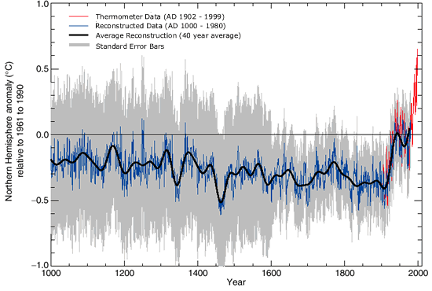
Global Warming
Then in the 1900’s there is a dramatic increase in temperature!!
Temperature stays within a normal pattern
for nearly 1900 years
Global Warming: The rise in the average temperature of Earth's atmosphere and oceans since the late 19th century.

Slide 23
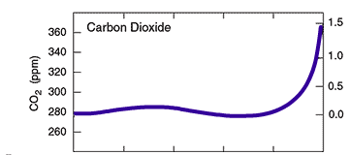
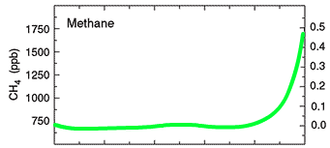
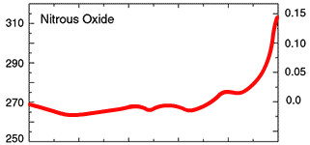
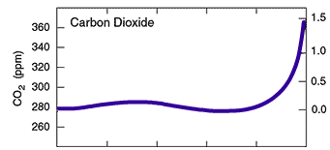
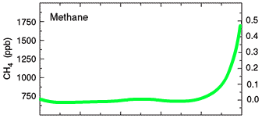
It’s no wonder when you consider this!!
These graphs show that there has been an exponential increase in the amount of greenhouse gas that can be detected in the atmosphere

Slide 24
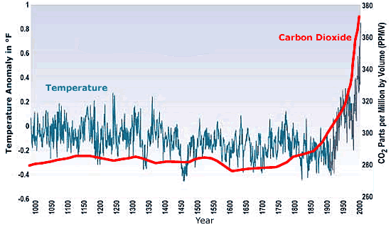
The Link To CO2
Temperature increase over the last 1000 years shows a link with an increase in CO2 production

Slide 25
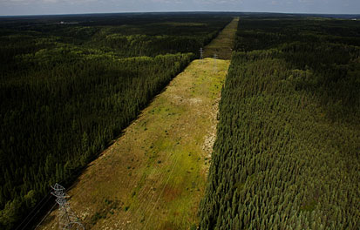
Vegetation
Geographers divide the earth into regions to make
it easier to understand them
Biome: A large region on earth which is named for the
distinct characteristics of the plants that live within it
The plants that grow in a biome are a product of the climate
and landforms of the region
Can you link this to the natural systems?

Slide 26
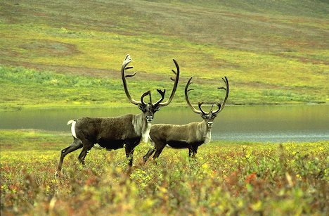
Biomes
Natural Vegetation: The plants that are native to an area.
Not planted by humans
Natural Vegetation is influenced by:
Precipitation
Soil Conditions
Temperature
Steepness and elevation of land

Slide 27
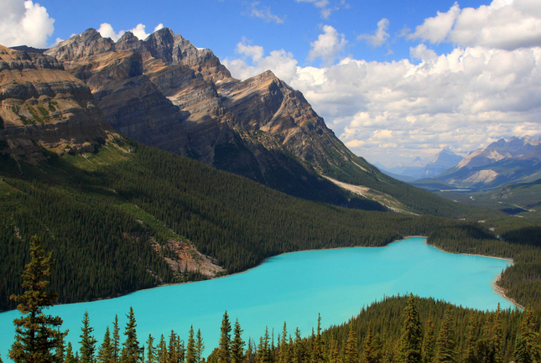
Canada’s Seven Biomes
Tundra
Grassland
Mixed Forest
Mountain Forest
Deciduous Forest
Temperate Rainforest
Boreal Coniferous Forest

Slide 28
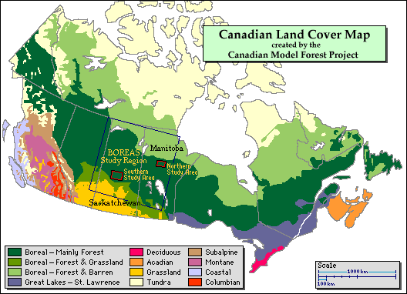

Slide 29
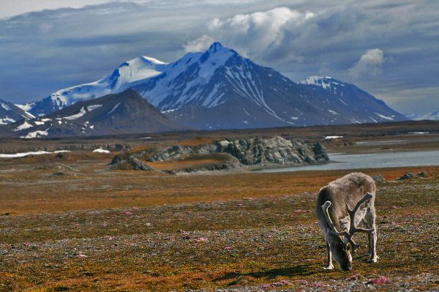
Tundra
Tundra: Land where it is too cold for trees to grow
Tree line: A natural boundary that marks
the latitude at which trees can no longer grow
Characteristics:
No Trees
Found in the far north
There will be grass and shrubs

Slide 30
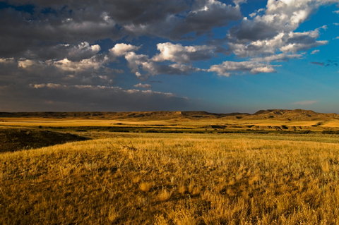
Grasslands
Grasslands: Land that is covered by grasses because it is
too dry to support larger plants
Characteristics:
Dry
Warm
At risk biome only ¼ of Canada's natural grasslands still exist

Slide 31
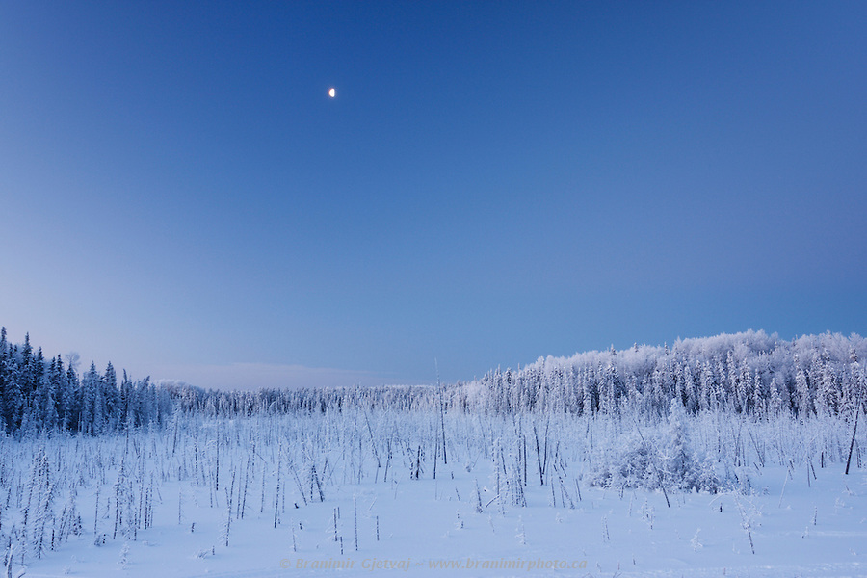
Boreal Coniferous Forest
Boreal=Northern
Boreal Coniferous Forest: The northern forest that covers
most of Canada
Coniferous: Trees that keep their leaves (needles) all year round
Deciduous: Trees that lose there leaves in the winter
Characteristics
Cold Winters but Warm summers
Moderate amounts of precipitation
Consists of both coniferous and deciduous trees

Slide 32
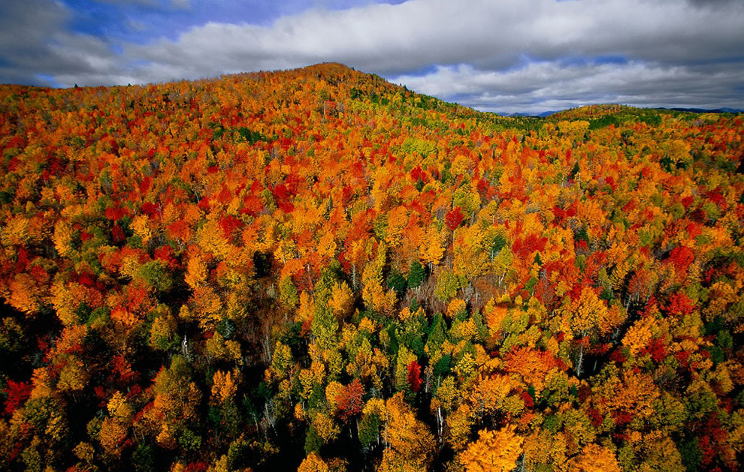
Mixed Forest
Mixed Forest: Forest that acts as a transition from
deciduous forest to coniferous forest
Characteristics:
Warm summers cold winters
Lots of precipitation
Both deciduous and coniferous trees

Slide 33
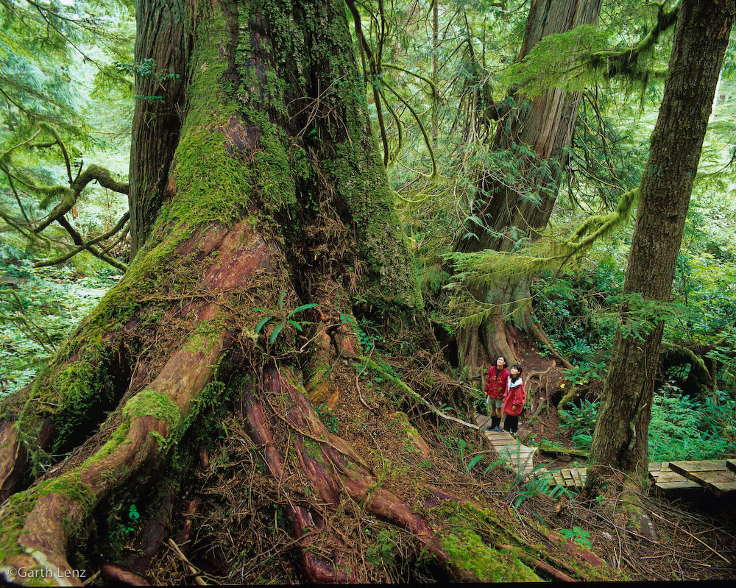
Temperate Rainforest
Temperate Rainforest: Area of large coniferous trees
found in British Columbia
Characteristics:
High amount of precipitation
Warm all year round
Very big trees

Slide 34
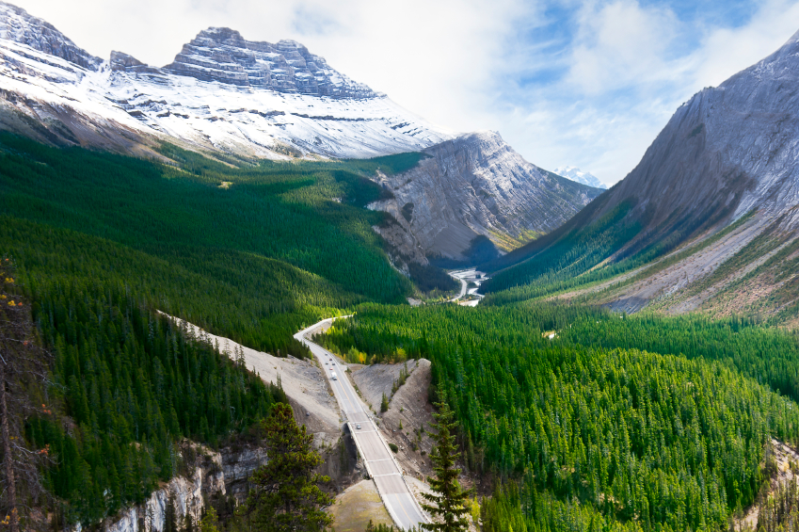
Mountain Forest
Mountain Forest: Forest that is found in mountainous
regions where altitude and soil conditions play a role in
what can grow
Characteristics:
Mixed forest in lower altitudes, then boreal, then tundra in high peaks
Altitude influences temperature range
Lack of good soil can be an issue on steep slopes

Slide 35
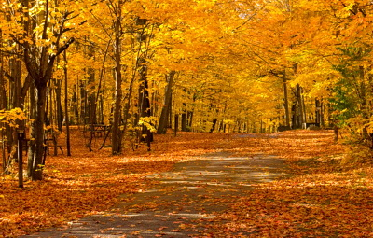
Deciduous Forest
Deciduous Forest: Forest that consist mostly of trees
that lose their leaves in the winter
Characteristics:
Warm summers and winters
Moderate to high amounts of precipitation
Trees lose their leaves in winter

Slide 36
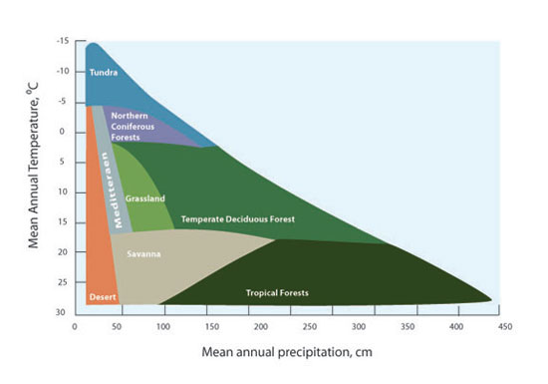
Temperature, Precipitation and Climate

Slide 38
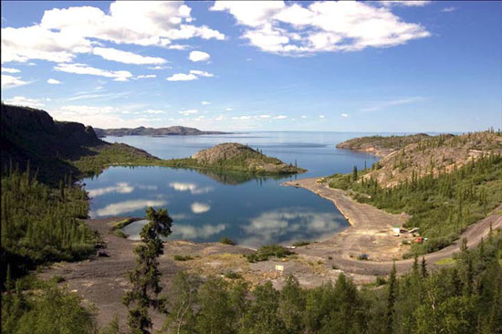
Canada’s Water Systems
Canada’s water system is made up of an interconnected network of lakes rivers, wetlands and underground waterways
Runoff: All of the water that collects in, and moves
through the water system after falling from the atmosphere
Canada has a lot of runoff because the cold climate restricts evaporation
Ground Water: Water that filters down through the soil

Slide 39
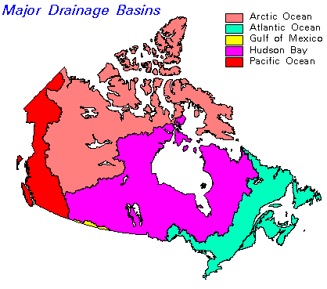
Canada’s Drainage Basins
Drainage Basin: The area of land from which all water received as
precipitation flows to a particular ocean
Watersheds: The area that a particular lake or river is responsible for draining, usually named after the river or lake.
Drainage Divides: Areas of highland that separates drainage basins
Canada’s 5 Drainage Basins
Gulf of Mexico
Atlantic Ocean
Hudson Bay
Arctic Ocean
Pacific Ocean

Slide 40
Canada’s Soil System
All life depends on soil
Soil is important because:
It allows plants to grow which provide us with clean air
The plants that grow out of it can be eaten
It filters water

Slide 41
How do Humans influence Soil
Fertilizers: Nutrients that are artificially added to soils by farmers
Fertilizers are used to increase farm production
They can have some negative effects on the natural systems
Pesticides: Chemicals that are added to the soil to kill pests that
compete with farm crops
Some pesticides are dangerous as they work their way into the food chain
Pesticides often kill species other than their intended pest. This hurts the ecosystem

Slide 42
The Composition of Soil
Soil has four parts:
Air: necessary because plants need air
around their roots
2. Water: Plants need water to grow, and also
to help break down the minerals and humus
3. Humus: Decayed remains of plant and
animal life.
4. Minerals: Broken down rock particles that
form either sand, loam or clay. They contain
the nutrients that plants need to grow.

Slide 43
Soil Profile
Soil Profile: A cross-section of different layers in the soil and rock below the soil and their physical, chemical, and biological characteristics.

Slide 44
O Horizon: Organic material: Where plant and animal material decompose
A Horizon: Topsoil: Humus layer: Rich with minerals from the O horizon. Usually the most fertile area of the soil. This layer is rich in humus
Rain Carries Nutrients Downward
B Horizon: Subsoil: Area of the soil
where minerals from the upper layers mix with minerals from the lower layers of soil
C Horizon: Parent Material: Area where rock is weathered away. Very little life is found here
D Horizon: Bedrock: The solid rock thatis found under all soils

Slide 45
Soils of Canada
Podzol: Soils found in areas covered by forests. This soil is acidic and is not very fertile
Chernozems: Thick grassland soil that is rich in humus that covers a large part of the prairie provinces. This is fertile soil that is rich in nutrients.

Slide 46
Describe how the two soil profiles are different
Podzol
Chernozem

Slide 47
Ecological Footprint
Ecological Footprint: Refers to how much damage a human
activity has on the environment
Activities with high ecological footprints are more damaging to the
environment
Activities with low ecological footprints focus on sustainable resource use and protecting the environment

Slide 48
Canada’s Ecological Footprint
Canada has a low population and a high need for energy
This gives us as a country the worlds 8th largest ecological footprint
Industries like manufacturing and energy production
have the largest footprints
Different provinces have different footprints
Alberta is one of the worst

Slide 52
Alberta: The Oil Sands

Slide 54
Tailings Ponds
Tailings ponds are reservoirs for the water that is used in
the processing of tar sands
They are filled with water that contains a high concentration
of toxic materials
These ponds are often unlined and leaking
This is damaging to the water system of the area

Slide 56
Refining
Refining pumps toxins into the atmosphere
These toxins then fall back to earth through precipitation
The effects from a refinery can be felt for many kilometers around
the site

Slide 57
Reducing your Ecological Footprint
At Home
On The Road
Recycling
Buy a fuel-efficient vehicle
Water conservation
Travelling green
Outdoors
Use less fuel
At School
Go on Stand By
Reduce Packaging
Turn out the lights

Slide 58
Life on the Tundra
There are very few areas of settlement in the tundra, due to its low temperatures and remote locations
most folks making their livelihoods from such economic activities as mining, fishing, hunting and nomadic herding
Tourists come to the tundra to experience the unique biome that is present there.

Slide 59
Threats to the Tundra
The melting of the permafrost as a result of global warming could radically change the landscape and what species are able to live there.
Ozone depletion at the North and South Poles means stronger ultraviolet rays that will harm the tundra.
Air pollution can cause smog clouds that contaminate lichen, a significant food source for many animals.
Exploration of oil, gas, and minerals and construction of pipelines and roads can cause physical disturbances and habitat fragmentation.
Oil spills can kill wildlife and significantly damage tundra ecosystems.
Buildings and roads put heat and pressure on the permafrost, causing it to melt.
Invasive species push aside native vegetation and reduce diversity of plant cover.

Slide 60
Solutions
Solutions
Switch to alternative energy uses to minimize human-made global warming.
Establish protected areas and park reserves to restrict human influence.
Limit road construction, mining activities, and the building of pipelines in tundra habitat.
Limit tourism and respect local cultures

Slide 61
Life on the Grasslands

Slide 62
Threats to Grasslands
There are three major threats to grasslands - conversion to agriculture, Conversion to urban areas, and global warming and its attendant changes in precipitation

Slide 63
soil

Slide 64
ecological footprint as a means to quantify the environmental cost of human activity

