Slide 1
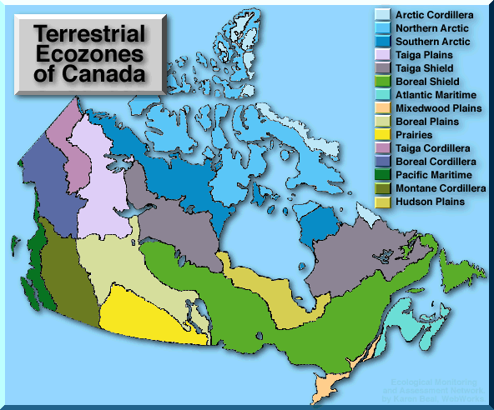
Canadian Geography 1202
Unit 1: Part Two Ecozones

Slide 2
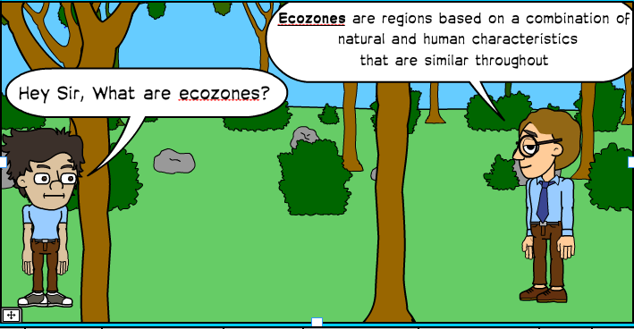
What is an Ecozone?
Ecozone: A region based on a combination of natural and
human characteristics that are similar everywhere in it

Slide 3
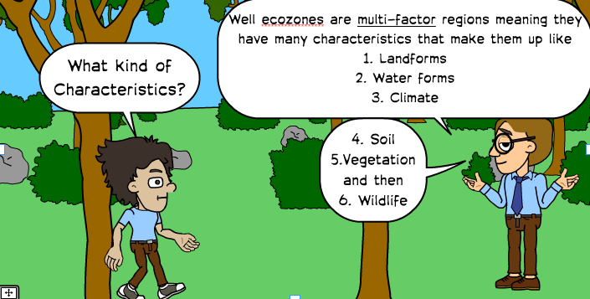
Characteristics of Ecozones

Slide 4
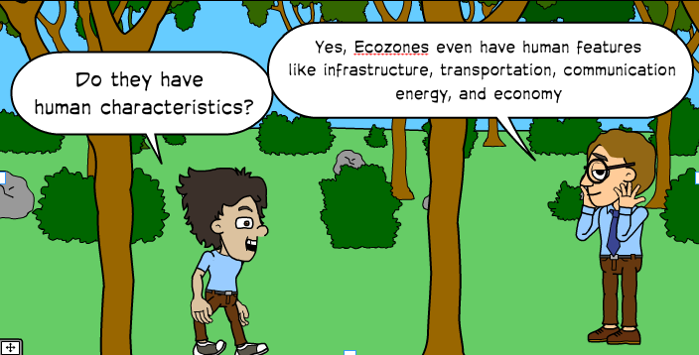
Characteristics of Ecozones
Multifactor region: many factors contribute to the formation
of the region
Characteristics of Ecozones
1. Landforms
4. Soil
2.Water forms
5. Vegetation
3. Climate
6. Wildlife
7. Human Features

Slide 5
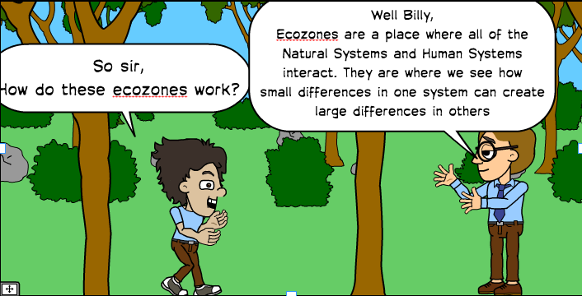
How do Ecozones Work?
Ecozones are places where systems interact
Different combinations of systems will create
different conditions
Example: low amounts of water will create dry ecozones
The specific conditions of the natural systems often tell us
what human activities will be able to happen in an ecozone

Slide 6
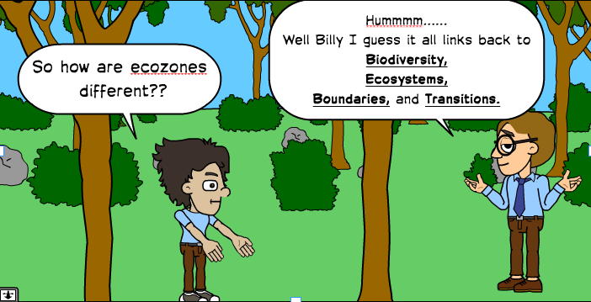
Differences between Ecozones
Ecozone vary in terms of:
1. Biodiversity
2. The variety of ecosystems within them
3. Their boundaries and transitional areas

Slide 7
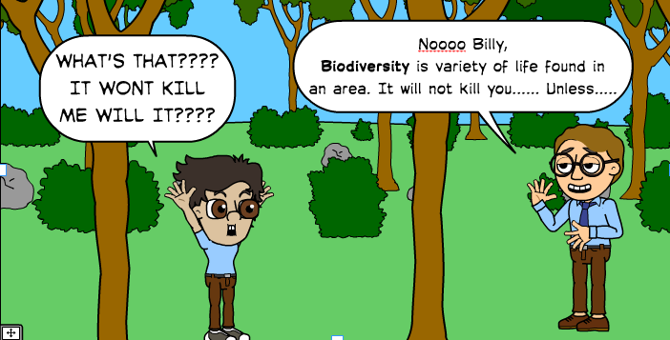
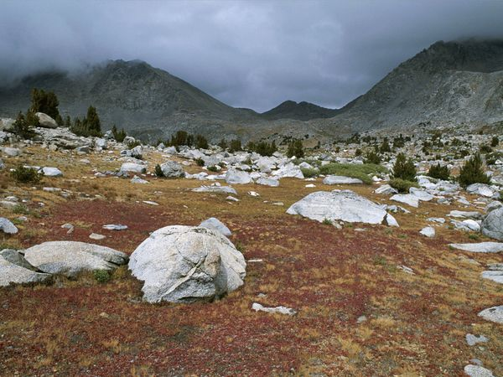
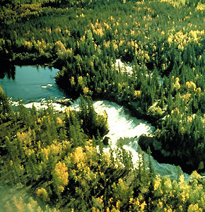
Biodiversity
Biodiversity: The variety of life found in an area
This includes plants and animals
How might these two areas diverse

Slide 8
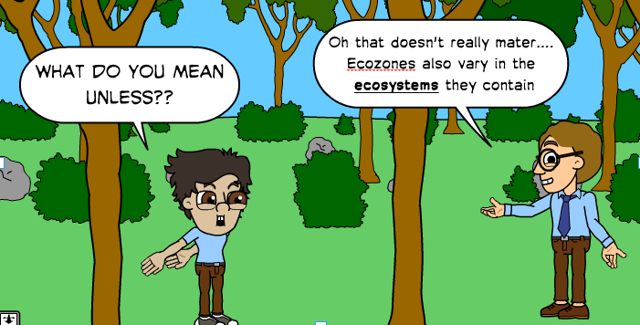
Ecosystems
Ecosystem: A community of plants and animals that interact with one another and with their environment
Different ecozones will have different groups of plants and animals interacting

Slide 9
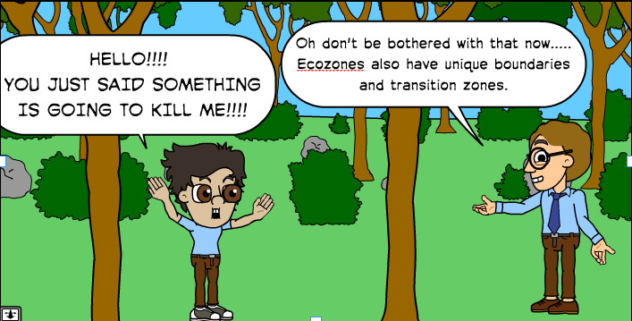
Boundaries and Transitions
Boundaries: The line on a map that separates one area from another
In reality there are no lines that mark the regions there
are transition zones
Transition Zone: The area or boundary where one ecozone gradually
blends into the next

Slide 10
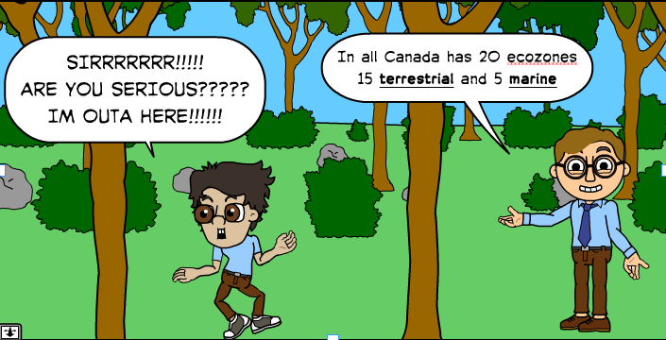
Canada’s Diverse Ecozones
Canada has 20 ecozones
15 terrestrial and 5 marine
Terrestrial: On land
Marine: In the water
We talk about six:
Boreal Shield
The Southern Arctic
The Prairie
Mixedwood Plains
The Atlantic
The Montane Cordillera

Slide 11
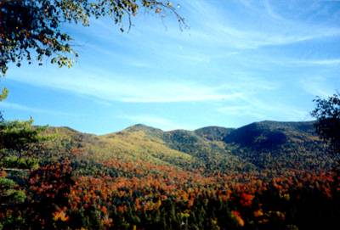
The Boreal Shield
Location The Boreal Shield can be found from Alberta to Newfoundland, between the Taiga Shield and the Boreal Plains.
1. Landforms
Rolling hills
Exposed bedrock
Evidence of glacial weathering
Old Mountains

Slide 12
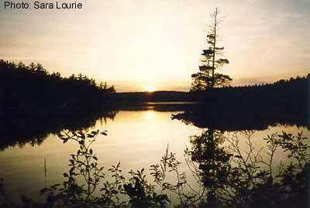
The Boreal Shield
2.Water forms
Glaciers left behind many depressions in the earth
These depression form millions of lakes and
wetlands

Slide 13
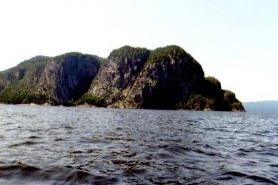
The Boreal Shield
3. Climate
Average summer temperature of 13°C
Nearness to oceans moderates winter temperature
Places near the ocean have milder winters average temperature -1°C
Places far away from the ocean have cold winters -20°C
Precipitation in the west 400mm per year, in the
east 1600mm per year

Slide 14
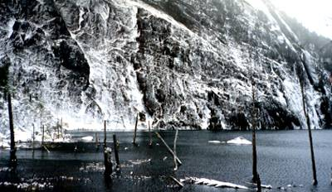
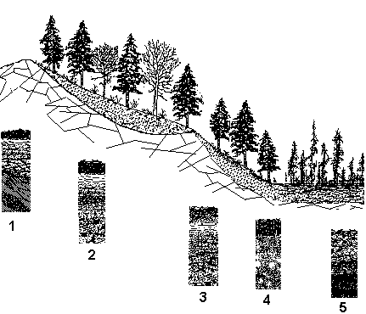
The Boreal Shield
4. Soil
Glaciers have created areas of depressions and
deposits within the Boreal Shield
Most areas have thin acidic soils but there are
some area with thick acidic soil

Slide 15
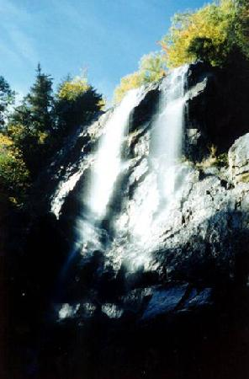
The Boreal Shield
5. Vegetation
Trees to the north are coniferous
Broadleaf trees appear further south
Bogs and other wetlands, some of the most diverse and productive areas in the Boreal Shield
Forest fires create a patchwork of forest types in different stages of recovery
White spruce
Black spruce
Balsam fir
Paper birch

Slide 16
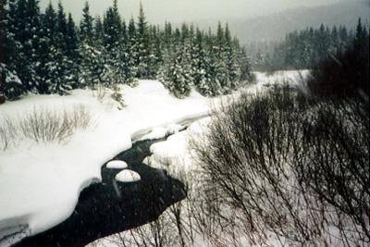
The Boreal Shield
6. Wildlife
Herbivores: Caribou, Deer, Moose, Raccoon, Beaver, Snowshoe Hare
Carnivores: Black Bear, Lynx, Bobcat, Wolf
Birds: Owls, Hawks, Eagles, Jays, Ravens, Grouse, Canada Geese, Ducks
Reptiles and Amphibians: Frogs, Salamander, Newts, Common
and snapping Turtle, Garter Snake, Red Belly Shake
Many different fish, mollusks, and Insects

Slide 17
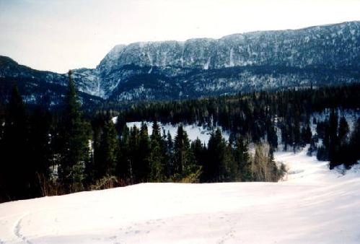
The Boreal Shield
7. Human Features
The waterways in the Boreal Shield were once the roads of the fur trade
Some rivers have been damaged by mining, hydroelectric development, and logging.
Insect control, monoculture tree plantings, control of natural forest fires and acidification of the lakes and soil all affect the natural system
Insect control, monoculture tree plantings, control of natural forest fires and acidification of the lakes and soil all affect the natural system

Slide 18
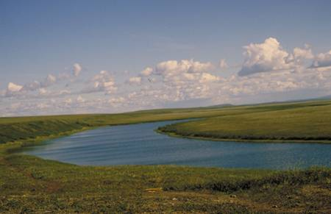
The Southern Arctic
The Southern Arctic extends across the northern edge of much of the continental Northwest Territories and Quebec, bordered by the tree line to the south and the Northern Arctic ecozone to the north.
1. Landforms
Permafrost is found throughout the region, sometimes only a few centimeters below the surface
The look of the Southern Arctic is largely the result of glaciers
As the glaciers expanded and moved south, they carried rocks and earth with them

Slide 19
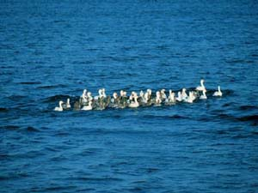
The Southern Arctic
2.Water forms
Ponds, lakes and rivers dot the Southern Arctic
Nearness to the ocean also provides a moderating effect
on temperatures in the region

Slide 20
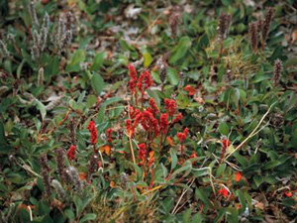
The Southern Arctic
3. Climate
Summers are short and cool
Summers average 5ºC
Winters are long, cold, and dark
Winters vary between an average of -28ºC near the Mackenzie Delta to -18ºC in northern Quebec
Precipitation in the west is low, approximately 250mm-500 mm per year

Slide 21
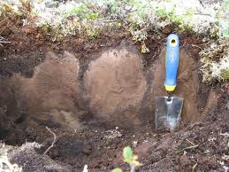
The Southern Arctic
4. Soil
Glaciers carried away most of the soil in the area
We now see thin soils and exposed bedrock over most
of the area
This soil profile shows thin organic and topsoil horizons with a thicker subsoil.

Slide 22
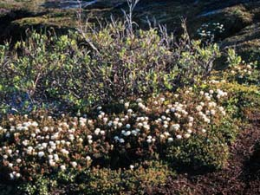
The Southern Arctic
5. Vegetation
The southern edge of the Southern Arctic is the tree line.
The low temperatures, low precipitation, and high winds in most of the ecozone encourages low plants
Shrubs, Lichens, and dwarfed trees are common in this ecozone

Slide 23
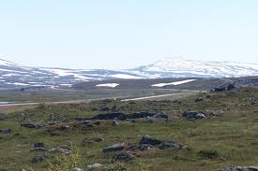
The Southern Arctic
6. Wildlife
Carnivores: grizzly bear, black bear, polar bear, wolves, fox, lynx, coyote, weasel, and wolverine
Herbivores: Caribou, Moose, Muskox, squirrels, lemmings,
hares, mice, beavers
Birds: The southern arctic is a migratory destination for many species of birds
This ecozone is too harsh for amphibians and reptiles to live

Slide 24
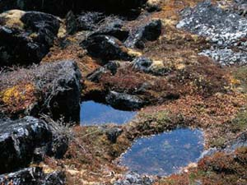
The Southern Arctic
7. Human Features
Extremely few people (only about 10 000) live here.
Most people live through subsistence activities, such as hunting, trapping and fishing.
Gas and oil exploration provide a living for some.
Tourism is another growing sector in the Southern Arctic

Slide 25
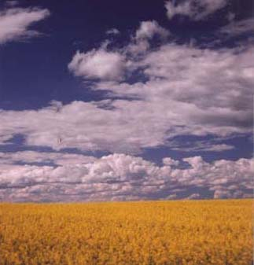
The Prairie
The Prairies cover the south of Alberta, Manitoba and Saskatchewan.
1. Landforms
Glaciations have left behind large deposits of fertile soil on the
prairies
Glaciers have also flattened the land
Canola Feild

Slide 26
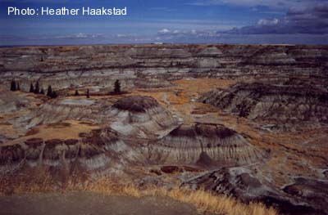
The Prairie
2.Water forms
Long periods without moisture create a dry
landscape
Huge numbers of small temporary wetlands form in years with high precipitation.

Slide 27
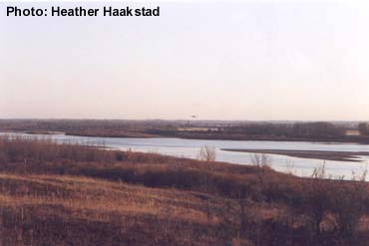
The Prairie
3. Climate
Temperatures are extreme due to the lack of access to the ocean's buffering. and
Winter temperatures average -10ºC
summers average 15ºC.
This is an area of rain shadow.
The mountains to the west block much of the precipitation

Slide 28
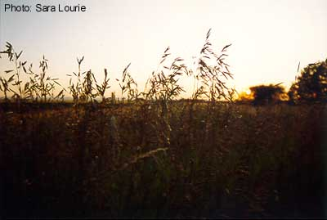
The Prairie
4. Soil
Glaciers deposited soils from all over Canada here
These deposits are now the fertile plains that largely define the Breadbasket of Canada.
These Glacial soils are known as Chernozems, and are very fertile

Slide 29
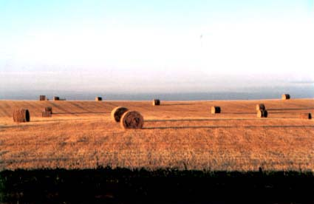
The Prairie
5. Vegetation
Almost 95% of the Prairies have been converted into farmland, with predictable effects on the original plant populations
Grassland is natural vegetation of the Prairie ecozone
Trees and shrubs are most commonly found in the eastern region

Slide 30
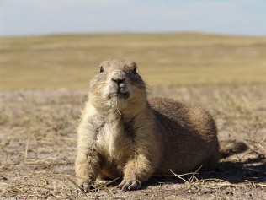
The Prairie
6. Wildlife
The changing of the natural habitat has caused the loss of population and ranges of many animals
Prairies contain a disproportionate number of threatened and endangered species
Carnivore: black bear, coyote, badger, red fox,
Herbivores: deer antelope, elk, and moose.
Rodents: Squirrels, prairie dogs, chipmunks, mouse

Slide 31
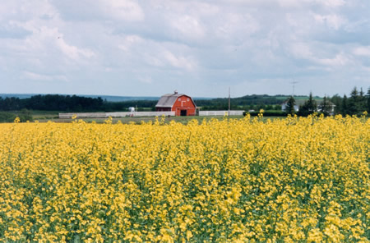
The Prairie
7. Human Features
The Prairies are the most altered of the ecozones.
Agriculture covers almost all of the land, and almost none of the original ecosystems are left.
Farming, farmers comprise less than 10% of the four million people.
Mining and services are the employers of most of the population.

Slide 32
Mixedwood Plains
The Mixedwood Plains extends along the Quebec City-Windsor corridor, including the densely-populated region of southern Ontario.
1. Landforms
Plains and gently rolling hills are found here

Slide 33
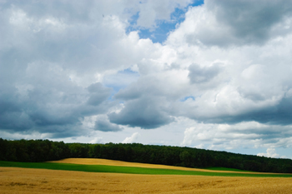
Mixedwood Plains
2.Water forms
Several major waterways and lakes, from three of the great lakes to the St. Lawrence river and its tributaries, dominate much of the region

Slide 34
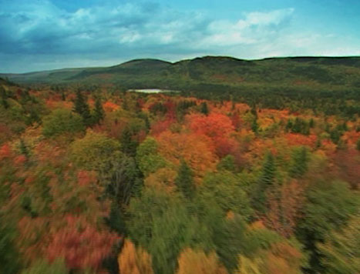
Mixedwood Plains
3. Climate
Cool winters (average temperature -5ºC)
Warm summers (average temperature 17ºC)
Prone to highly changeable weather, as the ecozone is in one of the major storm tracks of North America.

Slide 35
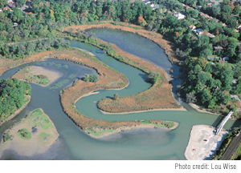
Mixedwood Plains
4. Soil
Deposits from ancient water bodies and glaciers make the soil here the most productive in Canada.
Carbonate-rich Paleozoic bedrock characterizes the geology of the Mixedwood Plains.

Slide 36
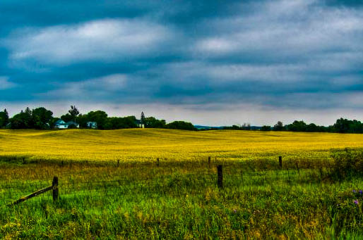
Mixedwood Plains
5. Vegetation
A mix of coniferous and deciduous trees are found here
Urbanization and Agriculture have destroyed most of the original forest

Slide 37
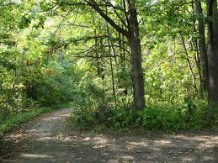
Mixedwood Plains
6. Wildlife
Carnivores: black bear, wolf, bobcat, coyote, muskrat, raccoon, skunk, red fox, and river otter
Herbivores: moose and white-tailed deer, squirrel, flying squirrel, hares, mouse, groudhogs
Many birds amphibians reptiles and fish

Slide 38
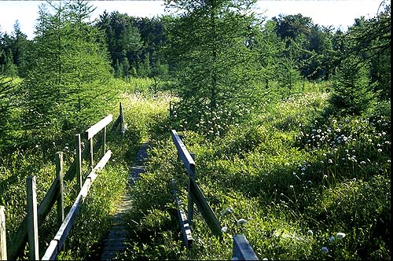
Mixedwood Plains
7. Human Features
Half of Canada's population lives here
Pressure from urban expansion and agriculture is
destroying the ecozone.

Slide 39
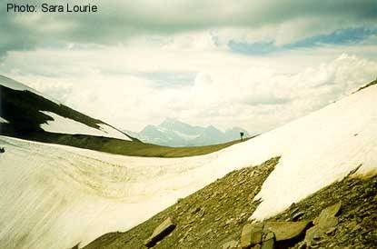
The Montane Cordillera
This ecozone covers most of southern British Columbia and some of southwestern Alberta.
1. Landforms
The plains and valleys here often consist of glacial moraine or deposits from ancient lakes.

Slide 40
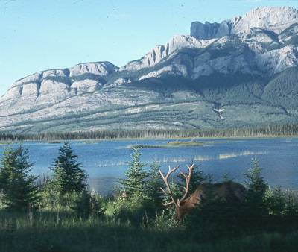
The Montane Cordillera
2.Water forms
Runoff from the mountain slopes collects in rivers and streams
Where glaciers have carved depressions lakes and ponds may form

Slide 41
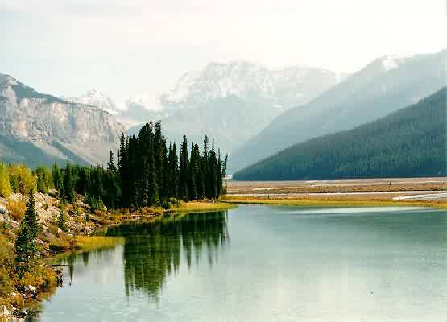
The Montane Cordillera
3. Climate
The Montane Cordillera has a diverse climate
As altitude increases temperature decreases
In the north temperatures are colder
In the south temperatures are warmer
Dry summers and moist winters are common

Slide 42
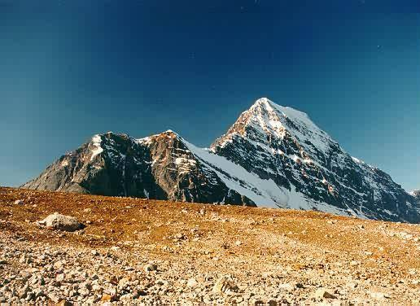
The Montane Cordillera
4. Soil
The Montane cordillera has a diverse soil profile
On steep mountain slopes there is very little soil.
In warmer areas where trees grow acidic soils form
The soil of interior plains support grassland growth

Slide 43
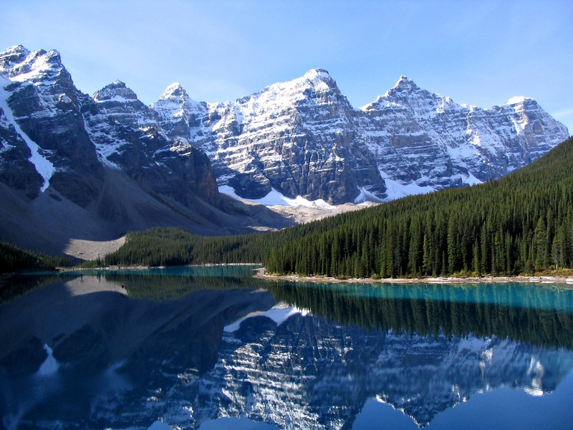
The Montane Cordillera
5. Vegetation
The plants that grow here are influenced by the land
they grow on
Depending slope of the land, soil depth, and altitude many different forms of vegetation can form
Trees grow on gentle slopes where there is soil for roots
Shrubs and smaller plants will grow on steeper
slopes and at higher altitudes

Slide 44
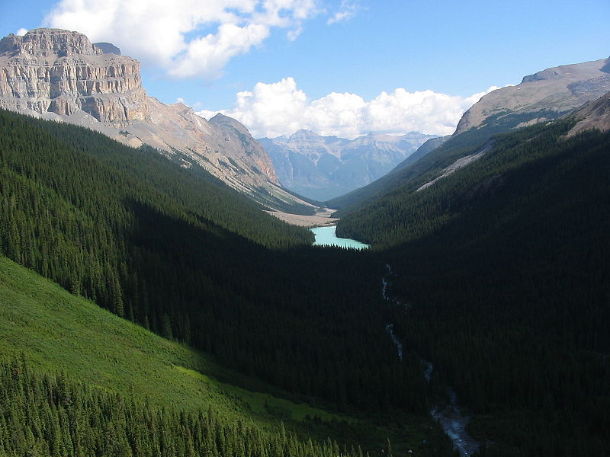
The Montane Cordillera
6. Wildlife
Carnivores: black bear, grizzly bear, wolf, lynx, bobcat, cougar, coyote, red fox, marten, wolverine, muskrat, badger, marten, mink, pallid bat, and striped skunk.
Herbivores: caribou, mule deer, white-tailed deer, moose, mountain goat,
California bighorn sheep, American elk, hoary marmot, yellowbelly marmot,
squirrel, beaver, golden-mantled squirrel, yellow pine chipmunk,
redtail chipmunk, beaver, northern bog lemming, and pika
Birds: Many various of predatory and non predatory birds live here
Fish: Many species of fish live in the waterways, including several species
of salmon that come to these areas to spawn

Slide 45
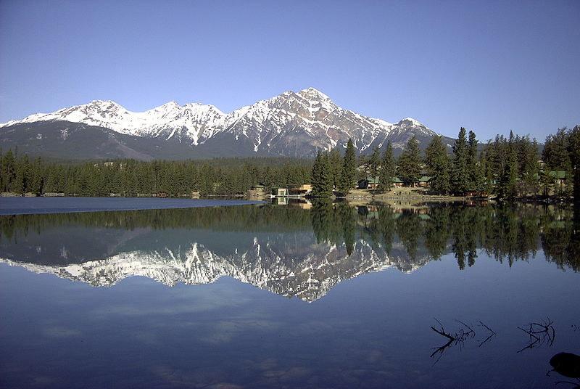
The Montane Cordillera
7. Human Features
Major Human Activities:
Cattle Grazing
Tourism
Forestry
Mining
These human activities are have harmful effects on the ecosystem

Slide 46
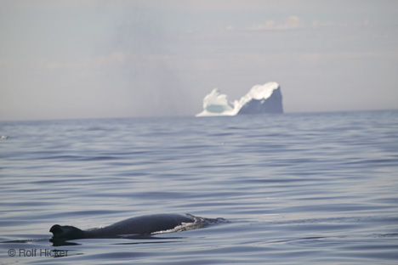
The Atlantic
This ecozone only touches land at the southern coast of New Brunswick and Nova Scotia and the eastern coast of Nova Scotia and Newfoundland.
1. Landforms
Most of the ecozone is thousands of meters deep, although the famous Grand Banks off of Newfoundland average only 150 meters over large areas

Slide 47
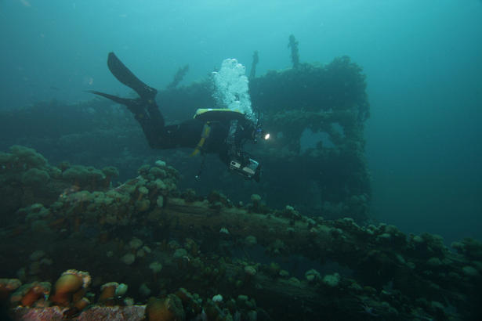
The Atlantic
2.Water forms
This area is heavily influenced by the gulf stream
The Gulf Stream brings more temperate waters to the shores
of Nova Scotia, New Brunswick and Newfoundland and Labrador
The Labrador Current also plays a role here, as its cool water come
in from the north

Slide 48
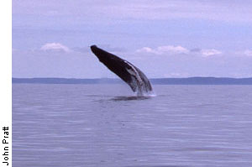
The Atlantic
3. Climate
Winds coming from the land and the warm Gulf Stream make the Atlantic Marine ecozone more temperate than it would otherwise be
There is a lot of fog because warm and cool ocean currents
meet there
The Gulf Stream = Warm
The Labrador Current = Cold
In the spring Ice Burgs can be found here

Slide 49
The Atlantic
4. Soil
The soil of the fish banks found in this ecozone are rich in nutrients
Fish Bank: Area of water that is less than 250m deep.
These nutrients are essential for fish to survive and
thrive in the ocean ecozone

Slide 50
The Atlantic
5. Vegetation
Tiny aquatic organisms called phytoplankton live in the ocean.
Giant kelp and seaweed are common in intertidal zones
Salt marshes that are found at the water’s edge contain many plant species

Slide 51
The Atlantic
6. Wildlife
Marine mammals, like seals, porpoise, dolphins, orca, and many whales are found here.
Birds found in the area include northern fulmar, greater shearwater,
dovekie, murre, petrel, tern, eider, kittiwakes, puffins, cormorants and gulls
Many species of fish including cod, herring, hake, halibut are found here
Many crustaceans and invertebrates can be found in the Atlantic Ecozone

Slide 52
The Atlantic
7. Human Features
The Grand Banks lie here off the Newfoundland coast.
European settlers said there was so much fish that boats would
Be slowed
Overfishing has destroyed much of the fish population
In 1992 Cod fishing was banned
Since 1992 other species have been targeted
Today oil and gas fields are exploited the help meet the
needs of the people

