Slide 1
Canadian Geography 1202
Economic Issues in Canadian Geography

Slide 2
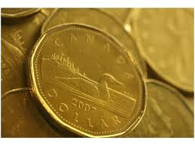
Economics
Economics: The study of how we use our limited resources to meet our relatively unlimited needs and wants
Remember: The economic system is one of our human systems from Unit 1

Slide 3
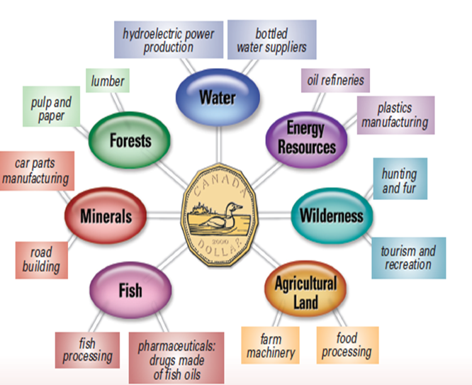
Natural resources
Natural resources – anything found in nature that can be used by people.
What are some examples of natural resources?
What can they be used for?

Slide 4
The Relationship Between Supply, Demand and Price
Supply: The amount of product that is available to customers.
Demand: Describes a consumer's desire, willingness and ability to
pay a price for a specific good or service
Demand is related to the needs and wants of society, as they change so does demand
Price: Amount of payment given for a good or service
Supply, demand and price are directly related.
A change in one can directly influence both of the others
What happens to the demand and supply of an item when the
price goes up?

Slide 5
When price increases, Demand decreases, and supply increases
When Price decreases, demand increases, and supply decreases

Slide 6
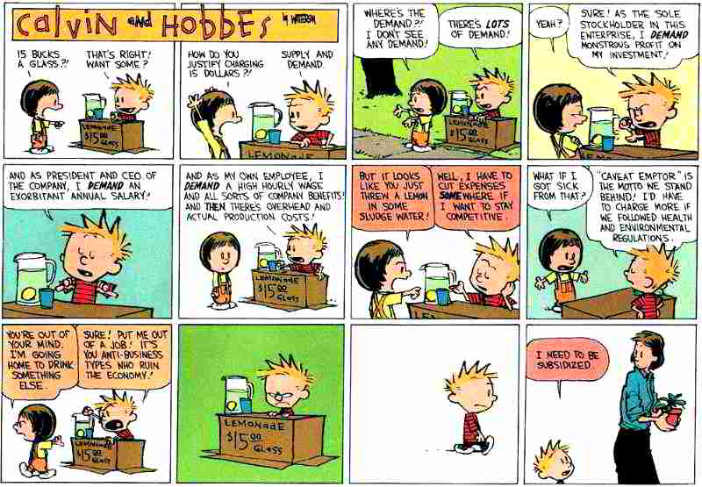
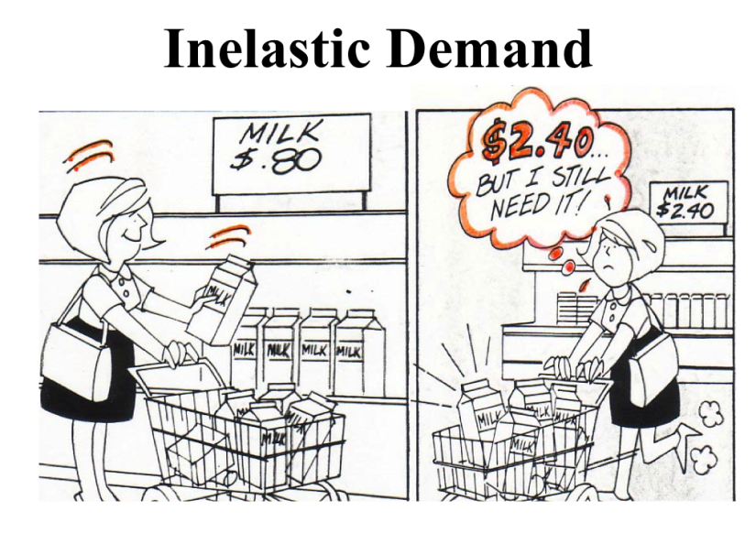

Slide 7
PRODUCT | EVENT
1. wheat | A drought destroys much of the crop.
2. cigars | A study says smoking cigars results in lots of wrinkles.
3. yo-yo’s | A rock star says he loves playing with a yo-yo.
4. gasoline | Small cars start out-selling large cars.
5. apples | A new pesticide kills caterpillars that eat apples.
6. Canadian cars | Canada places a tax on Japanese cars coming into Canada.
7. hospital beds | Scientists discover a cure for cancer.
8. cement | A huge earthquake hits Toronto.
9. video rentals | The price to see a movie in a theatre increases.
10.butter | A disease kills a lot of dairy cows.
11.Burger King whoppers | McDonalds increases the price of Big Macs.
12.hot dog buns | The price of flour is lowered.
13.taxi service | The local bus service goes out of business.
14.candles | A big winter storm is forecast.
15.gasoline | Two large supertankers collide and sink.

Slide 8
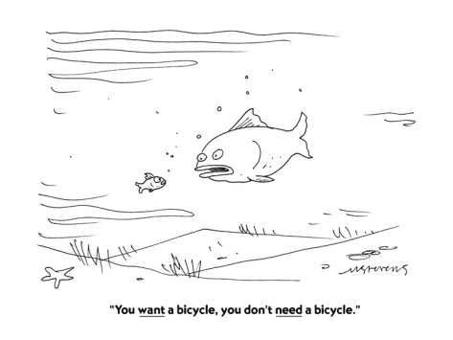
Needs and Wants;
Needs: Something that is necessary for a organism’s healthy living.
Without it life would be much more difficult and possibly lead to death
Wants: Something that is desired, but is not essential to an organisms
survival.
Specialization: Focusing on producing one type of good or service so
that it can be produced more efficiently
Trade: Exchanging one form of good or service for another
specialization and trade help maximize economic activity, allowing us to meet more of our needs and wants;

Slide 9
Specialization
Specialization lets people do what they do best.
There are many reasons to specialize:
You improve your methods of production over time
There is no cost of switching between activities
You only need one set of tools
You are able to choose something that you like to do and do it

Slide 10
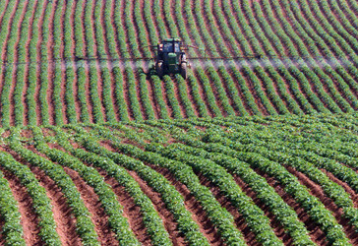
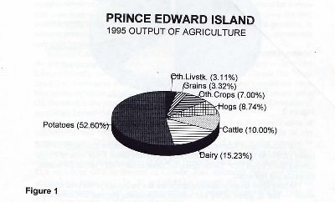
Example of Specialization
Prince Edward Island has a highly specialized agricultural sector.
They grow mostly one crop, potatoes
Specializing in growing potatoes has helped the provincial economy succeed.
They can use the profit form
Growing potatoes to trade to
Meet their other needs and
wants

Slide 11
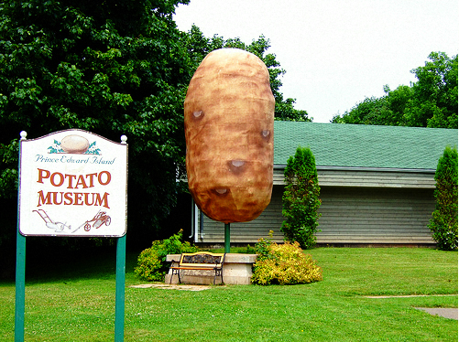
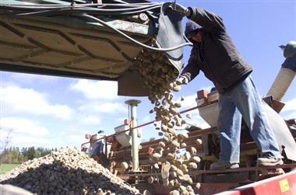

Slide 12
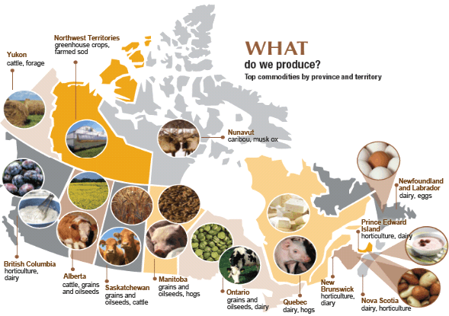
Example of Specialization

Slide 13
Trade
Trade allows for the exchange of one good for another
Trade allows consumers to buy goods and services that they would not be able to access locally (Fresh fruit and vegetables in the winter)
Trade allows us to meet some of our needs in wants when we could not locally.
It increases our standard of living
Trade encourages companies to offer higher wages, better working conditions and Better products.

Slide 14
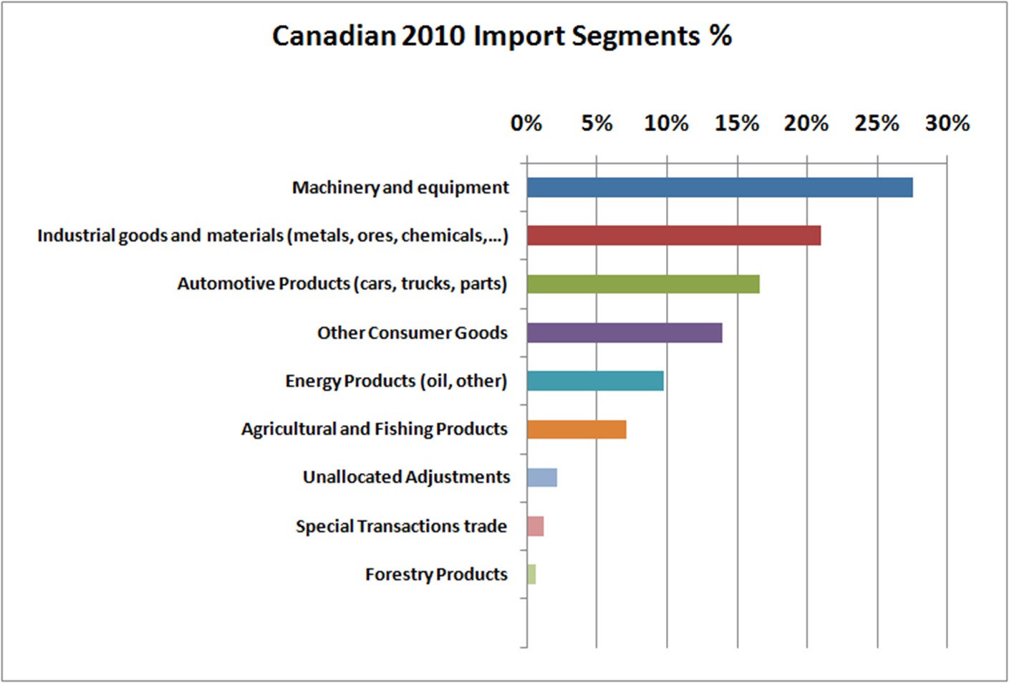
Trade helps Canada get things that we cannot provide ourselves.
Importing – when goods and services are brought into a country.
What kind of things are exported into Canada?

Slide 15
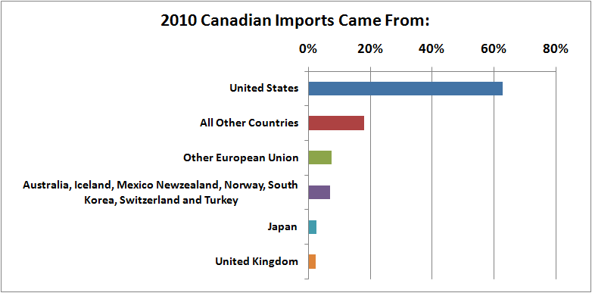
What countries do we import from?

Slide 16
As we get and use resources we contribute to industry and the economy.
Industry – the particular types of labour that are done in exchange for pay.
Economy – a system in which a country produces and distributes goods and services to create wealth.

Slide 17
Export: Goods or services that are produced in an country and shipped elsewhere.
Balance of Trade: The ratio of goods and services exported to goods and services imported.
Trade surplus: When the balance of trade is a positive number.
Trade Deficit: When the balance of trade is a negative number.
Having a trade surplus or deficit has a large impact on a nations economy and future planning.

Slide 19
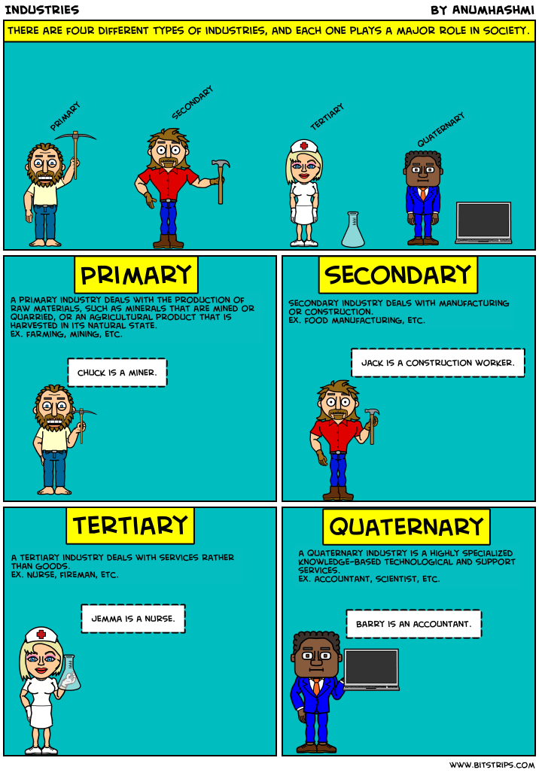
The Four Economic Areas
Economic activity can be categorized into one of four areas:
Primary: Resource extraction ( Fishing, forestry, mining, oil)
Secondary: Manufacturing ( Making things out of other things)
Tertiary: Service industry (Providing services)
Quaternary: Information, research and development.

Slide 21
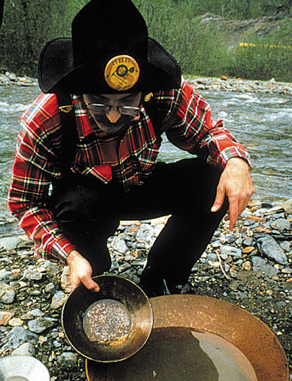
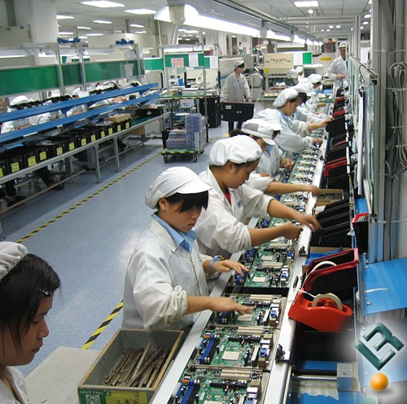
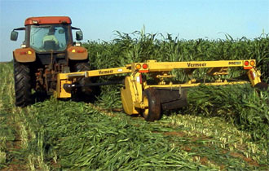
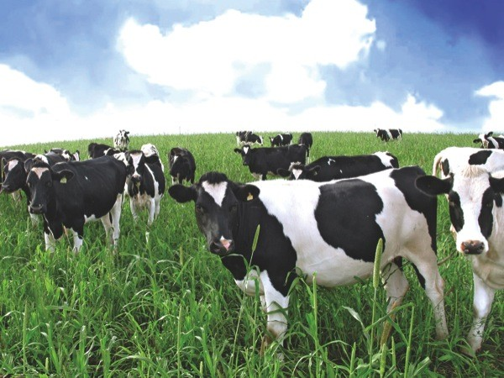
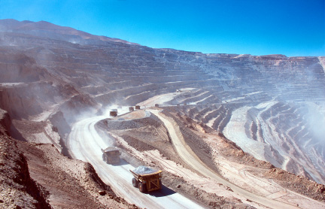
Primary, Secondary, Tertiary, or Quaternary
Write down in your notes if each of the following pictures is primary, secondary, tertiary, or quaternary.
The person with the most correct gets a prize!!!

Slide 22
Economic Diversification
Economic Diversification: Entering many industries, so that a countries or region income does not come from only one source
economic diversification.
Why Diversify?
Diversification protects from any one industry collapsing
the significance of economic diversification.
This promotes sustainability in the economy
It helps rural communities survive
e.g. Newfoundland and the fishery…..

Slide 23
Why is economic diversification important?
People can find work in different economic areas.
Economy is not dependent on one industry.
If demand for one industry declines the economy will not be devastated.
More money and jobs are produced by having secondary and tertiary industries.

Slide 25
Industry | Number | Per-Cent
Agriculture | 1,820 | 0.7
Fishing | 8,775 | 3.6
Logging | 2,430 | 1.0
Mining | 2,800 | 1.1
Petroleum | 775 | 0.3
Fish Products | 9,660 | 3.9
Pulp and Paper | 2,450 | 1.0
Other Manufacturing | 9,975 | 4.1
Construction | 17,215 | 7.0
Transportation | 9,950 | 4.0
Communications | 4,230 | 1.7
Wholesale Trade | 8,110 | 3.3
Retail Trade | 31,760 | 12.9
Finance and Insurance | 4,250 | 1.7
Business Services | 7,320 | 3.0
Government Services | 21,485 | 8.7
Educational Services | 20,715 | 8.4
Health and Social Services | 26,465 | 10.8
Accommodation Services | 3,600 | 1.5
Food and Beverage Services | 10,345 | 4.2
Personal and Household Services | 6,455 | 2.6
Total Labour Force | 246,065 | 100.0
Labour Force 15 Years and Over by Selected Industry Divisions and Major Groups, 1996. NL and Labrador.

Slide 26
Economic Geography
Economic geography is important because it helps make better decisions around the production, distribution, and consumption of goods and services that fulfill peoples’ needs and wants.
By evaluating the natural and human systems of an area and assessing
the potential uses of the resources within these systems people can
use their geography to support their economy

Slide 27
Transnational Corporation
Trans National: A business or corporation that operates in more than one country.
Operating in more than one country allows companies to extract a variety of
resources, and find the best conditions for manufacturing
They are able to take advantages of low wages in developing countries, as well
as harvest resources anywhere in the world
Many transnational companies give back to the communities that
they extract resources from. Building schools, arenas, and other buildings.
However many do not
Often transnational corporations use multiple countries to avoid having to follow
the rules

Slide 28
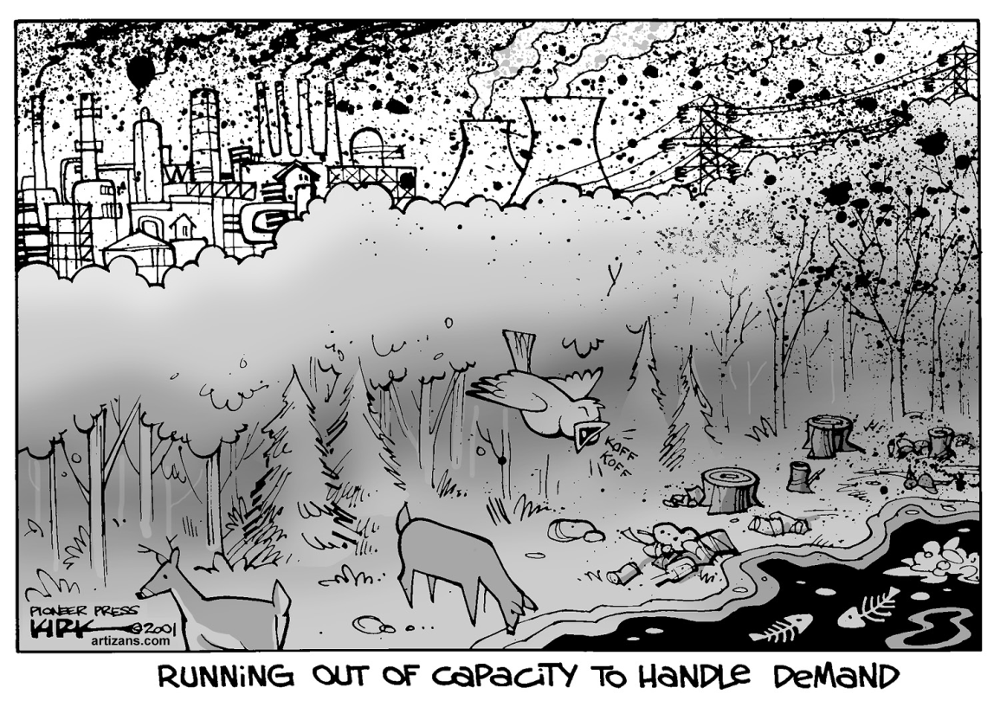
Sustainable Development
When deciding to harvest a resource
We must decide if the trade off
Between a strong economy, the needs
Of the community, and the environment
To help people make this decision
The Canadian government requires
All new resource projects to undergo
An environmental assessment process
Environmental Assessment: a detailed study that tries to determine the potential environmental impact of a proposed development

