Slide 1
Canadian Geography
5.2 Part 2: Natural Resources

Slide 2
AGRICULTURE: ECONOMIC IMPORTANCE
Agriculture generates 1.7% of Canada’s gross domestic product
Agriculture supports many rural communities
and provides Canadians with a safe, abundant food supply.
provides jobs, directly and indirectly, to approximately
one in 86 Canadians

Slide 3
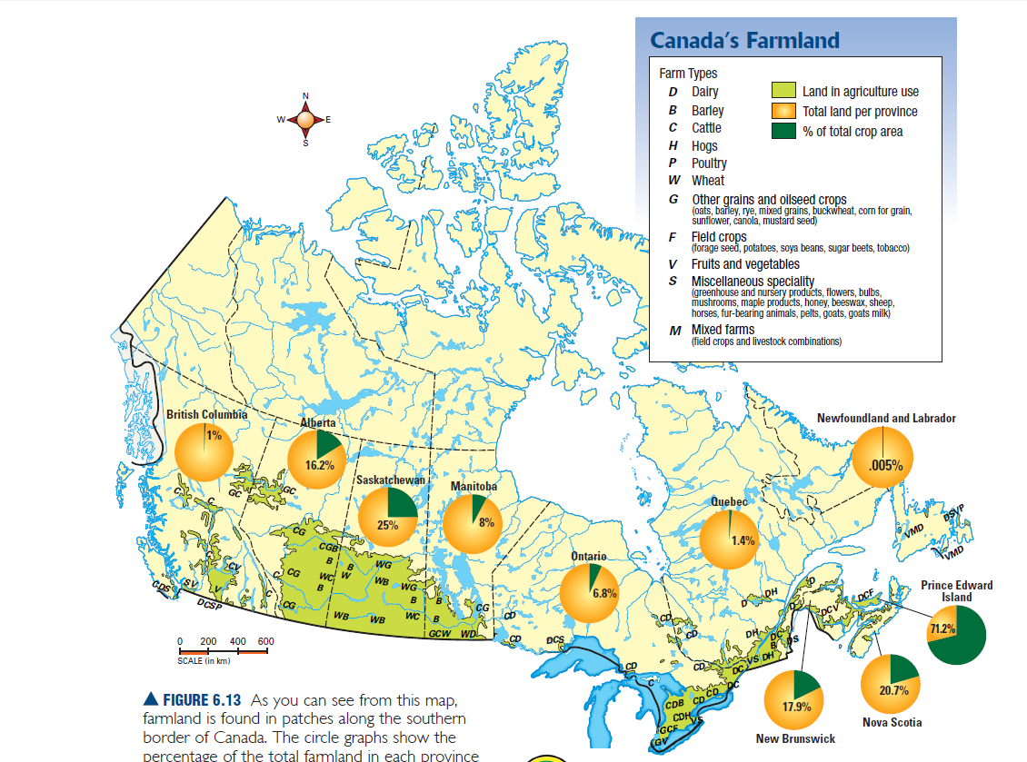
AGRICULTURE
Areas of agricultural activity:
1.The prairie provinces Alberta, Saskatchewan and Manitoba
2. The Great Lakes-St. Lawrence Area. Southern Ontario and Quebec
3. Prince Edward Island

Slide 4
AGRICULTURE: Challenges
• Natural hazards early frosts, drought, floods,
animal diseases such as mad cow disease, avian flu in poultry
•High costs for fuel and equipment
• Competition from large, industrialized factory farms, some owned by big corporations
• low crop prices
• competition from more heavily subsidized farmers in other countries

Slide 5
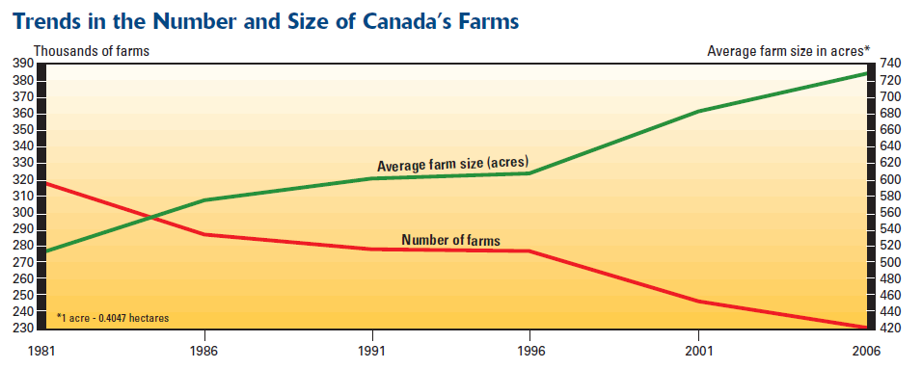
AGRICULTURE: TRENDS
1. Fewer farms but bigger farms
2. Agribusiness: Large corporations control all aspects of the farming operation
fromplanting, to transportation to sales.
3. Factory Farms: Large industrial farms that have thousands of animals in small
contained spaces

Slide 6
AGRICULTURE: Sustainability
Sustainable Agriculture: Agriculture that will last into the future
Canada needs to make changes to the agriculture system so that:
There will be no loss of arable land
Arable Land: Land that can be used for farming
The natural systems will be protected from harmful pesticides and fertilizers
It uses fossil fuels more efficiently
It provides as many jobs as possible(even in small farm settings)
It supports Canada’s need for food

Slide 7
FISHERY: Economic Importance
Contributes to over $4 Billion in trade
The value of Canada's fisheries is increasing
The economic importance relies on where you live, there is a greater value in
areas near the ocean

Slide 8
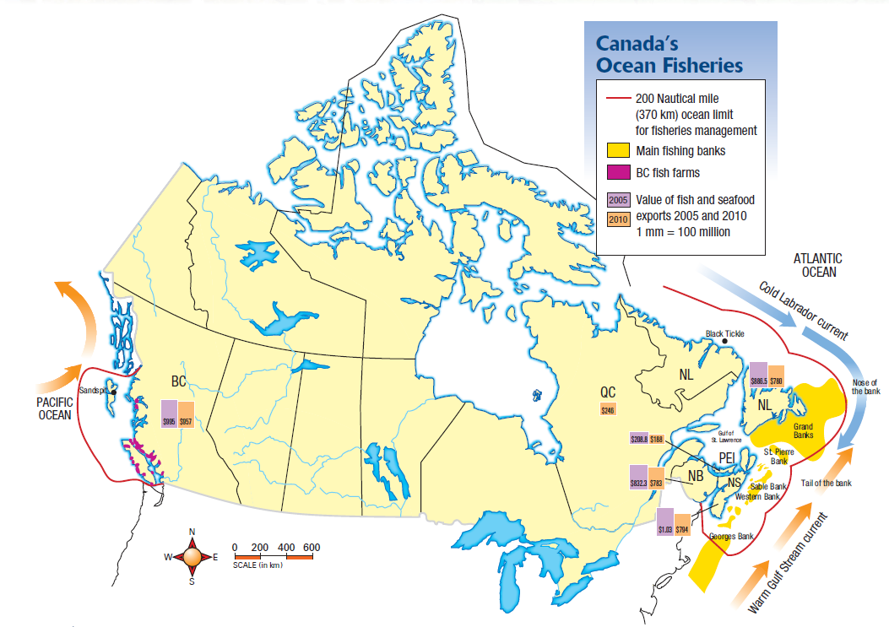
FISHERY
The Atlantic:
The presence of fish banks has provided a great habitat for fish and a great
resource for the people
The Pacific:
The presence of great rivers have provided a natural breeding for
salmon and a resource for people to exploit

Slide 9
FISHERY: Challenges
Changing Technology: Factory freezer trawlers can catch process and freeze fish on
board the ship. This allows them to stay at sea for long periods and catch a lot of fish
2. Overfishing: Catching too many fish. This happens because fishers need to pay for their
equipment and turn a profit Also many other species are caught in nets Bycatch.
3. The quota system: A quota is a limit to how much you can catch. By setting quota’s too high
Fish stocks may be harmed. If set too low fishing will not be profitable.

Slide 10
FISHERY: Trends
Aquaculture: Commercial fish farming
In Canada there has been a large increase in the amount of aquaculture.
This takes the pressure off of natural fish populations and allows stocks to recover
Aquaculture operations are expensive to start, but often are subsidized by the government
Aquaculture is seen by many as the future of sustainable fisheries

Slide 11
FISHERY: Sustainability
Care needs to be taken in the this industry so that the natural stock of fish is not destroyed
Government needs to set regulations to protect the existing stocks and
encourage regrowth
2. Aquaculture needs to be encouraged and subsidised
3. Consumers need to be more responsible and choose fish from sources that are
Environmentally secure and not at danger

Slide 12
MINING: Economic Importance
Ontario, Saskatchewan, British Columbia, and Quebec produce about 80% of the total value of Canada’s minerals.
The mining industry plays an important role in the economy of Newfoundland and Labrador, representing 8.6% of the province’s total GDP
Nunavut, with its vast territory of Canadian Shield rock, is a good location for exploration and development of gold, base metals, and diamond mines.

Slide 13
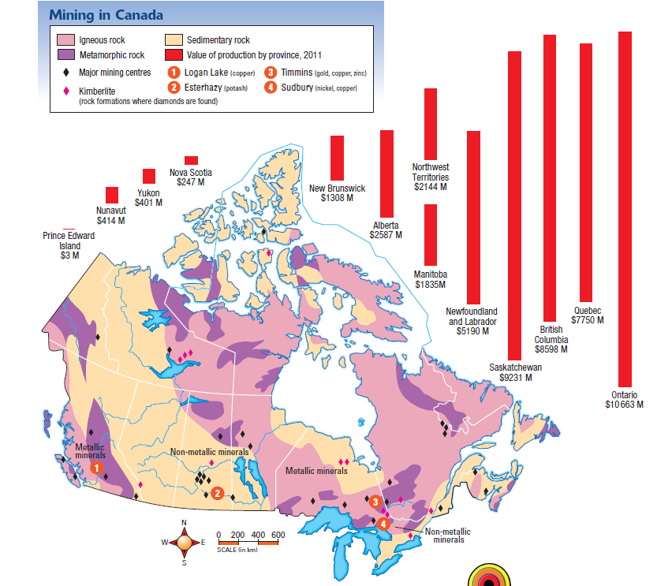
MINING

Slide 14
MINING: Challenges
Diversification: Towns pop up around mining areas. The economies in
these towns do well while the mine is operating, however when the minerals run out, or if the price of the mineral drops the economy suffers. To remedy this towns need to diversify their economies.
Diversification: Exploring multiple sectors of the economy to
help prevent damage from the loss of any one sector
2. Acid Rain: Includes rain, fog, and snow that is highly acidic and a threat to
the forests, lakes, fish, and the shallow soils of the Canadian Shield. The refining
and smelting of minerals produces acid rain
Refining: a part of the process that removes impurities when metal is
separated from the rock ore in which it is found
Smelting: the heating and melting of ore to extract a pure metal

Slide 15
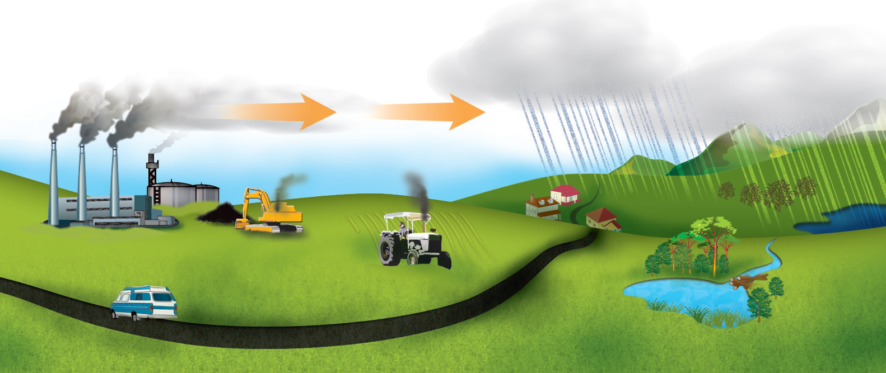
MINING: Challenges
Acid Rain

Slide 16
MINING: Trends
Improved Air Quality: The use of better technology in smelting processes
have led to gradual improvements in air quality around smelters
2. Increased Protection of the environment: Governments are now requiring
Industry to plan for the future of mining sites, and help the natural systems
recover when mining finishes
3. The Push North: As minerals become more valuable, and technology
improves minerals in Canada’s north are becoming more accessible and
we are seeing more projects being taken on there

Slide 17
MINING: Sustainability

Slide 18
FORESTRY: Economic Importance
More than 300 communities in Canada depend on forestry
provides jobs to 195 000 people directly and many more people
indirectly
More than 5500 people work in forestry industries in Newfoundland and Labrador
People employed in forestry work for logging, pulp and paper, transportation,
and consulting companies, as well as for the government, universities,
colleges, and NGOs.
Canada exports about $24 billion worth of forest products each
year.

Slide 19
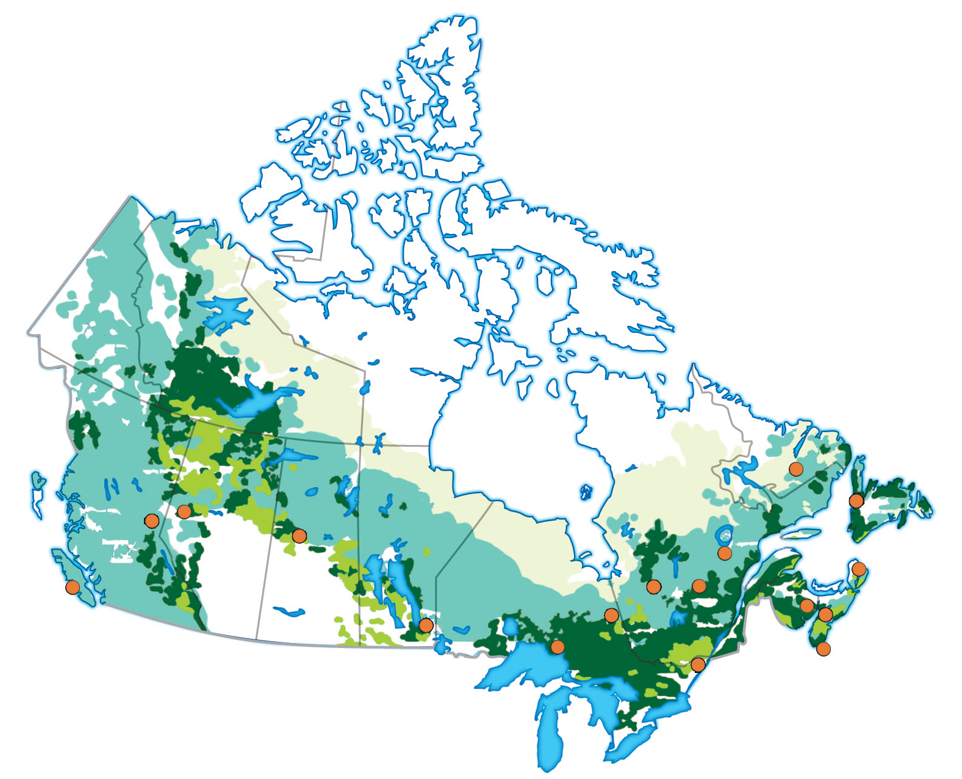
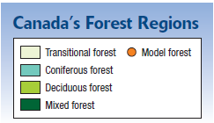
FORESTRY

Slide 20
FORESTRY: Challenges
De-forestation: Companies must be careful not to take to many trees,
and to replant areas that have been harvested so that the resource will be
available in the future
2. Decreased Demand: The reduction in demand for news print is causing
many companies to close pulp and paper mills
3. Damaging harvesting methods: Clear cutting is a very damaging method
of harvesting trees. Companies should use alternative methods.
(Strip cutting, Shelter wood Loging, Selective cutting)

Slide 21
FORESTRY: Trends
Model Forests:
Working model forests are a new approach to managing small areas
of local forest.
There are 15 model forests across Canada
Communities work together to find solutions to solve problems facing
their forests
While this is a good approach to managing forests it often takes a long time
as you have many groups with different needs and wants

Slide 22
FORESTRY: Sustainability
The most important piece in promoting a sustainable forest is a
Forest Management Plan
Forest management plan: a plan of long-term goals for an area to be logged, or reforested. It is required by law in Ontario
Ways to improve forest management include:
• leaving a band of forest around the shores of lakes and rivers
and avoiding cutting on slopes to reduce erosion
• reducing the size of clear-cut areas
• setting aside large enough areas of the forest to provide intact
ecosystems for wildlife or for seed reserves for future tree
growth

Slide 23
WATER: Economic Importance
We build all our settlements close to water
All of our economic activities depend on water in some way or another.
The distribution of water from sources to homes employs many people
The treatment and bottling of water is a growing industry as world water
demand increases
While the exporting of bulk water is not permitted, it is a possible growth industry
for Canada in the future.

Slide 24
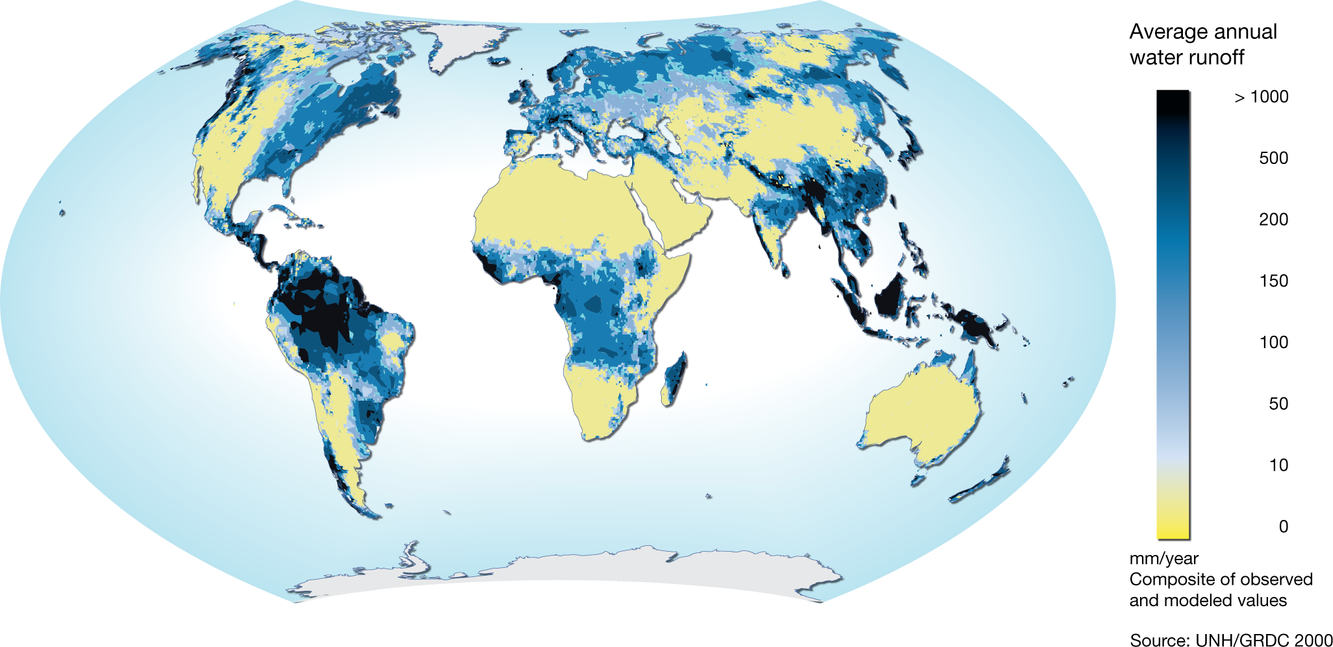
WATER: Location
Compared to the rest of the world Canada has a great deal of water runoff
The only areas with a greater amount of runoff can be found in the tropics

Slide 25
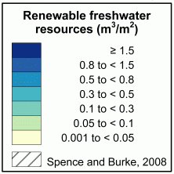
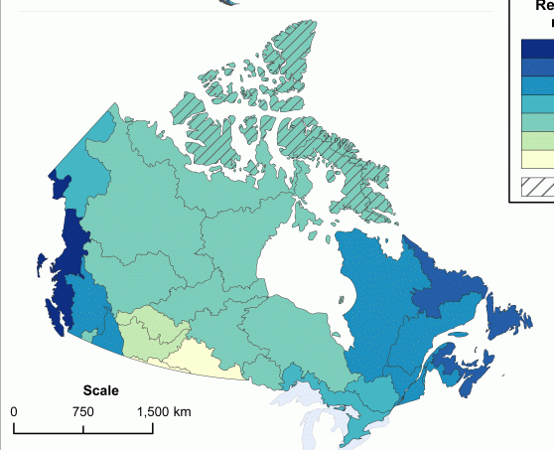
Canada’s water resource is not evenly distributed.
Both the east and west coasts receive more rainfall than the interior
In the north water is not considered a resource in the same way as it is usually frozen

Slide 26
WATER: Challenges
Water Ethics: a set of moral principles or beliefs about what is right and wrong when considering the use of water
Is water a product to be bought and sold, or is it a basic human right and a commonly owned public good? Or is it both?
Some people see water as part of the commons, and believe that it belongs to everyone
Commons: Natural resources that belong to everyone and are protected by the
government
Others see water as an economic resource—a commodity that may be owned privately and sold for a profit.
Commodity: A resource that can be harvested and sold for a profit.

Slide 27
WATER: Trends
Water Diversions
Many areas in the United States are employing water diverting to solve water shortage problems
Water diversion: is the rerouting of water from one drainage basin to another.
This can cause problems in Canada as the water being diverted comes from the Great Lakes.
In 2007 a treaty was signed to stop water diversions from the Great Lakes, however as the economy continues to grow in the region the pressure to change the treaty is growing

Slide 28
WATER: Trends
Privatization:
Canada is involved in the worldwide trend toward privatization of water supplies.
Privatization: Owned by a corporation not the public.
Privatization means selling for profit. This will lead to a shift from conservation to
consumption

Slide 29
WATER: Sustainability
Groundwater Contamination
Groundwater: Water that is held in soil and rocks located under the surface of the Earth. It is naturally filtered by several layers of sand and gravel, that clean it.
Industries must be controlled so they do not but materials in the ground that contaminate
ground water.
Treating Sewage:
Many people who live in rural areas must be careful not to contaminate water with
Sewage runoff.
Sewage runoff can contaminate wells and cause serious sickness

