Slide 1
Canadian Geography
Types of Resources

Slide 2
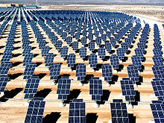
The Three Types of Resources
1. Renewable
2. Non Renewable
3. Flow

Slide 3
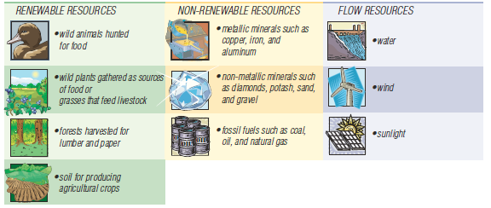
Renewable Resources
Renewable Resource: a resource, such as forests or fish,
that can be replaced by natural environmental processes,
unless badly mismanaged
…….If you use it wisely it will be around forever!!!!!

Slide 4
Non Renewable Resources
non-renewable resource: a resource, such as fossil
fuels, that exists in finite amounts or that replaces itself
very slowly
……… Once you use it, its gone

Slide 5
Flow Resources
flow resource: a resource, such as running water or
wind, that is used and replaced simultaneously
It will never end……

Slide 6
The Value of Resources
Natural resources have three general types of value:
1. Economic
2. Ecological
3. Aesthetic
Sustainable resource system - will last into the future and the natural resources are not used up faster than they can either renew themselves, be recycled, or be replaced with other resources.

Slide 7
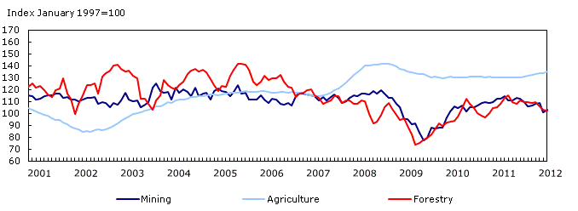
Economical Value
Extracting natural resources brings money into the economy in three ways.
1. Employment in resource industries
2. Through royalties paid on exports
3. Through related spin-off industries
Royalties: Fees paid to the government for the use of a resource
Exports: Goods or services that leave a country
Spin-off Industries: Industries that support or provide services to any
other industry.

Slide 8
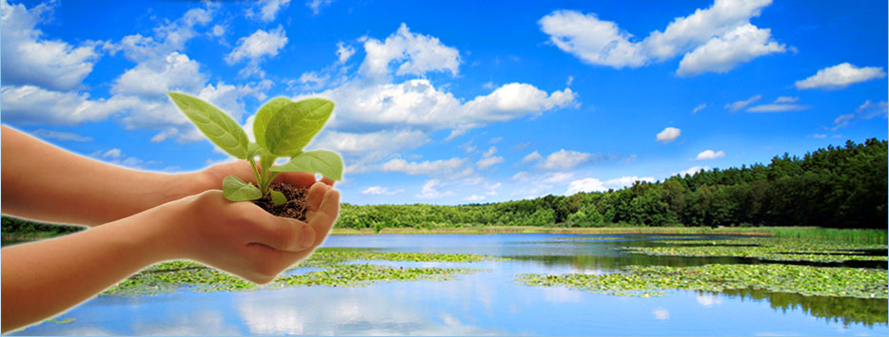
Ecological Value
Natural resources often play roles within the ecosystems in
which they are found
Extracting the resource often comes at a cost for the ecosystem
Trees produce oxygen and clean the air -> by cutting trees the ability of the ecosystem to clean air and produce oxygen is reduced
Ducks are part of the food chain -> by killing ducks the food chain will be impacted which will hurt other animals in the ecosystem

Slide 9
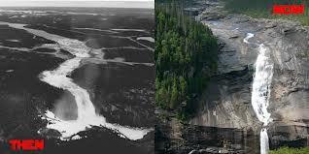
Aesthetic Value
The aesthetic value of a resource had to do with the value that
people put on the beauty of open spaces, green spaces, fresh
water, wildlife
People put great value on these resources both physically and
psychologically
Contact with nature is important to psychological well being
As people are becoming crowed into cities this is becoming more
apparent

Slide 10
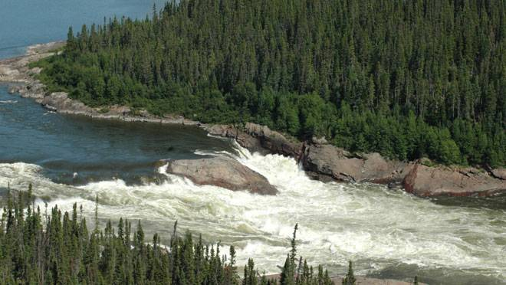
Muskrat Falls
How will the future look????

Slide 11
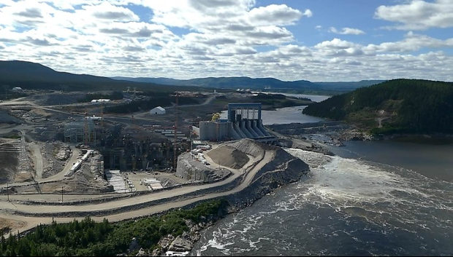

Slide 13
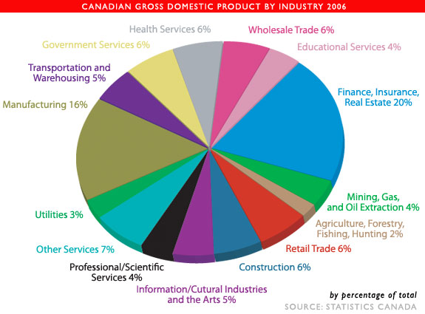
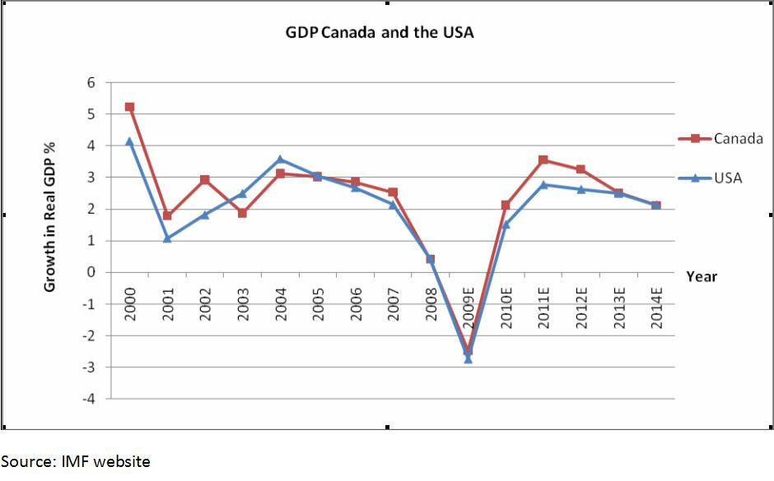
Measuring the Value
Gross Domestic Product: An economic indicator that measures the
value of all of the goods and services in one country in one year
In Canada natural resources and related industries account for roughly 13% of the
national GDP

Slide 14
Using Resources – The Trade-off
The decision to use a resource is not an easy one, when a resource is extracted there is damage to the natural systems.
The decision must take into account all three different values of the resource
If the economic value outweighs the ecological and aesthetic value of
the resource extraction will usually go ahead

