Slide 1
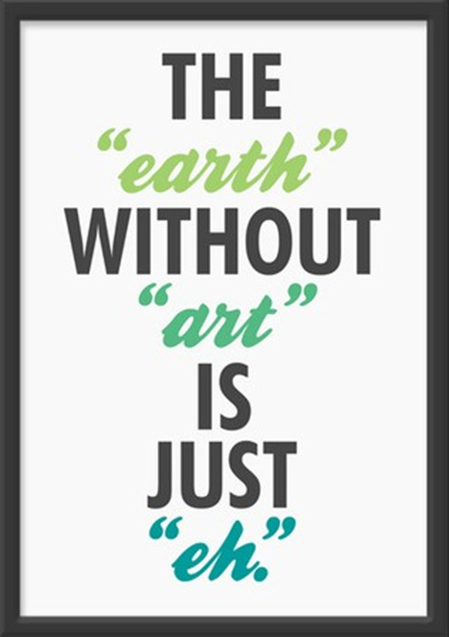
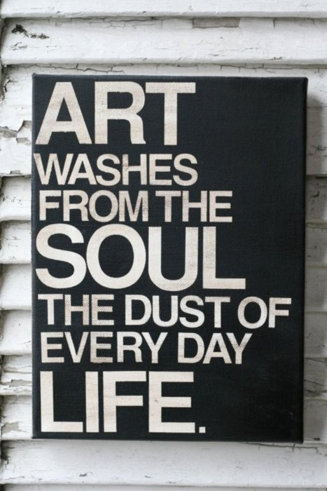
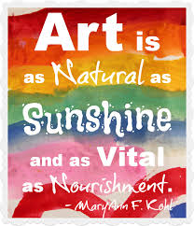
Artistic Visual Terminology

Slide 2
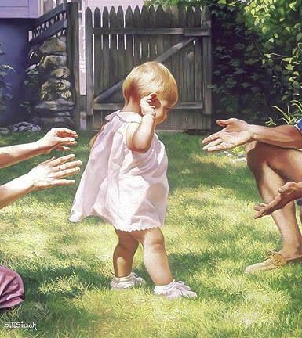
FOCAL POINT
Focal Point – The main area of interest in a visual.
Here the baby, who is probably taking her first steps, is the focal point of the picture.
The background (the yard, gate) is noticed after the baby, and as are the people’s arms and limbs. Thus the baby is the main focus of this picture.

Slide 3
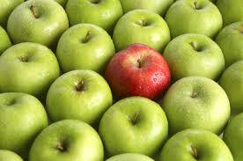
What Is …
The Focal Point?

Slide 4
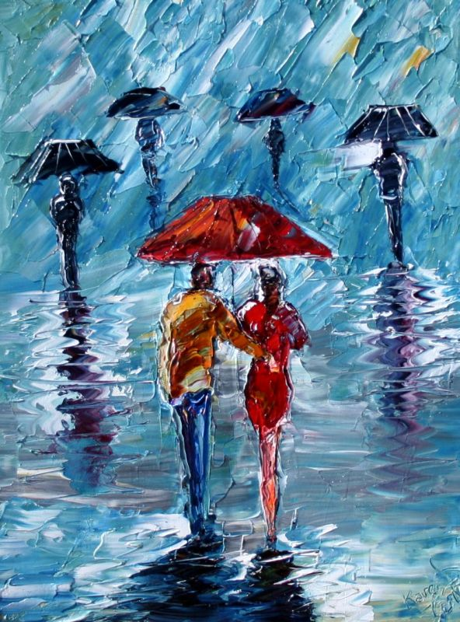
What Is …
The Focal Point?

Slide 5
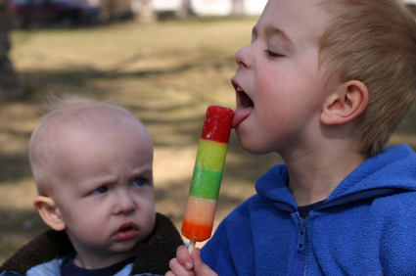
What Is …
The Focal Point?

Slide 6
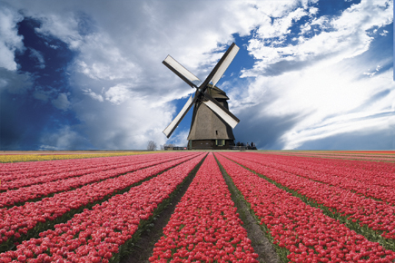
What Is …
The Focal Point?

Slide 7
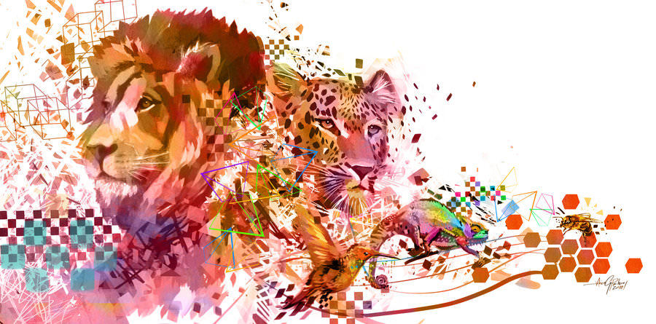
What Is …
The Focal Point?

Slide 8
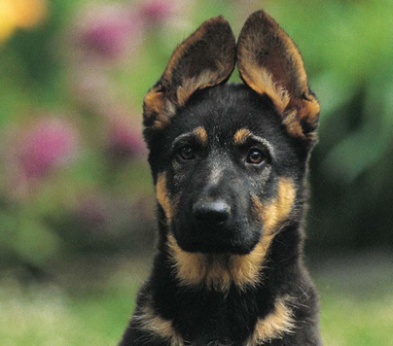
FOREGROUND/ BACKGROUND
Foreground – the part of the visual that is nearest the viewer.
Background – the part of the visual that is furthest away from the viewer.
Here the German Sheppard is in the foreground of this visual, while the garden (shrubs and flowers) are the background.

Slide 9
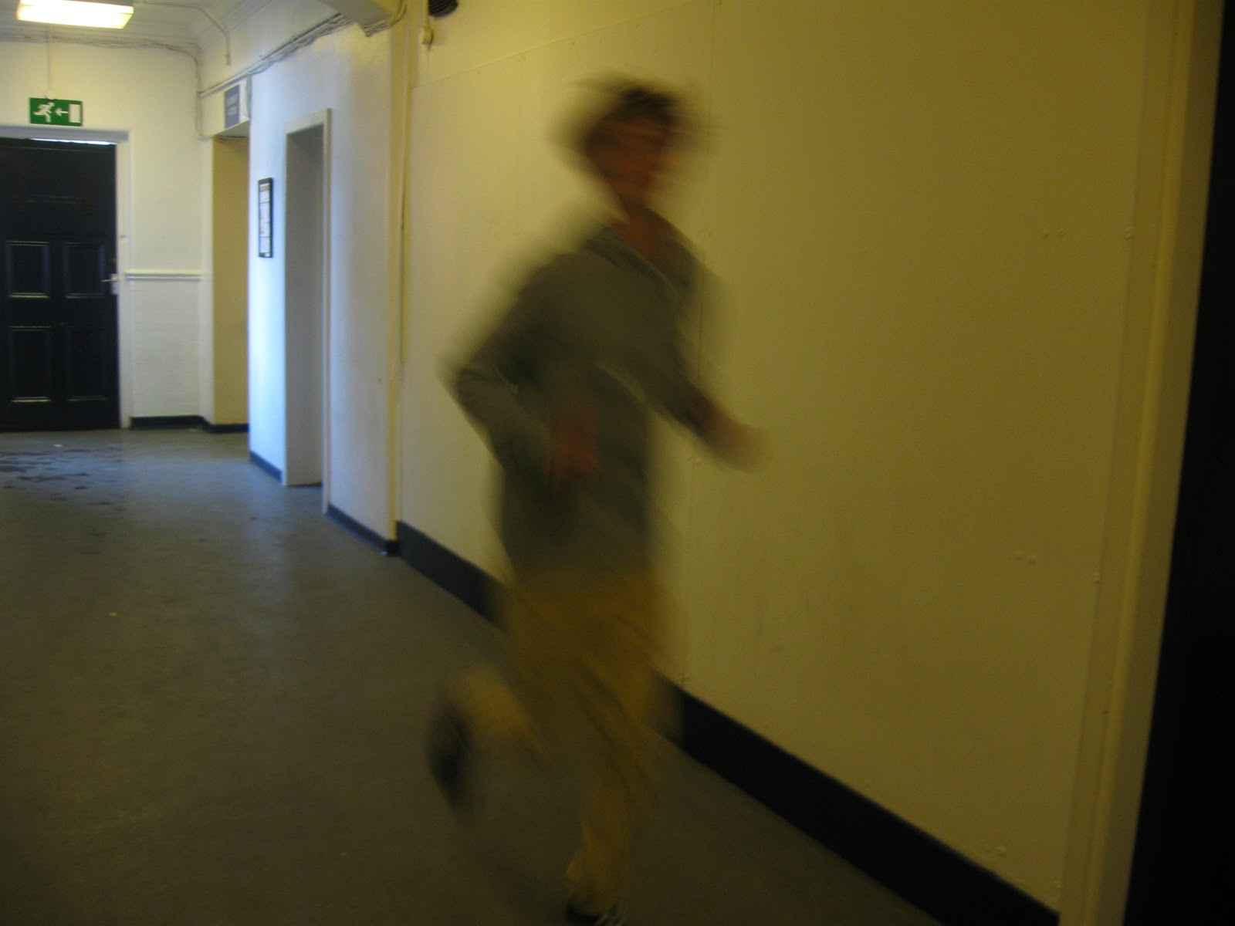
What Is …
The foreground of this visual?
The background of the visual?

Slide 10
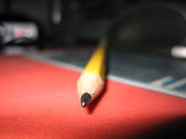
What Is …
The foreground of this visual?
The background of the visual?

Slide 11
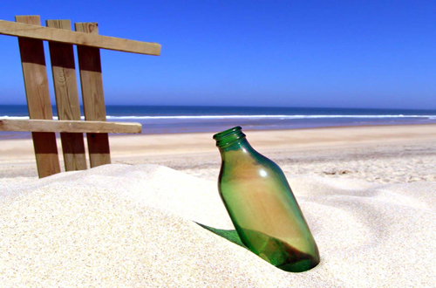
What Is …
The foreground of this visual?
The background of the visual?
What is the focal point of the visual?

Slide 12
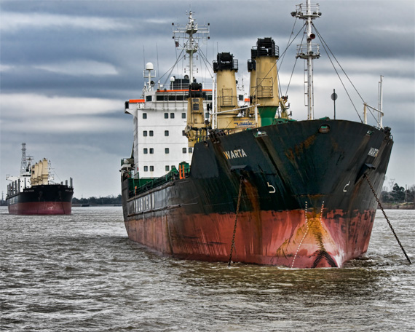
What Is …
The foreground of this visual?
The background of the visual?
What is the focal point of the visual?

Slide 13
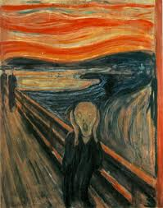
LINE
Sharp curves – as a general rule, bring about a feeling of unease or chaos.
The character in the painting is screaming, with hands to the face, this alerts the audience to the fact that the character is unhappy - some would even say stressed.
When we see the lines used in this painting we can connect the character’s expression to the chaos around him. The audience’s overall feeling of this painting, because of these elements, is unease (apprehension)

Slide 14
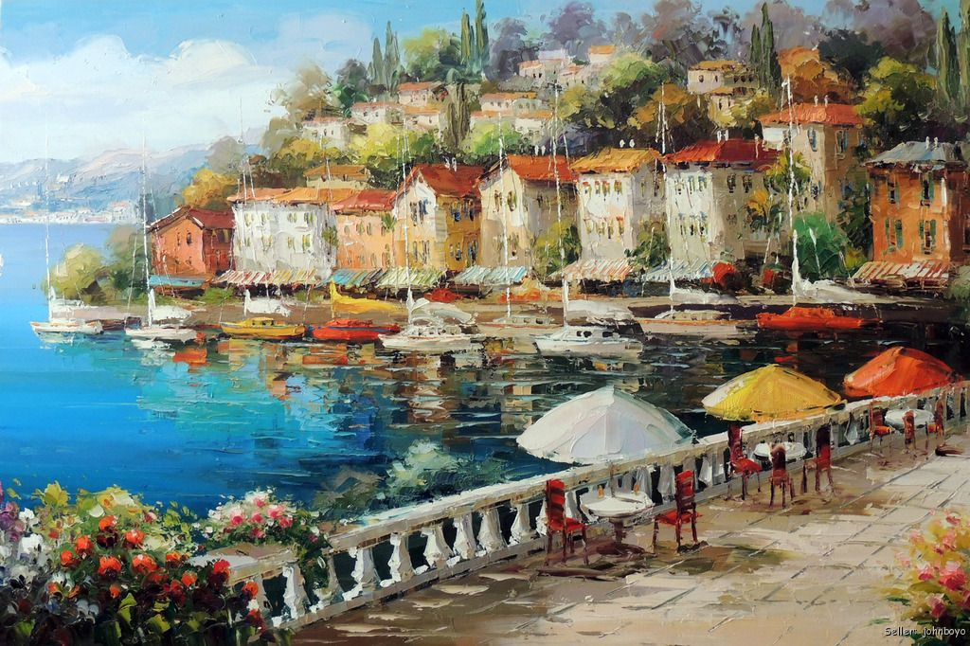
LINE
Straight lines – as a general rule, bring order and a sense of harmony to a painting.
This painting is of a casual and airy seaside scene. This peacefulness can be recognized throughout the straight lines used by the artist – the shoreline, buildings, boardwalk, masses of sail boats, trees.

Slide 15
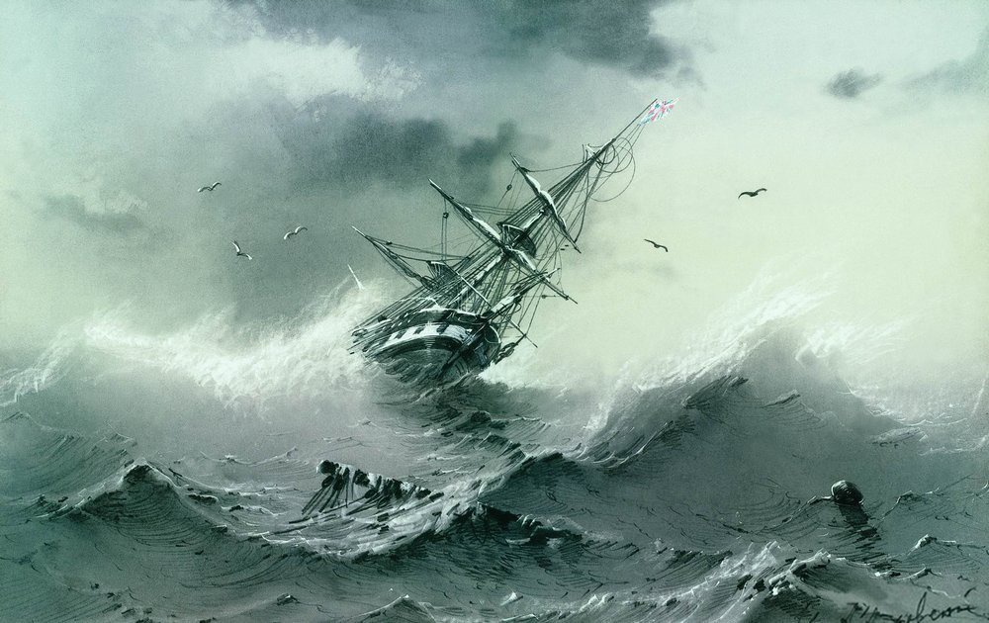
LINE
Jagged lines usually create a sense of fear or doom. They represent chaos or tensions.
In this panting we have a ship keeling over in huge fierce waves. Nearly every part of this picture has sharp jagged lines – this proves the lack of calm in the picture. The artist uses the sharp lines to create fear.

Slide 16
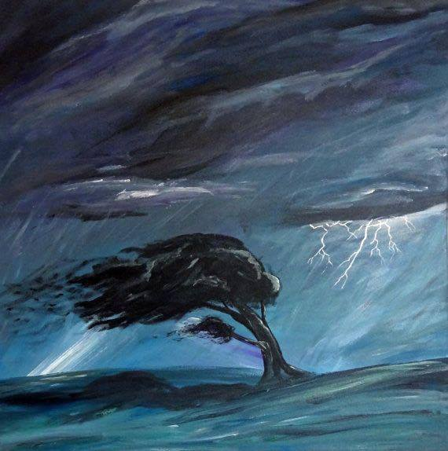
LINE
Gradually curved (or bending) lines help to create movement in a piece of artwork.
Here you see a tree bending in the wind. Here the curve of the tree helps the audience identify the movement in the painting.

Slide 17
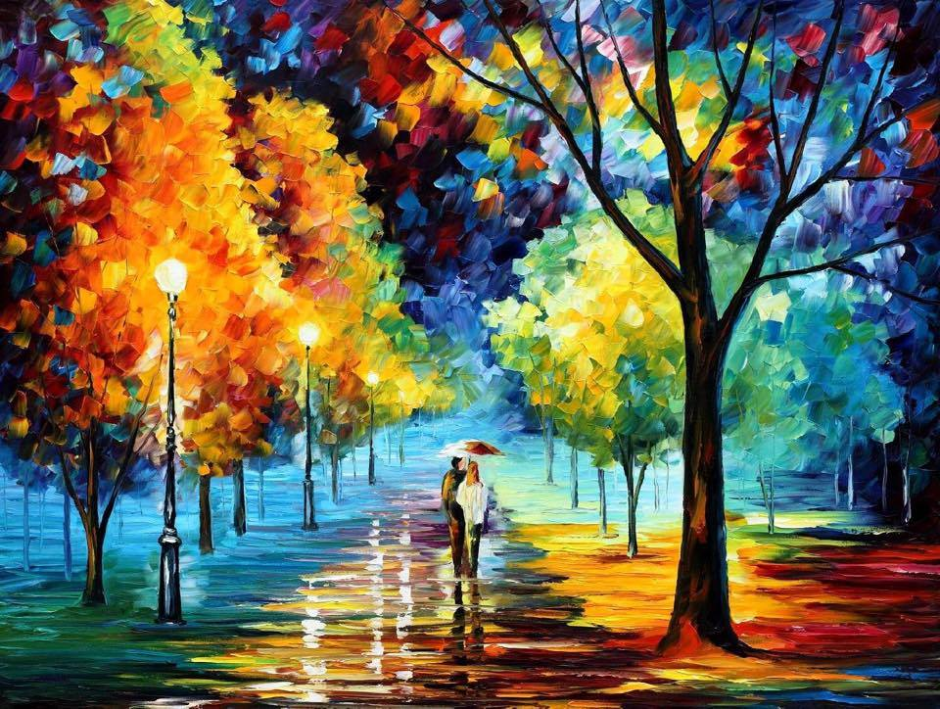
Which type of lines…

Slide 18
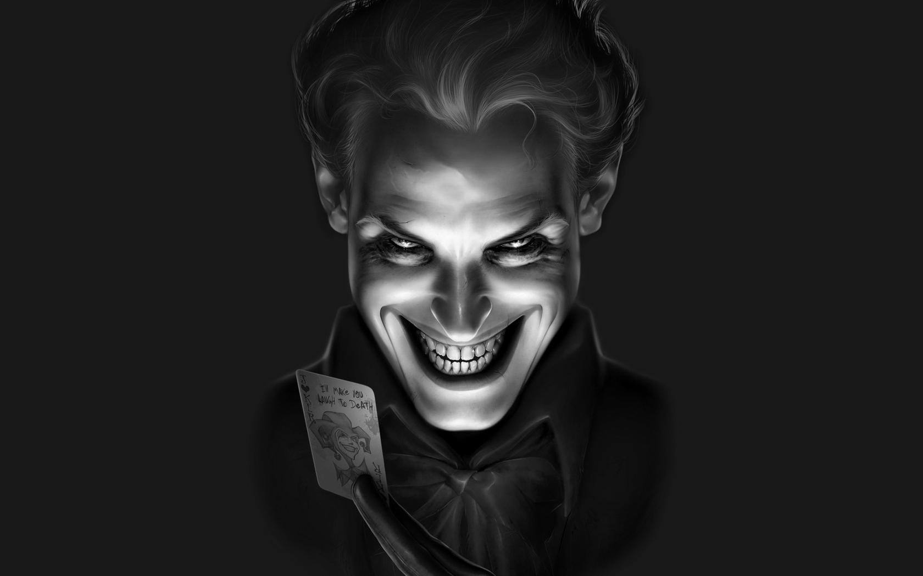
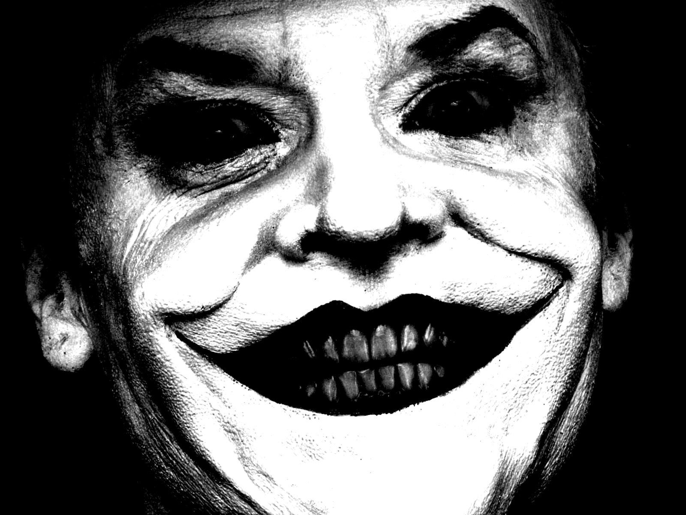
Which type of lines…

Slide 19
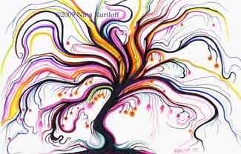
Which type of lines…

Slide 20
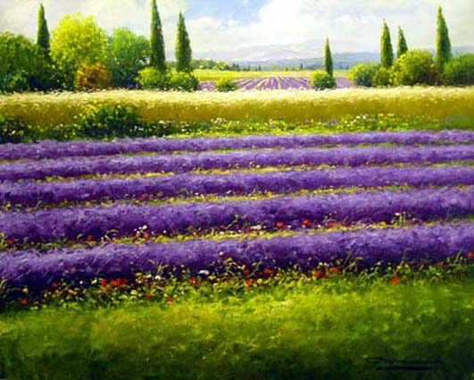
Which type of lines…

Slide 21
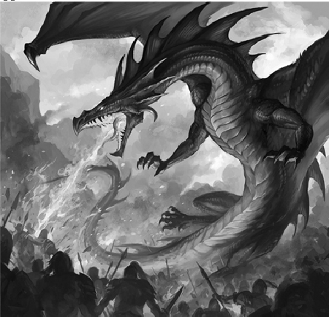
Which type of lines…

Slide 22
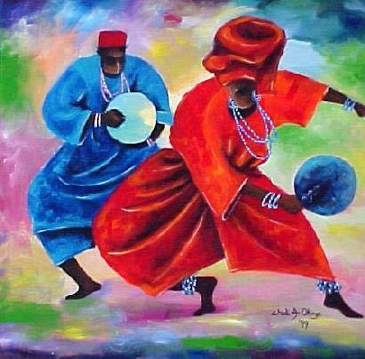
Which type of lines…

Slide 23
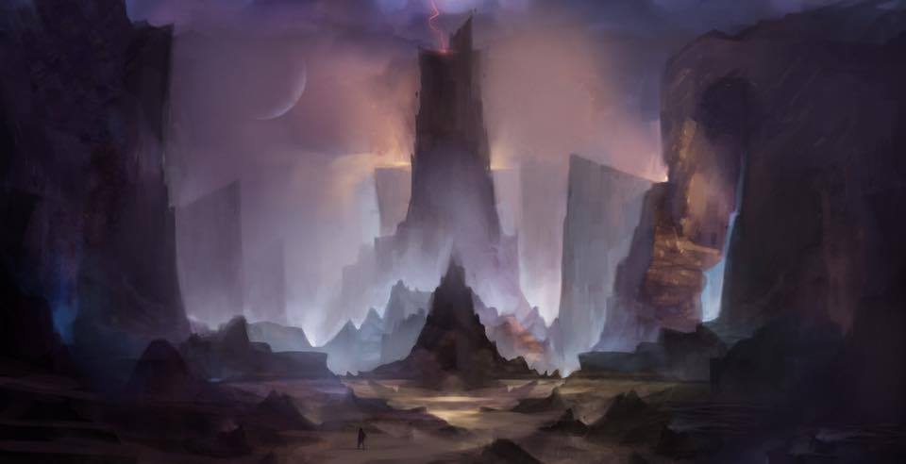
Which type of lines…

Slide 24
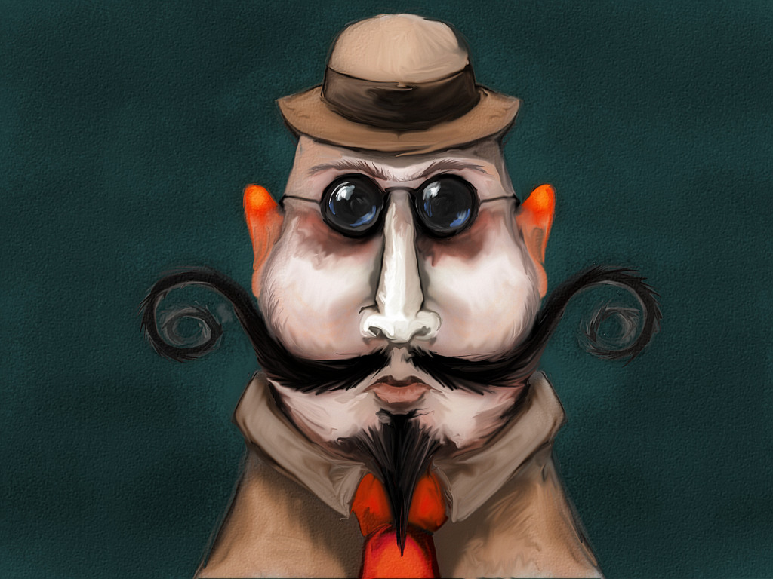
Symmetry
Symmetry is the ULTIMATE form of balance and creates a true sense of harmony.
A piece of artwork is symmetrical when both sides of the piece are the same on either side of an imaginary central divide (the mirror point).
Symmetry can be created vertically, horizontally, or diagonally.
Here in this painting, if we draw a line down the center of his face we would find that he is symmetrical.

Slide 25
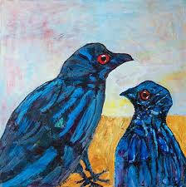
Asymmetry
Asymmetry is the lack of equality, balance, or harmony.
Asymmetry is when something is not “matched” across an imaginary central divide.
In this painting if we fold it in half vertically, horizontally, or diagonally neither of the halves will match.

Slide 26
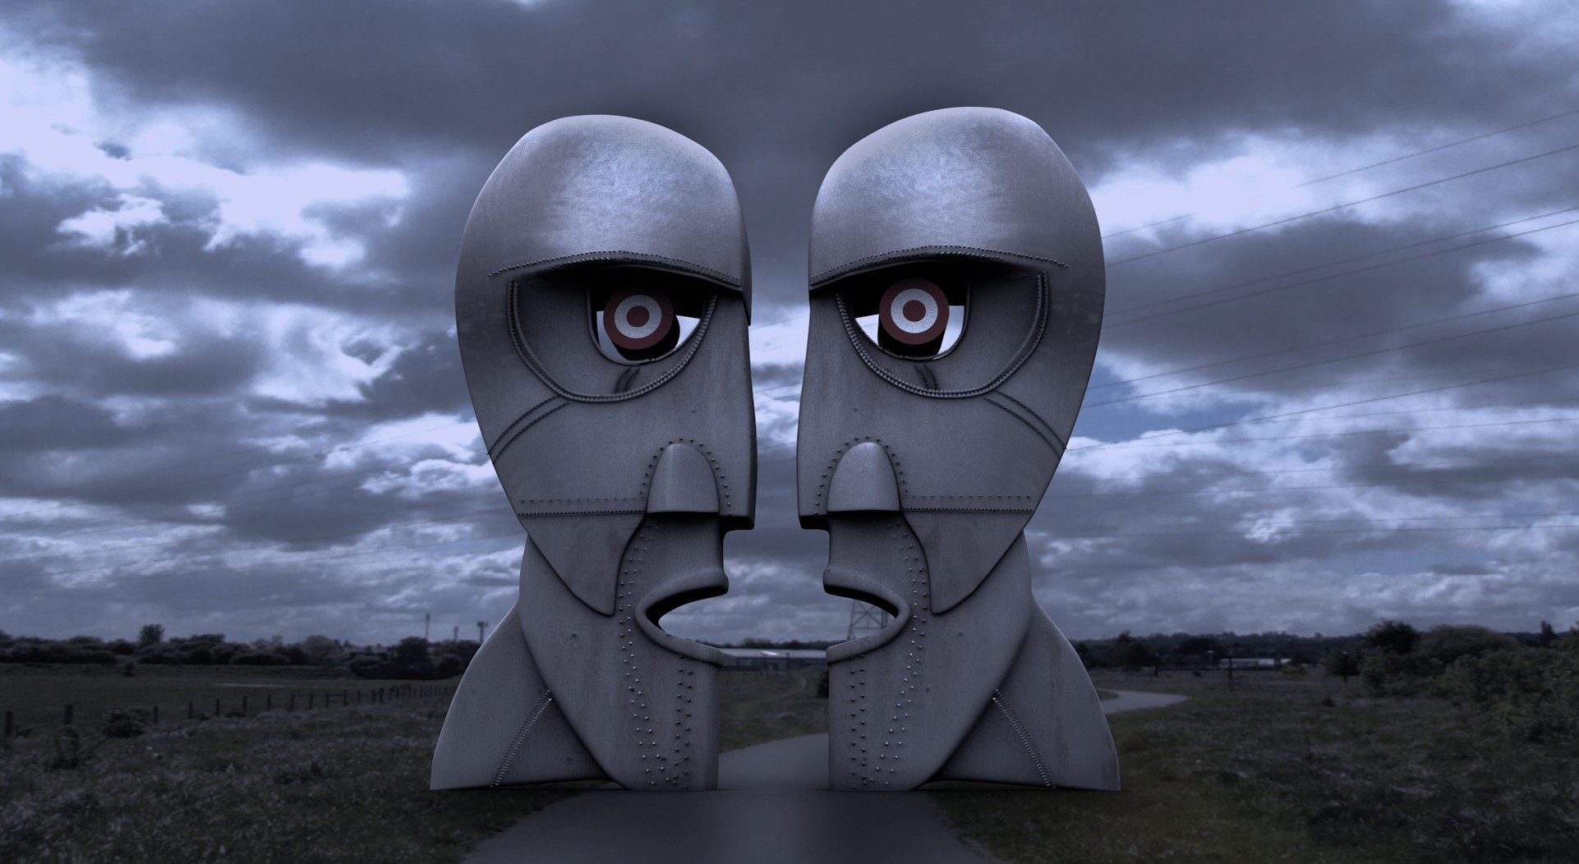
Symmetry or Asymmetry…

Slide 27
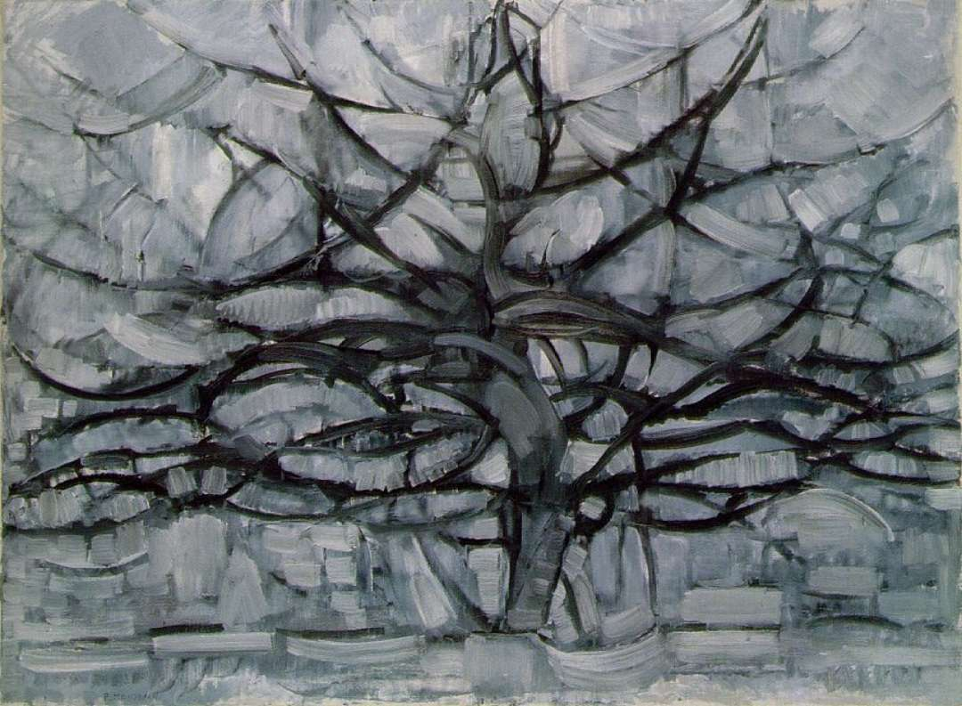
Symmetry or Asymmetry…

Slide 28
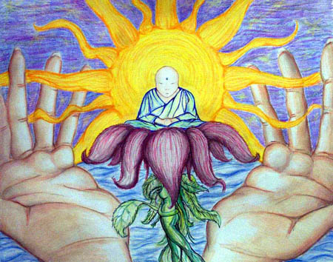
Symmetry or Asymmetry…

Slide 29
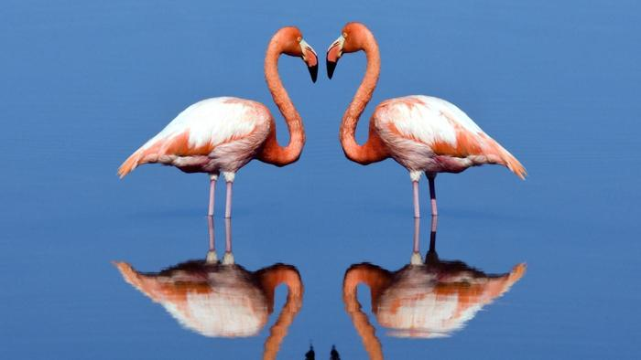
Symmetry or Asymmetry…

Slide 30
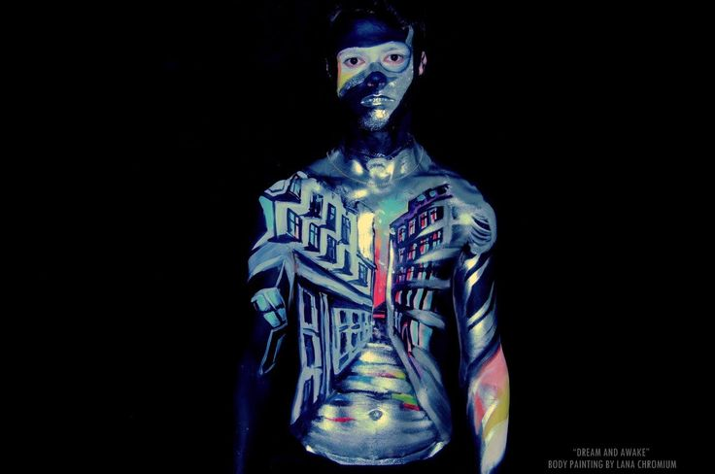
Symmetry or Asymmetry…

Slide 31
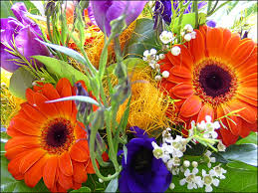
Balance
Balance is the arrangement of shapes and colours within a piece of art.
Here the large orange flowers balance the picture. Since there is one on either side, the picture does not seem unbalanced or lacking harmony.

Slide 32
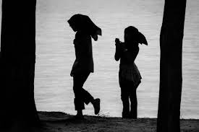
Balanced or not?

Slide 33
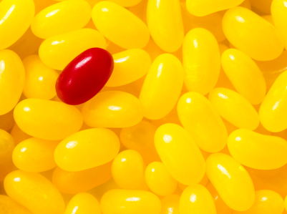
Balanced or not?

Slide 34
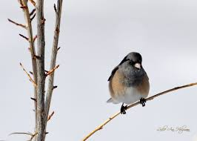
Balanced or not?

Slide 35
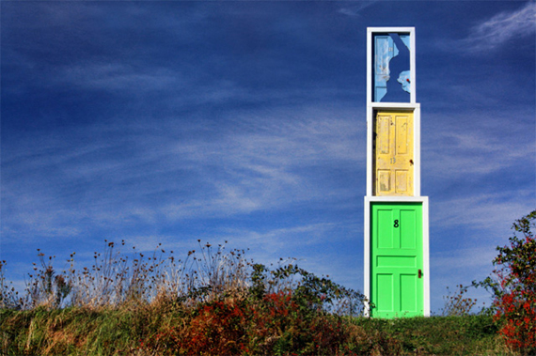
Balanced or not?

Slide 36
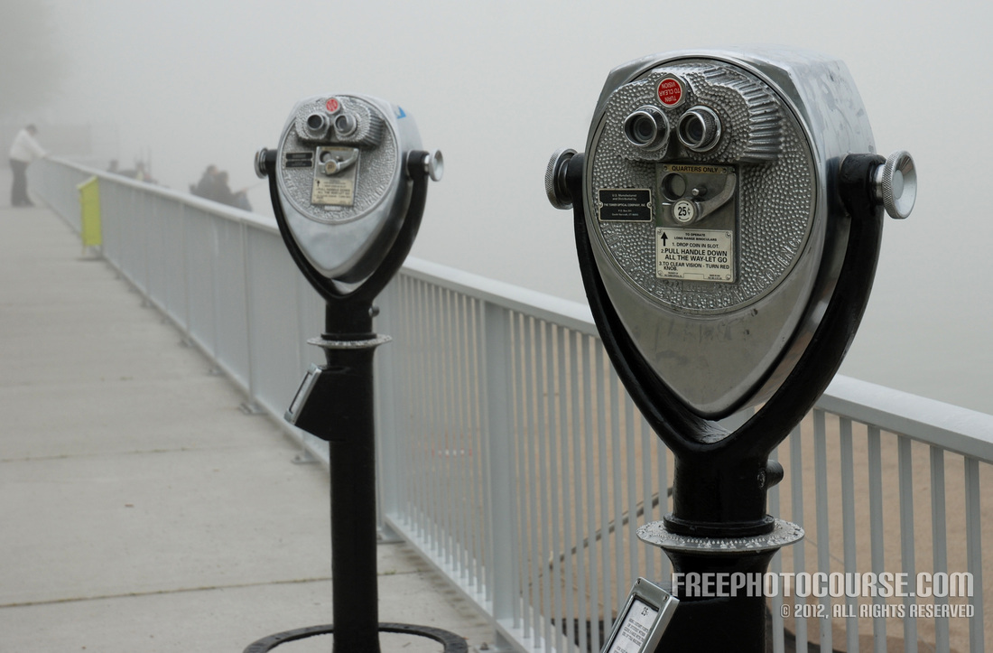
Balanced or not?

Slide 37
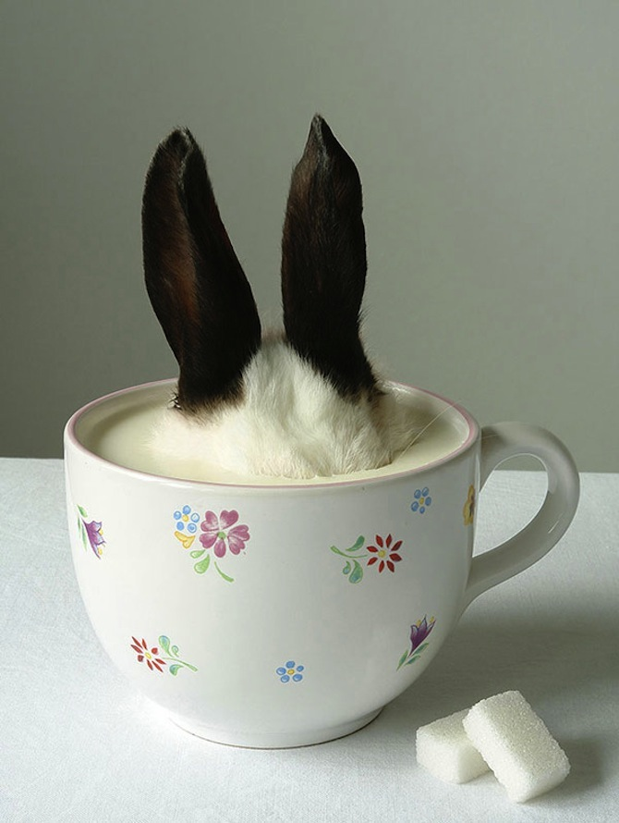
Balanced or not?

Slide 38
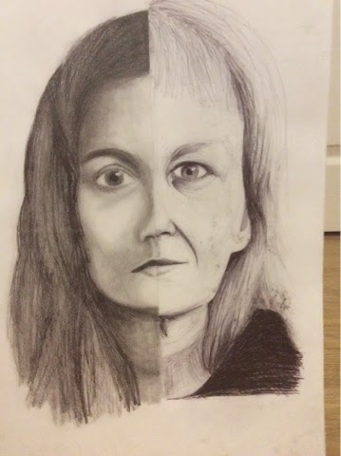
Symmetry
vs. Balance
A piece of artwork CAN be Balanced without Symmetry, but CANNOT be Symmetrical without Balance.
In the visual to the left we have a merged drawing of a younger woman and an older woman. While their features are balanced (they both have eyes, nose, mouth, chin, neck) and in proportion with each other, we can tell that over the “imaginary center divide” they are not the same/identical.

Slide 39
Colour
Red Red is optimistic, a vital colour of activity, heat, movement, struggle, and passionate. It is the most expressive colour associated with fullness of life, courage, sacrifice, love, strong emotions and acts of passion.
Orange
Orange is a bright, shiny, warm colour of fire and sun. It is associated with sunrise or sunset, delicious fruits such as apricots, mandarins, oranges. It can symbolizes courage and sacrifice. It is an emotional stimulant, orange reflects warmth, generosity, it is light and playful.
Yellow
Yellow is the colour of sun, light, and optimism, which stimulates, activates and frees from fear. It retains the alertness and promotes concentration, symbolizes the creativity and wisdom.

Slide 40
Colour
Green
Green has two sides. It can symbolize nature and the natural aspects of life resulting in a calming effect, but it can also represent jealousy and greed.
Blue
In nature, blue is widespread like in the sky, which is reflected in the water. The symbolism of blue: wisdom, intelligence, immortality, infinity. It represents a fresh atmosphere, transparency, distance, and quiet. They say it is the colour of peace and rest.
Purple Purple is the colour of royalty; it represents the high life, riches and jewels, and nobility.

Slide 41
Colour
White White is the colour of clarity. It symbolizes innocence and purity, as well as a new beginning or rebirth. It is also a symbol of divinity, perfection, pride, kindness and the eternal.
Black Black is the colour of doom and death. It symbolizes fear and destruction, as well as “the end”. It may also represent evil forces, greed, sadness, and depression.

Slide 42
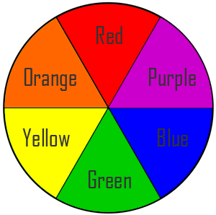
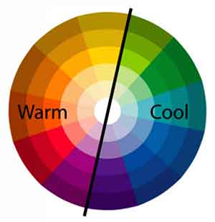
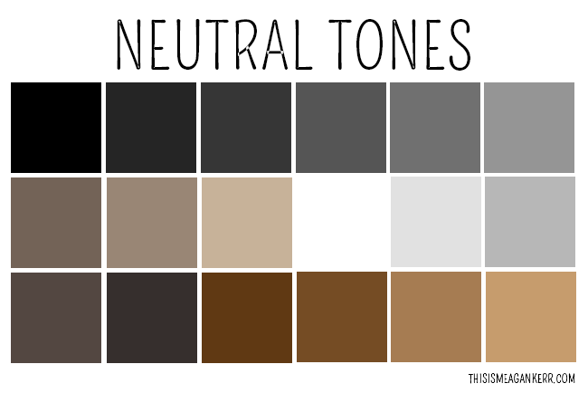
Colour
Primary colours = red, yellow, blue
Secondary colours = are composed of two primary colours; orange, green, purple)
Warm colours = red, orange, yellow, brown
Cold colours = blue, green, purple
Neutral colours = white, brown, beige, black, grey, tan

Slide 43
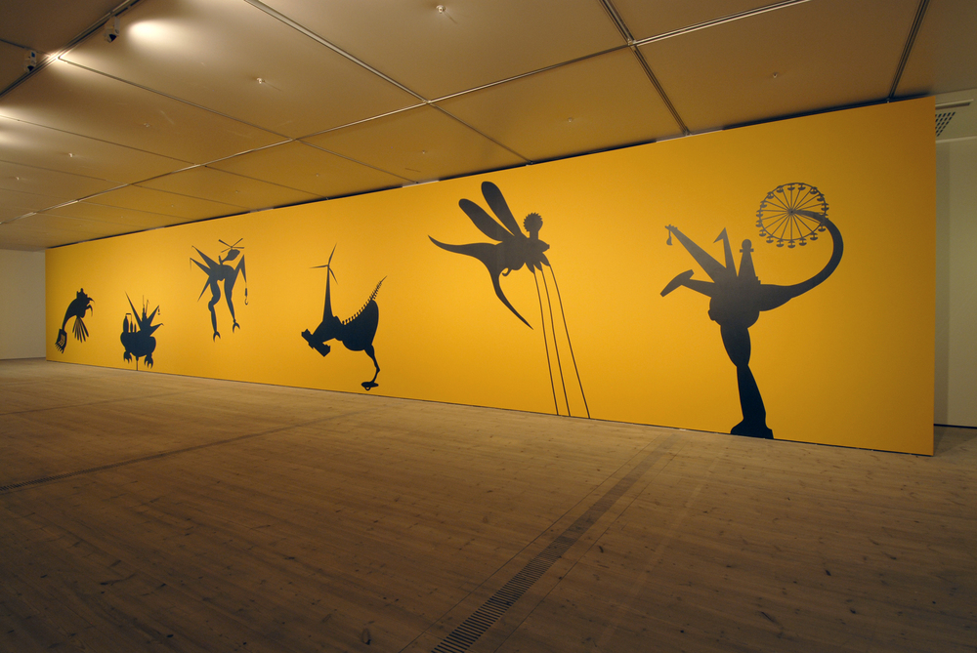
Scale & Proportion
Scale = is the relative size of objects within a visual, in comparison to the world around them.
Things to consider: Are the elements proportional? Out of proportion? All large? All small? “Regular” size? Over-exaggerated?
Proportion = is the relationship of sizes between different parts of a work.

Slide 44
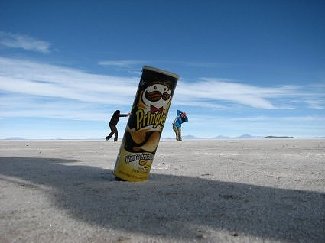
Scale & Proportion
Some artist play with Scale and Proportion.
Here we see a Pringles tube that is appropriate in scale (compared to the real world) and two people who do not seem to be appropriately scaled due to their distance from the camera.
The artist (photographer) has used distance to alter the elements proportions in this picture. The people appear smaller than the Pringles tube.

Slide 45
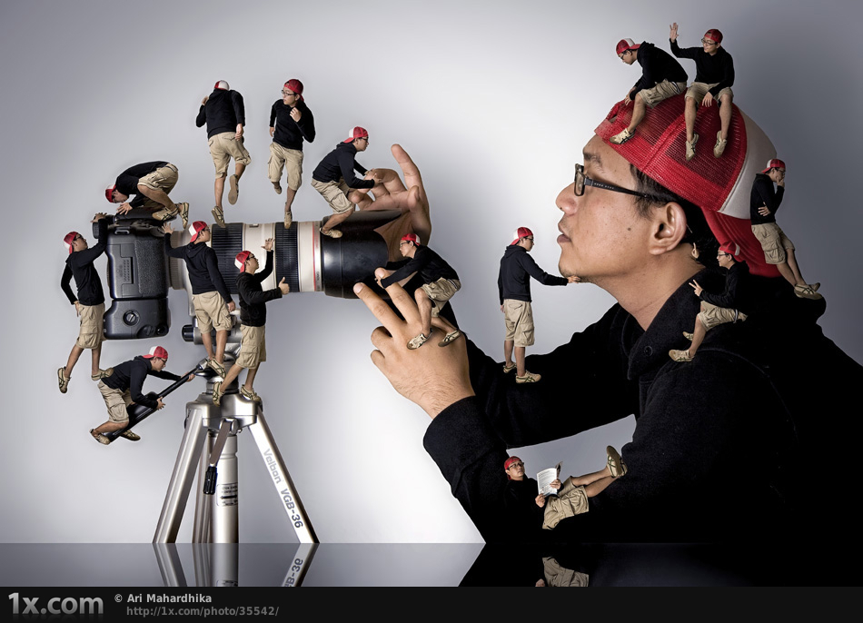
Scale & Proportion
What is appropriate to scale here?
What is similarly proportioned?

Slide 46
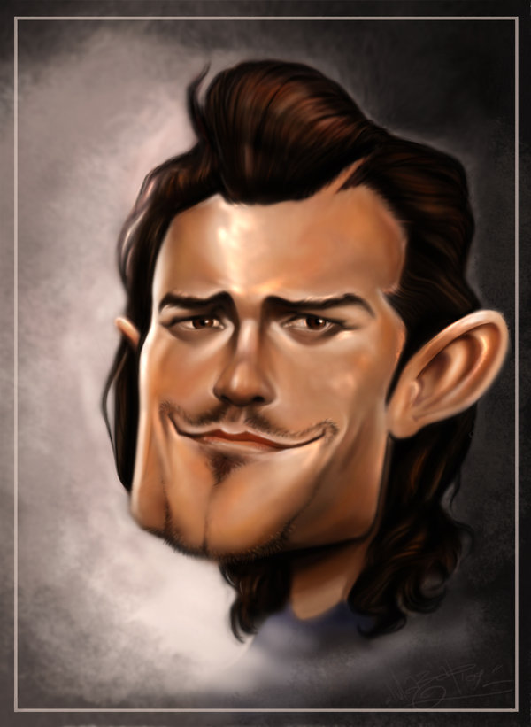
Scale & Proportion
What is appropriate to scale here?
Caricatures usually blow elements out of ___________
Hey Josh, it’s Orlando Bloom!

Slide 47
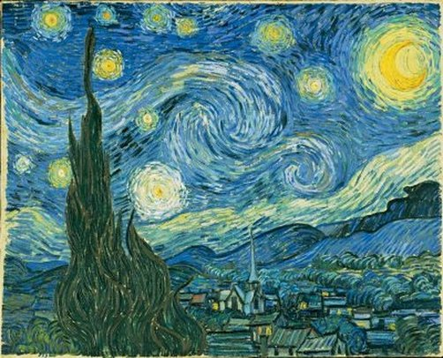
Texture
Texture is the effective use of lines and dots in visual images which can be “felt” with the eyes; rough or smoothness.
Texture is achieved by the use of line, shading, and colour.
Here there is ACTUAL TEXTURE in the sky (created by excess paint – the canvas will not be smooth) adds depth to the painting.

Slide 48
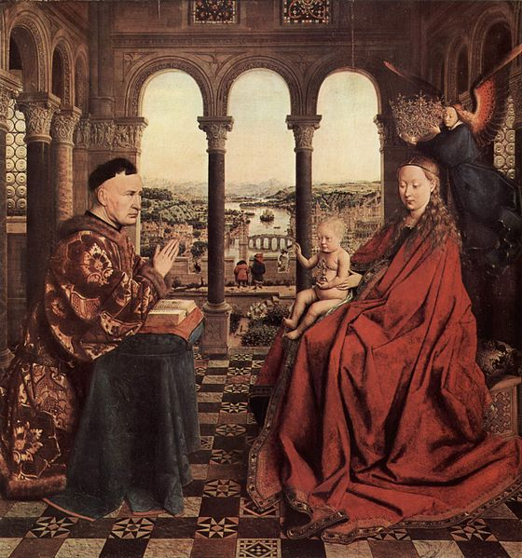
Texture
What is the source of the texture in the painting?
Here there is VISUAL TEXTURE (created with colour and shading – the canvas would be smooth) adds royalty to the painting – a true sense of riches.

Slide 49
What type?
What type of texture can be identified in this painting?
What does the texture create in this painting?

Slide 50
What type?
What type of texture can be identified in this painting?
What does the texture create in this painting?

Slide 51
Form/ Genre
Form/ Genre is the category that a piece of artwork falls into.
There are 100s of categories, but for the purpose of right now, you will need to know:

Slide 52
Form/ Genre
Collage

Slide 53
Form/ Genre
Drawing / Sketch

Slide 54
Form/ Genre
Graffiti

Slide 55
Form/ Genre
Cartoons

Slide 56
Form/ Genre
Caricature

Slide 57
Form/ Genre
Word / Text

Slide 58
Form/ Genre
Painting

Slide 59
Form/ Genre
Mosaic

Slide 60
Form/ Genre
Photography

Slide 61
Form/ Genre
Sculpture

