Slide 1
Canada and the Global Economy

Slide 2
NAFTA
NAFTA - North American Free Trade Agreement
- An agreement made between Canada, the United States, and Mexico in 1992 that marked the phasing out of tariffs (taxes imposed on products brought into a country). The agreement eliminated a number of fees to encourage trade between these countries

Slide 3
Successes in NAFTA
NAFTA has opened up many possibilities for Canadian companies in the United States and Mexico
ex: Mad Science
- franchise that creates science activities for children ages 3-12.
- has found a niche in Mexico
- Niche: a section of the business market especially suited to a company's specialized goods and services
- has helped increase science literacy for thousands of Mexican children

Slide 4
Challenges of NAFTA
- NAFTA aims to increase trade opportunities, and since its creation trade between Canada, the United States and Mexico increased to over $1 trillion.
Problem: NAFTA benefits transnational corporations in particular.
-These companies sell there products in new markets and move their production to countries where labor and other costs are lower.
- As a result, many manufacturing companies leave Canada for countries where costs are lower (ex: Mexico)

Slide 5
Problem: The rules of NAFTA
The NAFTA agreement often brings disputes between countries and companies.
Ex: Prices of Crab were low in 2010 in Newfoundland. Government could not subsidize the fishermen because it would have been considered an illegal subsidy according to the NAFTA agreement.

Slide 6
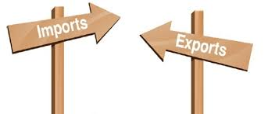
Imports and Exports
Importing: When goods and services are brought into a country.
Exporting: When goods and services are sold to another country.
A favorable balance of trade is when you have more exports than imports into your country. Canada has an overall favorable balance of trade.

Slide 7
Fig. 9.23 (pg. 406)

Slide 8
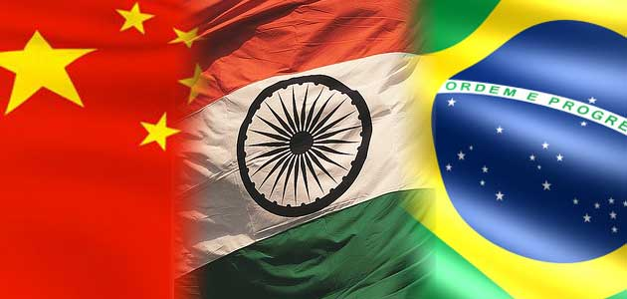
As a trading country, our prosperity depends on finding new opportunities for trade. Although one of our strongest trade relationship is with the United States, the Canadian government is working to improve trade relationships with other countries and open the door to new export markets (China, India, Brazil).

Slide 9
Canada’s Import Partners (2011)
United States ($281 billion): 62%
United Kingdom ($11 billion): 2%
Japan ($9 billion): 2%
The rest of Europe ($35 billion): 8%
The rest of the world ($119 billion):26%

Slide 10
Canada’s Export Partners (2011)
United States ($330 billion): 72%
United Kingdom ($19 billion): 4%
Japan ($11 billion): 3%
The rest of Europe ($23 billion): 5%
The rest of the world ($73 billion): 16%

Slide 11
Canada controls the general flow of its imports and exports:
- restricts on imports: arms, industrial waste
- controls on agricultural products: chickens
- growing concerns for sustainable development, protection of human rights, and the environment.

Slide 12
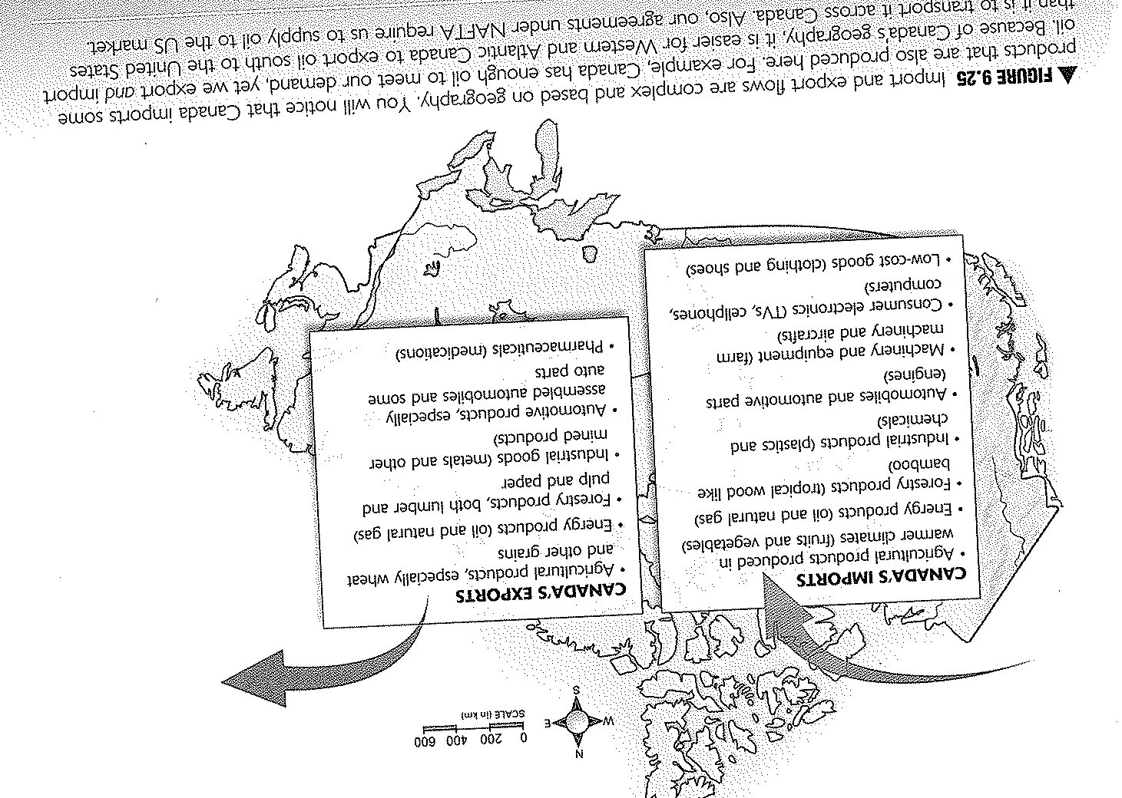
Fig. 9.25 (pg. 407)

Slide 13
Canada exports not only goods, but services as well:
banking and insurance
research development
Computer and information services
Architectural and engineering services

Slide 14
Import Substitution
While Canada imports many goods and services, import substitution is also important.
Import Substitution: The practice of buying Canadian products instead of goods produced elsewhere.
Saves jobs (employment is kept here)
Reduces our ecological footprint (products do not have to travel long distances = less energy used)

Slide 15
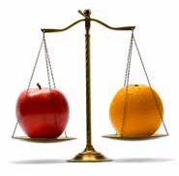
Ex: Choosing apples from British Columbia’s Okanagan Valley instead of oranges from Florida.

Slide 16
Trade Issues with Import Substitution
Although Import Substitution can encourage the Canadian economy, it can cause issues with our foreign connections.
Would we have many trading partners?
What would our foreign connections be like?

Slide 17
What’s Fair in Trade?
Millions of people do not benefit from current global trade.
The rules of global trading often benefit the wealthiest corporations, farmers and business people.
World Trade Organization – develops guidelines for international trade.

Slide 18
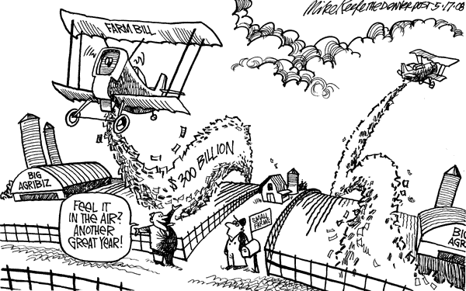
Unfair Global Trade - Use of Subsidies
North American and European farmers are often subsidized by their government. These subsidy payments allow them to produce more of what they need.
A surplus of these products enters the world markets.

Slide 19
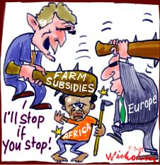
Farmers in developing countries cannot compete with these heavily subsidized (and therefore cheaper) products.
Local markets are destroyed, Farmers are forced to stop growing traditional foods.
Farmers go to work in factories and plantations that produces foods and products for industrialized countries.
Work conditions are often poor.

Slide 20
People are becoming more aware of unfair trade practices and international organizations are working to improve trade conditions.
Free Trade – an organized social movement that encourages the trade of products such as coffee, chocolate, or carpets; ensures that there is no child or forced labor, that workers have humane working conditions and that they receive a direct and equitable share of profits.

Slide 21
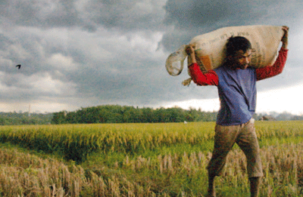
With increased profits, these farmers can build better homes, send their kids to school, and feed their families better meals.

Slide 22
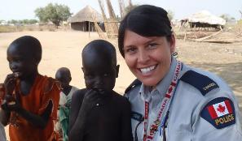
Canadian’s Making a Difference ☺

Slide 23
As the world becomes more of an interconnected place, more people and organizations are gaining a sense of responsibility for the planet and the people who live on it.

Slide 24
Pause for Thought
Can you think of any international events (hurricanes, earthquakes, famine, national tragedies) where organizations in Canada have raised funds to support those affected?

Slide 25
Canada and The United Nations
United Nations – An international organization that was formed to create peace, security, and cooperation among the countries of the world.
Canada is one of the 192 countries involved in the UN and has played a key role since the organizations founding in 1945.
The UN addresses acts of terrorism, human rights, natural disasters, and maintaining peace and security.

Slide 26
CIDA
The Canadian International Development Agency
Established to assist regions of the world encountering hardships (war, disease, famine)
Purpose is to help countries that require humanitarian assistance and promote sustainable development.
Works to establish projects and programs to assist local people.

