Slide 1
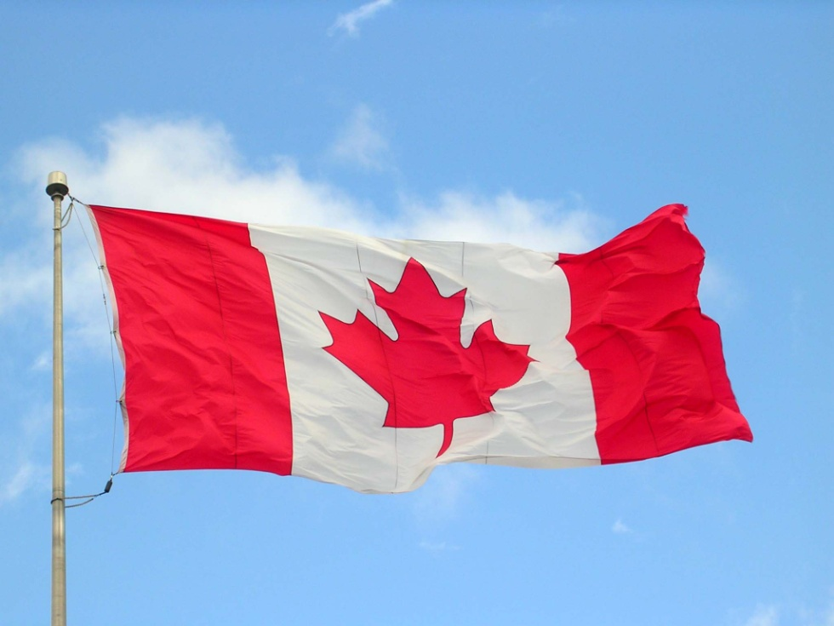
Canadians as Global Citizens

Slide 2
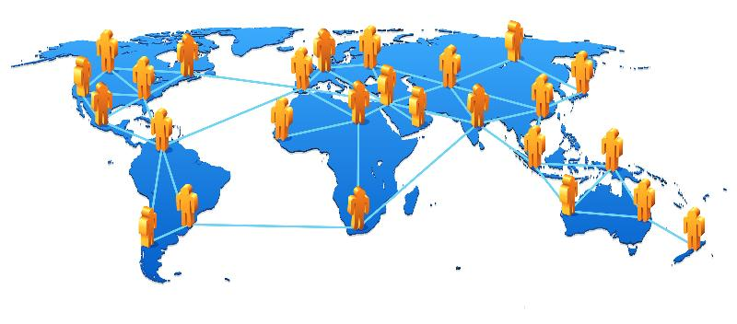
Interconnections: From Local to Global
We are connected to other people and places in a number of ways
"A Global Morning" p.385

Slide 3
Global Village - the concept that people around the world can interact almost as easily as if the world were one large village due to advances in communications and technology.
Advances in technology, especially in communications and transportation, have brought people closer together.
Canadians use natural resources, manufactured goods and services from other countries everyday.

Slide 4
Globalization
Globalization - The complex international relationship of increasing economic and social interaction.

Slide 5
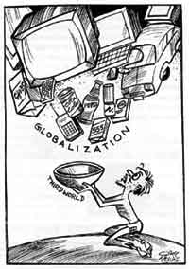
Challenges of Globalization
As the world grows more globalized, we become more aware of the issues from globalization that affect people in Canada and around the world.
Once we are aware of these issues, the challenge is what we should do about them.

Slide 6
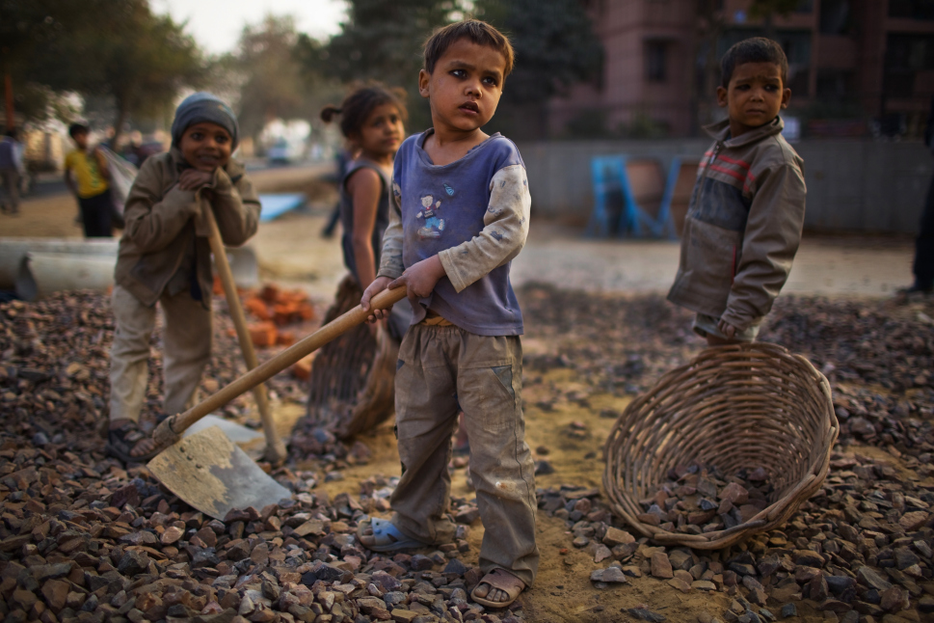
Ex: Global Issue - Child Labor (Local stores importing carpets, shoes or clothing made by children)
Because there are so many complex issues, that it is best to choose one that interests you and find out as much as you can about it.

Slide 7
NGO’s
International non-governmental organizations (NGO's) try to find solutions to these global solutions such as child labor and environmental issues.
Examples of NGO's - Amnesty International, World Wildlife Fund,

Slide 8
Becoming a Global Citizen
A global citizen is someone who wants to make the world a better place.
Everyone has the potential to take action and make the world a better place:
- speaking out about global issues
- join or start an organization
- welcoming a new student to your school

Slide 9
Preserving Canada’s Culture

Slide 10
UNESCO
UNESCO - United Nations Educational Scientific and Cultural Organization
formed to help preserve cultural and natural sites around the world.
Canada has been a part of UNESCO since 1946
Currently has 15 world heritage sites.

Slide 11
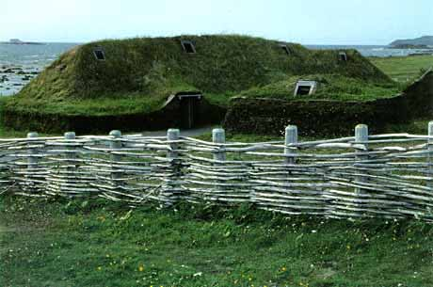
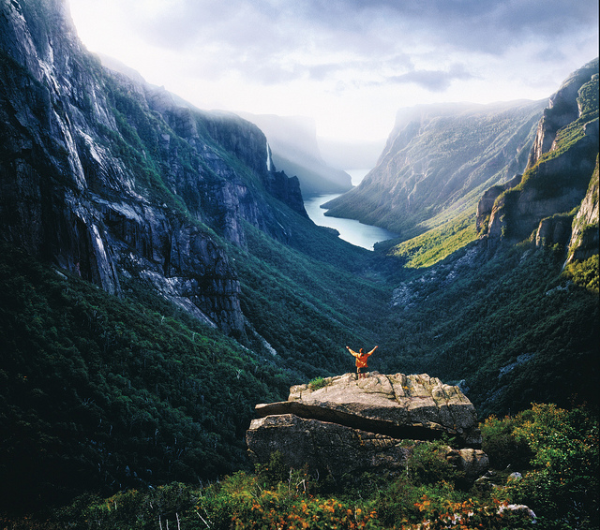
World Heritage Sites
To be a World Heritage Site, the location:
- must have a strong geographic value
- strong cultural connection
Examples of Canadian Historic Sites
- Historic District of Quebec City
- L'Anse aux Meadows
- Gros Morne National Park
Preserving these sites ensures that future generations will be able to enjoy them.

Slide 12
Quality of Life
Human Development Index (HDI) - measures the well-being of people by examining three major factors:
- Longevity: How long people's lives are.
- Knowledge: Measured by literacy rates and education levels.
- Decent Standard of Living: measured by per capita gross domestic product
HDI is used to compare the quality of life in over 187 countries.
Between 1994-2000, Canada was ranked #1 in for world for quality of life.

Slide 13
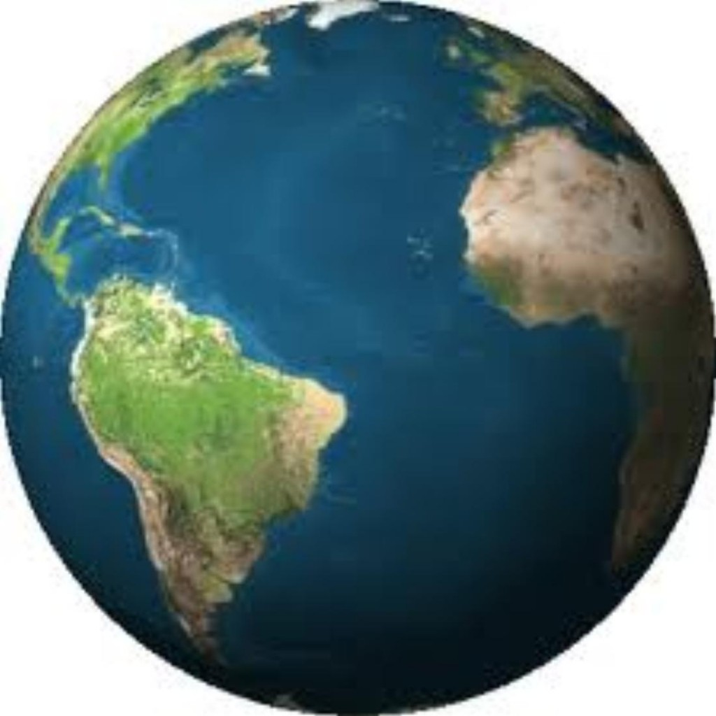
Variations in people's quality of life depend, in part, on a countries developmental status.
Developmental Status - a rating of a country's social systems, such as education and healthcare, as well as its economic systems.

Slide 14
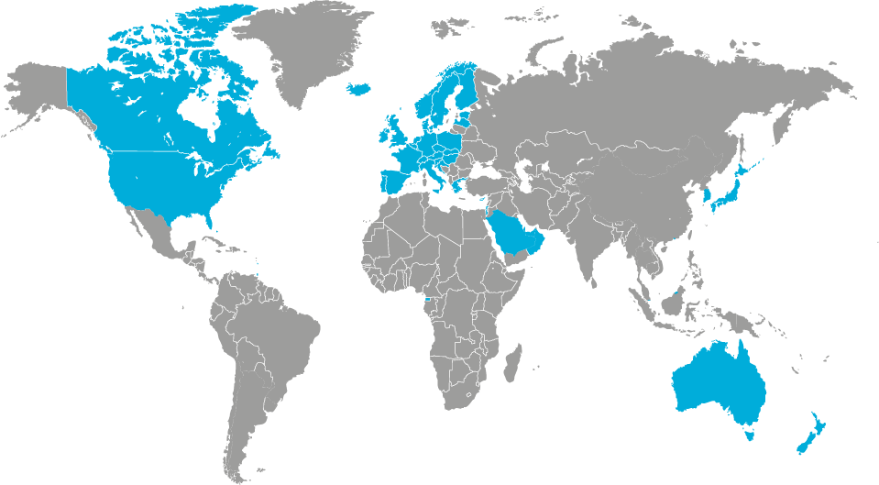
Development Status of Countries
Three main classifications:
Developed
- Nations that have a high standard of living
- Usually have high GDP, strong economy, well developed infrastructure, and a strong social network that includes healthcare and education.
- Ex: Canada

Slide 15
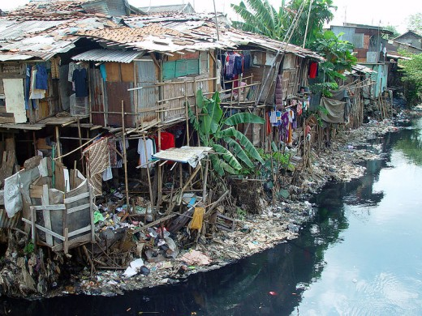
Developing
Nations with a low standard of living
Economy is usually focused on primary industries (agriculture) and very little processing and manufacturing, which means there is little income to be gained.
- Little Money is available to develop aspects of society such as roads and health care systems.
- Ex: several countries in Sub Sahara Africa

Slide 16
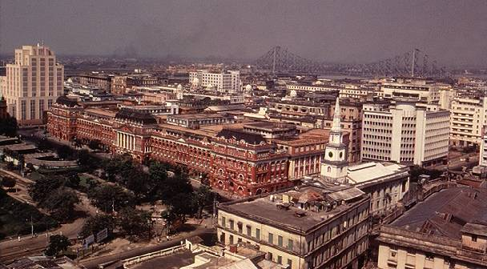
Newly Industrialized Countries
- Rank between developed and developing countries.
- Economies traditionally centered on agriculture, with developing secondary industries, such as manufacturing and technology
- Ex: Brazil, India, China

Slide 17
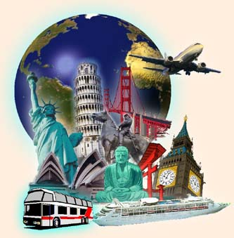
A Great Big World to Discover
Travel and Tourism

Slide 18
Tourism and Travel
Tourism: traveling and the business of planning vacations
Domestic Travel: When Canadians travel within Canada
International Travel: Traveling across borders into other countries.

Slide 19
The Tourism Industry
Tourism is very important to the Canadian economy.
As Canadians travel within Canada and international tourists come, money circulates through hotels, restaurants, etc.
This in turn ripples through the economy, paying workers, landscapers and in taxes to the government.
Multiplier Effect: The direct or indirect effects on the economy caused by an activity in one part of the economy (ex: tourist spending money when visiting a place can cause an increase in the number of jobs in the local economy, which in turn supports the need for more services and thus more jobs).

Slide 20
Tourism is among the top five sources of economic activity in all provinces.
When Canadian's travel outside of Canada, the Canadian economy loses money to international markets.
2010 International Travel Deficit - $1.4 billion
The government's job is to encourage international visitors to come to Canada.
There are many factors that can impact a province's tourism

Slide 21
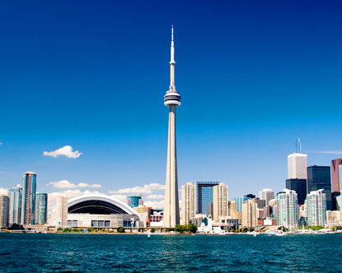
Factors that impact Canada’s Tourism
Negative Impact
SARS outbreak in Toronto (2003)
- Tourism industry suffered greatly.
- workers laid off
- bus tours canceled
- conventions canceled
- Hotel cancellations
- Many strategies were used to try and revive tourism in Toronto:
- Hotel, Game, Flight packages
- Ad campaigns
- Tax exemptions on hotel accommodations

Slide 22
Factors that Impact Canada’s Tourism
Positive Impact:
2010 Winter Olympic Games in Whistler, British Columbia
- Brought increased revenue to the province
- Revenue: income generated for goods and services.
- This revenue was used to develop local infrastructures, like roads, disposal systems and transportation routes.

Slide 23
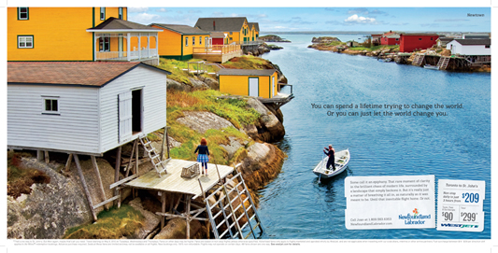
Newfoundland has an award winning marketing campaign to attract more tourists.
https://www.youtube.com/watch?v=mthuKmagC-E

