Slide 1
Chapter 10: Changing Times
Unit 4: Decades of Change

Slide 2
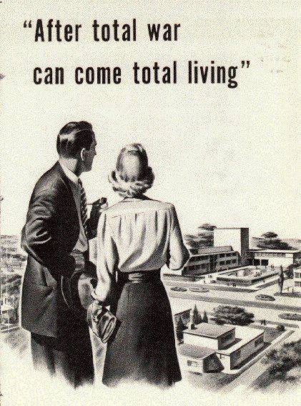
Conformity in the 1950’s
Canadians wanted a peaceful secure, and safe life after the Second World War
A conservative lifestyle was very popular
Conservative: Preferring things not to change, routines are defined and accepted.

Slide 3
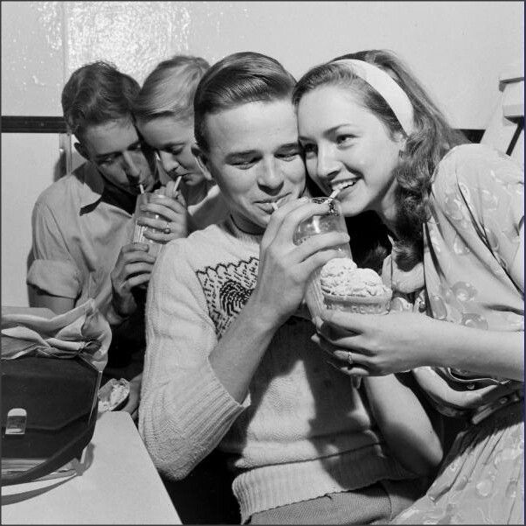
Conformity in the 1950’s
Teenagers:
The idea of being a teenager began in the 1950’s
The post war baby boom leads to there being a lot of teenagers in the 1950’s and 60’s
Teenagers now had money to spend, worked jobs, and gained importance as a market for goods and advertising.

Slide 4
Conformity in the 1950’s
Teens engaged in safe conservative activities
Dances
Hanging out at restaurants
Going to drive in movies
The development of teen culture in the 1950’s leads to a generation gap between children and their parents.
Generation Gap: a difference in attitudes, and beliefs between younger and older people.

Slide 5
Conformity in the 1950’s
The Media:
A big concern in Canada was the influence of American media on Canadian culture.
Advertising, T.V and Radio shows were predominantly American

Slide 6
Conformity in the 1950’s
Many artists were leaving Canada to go to other countries
The Canadian Government sets up the CRTC to regulate the media industry.
The CRTC sets the regulations for Canadian content in all forms of broadcasting in Canada
In recent years there were issues with Netflix and the CRTC.
In 2017 Netflix agreed to pay the CRTC $500 Million to fund original Canadian shows and movies.

Slide 7
Conformity in the 1950’s
Canadian Television:
Canadians liked T.V. shows that featured Canadian musical acts.
Another popular TV show was Hockey Night in Canada (first aired in 1952)

Slide 8
Conformity in the 1950’s
Moving away from Conformity:
Music
Music became a important part of teen life.
Rock and Roll music became popular:
Elvis, Chuck Berry, Stevie Wonder, the Beatles
Many adults did not like this new music and found the liberal, and suggestive lyrics, and dances offensive

Slide 9
Conformity in the 1950’s
Changing Styles:
In the 1950’s women wore dresses, and men wore cuffed wide legged pants
It was not acceptable for women to wear pants to work or school untill the late 1960’s
Men working in offices, or business were expected to wear a suit and tie.
However as the 50’s and 60’s began to pass there were growing signs of the rejection of these conservative ideas.
Rockers/hoods/ Greasers began slicking their hair and wearing leather jackets.
Women began wearing pants.

Slide 10
10.2 A Developing Idealism
Counter Culture
In the 1960’s children began to question their parents values
Counter Culture: a culture that runs against the dominant values and beliefs of society
Defiance was shown in many ways
Style of dress
Protesting
Using drugs
Hippies were a group of rebellious people who would often move to communes where they would share resources and live a life devoted to peace and love.

Slide 11
10.2 A Developing Idealism
Movements for Change
Civil Rights Movement
The Canadian Civil Rights Movement was much less violent than that of the United States
In the 1950’s laws were passed that made it illegal to discriminate based on race or religion
Racist immigration laws were abolished in the 1960’s allowing Asians and African equal opportunity to come to Canada

Slide 12
10.2 A Developing Idealism
Movements for Change
Multiculturalism:
In 1971 under Prime Minister Pierre Elliot Trudeau Canada became a bilingual country.
Pierre Elliot Trudeau also promoted Cultural Pluralism
Cultural Pluralism: All Canadians should partake equally in Canadian society while preserving their own cultural identities.
The idea of Canada as a cultural mosaic becomes important
Mosaic (Canada) vs. Melting Pot (United States)

Slide 13
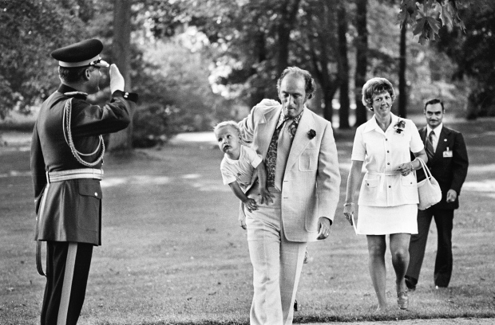
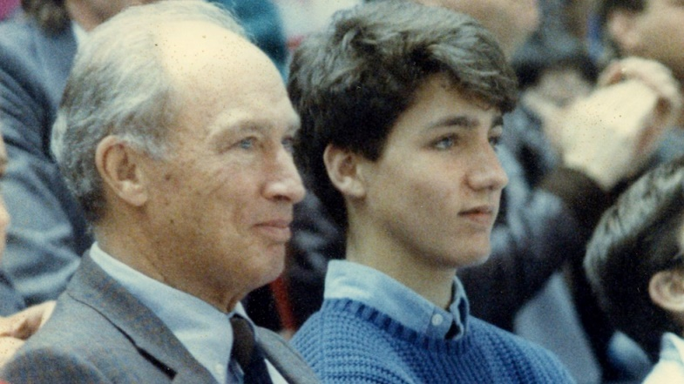
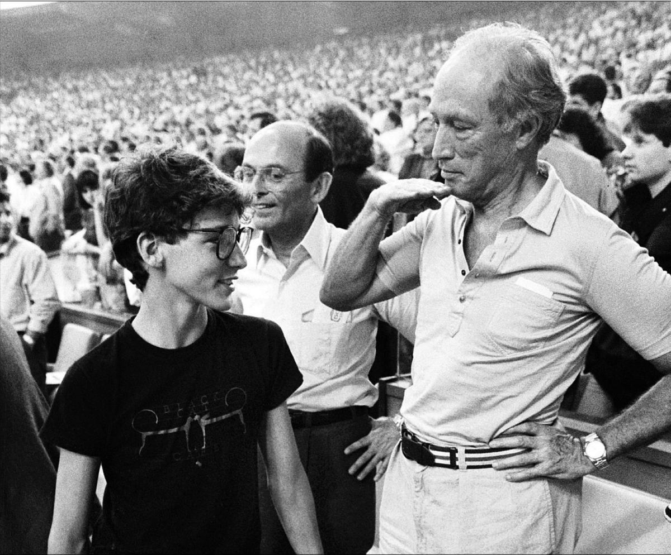

Slide 14
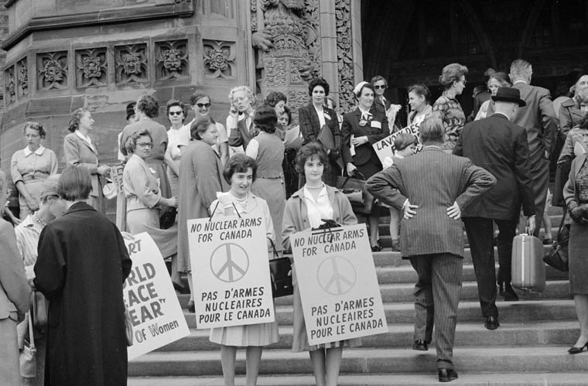
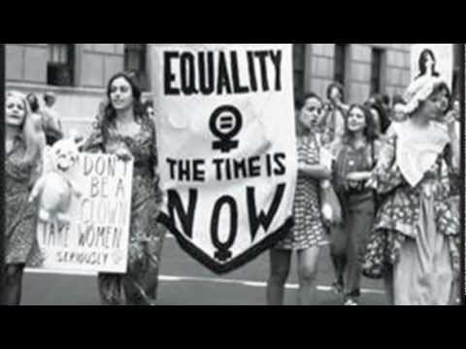
10.2 A Developing Idealism
Movements for Change
Women's Movement
Women begin to question their role in society
Demand equal roles in the workplace
An end to domestic/child care role being dictated to them
Equal pay
Despite this many rights are not gained until the late 1970’s

Slide 15
10.2 A Developing Idealism
Movements for Change
First Nations
Gained the freedom to form political institutions to promote their own rights
However the rights of First Nations are far from safe in this period
In 1969 the Liberal Government introduces the “White Paper”
Proposes the elimination of status for First Nations
Supports assimilation
The White Paper is not passed in government but the event sets the stage for ongoing struggles by Aboriginal peoples to gain their rights.

Slide 16
