Slide 1
Grade 9 Social Studies
Unit 1: Exploring Canadian Identity

Slide 2
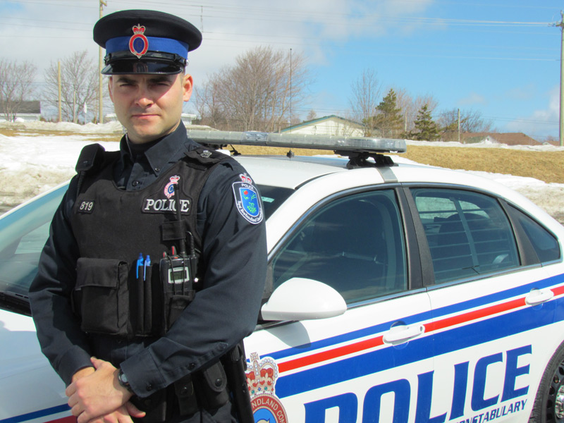
What Does “Identity” Mean?
Identity: The fact of being who or what a person or thing is.
Do the images below portray any identities?

Slide 3
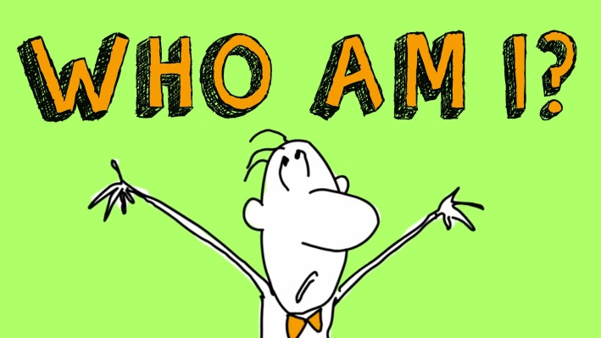
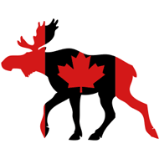
Who am I?
Before thinking about a Canadian identity it is important to think about your own identity.
Your own identity is made up of factors including; gender, culture, ethnic origin, traditions, activities, and many more
Create a concept web in your notebook with “Who am I” at the centre. Write or draw your ideas about your own identity on the concept web.

Slide 4
What is Canadian?
To determine what a Canadian identity might look like we need to determine what Canada is.
Lets do a short brainstorm activity.
With a partner list everything that comes to mind when you hear the word “Canadian”.

Slide 5
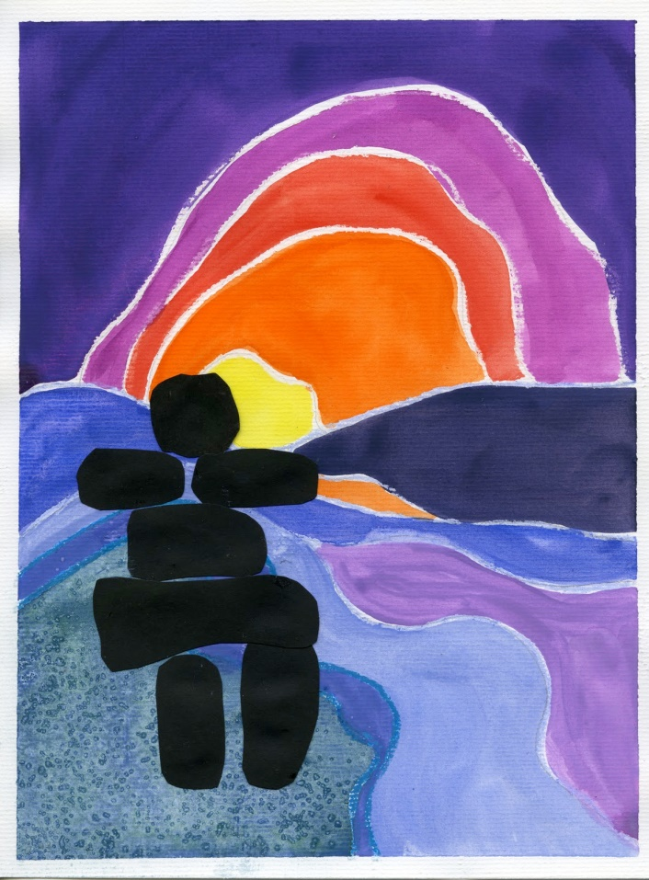
How Do We Examine Canadian Identity?
To examine the concept of Canadian identity we can look at several sources:
Music
Film
Paintings
Sculptures

Slide 6
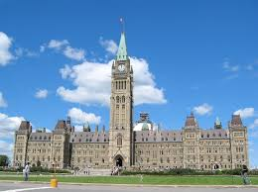
SO, WHO ARE WE?
Surface area: 2nd largest in the world
Population: ~35 782 741
Canadian Population Clock: http://countrymeters.info/en/Canada
Official languages: French and English
National Capitol: Ottawa, Ontario
Date of Confederation: 1867 (we’re almost 150!)
- The creation of a federal Dominion of Canada joining the previously existing provinces into a nation (semi-independent from the Crown (on internal matters only))
- Brought together the provinces of Nova Scotia, New Brunswick, Upper and Lower Canada (the provinces we know today as Ontario and Quebec)
Canada 2015: 10 provinces, 3 territories

Slide 7
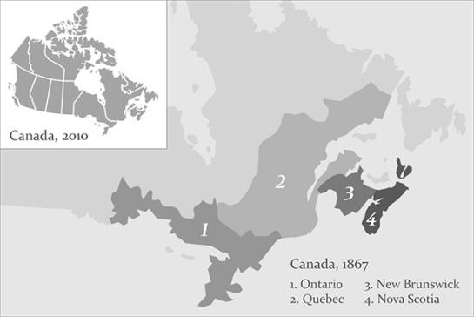
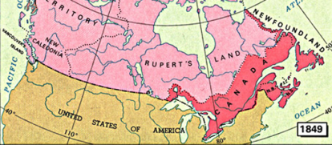

Slide 8
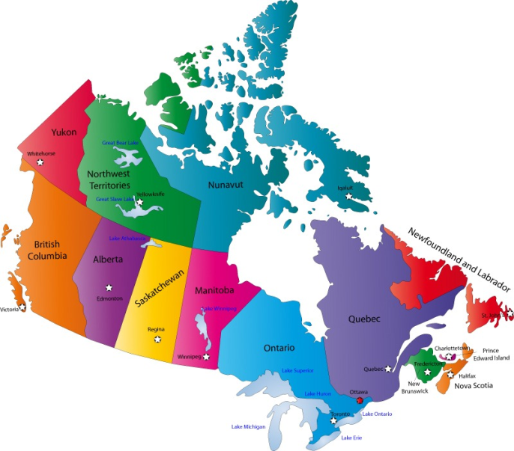
10 PROVINCES, 3 TERRITORIES

Slide 9
CANADIAN CREATION
The Fathers of Confederation (36 in total):
Sir John A. Macdonald (first Prime Minister)
Sir George- Etienne Cartier
These men were the original founders of Canada
The British North American Act (BNA Act)
The fathers of confederation wrote a constitution (document indicating the highest form of law) outlining what Canada should look like/how it should be run (i.e. laws, division of power between the provincial and federal governments, etc.)
This constitution had to be passed by British Parliament as we were still a British colony governed by the Brits

Slide 10
The rest of Canada’s provinces and territories joined Confederation (became a part of the country) at later dates:
1867 Ontario, Quebec, New Brunswick, Nova Scotia
1870 Manitoba, Northwest Territories
1871 British Columbia
1873 Prince Edward Island
1898 Yukon Territory
1905 Alberta, Saskatchewan
1949 Newfoundland and Labrador
1999 Nunavut

Slide 11
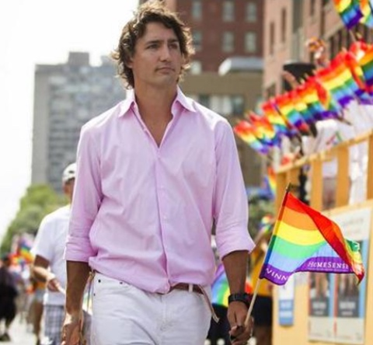
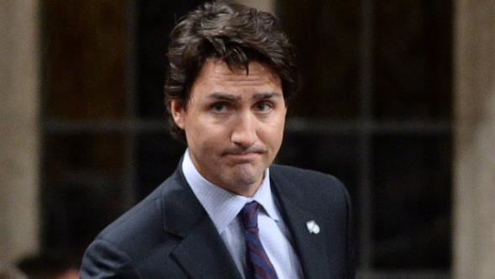
OUR PRIME MINISTER:
Justin Trudeau

Slide 12
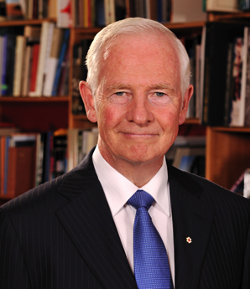
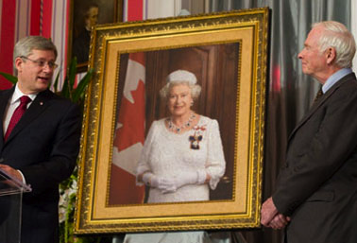
OUR
GOVERNOR GENERAL (REPRESENTATIVE OF BRITISH GOVERNMENTAL INFLUENCE):
David Johnson

Slide 13
GOVERNOR GENERAL’S ROLES AND RESPONSIBILITIES:
Ensures Canada always has a Prime Minister
Swears in the Prime Minister, the Chief Justice of Canada, and the Ministers
Summons and dissolves Parliament
Delivers the Speech from the Throne
Canadian Commander-in-Chief (recognizes military members at home/abroad)
Diplomatic duties
Etc.

Slide 14
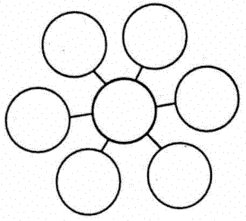
WHAT IS CANADIAN CULTURE?
What do we associate with our culture?
Activities?
Music?
Food?
Art?
Stores/companies?
Values?
Stereotypes?
Turn to pages 5-17 in your text to see aspects of Canadian culture

Slide 15
« It’s hard to pinpoint what Canadian culture is in one sentence and I think that’s fantastic. It’s multilingual. It’s people from all different religions and ethnic backgrounds. It’s crazy. » - Alan Doyle (Great Big Sea)

Slide 16
SOME KEY WORDS
Culture: Set of traditions, materials, ideas and customs that characterize an ethnic group or nation.
Multiculturalism: cohabitation of multiple cultures within one society
Mosaïc: something made from many different elements. (i.e., a cultural mosaic)

Slide 17
OTHER KEY WORDS
Ethnicity: collection of characteristics, traditions and language shared by a group of people
Nation: set of people living in the same territory, with a similar community, history, culture, tradition, language or political system.
Nationalism: pride and loyalty towards one’s country. Similar to patriotism.

Slide 18
TYPES OF IDENTITY:
Factors contributing to the creation of national identity (LARGE SCALE IDENTITY)
-Geography, landscape, climate
-Community
-language, culture, ethnicity
-Personal and collective histories and traditions
-Politicians and type of government
-Belief in peace, justice, freedom, equality, and rights
-Heroes

Slide 19
Factors contributing to the creation of provincial/regional Identity
Factors contributing to the creation of personal Identity (SMALL SCALE IDENTITY)
Where you live
Your family and friends
Your gender
your ethnicity
Your culture
Your values
Notice how many of these factors can overlap!

Slide 20
THIS LAND WAS MADE FOR YOU AND ME!
https://www.youtube.com/watch?v=WSjMuKh1Wpo

