Slide 1
Social Studies
CHAPTER 2: PART 2
CLIMATE AND WEATHER

Slide 2
Climate Weather and Identity
Climate and weather have a large influence on how Canadians build their identity.
We will study the factors that contribute to climate and how theses climates shape identity.

Slide 3
Meteorology: The science of weather
Weather: The day to day atmospheric conditions experienced in an area.
Today it is 10 degrees and sunny…
Climate: Long term patterns of weather conditions
Newfoundland has cool and wet summers

Slide 4
Climate
To describe climate and weather we can discuss several factors including:
Temperature: The amount of heat energy in the air
Precipitation: Rain, snow, sleet, or hail that falls to the ground.
Humidity: The amount of moisture held within the air.
Wind: The movement of air

Slide 5
Factors Influencing Climate
There are several factors that influence climate
Global Factors
Latitude
Air Masses and Wind
Ocean Currents
Clouds and Precipitation
Regional Factors
Altitude
Bodies of water
Mountain Barriers

Slide 6
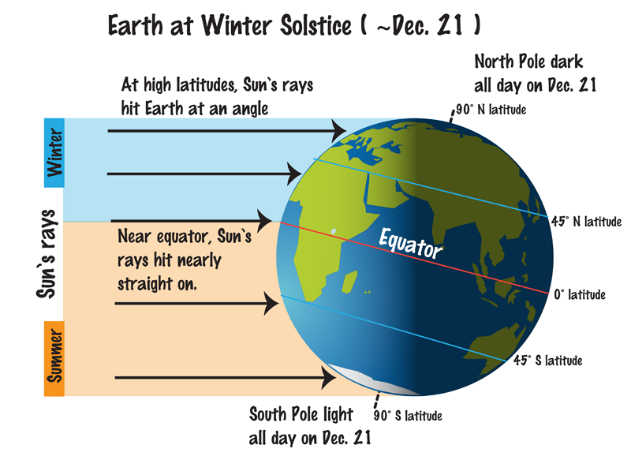
Latitude
Latitude: Distance north or south of the equator
Generally as latitude increases temperatures tend to decrease.
This has much to do with the shape of the earth and the angle at which the sun hits the land
At higher latitudes the sun has to heat larger areas with the same amount of energy
Video: Seasons and Latitude

Slide 7
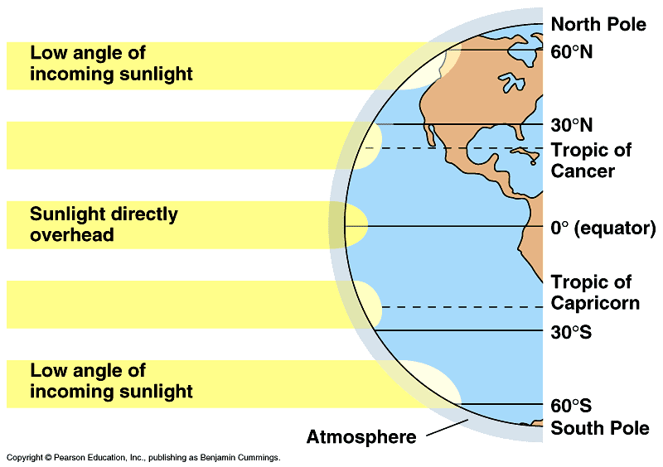

Slide 8
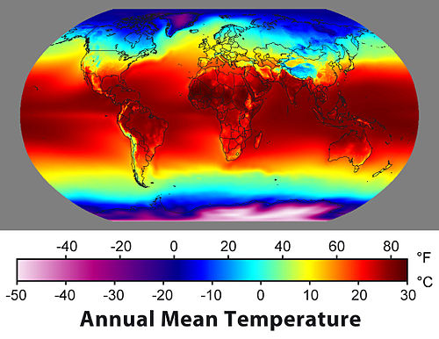

Slide 9
Air Masses and Winds
Air masses and bodies of water carry with them the characteristics of where they come from.
Air masses coming from land are dry
Maritime Tropical (mT): Warm water makes the air warm and moist
Maritime Polar (mP): Cold water makes the air cold and moist
Continental Artic (cA): Cold land makes the air cold and dry
Continental Tropical (cT): Deserts make the air hot and dry

Slide 10
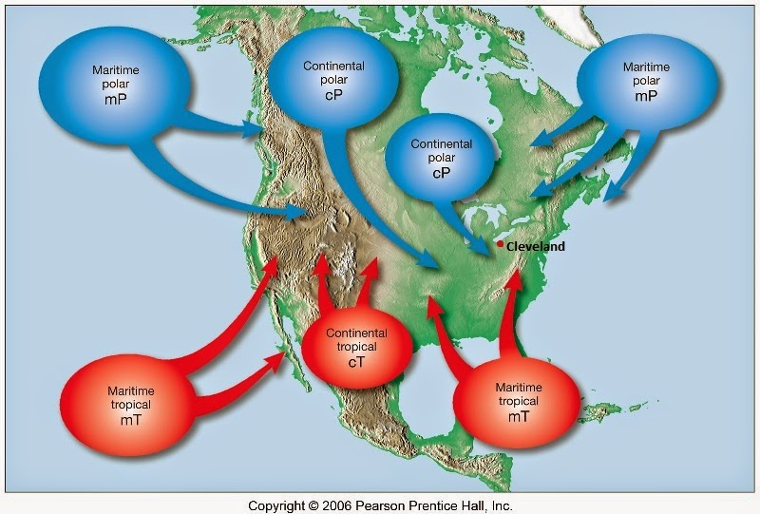

Slide 11
Air Masses Continued
Air masses tend to travel from west to east pushed by the jet stream
Jet Stream: A high and fast wind that flows across North America near the Canada/US boarder
Canada is most influenced by the polar continental air mass in the winter and the Maritime tropical in the summer

Slide 13
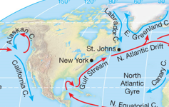
Ocean Currents
Ocean Current: Large bodies of water with similar characteristics of heat and density that travel together.
Ocean currents act like air masses in that they bring with them the characteristics of the places they come from
Currents that flow from the south are warm bringing warm air and moisture
Currents that flow from the north are cold bringing cool air and moisture

Slide 15
Clouds and Precipitation
Clouds: Masses of suspended solid or liquid water particles.
They form when water vapour in the air cools
Due Point: The temperature at which water particles in the air condense and form droplets.
When droplets become large enough they fall to the earth
We will learn about three types of precipitation:
Frontal precipitation
Convectional precipitation
Orographic/Relief precipitation

Slide 16
Frontal Precipitation
Front: The leading edge of an air mass
As fronts pass through an area weather changes.
Air moves from areas of high pressure to low
Warm air can force itself up and over a cold mass, this is known as a warm front.
Cool air can force itself under a warm air mass, a cold front

Slide 17
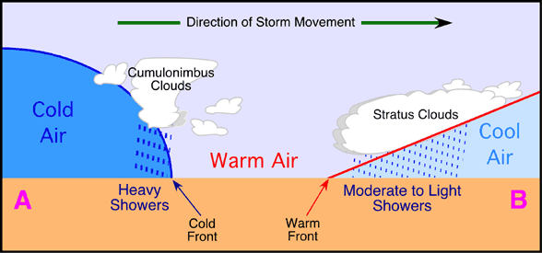
Frontal Precipitation
Caused when one air mass displaces another.
As a cold system (high pressure) moves in it forces warm air to rise.
Rain occurs at A
The warm air is forced over the cool system.
Rain occurs at B

Slide 18
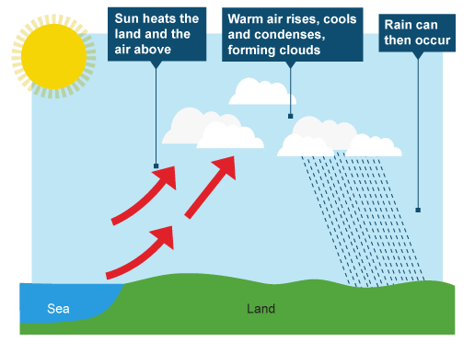
Convectional Precipitation
Occurs as a result of the vertical movement of a air mass.
The sun heats the crust, air is forced to rise.
As it rises it cools and condenses.
Rain occurs

Slide 19
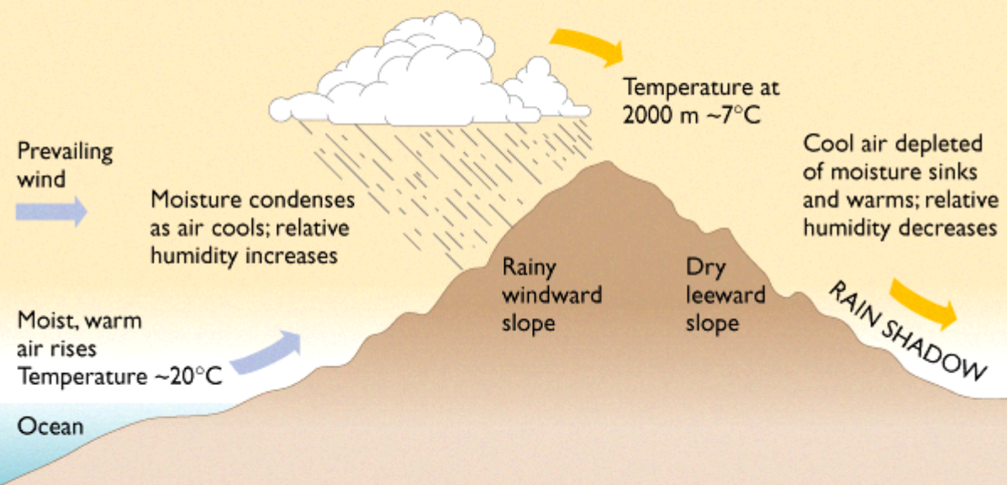
Relief/ Orographic Precipitation
Occurs when moist air moves of a mountain barrier.
As air blows from the ocean it is forced over a mountain.
It is forced to cool and drop it’s moisture as rain.
On the leeward side of the mountain we find a dry area known as a rain shadow

Slide 20
Regional Factors: Altitude
Altitude: height of an object in relation to the ground.
As altitude increases temperature decreases
The molecules move farther apart and hold less heat.
Environmental lapse rate: the rate of change of temperature with elevation.

Slide 21
Regional Factors: Bodies of Water
Bodies of water provide a moderating effect
Water heats and cools slower than land
Lakes and oceans bring cooling breezes in the summer, and warmer breezes in the winter.

Slide 22
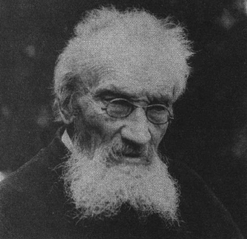
Climate Regions
Climate Region: an area that experiences similar weather conditions within its boundaries throughout the year.
Climate regions are based on a system developed in 1920 by Wladimir Köppen.
Köppen’s system classifies regions based on:
annual temperature
Annual precipitation
Vegetation
In Köppen’s system there are 5 regions ranging alphabetically from A-E

Slide 23
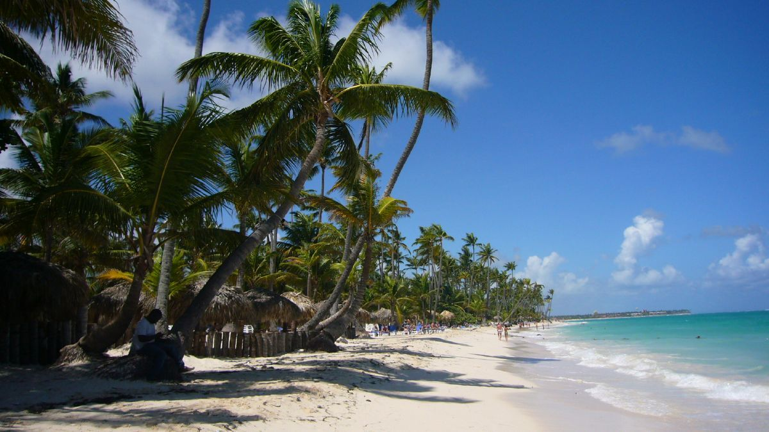
Canada’s Climate Regions
A: Tropical Climate: Canada has none.

Slide 24
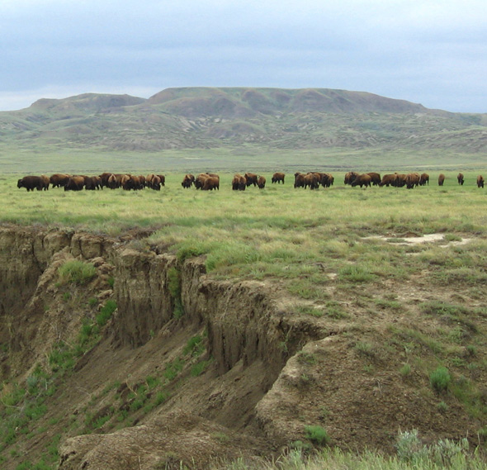
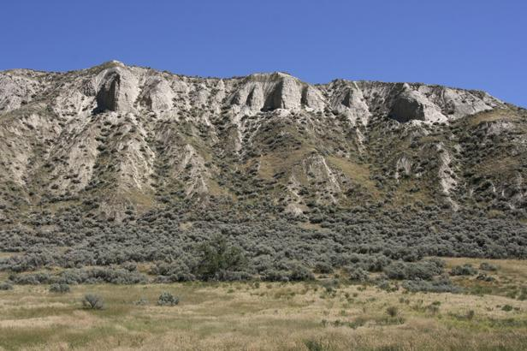
Canada’s Climate Regions
B: Dry Climate
Evaporation and transpiration may be greater than precipitation.
Some are warm, others are cool.
Found in the north, and in southern Alberta and Saskatchewan.

Slide 25
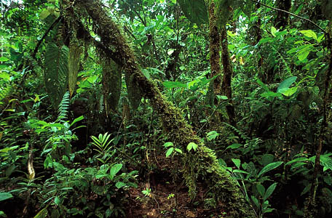
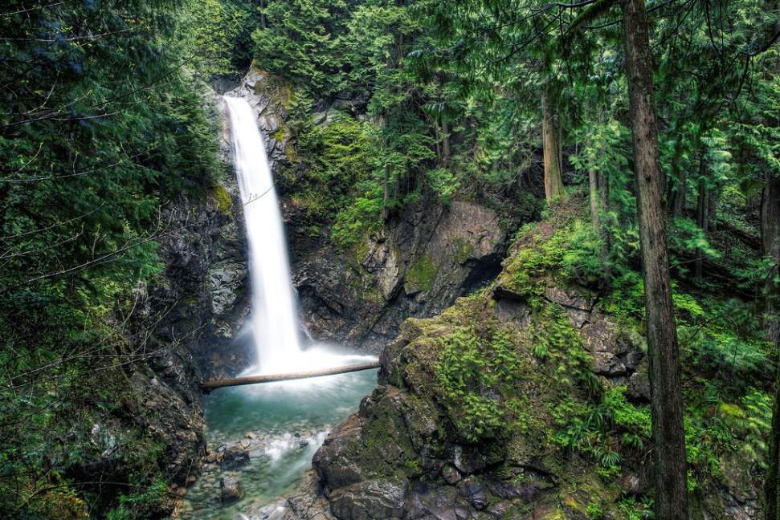
Canada’s Climate Regions
C: Warm, moist climates
Warm humid summers and mild winters
Found along the coast of British Columbia

Slide 26
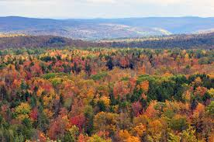
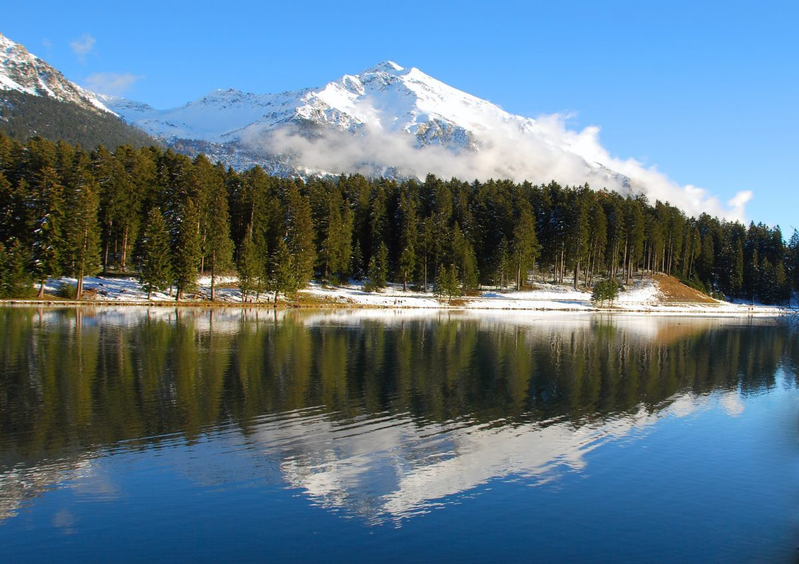
Canada’s Climate Regions
D: Cool, moist climates
Most of Canada
Ranges from warm climates of southern Ontario to the cold subarctic
Newfoundland is part of this region

Slide 27
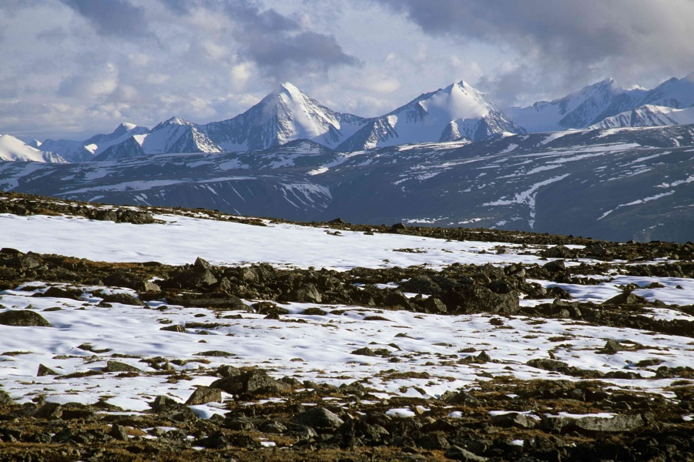
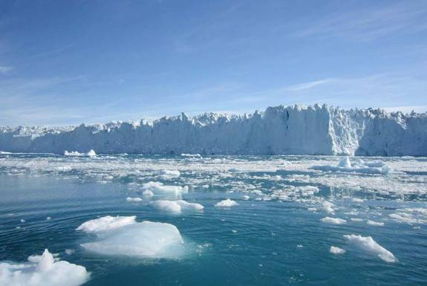
Canada’s Climate Regions
E: Polar Climates
Only found in Canada’s North and highland areas
Covers 25% of the country
Warmest month less than 10 degrees
Two types:
Tundra
Ice Cap

Slide 28
Microclimates
Microclimates: smaller areas within climate regions that do not fit the average conditions.
May be warmer, cooler, wetter, or drier.
Depressions in the land are known as frost hollows
Windward sides of mountains experience precipitation
Southern slopes get more sunlight and are better for farming
Large urban centers are often warmer due to the heat of the buildings, vehicles, and people

Slide 29
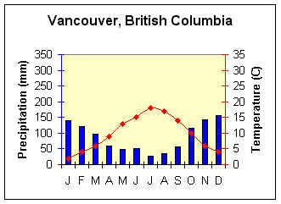
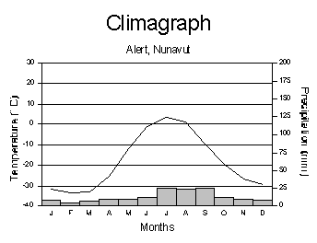
Climographs
A combination of two graphs
A bar graph drawn in blue to represent precipitation
A line graph drawn in red to represent temperature
Temperature and precipitation is measured on the y-axis
Months of the year on the x-axis

