Slide 1
Unit 2: Part 3
Geographic Influences on Identity
Place and People

Slide 2
Urban and Rural Areas
This chapter looks at the effect that a persons location has on their identity.
Communities can be broken into two different categories.
Urban Community: Large settlements of over 2500 people. They are often crowded and busy.
Rural Community: A large piece of land that has people scattered throughout. Not many people live here.
Notes:
Identify and describe rural and urban communities

Slide 3
Canada’s Human Landscape
When describing populations we will use three important terms.
Population distribution
Archipelago effect
Population density
Notes:
account for the growth and decline of settlements

Slide 4
Population Distribution
Population distribution: A description of where people have chosen to live in a particular area
Concentrated or Dispersed

Slide 5
Archipelago Effect
Archipelago effect: A term used to describe Canada’s pockets of settlement as a group of islands

Slide 6
Population Density
Population density: A measure of how closely together people live in a given country or area

Slide 7
Site and Situation
When studying location an growth of towns an cities geographers divide factors that determine the location of human settlements into two main categories
Site factors: features of the physical landscape.
Soil Minerals
Fish Trees
Situation factors: the sites relationship to other places.
Economic relations Transportation
Trade relations Location of Markets
Political relationships

Slide 8
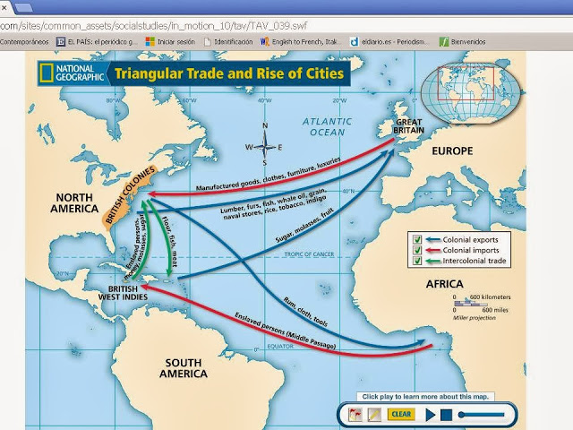
Site and Situation Factors
What site and situation factors led to the growth of St. Johns?
Notes:
Students should understand the difference between site and situation factors. Site factors include landscape and resources whereas situation factors include transportation and the economy. Students should realize that site and situation factors are major determinants for the growth or decline of an area.

Slide 9
Settlement Patterns
The relocation of first nations:
When Europeans first came to Canada they were attracted to the land the First Nations were inhabiting
Site and situation factors there provided the best survival opportunities.
Long-term contact between Europeans and First Nations almost always led to the relocation of the First Nations.
Europeans continued to take favorable lands, relocating the First Nations to areas that were less desirable, and with fewer economic resource.
Notes:
Students should be aware that over time our settlement patterns have been greatly influenced by our interaction with the physical landscape.
Students should also be aware that settlement patterns change due to external factors, more specifically students should understand that the interactions between European and Aboriginal Peoples led to the relocation of many of these Aboriginal Peoples.

Slide 10
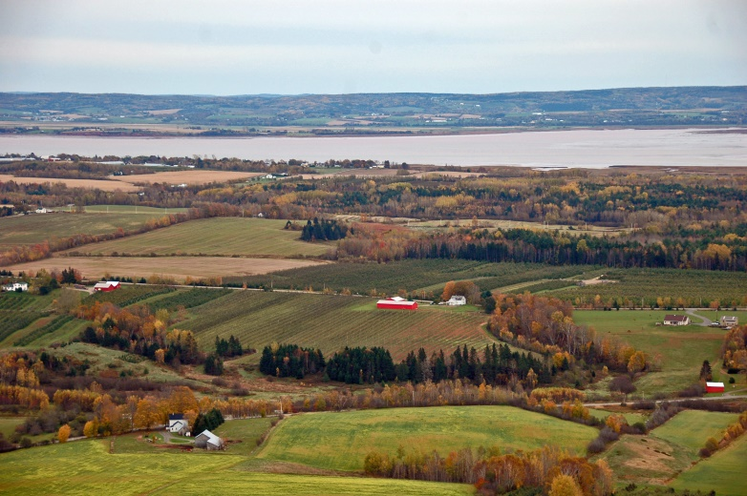
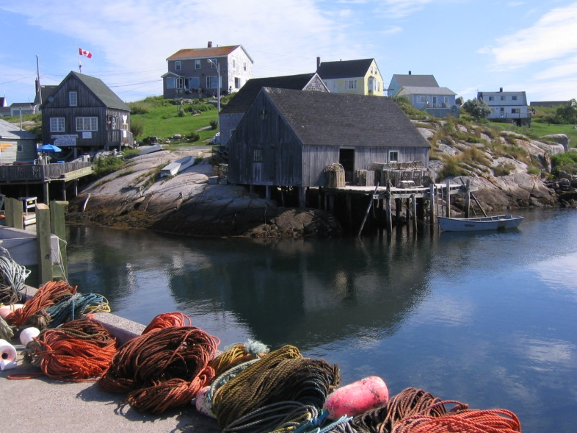
Settlement Patterns
Atlantic Canada:
People farmed where they could
PEI, Annapolis Valley, Cape Breton.
Mostly people settled near the ocean so they could fish

Slide 11
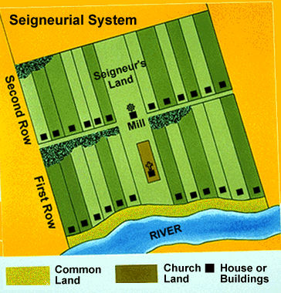
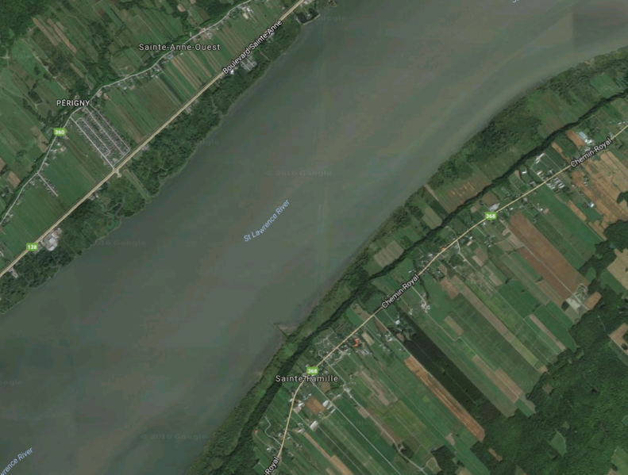
Settlement Patterns
New France:
Settlers wanted to be close to the river
It was the major system of transport, and source of water.
Settlement formed in the seigneurial system
Seigneurial System: Pattern that has long narrow lots of land that face the river.

Slide 12
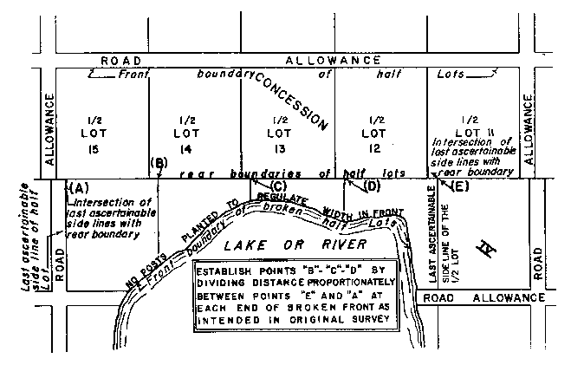
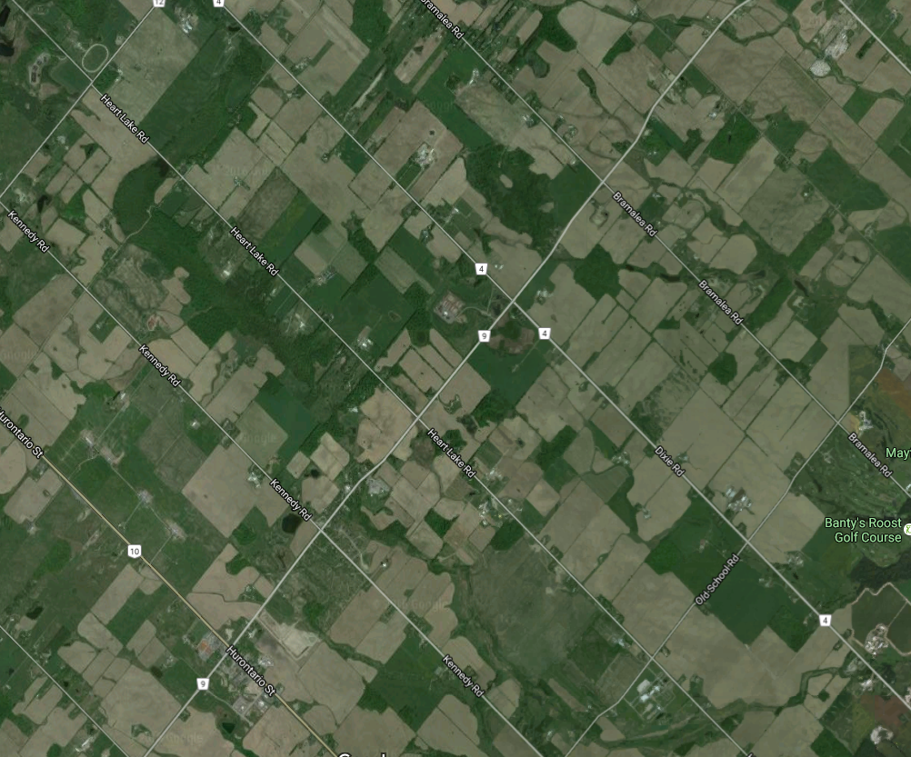
Settlement Patterns
Ontario:
The British settled Ontario so they adopted the Township system.
Township System: Uses square 100 acre lots.
The size of lots gradually increased due to the use of machines.

Slide 13
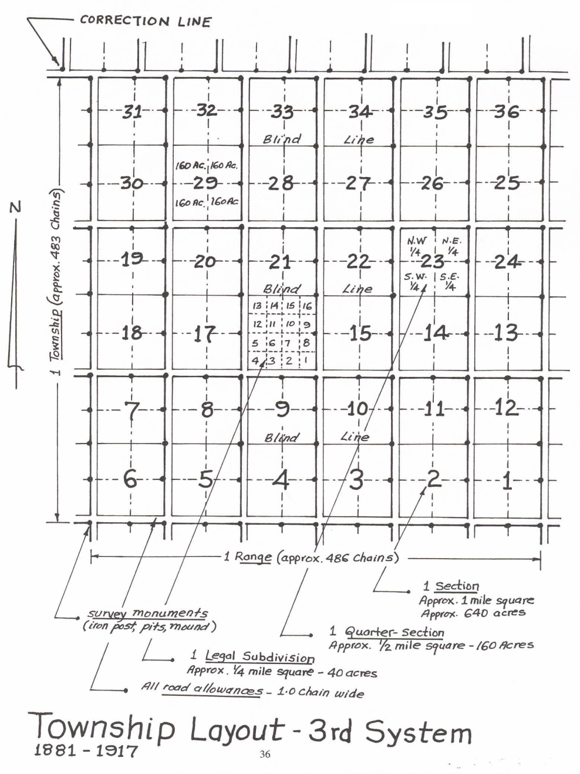
Settlement Patterns
The Prairies
Land was divided into grid pattern.
Like Ontario but the grid was much larger
Sections: 640 acre grids used to organize land ownership.
Sections were divided into quarter sections

Slide 14
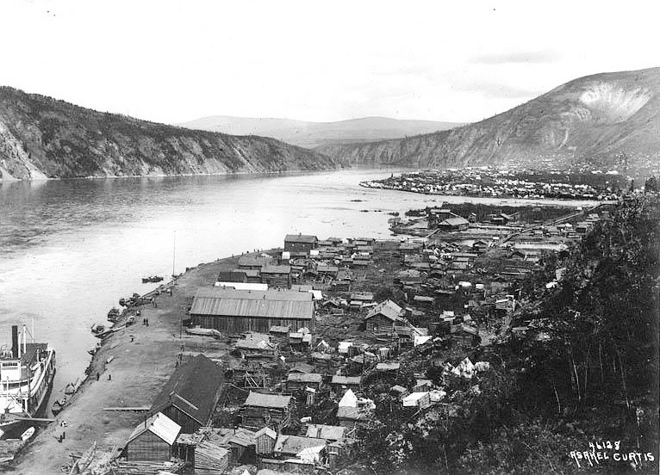
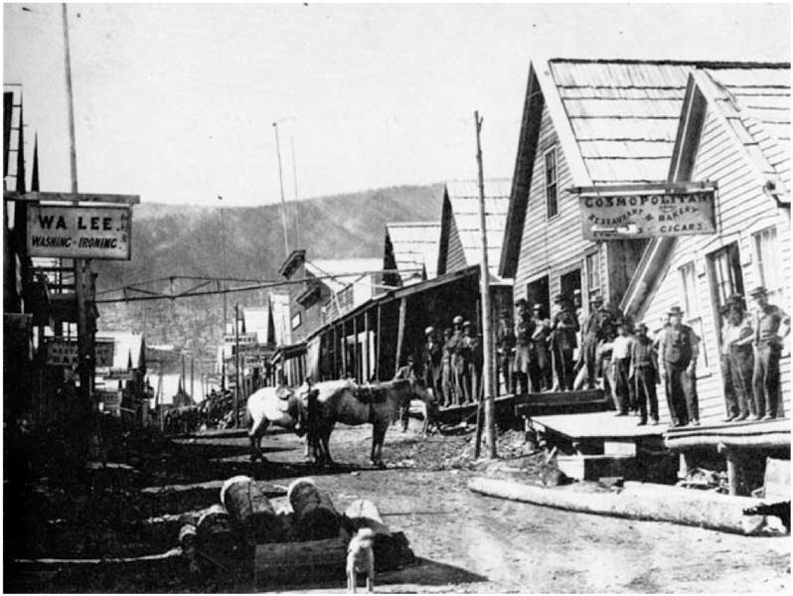
Settlement Patterns
The North:
Settlements formed around resource discoveries
Gold
British Columbia:
Settlement formed in fertile mountain valleys or near resources
Trees, mining, rivers
The Fraser River delta seen farming develop.

Slide 15
Growth And Decline
The growth of Canada is heavily influenced by Geography
Regional factors determined how the different parts of Canada would grow.
Notes:
Students should understand that settlements grow in different regions due to changes in services, transportation, climate and economics. Settlements decline due to (i) rural to urban drift, (ii) economic downturn and (iii) lack of services.

Slide 16
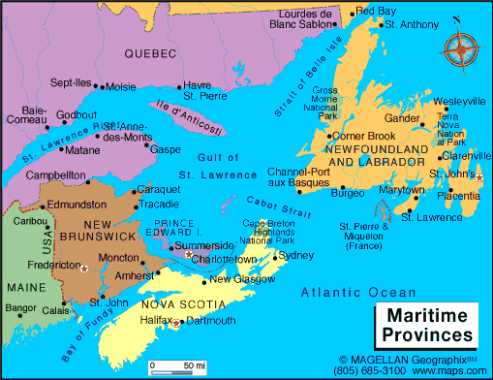
Growth
Atlantic Canada:
No large agricultural activities
Developed due to fishing, lumbering, shipbuilding industries.
This promoted the growth of port cities and costal settlements.
Caption: Notice how all of the cities/ towns are arranged near the coast.

Slide 17
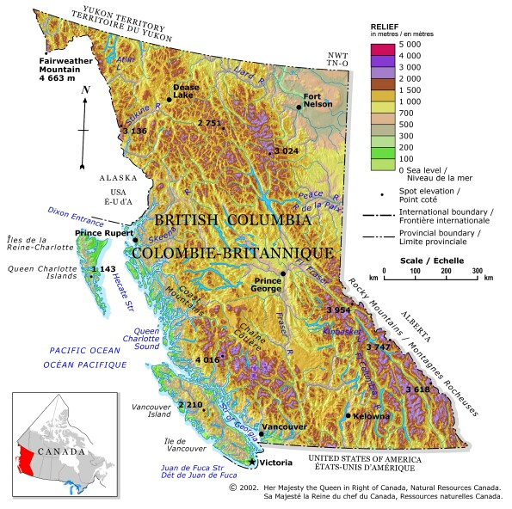
Growth
The West Coast:
The rugged mountains and coast promoted fishing and lumbering.
Farming was only possible in valleys and deltas.
Settlements grew along the coast and in valleys.

Slide 18
Growth
Great Lakes –St.Lawrence
Most of Canada’s large cities grew in this area
Great farming, access to services, markets to sell farm products, transportation systems.
Farms grew, and with that growth so did the industries that supported farming.

Slide 19
Hamilton to Quebec City
785 km
Roughly 9 million people

Slide 20
Decline
1881 75% of Canadians lived in rural settlements
Rural: areas located outside of towns and cities
Most Canadians were involved in primary industry activities
Fishing, farming, mining, hunting, forestry
This all began to change in the 1890’s and early 1900’s

Slide 21
Decline
Industrial revolution: transition from an economy based in agriculture to one based in manufacturing.
Towns in Ontario and southern Quebec became industrial, and service centres.
Fueled by railway, coal and steel
More people moved to urban areas
Urban: Towns or cities where the population is over 1000 and the population density is above 400 people per square kilometer.

Slide 23
Decline
Rural to Urban Shift: The movement of people out of rural areas in Canada and into cities.
By the 1940 less than half of Canadians lived in rural areas.
Urbanization: The process at which rural areas become urban
Towns based only on resources are disappearing.
As population goes down, serviced decrease, and more people leave to find better services

Slide 24
Canada’s Regions
Regional Analysis: A tool used by geographers help organize their study. It involves breaking down a large thing into smaller parts.
The characteristics of regions can be divided into four categories
Location: Where it is.
Physical and cultural characteristics: Clearly defined aspects of a region.
Political perspective: Where it fits in with the rest of Canada and the world.
Hierarchy: Smaller regions within the boundaries

Slide 25
Canada’s Political Regions
Canada’s has five political regions
Atlantic Canada
Central Canada
The Prairies
British Columbia
The North
The regions are based on the characteristics of regions listed previously.
They are useful when discussing different areas of Canada

Slide 26
Atlantic Canada
Location:
Nova Scotia, New Brunswick, PEI, Newfoundland and Labrador
Physical and Cultural Features:
Economic Hardship
Dominated by ocean activities
Pockets of Farming
Politics:
Connected to New England (USA)
Debate on uniting Maritime provinces
Hierarchy
Many smaller regions (Cape Breton, Labrador, Southern Shore)

Slide 27
Central Canada
Location:
Ontario and Quebec
Physical/Cultural Attributes:
Dominated by activity on the Great Lakes/St. Lawrence
Extensive farming
Heavy manufacturing
French and English culture
Politics:
Heavy ties to United States
Hierarchy
Split into northern and southern

Slide 28
The Prairies
Location:
Manitoba, Saskatchewan, and Alberta.
Physical/Cultural Attributes:
Flat dry grasslands
European settlement between 100-200 years ago
Heavy farming and oil activity
Politics:
Strong ties to USA due to oil and farming
Hierarchy:
Oil patch

Slide 29
British Columbia
Location:
British Columbia
Physical/Cultural Attributes:
Mountains and forests
Dry interior
Significant immigration from Pacific countries
Politics:
Connected to US west coast.
Economic ties to Asia
Hierarchy:
Local regions in the interior and on Vancouver Island

Slide 30
The North
Location:
Nunavut, Northwest Territories, Yukon
Physical/Cultural Attributes:
Predominantly First Nations and Innu
Forest in the West, Tundra in the East
Resource based economy
Political Perspective:
Territories of the Federal government
Hierarchy:
Mackenzie River Valley
Eastern Arctic
Yukon

Slide 31
The Core and the Periphery
Interaction among the 5 regions is a key factor in investigating the growth and prosperity of Canada.
A tool that geographers use to understand this relationship is the concept of core and periphery and the relationships that develop between them.

Slide 32
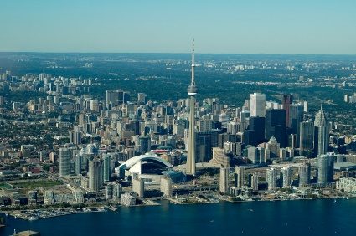
Core
The core is the nucleus of a geographic region, containing its most developed area, greatest wealth, and highest population density. Toronto is an example of a core.
Over half of Canada’s population lives in Southern Ontario and southern Quebec.

Slide 33
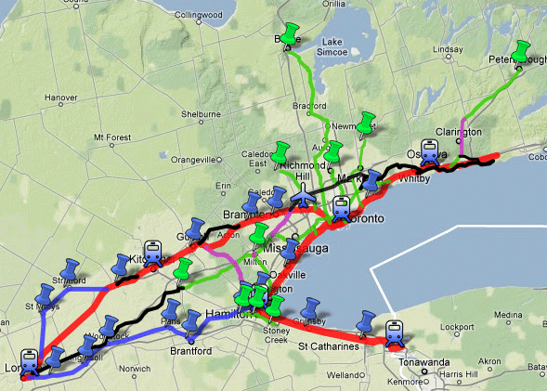
Periphery
The periphery is all the areas outside the core. It is sometimes referred to as the “hinterland”.
It supplies raw material, and provides a market for its manufactured products and services.

Slide 34
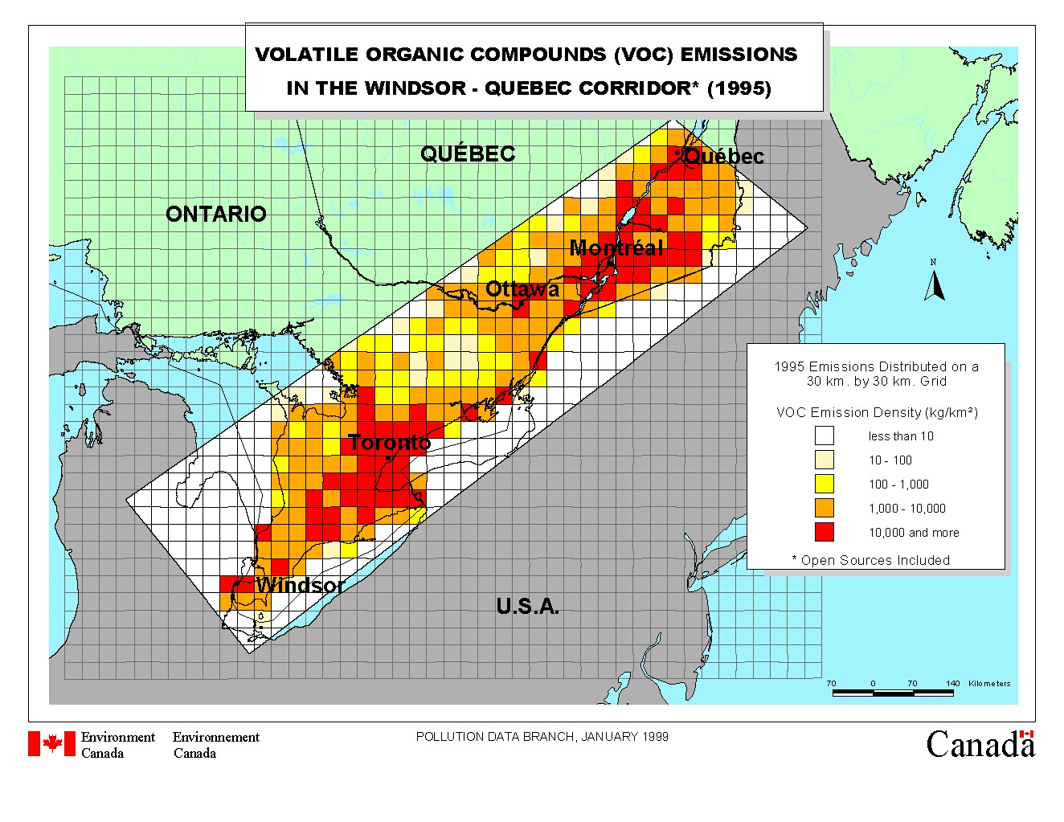
Windsor-Quebec City Corridor
Over time, this corridor became the centre of Canada’s financial services and the hub of transportation systems.
This area sends more Members of Parliament to Ottawa. Why? What affect does this have?

Slide 35
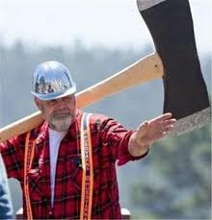
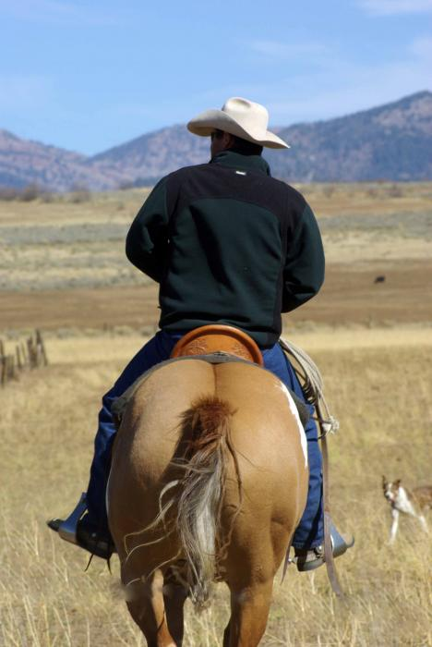
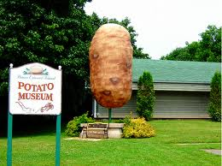
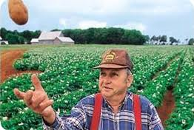
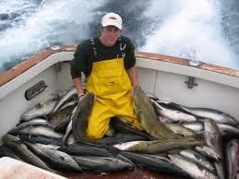
3.4 Regional Identities
Many regional identities are associated with local industries. What industries and identities are depicted below?
Notes:
http://www.cbc.ca/news/canada/newfoundland-labrador/story/2011/10/14/nl-fishermen-postcard-114.html

Slide 36
Three Jolly Fishermen
http://www.cbc.ca/news/canada/newfoundland-labrador/story/2011/10/14/nl-fishermen-postcard-114.html
(see video)

Slide 37
Regional Identities and Stereotypes
You are a Newfoundlander. Therefore you must...
Jig for cod? Dance the jig? Eat fish and brewis or flipper pie? Row a dory? Drink Screech? Live in a saltbox? Go mummering at Christmas? Play the fiddle or button accordion?
A stereotype is an oversimplified view of the characteristics held by members of a certain group or place.
Sometimes stereotypes are negative (as portrayed in “stupid Newfie” jokes) and can lead to a prejudiced view of a group.

Slide 38
Newfoundland Stereotypes
What stereotype of Newfoundlanders does the following video show?
http://www.youtube.com/watch?v=3m-y-qAbpL0
Notes:
http://www.cbc.ca/news/canada/newfoundland-labrador/story/2006/09/14/nissan-bonavista.html

Slide 39
Newfoundland Stereotypes
Look at the following poster.
http://www.heritage.nf.ca/nlsociety/chapter1topic1_8.pdf
Do you think the pictures shown are good representatives of our provincial identity or do they portray some stereotypes?

