Slide 1
Migration: People On The Move
Social Studies 9
Chapter 4

Slide 2
Migration and Identity
Canada’s identity is influenced by the movement of people
Whenever someone moves from one country to another, or from region to region they take ideas and ways of living with them.

Slide 3
First Nations and Inuit
There are four theories of where first nations people came from.
Beringia Land Bridge: First nations crossed a land-bridge from Russia during the last ice age.
This is the most widely accepted theory.
Humans spread south across the North America and into South America
It was only after the Ice age was over that they began to make their way back north
Beringia Theory Video
Notes:
Students should discuss the inconclusive theory concerning the migration of Asians across the Bering Strait, as early as 50 000 - 13 500 years ago.

Slide 4
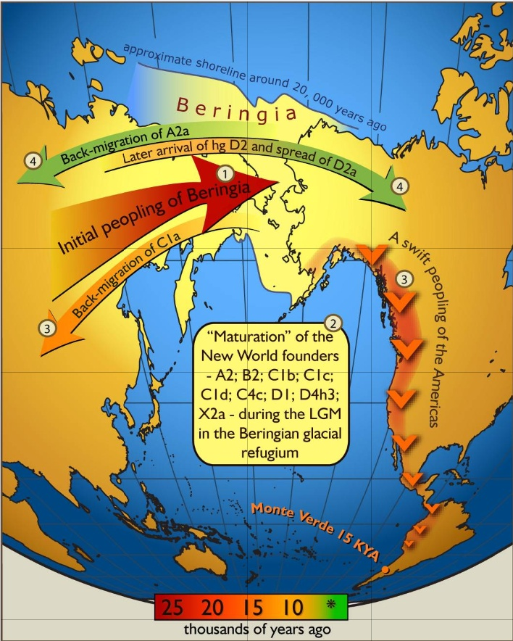

Slide 5
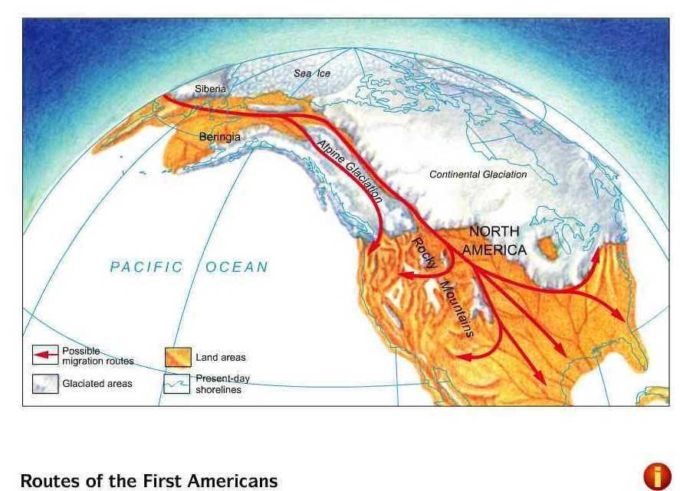

Slide 6
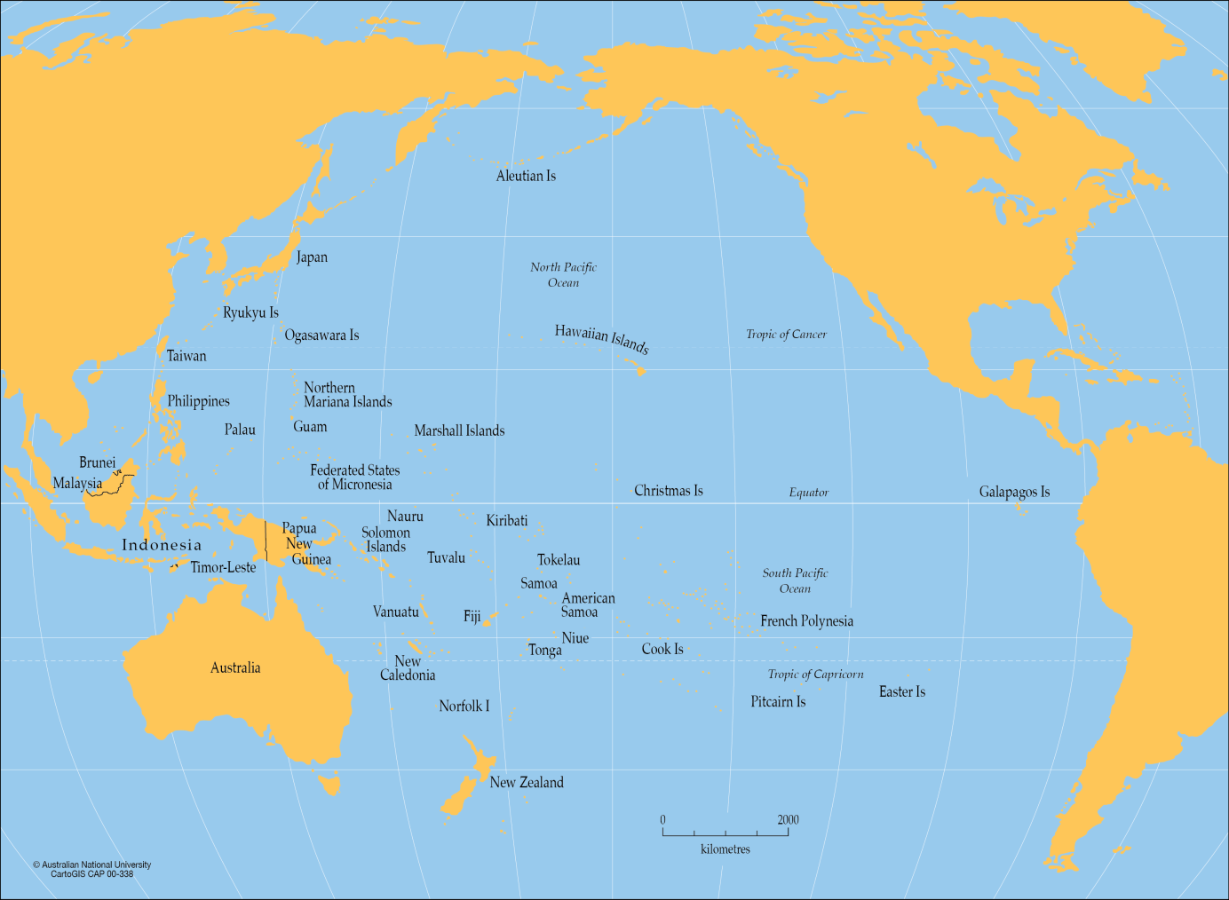
First Nations and Inuit
2. Crossing The Pacific:
There is evidence to support a theory that at least some of the populations of First Nations people in South America came from Australia, New Zealand and small Pacific Islands

Slide 7
First Nations and Inuit
3. Atlantic Ocean:
Theory that First Nations people came from across the Atlantic ocean.
4. Turtle Island:
Many First Nations people have their own belief about their origins.
Many believe they were here since the beginning.
Turtle Island Video

Slide 8
Why Do People Move?
Migrate: To move to a new location.
Geographers group the reasons why people migrate into two categories:
Push Factors: Things that cause people to leave a location.
Push Factors Include
War | Famine | Poverty | Climate Change
Unemployment | Natural Disaster | Lack of freedom
Notes:
Some Canadians move away from a location due to difficulties in their environment such as lack of employment - push factor. Others choose to move as a result of a new opportunity such as employment - pull factor. Immigrants from other countries often choose Canada as a destination due to its reputation as a multicultural country. Canada continues to promote an identity which is less ethnocentric, prejudiced and discriminating.

Slide 9
Migration
Pull Factors: Things that attract people to a new location.
Push and Pull Video
Canada has a reputation for welcoming immigrants.
The government decides who can come in and how many
Pull Factors Include
Good Economy | Available Land | Reunion of Family | Good Climate
New Resource | Access to Technology | Good Political System

Slide 10
Changing Immigration Patterns
Today Canada has a reputation for welcoming refugees.
Canada tries to promote peace, justice, human rights multiculturalism its immigration policy.
Multiculturalism is an official policy that recognizes and supports the many cultural customs of different groups living in Canada.

Slide 11
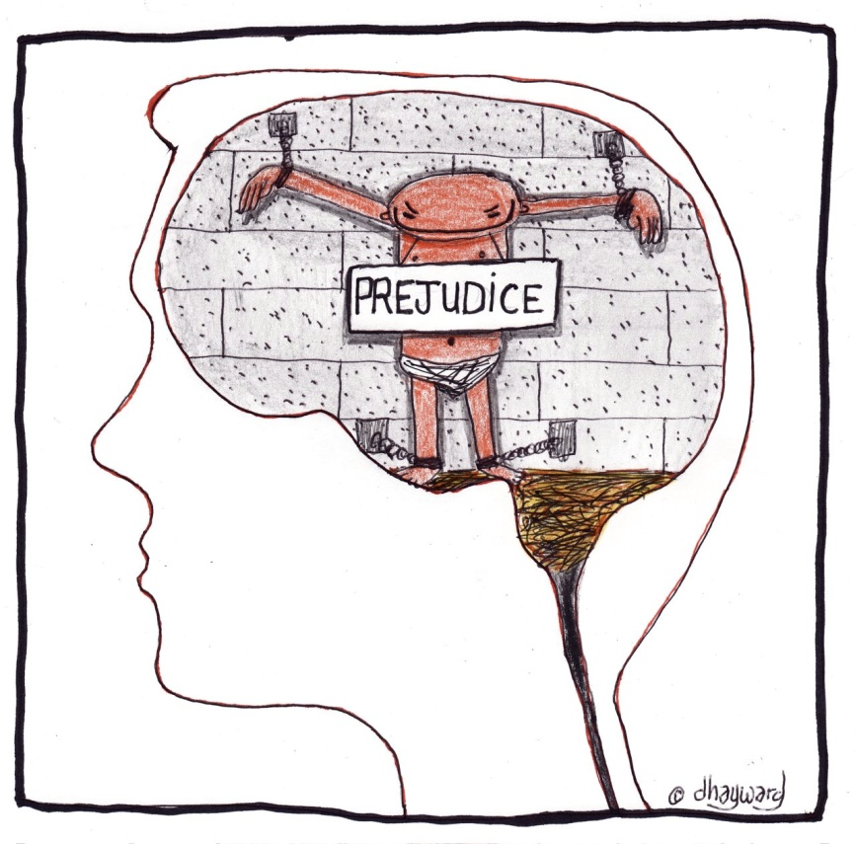
In the past, Canada was more ethnocentric.
Ethnocentrism is the belief that your culture and customs are better than everyone else’s.
Because of ethnocentrism, Canada’s immigration policy was influenced by prejudice.
Prejudice is the belief that all people are not of equal value.

Slide 12
Immigrants from Britain and the US were given preferential treatment. Others were discriminated against.
Discrimination is unfair treatment because of race, color, religion, etc…

Slide 13
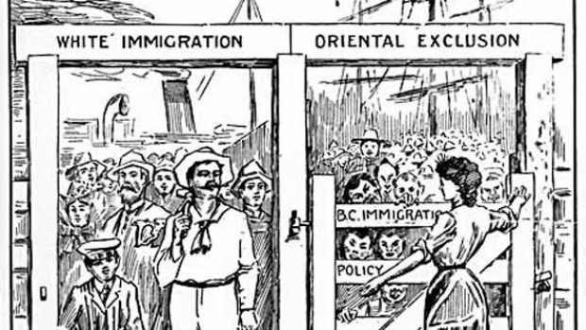
Examples of Canada’s racist immigration policy :
1. African-Americans =not suited to our climate
2. Chinese Immigration Act (1922)
3. Jewish refugees (WW2)
some Jews who did enter Canada were put in prison camps with Germans

Slide 14
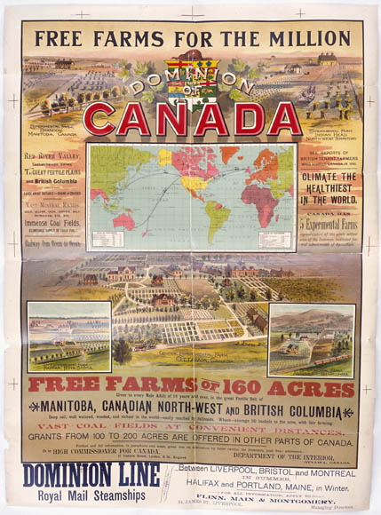
Immigration Before 1945
The Canadian Government was eager to settle the West with European farmers
First Nations who lived on the land were forced to resettle on reserves
Free land was offered to immigrants from Britain, the U.S, and even Eastern Europe

Slide 15
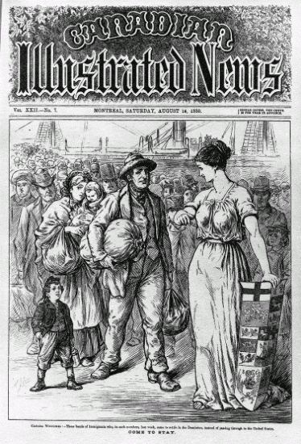
Canada was eager to settle the vast western frontier and eagerly promoted free land for new settlers from US and Britain and even eastern Europe.

Slide 16
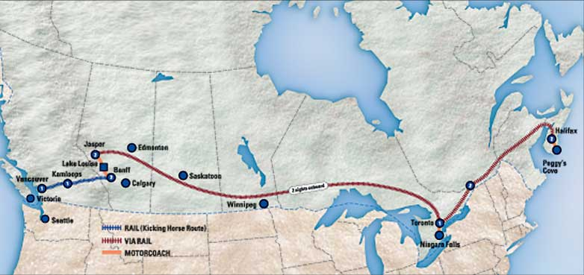
By the 1920’s most of the Prairies were settled.
Many new immigrants moved to the cities to work in growing industries.
Others worked on railroads or mines

Slide 17
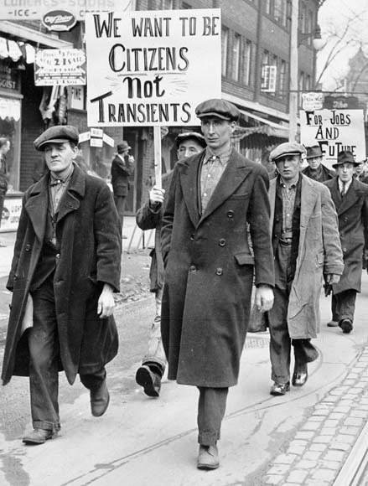
The Great Depression of the 1930’s forced the gov’t to change its policy in the face of widespread poverty and unemployment.

Slide 18
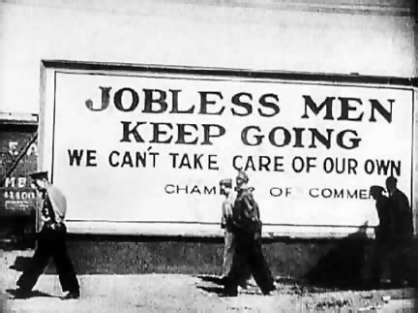
Most Canadians opposed immigration fearing a loss of more jobs to newcomers.

Slide 19
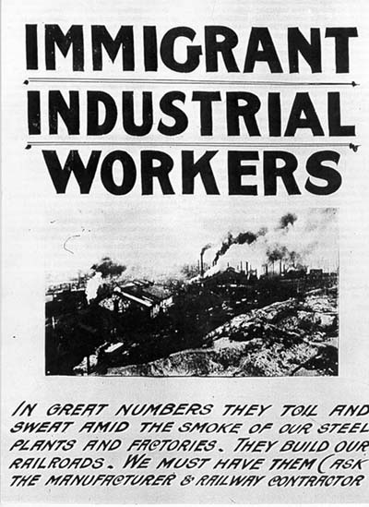
Post - 1945
Canada’s immigration policy was changed after WW2 being more sympathetic to refugees.
Workers were needed in post war industry boom.

Slide 20
Examples of Refugees Accepted
- 1947-50 WW2 refugees
- 1968-69 Czechoslovakia- 1971-80 Uganda
-1972 Chile
- 1975-81 Indo-Chinese (Boat people)
- 1999 Kosovo
- 2010 Sri-Lanka

Slide 21
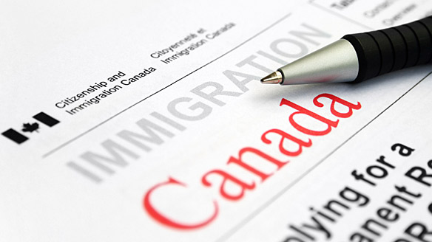
Today’s Immigration Policy
Canada’s current policy was started in the 1960’s. It aimed to end discrimination.
By 1976 a system was set up on the basis of a 3 class system

Slide 22
3 Class System
1. Family Class – a close relative already living in Canada can sponsor relatives
2. Refugee Class – someone fleeing “great personal danger”
3. Independent Class – these people are assessed based on a point system

Slide 23
4.4 Debate over Immigration & Refugees
Arguments for immigration :
- big country & small population ( more people are need to develop economy )
- immigrants provide new ideas and new skills
- they fill jobs that most Canadians turn down
- multiculturalism is enriched

Slide 24
Arguments Against Immigration :
1. lack of jobs for bigger population
2. they take jobs away from Canadians
3. Some draw on social welfare programs and services
4. different groups can increase racial tensions within Canada

Slide 25
Arguments for accepting refugees :
We must honour our commitment to the U.N. to aid “the displaced and persecuted”
- returning refugees will endanger their lives
- Canada is a big country with lots of room
- people in desperate conditions cannot afford the 2 year wait

Slide 26
Arguments Against New Refugees :
1. Not all claims are legitimate
2. Those without proper ID can cause security threats
3. Refugees can “skip” the line of others waiting to enter
4. Accepting them will promote others in the future
5. Accepting them will encourage“people smugglers”

Slide 27
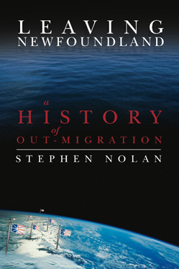
4.5 Changing Migration Within Canada
Outmigration or “internal migration”is the movement away from an area

Slide 28
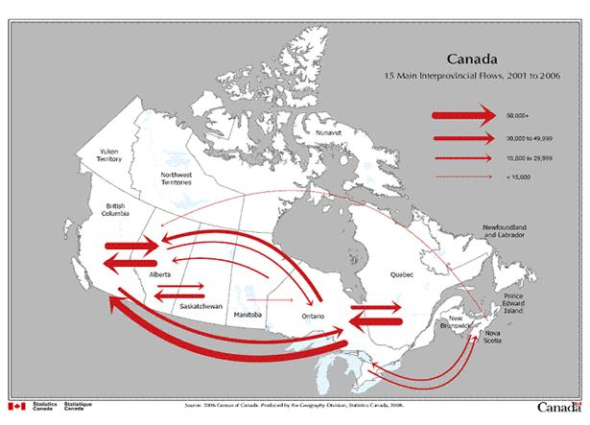
4.5 Changing Migration Within Canada
For Maritimers, out-migration began shortly after Confederation.
They sought better jobs or opportunities elsewhere

Slide 29
Cod Moratorium (1992)
Mass out-migration in Newfoundland began with the collapse of the cod fishery in NL in the 1990’s led to thousands of NLers losing their jobs overnight.
The Canadian gov’t responded with the TAGS program.
Once TAGS ended, thousands of Newfoundlanders left NL to find work elsewhere.

Slide 30
3 reasons why outmigration from NL :
A. Cod Moratorium
cod fishery closed due to possible extinction of the cod stocks. Many people affected and jobs and careers ended as a result
B. Recession
mines closed, economy slumped, loss of jobs

Slide 31
C. TAGS program
some fishermen did “under the table” jobs and hurt other professionals
End of Tags meant fishermen had no options but to leave the province to find work
Took seats from other young people who wanted a secondary education thereby forcing young people to leave to find work on the mainland

Slide 32
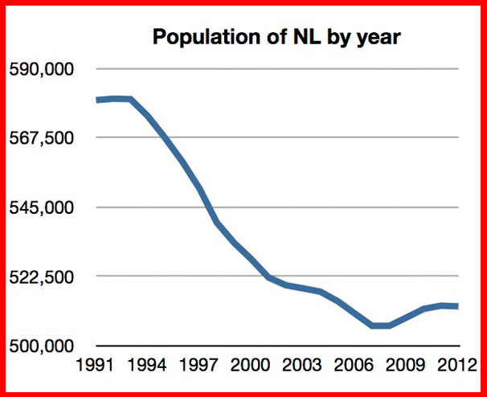

Slide 33
Effects of outmigration :
less people to collect taxes from
gov’t revenue declines as a result
many gov’t services have to be cut back or eliminated
When people leave, there is less money circulating in local businesses and less people hired to work in these industries
Atlantic Canadian governments receive less transfer payments from the federal gov’t for health and education programs.

Slide 34
Outmigration has a number of effects on Atlantic Canada :.
Brain Drain Young educated people who should be the most productive members of society move away. The costs of educating these people is not returned to the area.
Aging Population The average age of Atlantic Canadians is rising. These people produce less wealth and increase the demand and costs for health care.

Slide 35
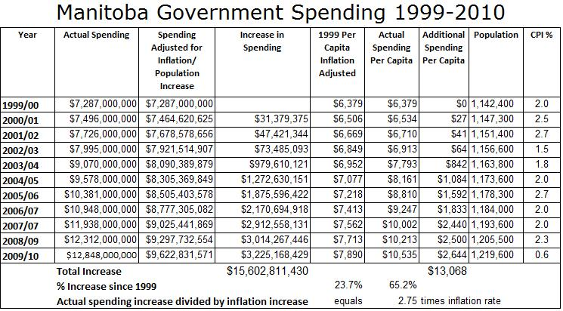
Workers Some employers are having difficulties finding qualified workers.
Government MoneyTransfer payments from the Canadian government are based on population. Fewer people means fewer dollars

Slide 36
4.6 Emigration
Emigration means to leave your country to live somewhere else.
Each year, about 50,000 Canadians emigrate to the US.
Many Canadians fear that Canada is suffering from a “brain drain” – a loss of highly educated people

Slide 37
Many people, however, think that “brain drain” is not a big issue for the following reasons.
Canada benefited from immigration of highly skilled workers
Due to greater number of immigrants to Canada more University graduates are entering the country than leaving
post-grads entering equal post grads leaving for U.S.

