Slide 1
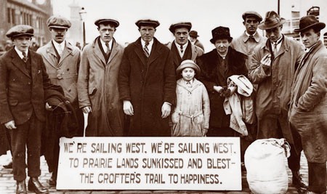
Social Studies 9
Unit Three – Historical Influences on Identity I: Significant Events (1920-1945)

Slide 2
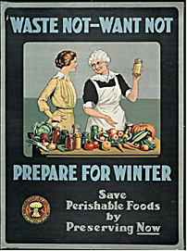
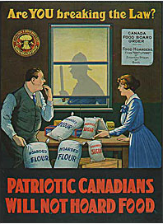
5.1 Factors That Account for Varying Levels of Prosperity in the 1920s
The Great War brought with it an economic boom in Canada
Wartime Economy: When the economy switches from manufacturing goods to meet needs at home to meeting the needs of the war.
Canada focused on producing manufactured products for the war
Weapons
Ammunition
Food

Slide 3
5.1 Factors That Account for Varying Levels of Prosperity in the 1920s
Peacetime Economy: Economy that is focused on providing for the needs of the country.
Europe’s demand for Canadian goods falls when the war ends.
This causes a slump in the Canadian economy
This hurts the Prairies and Maritimes the most
Sales of wheat and fish decline.

Slide 4
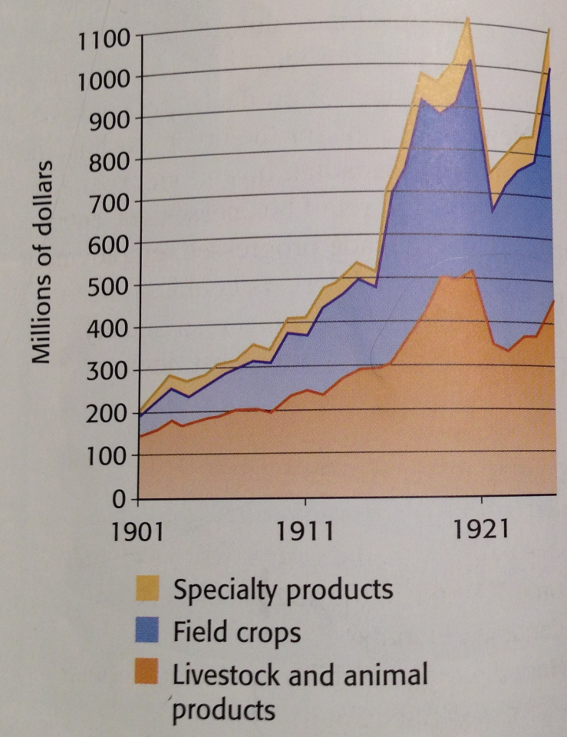
5.1 Factors That Account for Varying Levels of Prosperity in the 1920s
The wartime economy causes the price of goods in Canada to rise.
There are fewer being made.
Returning soldiers were not able to afford to the life they had dreamed of.
Many were unable to find work and the economy suffered even more.

Slide 5
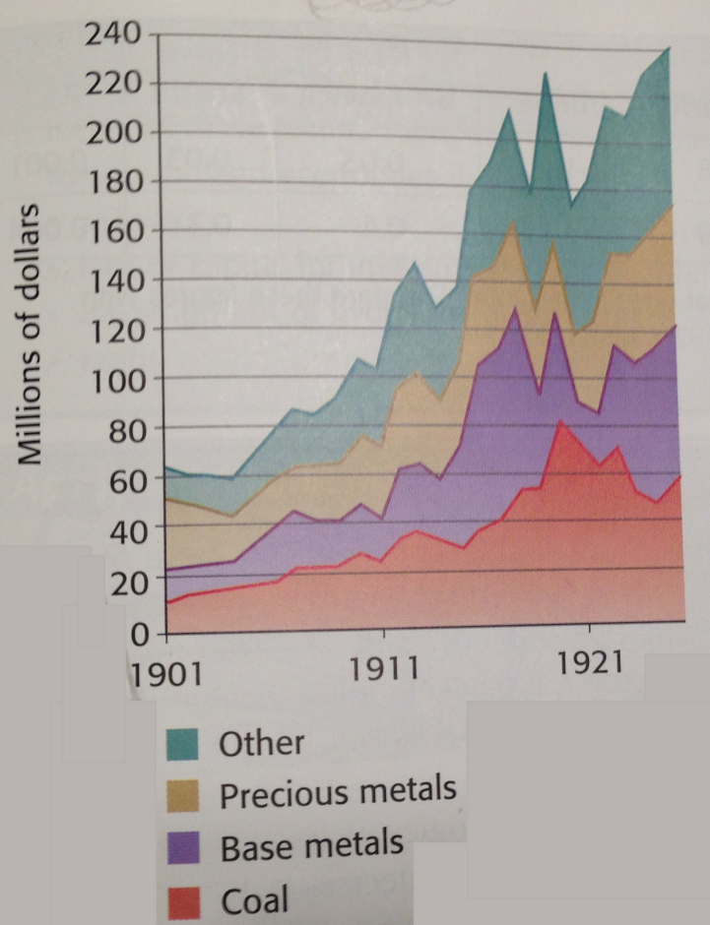
5.1 Factors That Account for Varying Levels of Prosperity in the 1920s
By 1923 Parts of Canada begin to recover.
Central Canada
Trade with the united states grows
Pulp and paper production, and manufacturing increase
Ford and GM set up branch plants in Ontario to avoid tariffs.
British Columbia
The demand for iron and other metals increases.
Prairies
Agricultural production increased as demand for wheat increases

Slide 6
5.1 Factors That Account for Varying Levels of Prosperity in the 1920s
Factors that helped the economy recover.
Electricity
Used in factories to increase production
Lights
Use of Gas Powered Machinery
Increased workplace production
Introduction of the Assembly Line
Assembly Line: A row of workers and machines where work is passed until the final product is made.
Increases number of products
Decreases the cost of production

Slide 7
5.1 Factors That Account for Varying Levels of Prosperity in the 1920s
The Maritimes
The 1920’s are difficult times in the Maritimes.
Shipbuilding slows
Halifax and Saint John are unable to modernize like the ports of Central Canada.
No Federal funding
Rail rates forced manufactures to increase the cost of products to cover the increased cost of shipping.
Hydroelectricity is slow to develop
Secondary industries, manufacturing, are slow to develop.
Primary Industries, resources, farming, fishing, logging, were the main source of employment
tariffs imposed by the United States hurt business and many to leave.

Slide 8
5.1 Factors That Account for Varying Levels of Prosperity in the 1920s
Newfoundland
Expansion in the forestry sector
Newsprint mills open in Corner Brook and Grand Falls.
There was some mining.
Over half of the workforce was employed in the fishery
The Country was not able to build any wealth as investors were mostly from away, profits were not reinvested in Newfoundland.

Slide 9
5.2 The Impact of New Technology on Lifestyle in the 1920s
Mass Production: the manufacture of large quantities of standardized products, frequently utilizing assembly line technology.
Canadians were able to but a greater number of products at lower prices.
People who once could not afford products were now able to purchase them.
New products freed up time in peoples lives
They would use these products to enjoy this newfound leisure time

Slide 10
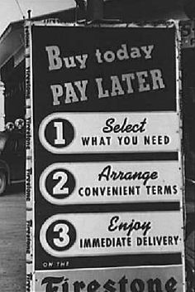
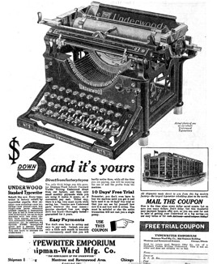
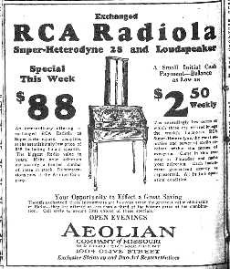
5.2 The Impact of New Technology on Lifestyle in the 1920s
People were beginning to buy things on credit.
Farmers who wanted new machines.
Workers wanted cars.
Installment Plan: A debt that is to be paid in regular periods with interest.
Notes:
electricity, cars, telephones and appliances.

Slide 11
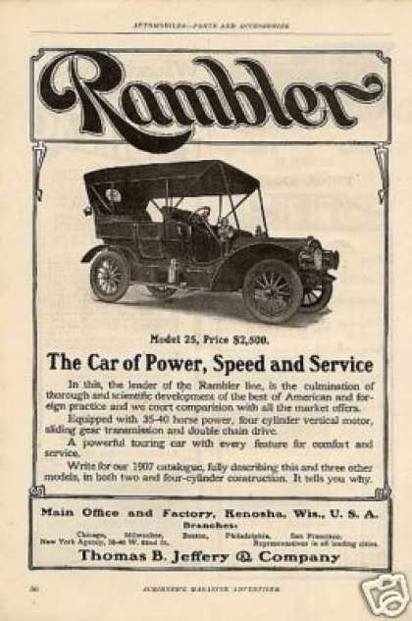
5.2 The Impact of New Technology on Lifestyle in the 1920s
Cars:
In 1923 a Ford cost $440
Cars made travel easier.
City dwellers could now enjoy the country
Country dwellers could now visit the city to shop

Slide 12
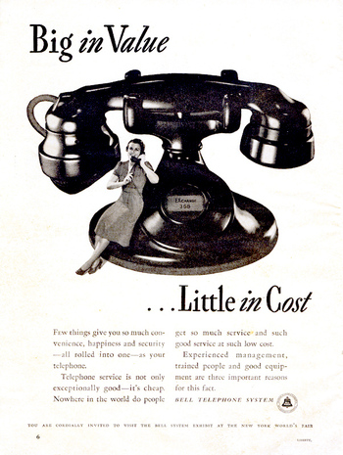
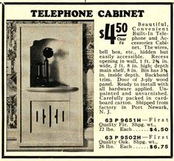
5.2 The Impact of New Technology on Lifestyle in the 1920s
Telephones:
By 1920 ¾ of Canadian families had telephones
Telephones enabled people from different areas around the country to communicate instantly

Slide 13
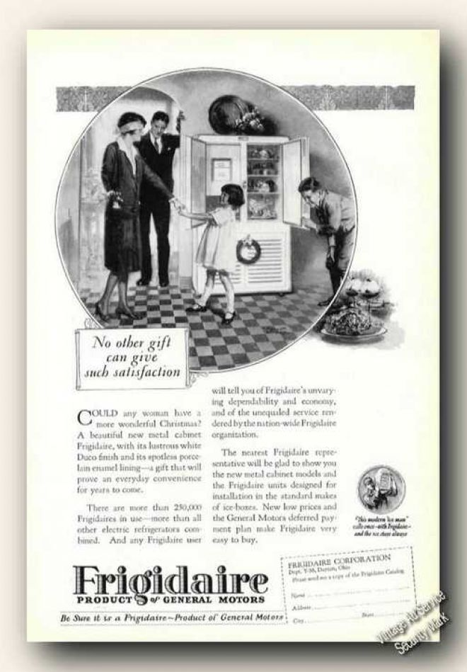
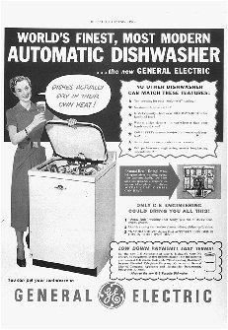
5.2 The Impact of New Technology on Lifestyle in the 1920s
Electric Appliances:
Monthly payments and layaway plans made new products available to many Canadians
Advertisements also persuaded many Canadians to buy appliances.

Slide 14
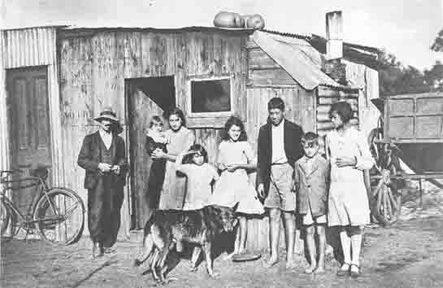
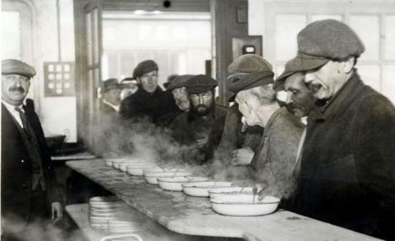
5.2 The Impact of New Technology on Lifestyle in the 1920s
Not all Canadians benefited from the prosperity of the 1920’s
The Working Poor:
Rural families with little money would trade to meet their basic needs
In cities the poor struggled to meet their daily needs.

Slide 15
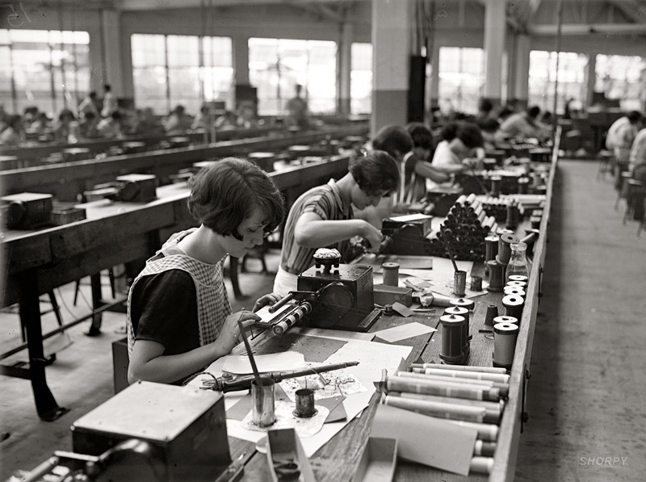
5.2 The Impact of New Technology on Lifestyle in the 1920s
Women:
Most women lost the jobs they held during the First World War to men as they returned.
Most girls left school by the age of 8
Only 16% of university graduates were women in 1920.
Women were paid far less than men for equal work.
Video

Slide 16
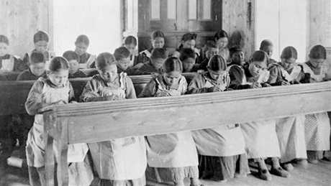
5.2 The Impact of New Technology on Lifestyle in the 1920s
First Nations, Inuit, and Metis:
The federal government hoped to assimilate these groups
Assimilate: To make become part of a larger group.
Residential schools were formed as a means of educating (assimilating) children aged 7-15
These schools forbid removed students from contacting their parents, speaking their native language, and practicing their cultural rituals.
Video

Slide 17
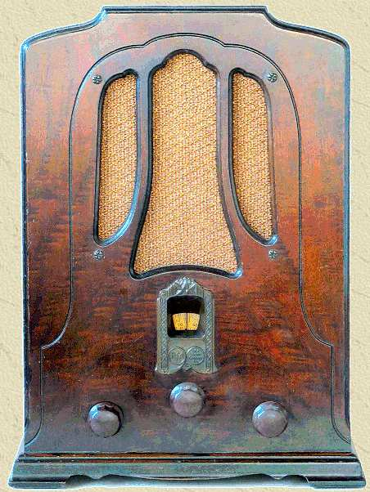
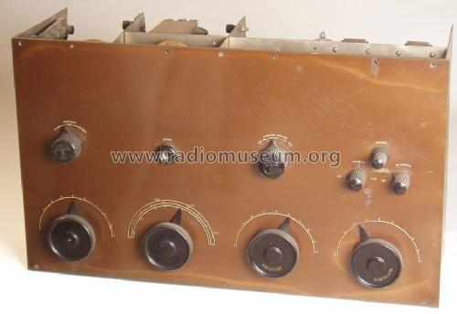
5.2 The Impact of New Technology on Lifestyle in the 1920s
Leisure
The invention of radio and motion pictures enhanced leisure activities.
1925 – 1st electric radio invented

Slide 18
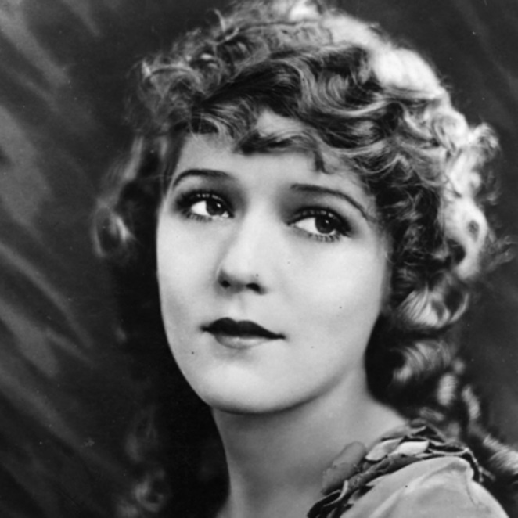
5.2 The Impact of New Technology on Lifestyle in the 1920s
Leisure
Radio popularized jazz music
1920’s jazz
Silent movies also became popular:
Canadian Mary Pickford became very popular
“America’s Sweetheart”
Tess and the Storm Country

Slide 19
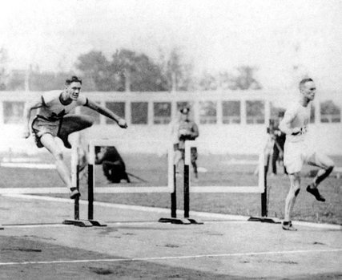
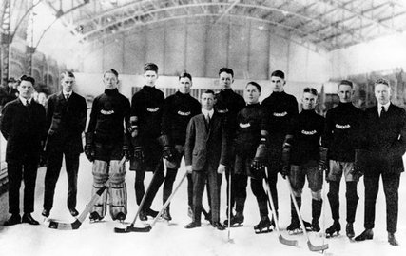
5.2 The Impact of New Technology on Lifestyle in the 1920s
Sports
1920’s were called Canada’s Golden Age of Sports.
Shorter working hours and more money gave Canadians more free time to play and watch sports.
Racing, rowing, swimming were popular sports.
Hockey was most popular across Canada. Hockey Night in Canada on Saturday night became a cultural icon

Slide 20
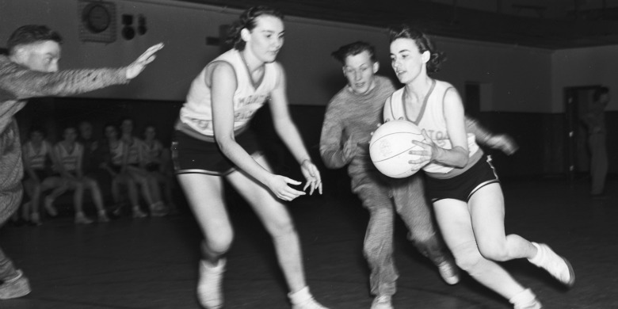
5.2 The Impact of New Technology on Lifestyle in the 1920s
1928 women competed in Olympics in track and field. Canadian women’s relay team won gold in 400m relay.
Edmonton Grads won basketball championship 17 years in a row. Women’s rules were different from the men. It was considered unhealthy for women to exert themselves as much as men.

Slide 21
5.2 The Impact of New Technology on Lifestyle in the 1920s
Changing and Conflicting Attitudes
Nightclubs became popular
Dancing, drinking, live music.
These attitudes reflected a country that was beginning to relax after a very tense period
Flappers: Group of young urban women who rebelled against cultural norms in dress and behavior.
Many people found the flappers behavior offensive.
Flappers dance the Charleston

Slide 22
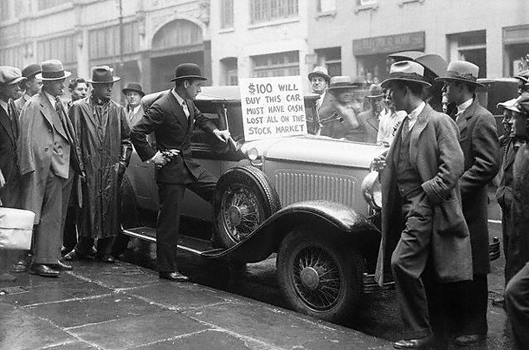
5.3 Causes of the Great Depression
The Stock-Market Crash
On Tuesday, Oct 29th, 1929, New York’s stock market crashed. This was called Black Tuesday
This was the beginning of the Great Depression

Slide 23
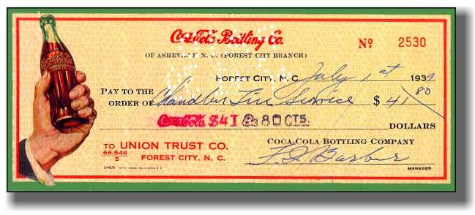
5.3 Causes of the Great Depression
A stock is a share in the ownership of a company.
Companies sold stocks to expand or develop new products. In return a person received a dividend or share in the company’s profit.

Slide 24
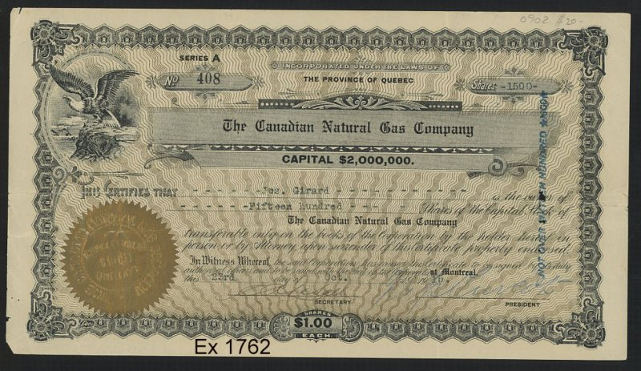

Slide 25
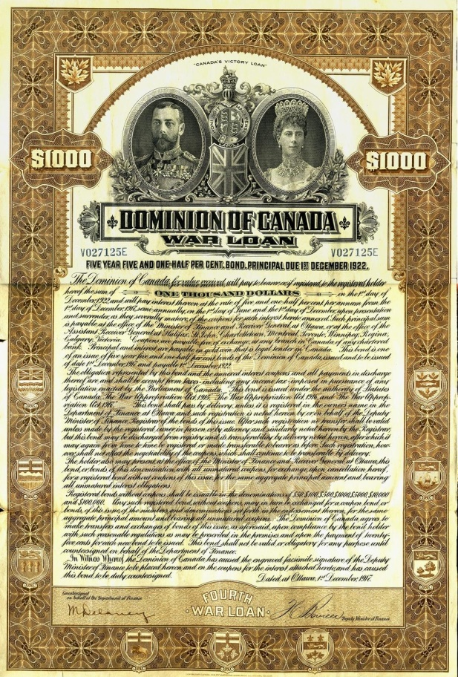
5.3 Causes of the Great Depression
During the first world war Canadians were encouraged to by Victory Bonds
Victory Bonds: Guaranteed certificates that were used to raise money for the war, and after the war were cashed in for interest.
By encouraging citizens to purchase victory bonds the Canadian government led the way for people to continue investing in other companies in the 1920’s

Slide 26
5.3 Causes of the Great Depression
While times were good people ignored the risk of investing
Many people invested all of the money they had.
On Thursday October 24, 1929 stock prices began to fall
The following Tuesday October 29,1929 is known as Black Tuesday.
Investors tried to sell all of their shares to avoid losing even more money
The market crashed.
The Great Depression begins

Slide 27
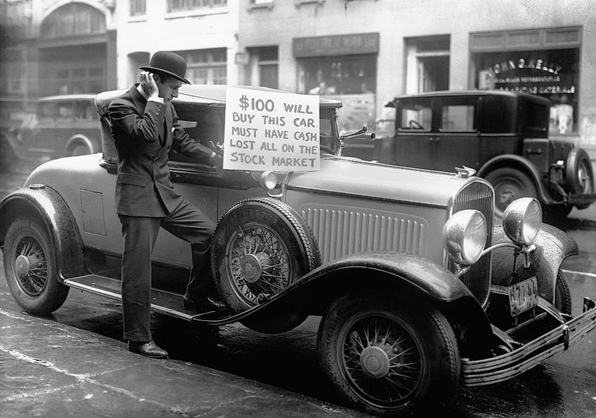
October 29,1929 - Black Tuesday.
The Great Depression Begins

Slide 28
5.3 Causes of the Great Depression
The Roots of The Depression
Spending and buying habits of the 1920’s
Credit was easy to get.
Canadians bought more manufactured goods.
Companies had to sell stock to expand quickly.
People became greedy and purchased more than they could afford.
People even bought stocks on credit.

Slide 29
5.3 Causes of the Great Depression
The Roots of The Depression
2. Manufacturing Practices
Manufacturers produced more goods than customers wanted
Surplus goods were stockpiled in warehouses
Wheat and grains from the prairies were treated the same.
When the economy slowed down the surplus goods could not be sold

Slide 30
5.3 Causes of the Great Depression
The Roots of The Depression
3. Close economic ties with the United States
Canada relied heavily on exports to the United States.
When the economy in the U.S. slowed trade decreased
American investors also closed up branch plants that caused thousands of employees to lose their jobs.

Slide 31
5.3 Causes of the Great Depression
The Roots of The Depression
4. Heavy reliance on global exports
As the depression began global demand for Canadian goods decreased
Wheat, lumber, newsprint, minerals all lost markets
This devastated the Canadian economy

Slide 32
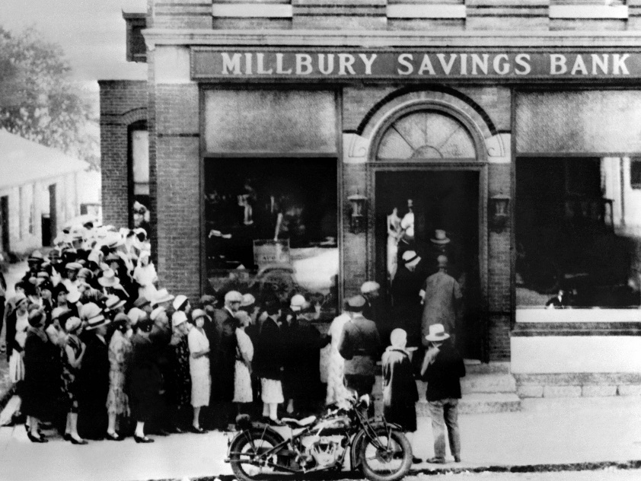
5.3 Causes of the Great Depression
The Roots of The Depression
5. Lack of regulations on Financial Institutions
Banks were not regulated like they are today
When they were forced to close anyone with money in the bank lost it.
6. Debt load and unemployment
As companies laid off workers they could not afford to pay their debts.
Companies in turn were not paid for products purchased on credit.
They had to lay off more workers to cover losses.

Slide 33
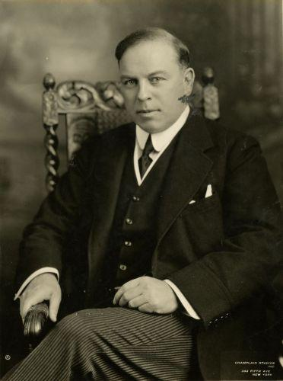
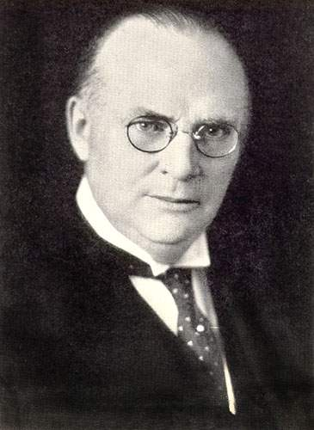
5.4 Effects of the Great Depression
Failing Economic Policies:
In 1929 the Prime Minister of Canada is Mackenzie King
He believes the depression is temporary and does very little to fix it
In 1930 he is defeated in an election by R.B Bennett
Bennett invests in Public Relief and Public Works
Public Relief: Welfare programs
Public Works: Road and bridge programs intended to get people working
He is unable to reduce tariffs with the U.S so exports continue to suffer
He tries to fix the depression with a balanced budget
This does not work
Mackenzie King
Bennett

Slide 34
5.4 Effects of the Great Depression
Social Conditions
Unemployment ruined lives
Most effected
Small business owners, unskilled labourers, farmers, young people
Discrimination and prejudice increased
Women, minorities, immigrants, First Nations all found it hard to find work, or lost the jobs they had
Luxurairies disappeared
Homelessness increased
No Medicare, no unemployment insurance, no child tax benefit… they were not invented yet

Slide 35
5.4 Effects of the Great Depression
Escaping the hard times:
Children often found simple homemade fun
Big band music was popular
Bing Crosby: Oh Brother Can you Spare a Dime?
Movies with colour and sound began to offer people escape
Movie clip

Slide 36
5.4 Effects of the Great Depression
Political Changes
Canadians came to believe that the traditional political parties could not solve the depression they started to look to new ideas
Communist Party: All people should have an equal share in societies prosperity.
Co-operative Commonwealth Federation: A coalition of farmers, labour leaders, and university professors who believed in public ownership not private.
Social Credit Party: Solve the Depression by giving everyone $25 to buy things.
Union Nationale Party of Quebec: Proposed reforms to end unemployment

Slide 37
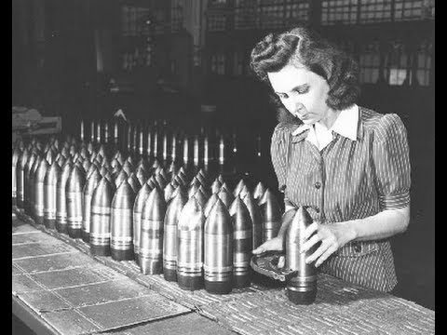
5.4 Effects of the Great Depression
The end of the Great Depression
Political policies did not end the depression
Economic conditions gradually improved as the 1930’s wore on
The Second World War was the event that ends the Great Depression.

