Slide 1
Chapter 9
Post- War Technology

Slide 2
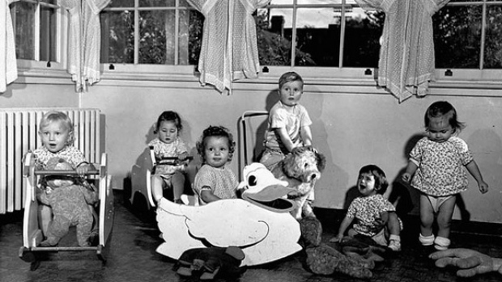
9.1 Technology and Lifestyle
Social and Economic Conditions in Canada:
Canada’s expanded role in Global affairs is due mostly to a strong economy
Many Canadians experience prosperity after the war
New technologies caused increased manufacturing and Industrial growth
The population and economy grew
These trends continued throughout the 1960’s and 1970’s

Slide 3
9.1 Technology and Lifestyle
The government is able to provide social security programs
Social Security: Social Insurance to protect citizens in time of need
Family allowance: Paid money to mothers so they would have cash to spend
Unemployment Insurance
Old-Age Pension
The goal of these programs is to protect from economic disasters like the Great depression

Slide 4
9.1 Technology and Lifestyle
Not all Canadians were able to be prosperous
25% of Canadians still lived in poverty (even with the Programs)
Regional Disparity: Inequality between regions
Canada takes on a regional disparity, where some areas are doing better economically and Socially than others
To deal with this Canada starts to pay equalization payments to areas with lower than average incomes
Equalization Payment: A payment made by the federal government to balance revenues among the provinces

Slide 5
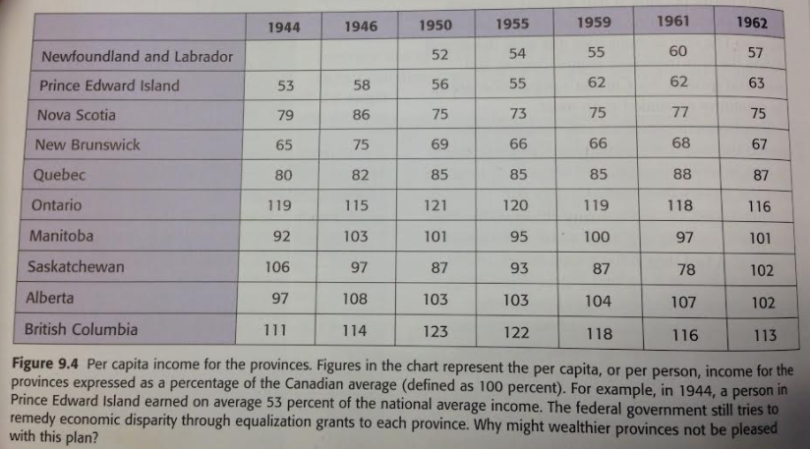
Regional Disparity

Slide 6
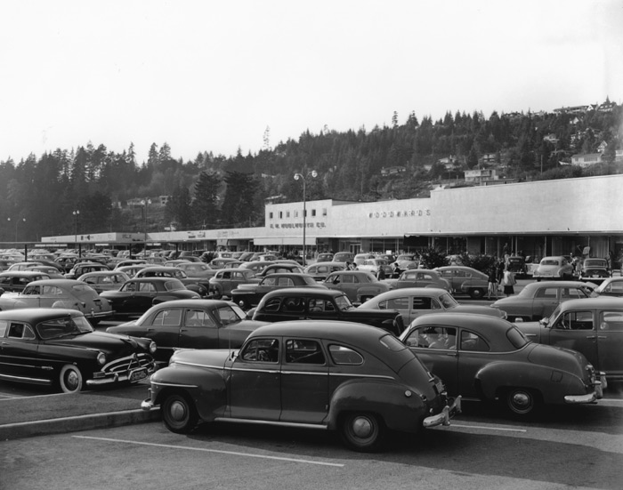
9.1 Technology and Lifestyle
Changes in Technology:
Transportation:
After World War 2 Cars became more popular as they were more affordable
The increase in the number of Cars caused major changes to cities
Paved roads
Bigger highways
Trucking jobs
the government passes the Trans-Canada Highway Act in 1949 promising a highway to connect St. Johns Nl, to Victoria BC
The project costs $1.4 billion and takes 13 years (finished in 62’)

Slide 7
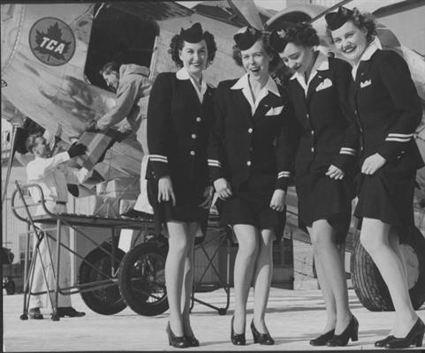
Transportation:
Railway
Diesel locomotives replaced traditional steam powered trains
Air
After world War 2 Commercial air travel became more popular
Air freight became more efficient bringing goods, services, and technology to more remote communities

Slide 8
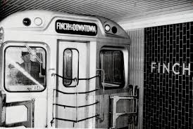
9.1 Technology and Lifestyle
Increased demand for better transportation and improved technology led to several major projects:
First Sub Way: Toronto 1954
Canso Causeway Nova Scotia 1955
Angus l. Macdonald Bridge Nova Scotia 1959
St. Lawrence Seaway, 1959

Slide 9
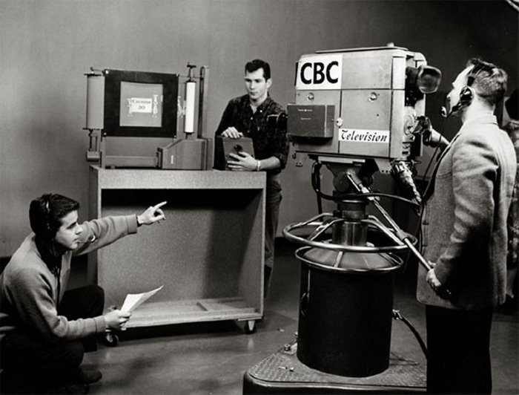
9.1 Technology and Lifestyle
Electricity, Television, and Telephone
Between 1930 and 1950 Electricity was expanded in Canada
Cbc began broadcasting on television in 1952
By 1962 85% of Canadians could watch cbc
In 1961 ctv begins broadcasting
Television brought Canadians together to watch
Television brought storytellers into Canadian homes
Telephones became common in the 1950’s
Several homes would be connected by one party line (eavesdropping)

Slide 10
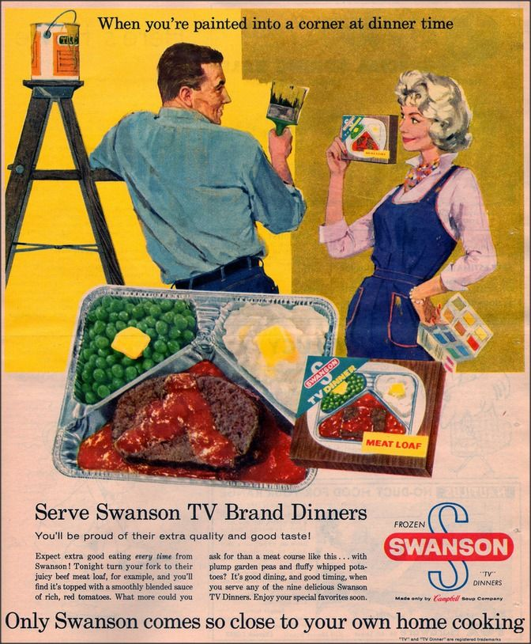
9.1 Technology and Lifestyle
Labour SAVING Devices
Innovation in areas such as plastics, synthetics, and electronics improved the affordability of products.
Disposable tissues
Hair Spray
Wash and Wear Clothing
Power Lawn Mowers
Electric Toasters
Cake Mixes
Instant Coffee
T.V. dinners
Automatic Washers and Dryers

Slide 11
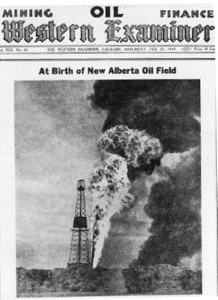
9.1 Technology and Lifestyle
Technological Change At Work
Technology enabled expansion in the mining industry
Developments in the oil and gas industry helps Alberta become the oil capital of Canada
Many new Hydroelectric programs brought electricity to new parts of Canada

Slide 12
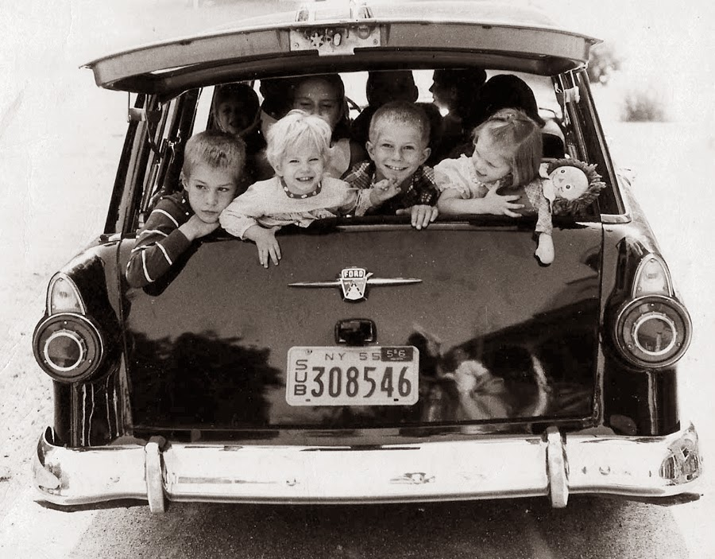
9.2 Attitudes and Values
A changing Society
Baby Boomers: Children born after the war
Marriage rates increase rapidly between 1945-1949
Population increases quickly
Canada brings in immigrants due to the strong economy

Slide 13
9.2 Attitudes and Values
Images of the Times
Home and family are the most important aspects of life
People want to forget the great depression
They buy homes and begin suburban life
The idea of the perfect family as one where the father works and mother stays home and cares for the house and children
This ideal was common in the media “leave it to Beaver”

Slide 14
9.2 Attitudes and Values
Advertising:
Television opens children up as a new target for advertisers
The "perfect family” requires
Toys
Bicycles
Children’s products

Slide 15
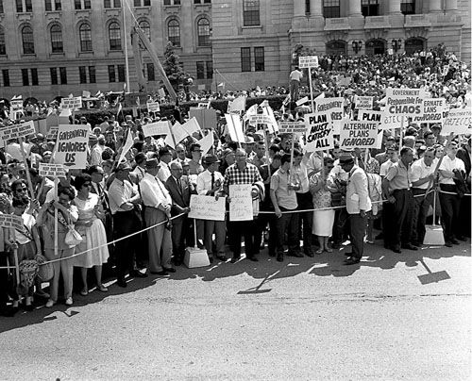
9.2 Attitudes and Values
Social Programs:
People wanted more comfort and benefits
School leaving age increased to 16 years old (twice what it was)
Health insurance programs were introduced in the 1950’s
This became Canada wide Medicare in 1971

