Slide 1
Unit 2: The Ecozone Jigsaw
Canadian Geography 1202

Slide 2
Ecozones
Ecozone: A region based on a combination of natural and human characteristics that are similar throughout.
Canada is divided into 20 ecozones
15 Terrestrial (land regions)
5 marine (ocean regions)
Geographers break Canada up into ecozones to help discuss Canada’s rich diversity
Without any one ecozone Canada is incomplete

Slide 3
Ecozones
Habitat: the natural environment in which something lives
Ecozones indicate the habitat of the plants and animals within them
Ecology: the study of the interactions of living things with one another and with the non living parts of the environment.
Ecologists and geographers use ecozones to study the interactions within a ecosystem.
Eg. How sunlight, and precipitation are related to the life in the forest.

Slide 4
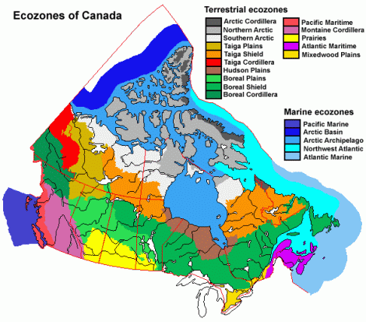
Canada’s Ecozones

Slide 5
Characteristics of Ecozones
Ecozones are multi-factor regions.
Multi-Factor Region: An area that is based on a combination of natural and human features that are the same throughout.
Some of the factors that are used to describe ecozones include:
Geology | Landforms | Wildlife | Humans
Climate | Soil | Natural Vegetation | Water

Slide 6
Are Ecozones Useful?
Ecozones help geographers organize their research.
Through looking at how all of the characteristics of an ecozone work together geographers are able to use systems thinking to address problems.
Ecozones are used by many government and non government agencies to study regions.
Ecozones can be used for everything from planning for resource extraction to managing pollution.

Slide 7
Humans And Ecozones
People affect nature and can affect it in different ways-this is why ecozones include humans and their activities
Humans are accelerating the pace of change in ecozones
Humans cause serious and sometimes irreversible damage. (smoggy air, polluted water, disappearing forests and animals, collapse of fisheries)

Slide 8
Biodiversity
Biodiversity: The diversity of species of life on earth.
Ecozones display biodiversity, they are all different.
Some are more diverse than others.
Observing the different species that occur in various ecozones provides a lot of information as to what is happening within the boundaries.

Slide 9
Separating Ecozones
Boundaries: Lines drawn on a map that separate one feature from another
The change from one ecozone to another is a gradual one.
When you see a boundary on a map of ecozones it acutally marks a transition zone
Transition Zone: Where the characteristics of one feature gradually blend into those of the next

Slide 10
Activity:
Complete questions 1-5 on page 105
Complete these questions and be prepare to discuss in class next day.

