Slide 1
Expository Essay

Slide 2
Video
Watch the following video

Slide 3
What is an expository essay?
The expository essay is a genre of essay that requires you to:
investigate an idea
evaluate evidence
Explain in detail the idea
Set forth an argument in a clear and concise manner.
This can be accomplished through comparison and contrast, definition, example, the analysis of cause and effect, etc.

Slide 4
Forms of Expository Essay
An expository essay can take on many forms
Comparison and contrast
Definition
Example
Cause and effect.

Slide 5
Structure of Expository Essays
Introduction:
Must contain a clear, concise, and defined thesis statement that occurs in the first paragraph of the essay.
The thesis statement needs to be focused and address the guidelines of the assignment.
The strength of the introductory paragraph determines how strong the essay will be.

Slide 6
Structure of Expository Essays
Body Paragraphs
In an expository essay the body paragraphs contain the evidence you use to support your thesis.
Each paragraph should be connected to the thesis in the opening of the paragraph.
Each paragraph should be limited to one idea.
By doing this it creates a clear direction in the essay, and makes it easier to read and understand.
The evidence that is used in the body paragraphs should be either:
Factual
Logical
Statistical
Anecdotal (Only if writing with little preparation)

Slide 7
Structure of Expository Essays
Conclusion:
This part of the essay often has a lasting impression on the reader
It is important to link all information presented in a logical way.
NO NEW INFORMATION IN THE CONCLUSION
The conclusion should address the thesis, and provide a final statement as that supports it.

Slide 8
Creativity
Expository essays are formal essays.
Formal Essay: A piece of writing that informs or persuades its audience
Formal essays generally stick to formal language.
However creative writing should still be attempted within this framework.
You should try to leave the reader with a lasting impression of your thesis, achieved through the use of formal structure supplemented with some creativity.

Slide 9
Exposition and Arguments
You can think of an expository essay as a conversation or debate.
There is a definite beginning, middle, and end.
It should flow logically from point to point.
Every point should be finished before the next one is made.
It must be complete, leaving no doubt of the thesis

Slide 10
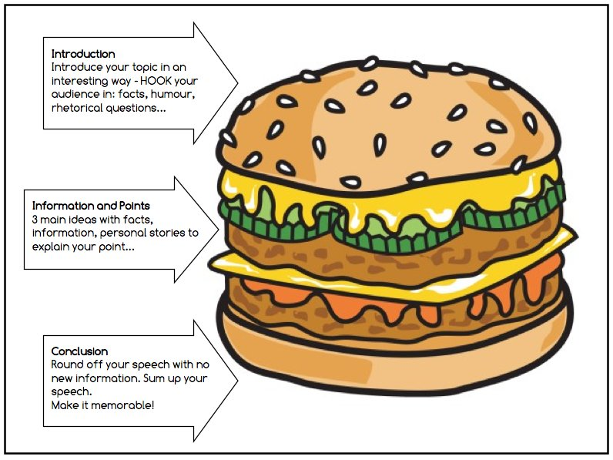
The Five Paragraph Essay
The most common method for writing an expository essay is a five-paragraph approach.
This is the most straightforward method
It consists of:
An introductory paragraph
Three evidentiary body paragraphs
A conclusion

