Slide 1
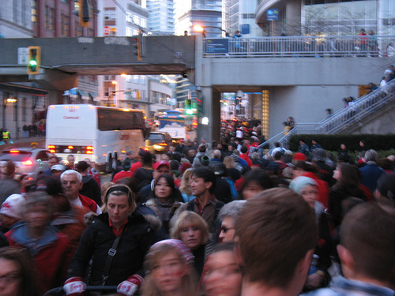
Canadian Geography 1202
Unit 2: Human Population Issues in Canadian Geography

Slide 3
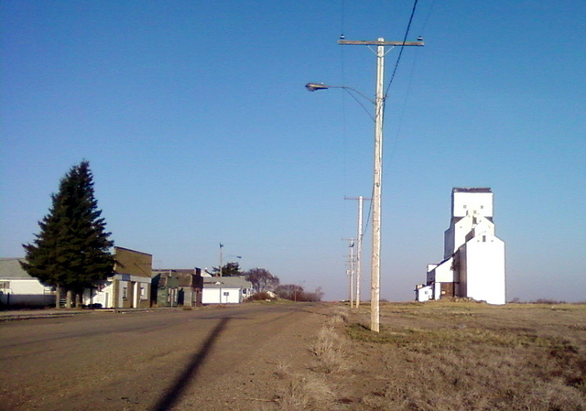
Canadian Geography 1202
3.0 Demographic Patterns and Trends in Canada

Slide 4
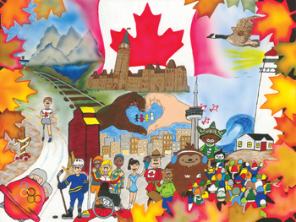
Canada’s Population
Population: The measure of the number of people living in a specific
place
Canada’s population is 33.5 million people
This is less than 1% of total world population
Canada’s population is known for its diversity
Diversity: A variety of different things
The people that make up the Canada come from all over the world

Slide 5
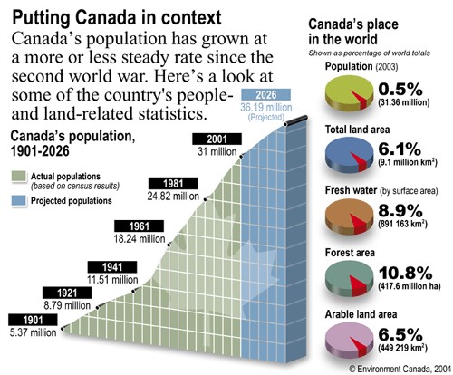

Slide 6
Demography
Demography – the numerical study of the characteristics,
trends, and issues of population.
We will examine:
Population Change
Population Dynamics
Population Trends

Slide 7
Demography
We study demography to determine the needs of Canadian society
How many schools will we need?
How many hospitals do we need?
Where should we put an old age home?
We study demography to help us plan for the future needs of
society
Do we need more workers?

Slide 8
Population Change
To study population change we look at four factors:
1. Deaths
2. Births
3. Emigration
4. Immigration

Slide 9
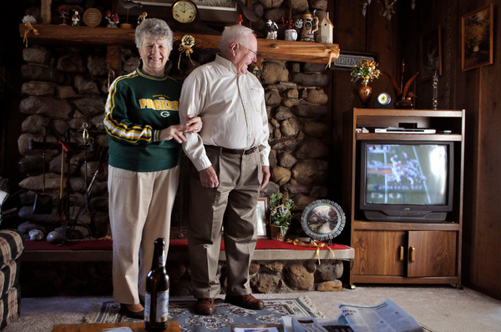
Population Change
There are two way we measure changes in populations
Natural Change
Actual Change

Slide 10
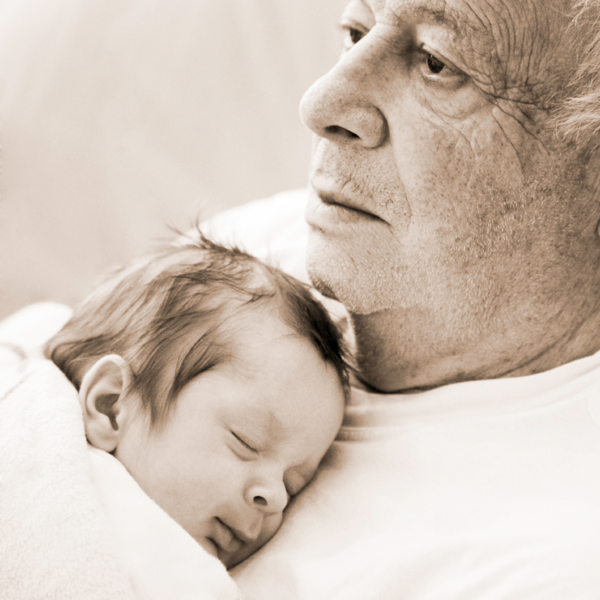
Natural Change
Natural Change: The change of population due to natural causes.
Formula:
Natural Change= Births - Deaths
Example:
Births: 3000
Deaths: 2000
Natural Change = Births – Deaths
Natural Change = 3000 – 2000
Natural Change = 1000
The population grew by 1000 people

Slide 11
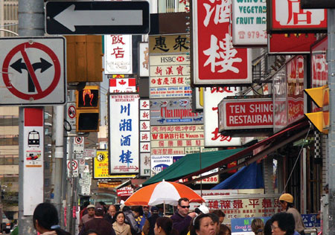
Immigration
Immigration: Moving into a country to live permanently
China town in Toronto is a good example of site where you
would find a lot of immigrants

Slide 12
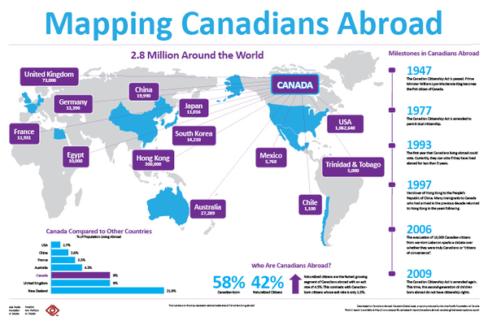
Emigration
Emigration: Leaving a country to live in another country
These are some popular destinations for Canadian emigrants

Slide 13
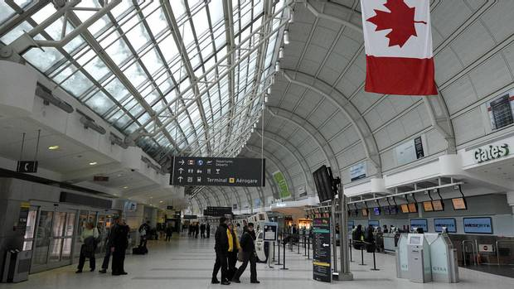
Actual Change
Actual Change: The population change due to natural change
and migration
Formula:
Actual Change = (Births - deaths) + ( Immigration - Emigration)
Births = 2000 Deaths = 500 Immigration=1000 Emigration = 1500
Actual Change = (Births - deaths) + ( Immigration - Emigration)
Actual Change = ( 2000 - 500) + (1000 - 1500)
Actual Change = (1500) + (-500)
Actual Change = 1000
The population grew by 1000 people

Slide 14
Birth Rate
Birth Rate: the number of children born in an area for every 1000
inhabitants
Canada has a birth rate of 11.3 children born for ever 1000 Canadians
The Canadian birth rate is the same as most other industrialized
countries
Formula:
$\frac{Number of live births}{Total Populaion}$ x 1000

Slide 15
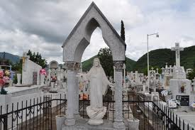
Death Rate
Death Rate: The number of people in a population that die for every
1000 inhabitants
Canada’s death rate is 7.3 deaths for every 1000 people
Formula:
$\frac{Number of Deaths}{Total Populaion}$ x 1000

Slide 16
Population Dynamics
Density
Distribution
Migration
Population pyramids;

Slide 17
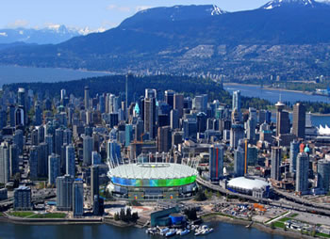
Population Density
Population density: A measure of how crowded a place is.
$$Population Density=\frac{Population}{Total Area \left({km}^{2}\right)}$$
Formula:
Overall Canada has a low population density of about 3 people
per ${km}^{2}$
However this is misleading because most of Canada’s population
is located in Cities along the boarder

Slide 18
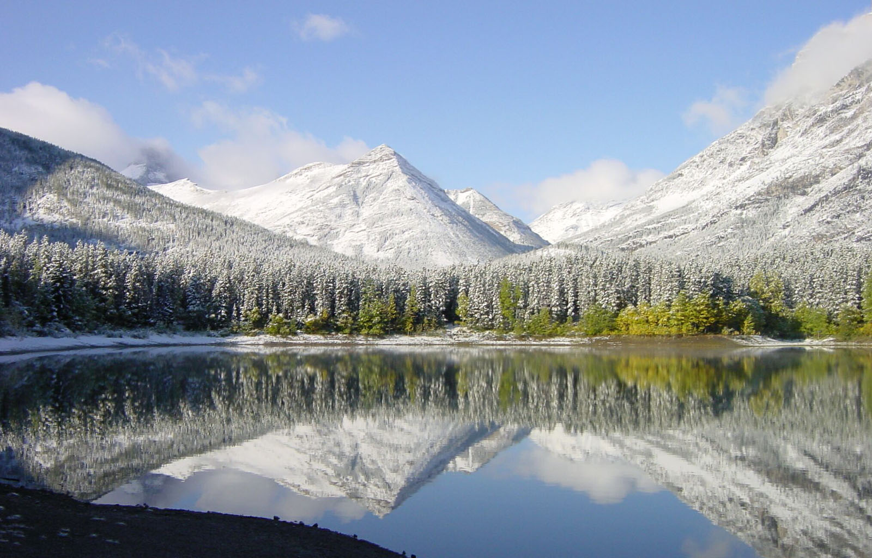
Talking about Density
Densely Populated: Large number of people per land
mass (>100)
Moderately Populated: Medium number of people per land
mass (10-100)
Sparsely Populated: low number of people per
land mass (0-10)

Slide 19
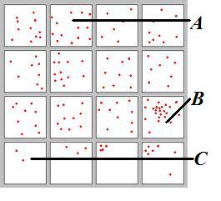
$$Population Density=\frac{Population}{Total Area \left({km}^{2}\right)}$$
$$Population Density=\frac{11 people}{1{km}^{2}}$$
$$Population Density=11 person per{ km}^{2}$$
$$Population Density=\frac{Population}{Total Area \left({km}^{2}\right)}$$
$$Population Density=\frac{50 People}{4{km}^{2}}$$
$$Population Density=12.5 person per{ km}^{2}$$
$$Population Density=\frac{Population}{Total Area \left({km}^{2}\right)}$$
$$Population Density=\frac{2 People}{1{km}^{2}}$$
$$Population Density=2 person per{ km}^{2}$$

Slide 20
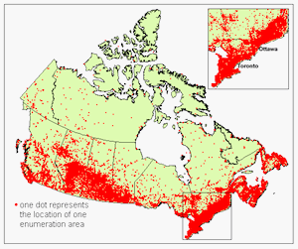

Slide 21
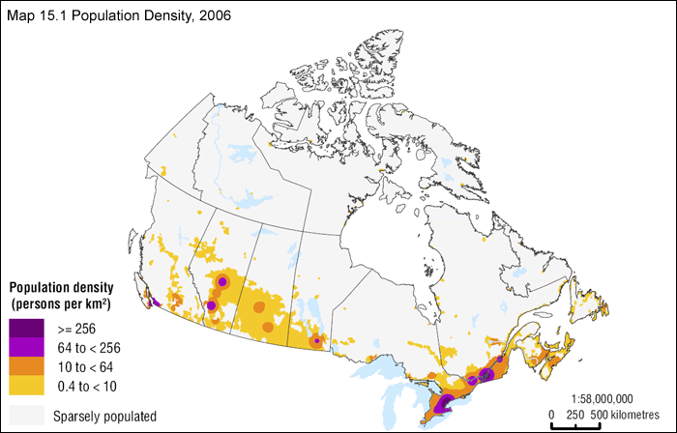

Slide 22
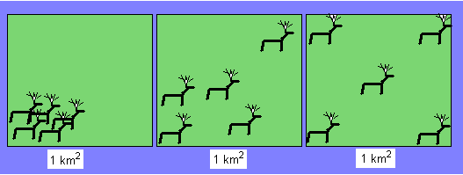
Problem!!!
Sometimes population density does
not allow you to describe a population
in useful ways
Look at these moose populations. They all have a density of five moose
per square kilometer but they are arranged in very different ways.
How can we describe them???
We will describe them by their distribution!

Slide 23
Population Distribution
Lets look at this population first:
It is all grouped in the lower corner of the area. We can say it is concentrated
Concentrated: Population is grouped into a small part of an area

Slide 24
Population Distribution
Now lets look at this population
We can see that it is spread out evenly over the entire area.
We can say that is dispersed
Dispersed: Population is spread out over an area

Slide 25
Population Distribution
Lastly we will talk about this one:
Well it is not concentrated…
and its not completely dispersed……
so how do we describe it???
We would say that this moose population is somewhat concentrated
We will have to look at it to see which it better represents!
Concentrated?
Dispersed?

Slide 26
Now lets look at Canada
How would you describe the population density?
Lets look at it like this:
How many of major cities in Canada are within 250 km of the U.S. boarder?
We could say that the Canadian population is mostly
concentrated near the United States boarder.

Slide 27
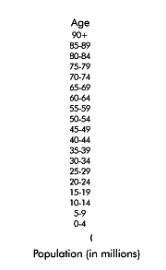
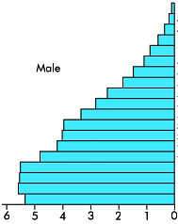
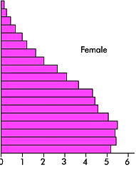
Population Pyramids
Population Pyramid: A graph that shows population by age group
Population pyramids are actually two bar graphs joined together
They show males on one side and females on the other.

Slide 28
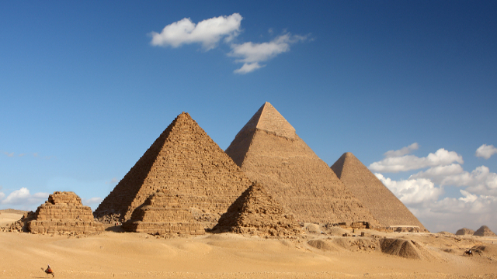
Population Pyramids
There are three general types:
Expanding
Stable
Contracting

Slide 29
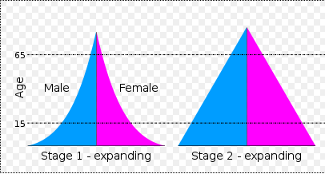
Population Pyramids
Expanding: Showing growing populations
Expanding pyramids can be broken down to include rapidly, and steady expanding
Expanding pyramids have wide bases
They show lots of children, suggesting a high birth rate
They also show a low life expectancy

Slide 30
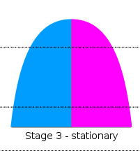
Population Pyramids
Stationary: These pyramids show a stable population, there is very
little growth.
Birth rates decline but life expectancy increases
These are common in developed countries

Slide 31
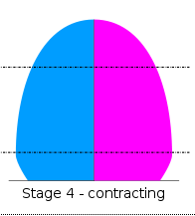
Population Pyramids
Contracting: Population pyramids that represent a population that is
shrinking
These pyramids are narrow at the bottom.
The population is older on average, with a long life expectancy but
also a low birth rate
Common in very developed countries, with
High education levels and access to birth
control and few negative environmental
factors.

Slide 32
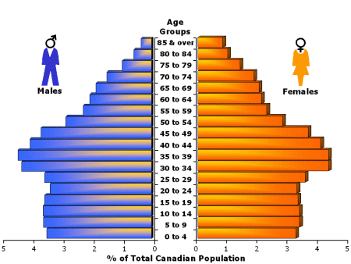
Canada’s Population Pyramid
Video
The population pyramid for Canada can be classified as stationary.
There is an anomaly in the bump that can be seen in the population aged 30-40
These are the children of the baby boom
Other than this bump all evidence points toward a stationary population pyramid
It is rectangular in shape leading up from the base with a peak at the top.

Slide 33
Migration
Push Factor: Conditions or situations that will cause a person to
leave their home country
War
Political Instability
Unemployment
Poor Living Conditions
Poor Economic Conditions
Pull Factor: Conditions or situations that will cause a person to
settle in one country or another
Employment Opportunities
Peaceful Society
Climate
Good Living Conditions
Attractive Culture

Slide 34
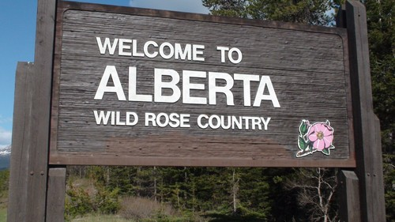
Migration in Canada
Migration happens within Canada, between the provinces
Each province has different push and pull factors
Over time these factors change causing different trends to be seen.
Out-migration: When people leave a province or territory
In-migration: When people move to line in a new province or territory

Slide 35
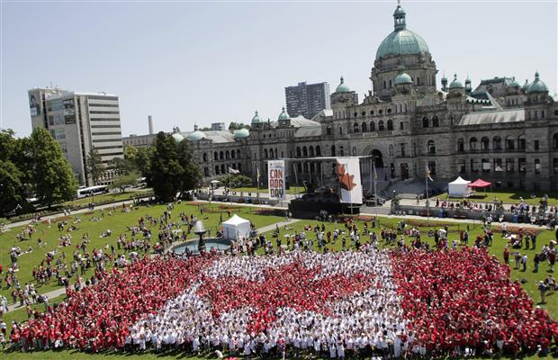
Population Trends
There are five Trends in Canada’s population that we will study in
this course:
• aging population;
• declining birth rate;
• shortages in workers in particular sectors of the economy;
• arrival of refugees; and
• population distribution.
In this section we will focus on analyzing data to identify
some of these trends

Slide 36
Population Trends: Aging Population
Aging Population: A population where the median age is rising.
Median is the middle number in an ordered data set
1 , 5 , 5 , 7 , 8 , 10, 12, 14, 16, 22, 35
The Canadian population is aging. In 2011, the median age in Canada was 39.9 years, meaning that half of the population was older than that and half was younger. In 1971, the median age was 26.2 years

Slide 37
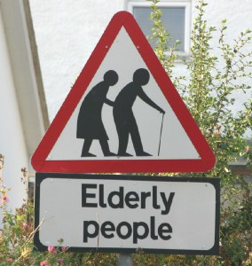
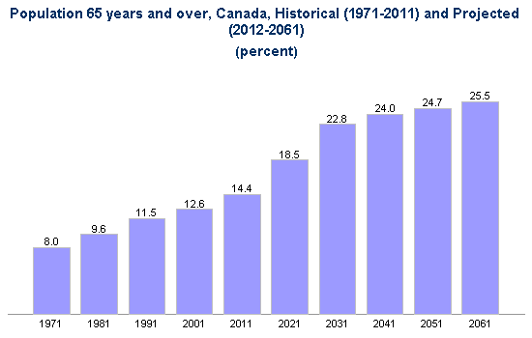
Population Trends: Aging Population
As the population of senior citizens increases the mean age of the Canadian population will
Increase unless there is a influx of young people
By 2061 it is predicted that 25.5% will be over 65 years old
This will cause a great deal of stress for todays systems

Slide 38
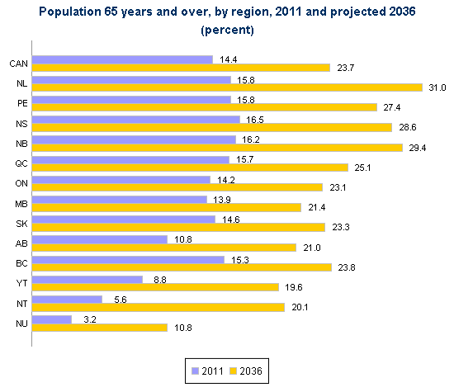
Population Trends: Aging Population
Canada’s aging population is highly regionalized
You can see this by looking at the population over age 65 in each province
The populations with the highest percentage of over 65 people are in NL, PEI, NS, and NB
All Atlantic Provinces!!!!!

Slide 39
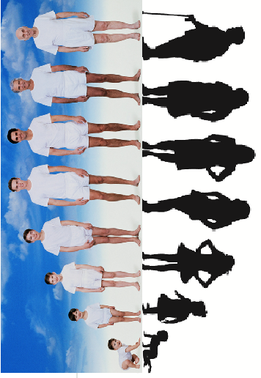

Slide 40
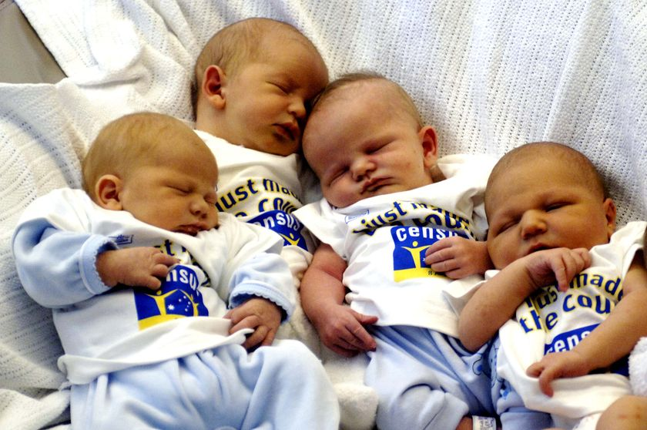
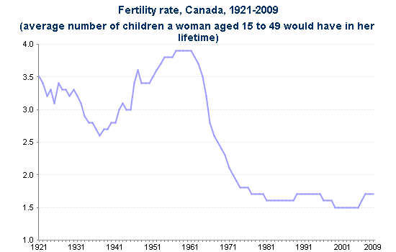
Population Trends: Declining Birth Rate
Birth rate refers to the amount of children born per 1000 people
in a population
If you look at individual averages the replacement rate is 2.1 children
per woman
Replacement Rate: The number at which a population will remain
stable, will not go up or down.

Slide 41
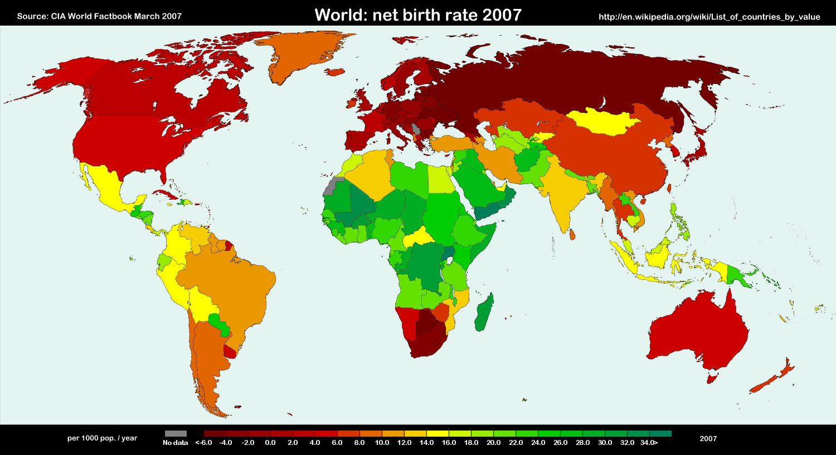
Population Trends: Declining Birth Rate
Since the 1970’s Canada has had a birth rate lower than the replacement rate
Higher education, a change in societal norms, and access to birth
control have all combined to produce this decrease in birth rate
When there are fewer people being born it causes stress on social systems as there will be nobody to pay for services in the future.
Lower birth rates reduce the actual change, and lower growth rates
To keep the country running The government needs to recruit people
from other areas of the world

Slide 42
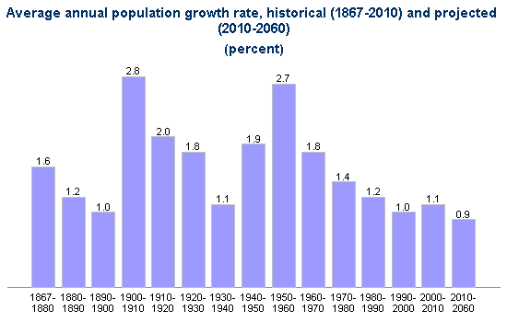
Note: From 1867 to 1901, the population count that was used to calculate population growth was that of April 1. From 1902 to 1970, the population count was that of June 1. From 1971 to present, the population count was that of July 1. The population of Newfoundland and Labrador is excluded before 1949

Slide 43
Worker Shortage
Canada has a shortage of skilled workers.
Skilled Worker: A worker who is trained to do a particular job that would not be able
to be Completed by someone without this training.
Mining, Business, and Health industries are all facing serious skilled worker shortages
The province with the greatest shortage is Alberta
Worker shortages stall economic growth

Slide 44
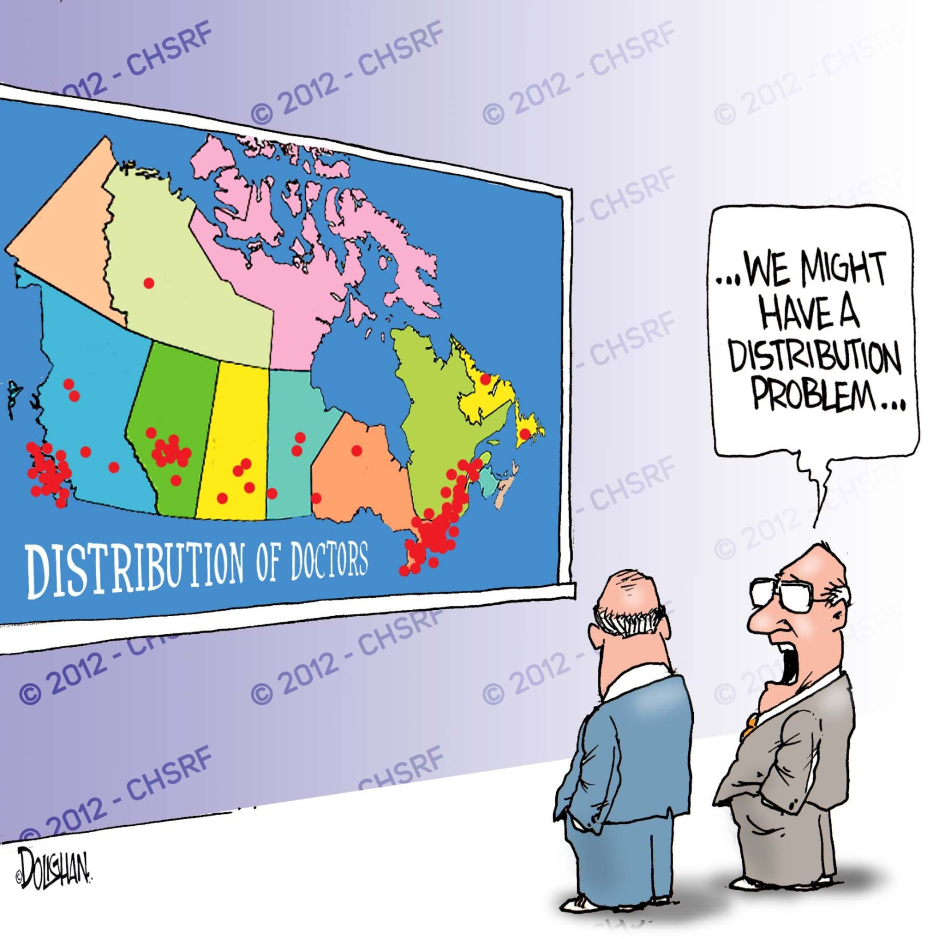
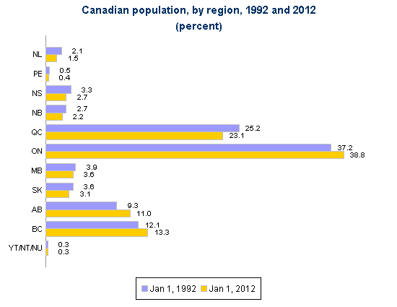
Population Distribution
Most of Canada’s population is concentrated in major urban areas
This creates islands of population in a vast sea of unpopulated areas

Slide 45
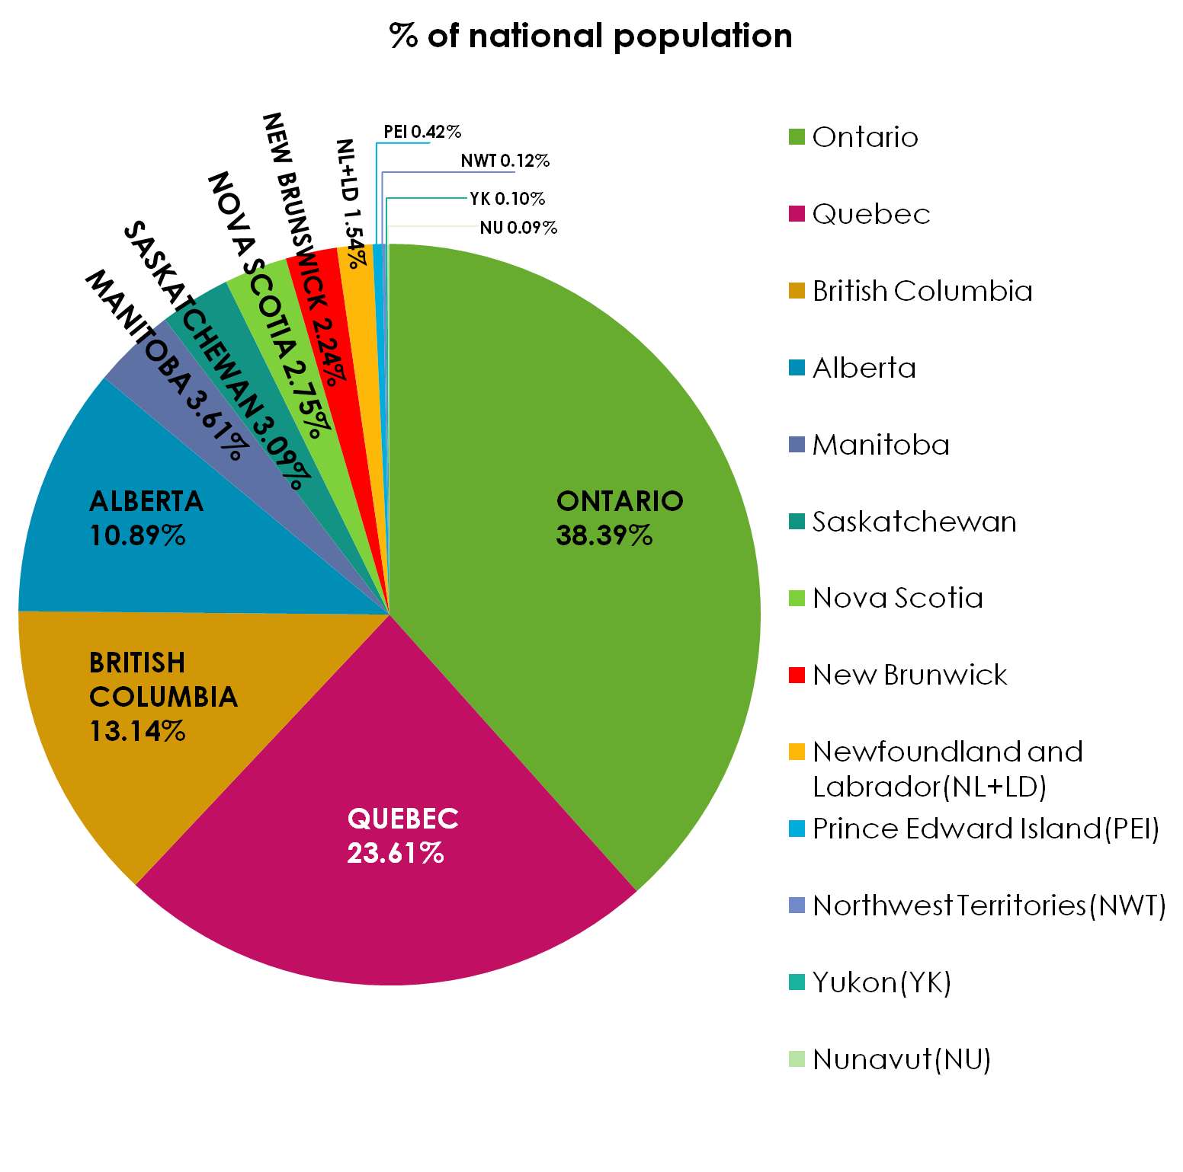
Population Distribution
Most of Canada’s population is concentrated in four provinces
Ontario has by far the largest percentage with almost 40% of all Canadians living there

Slide 46
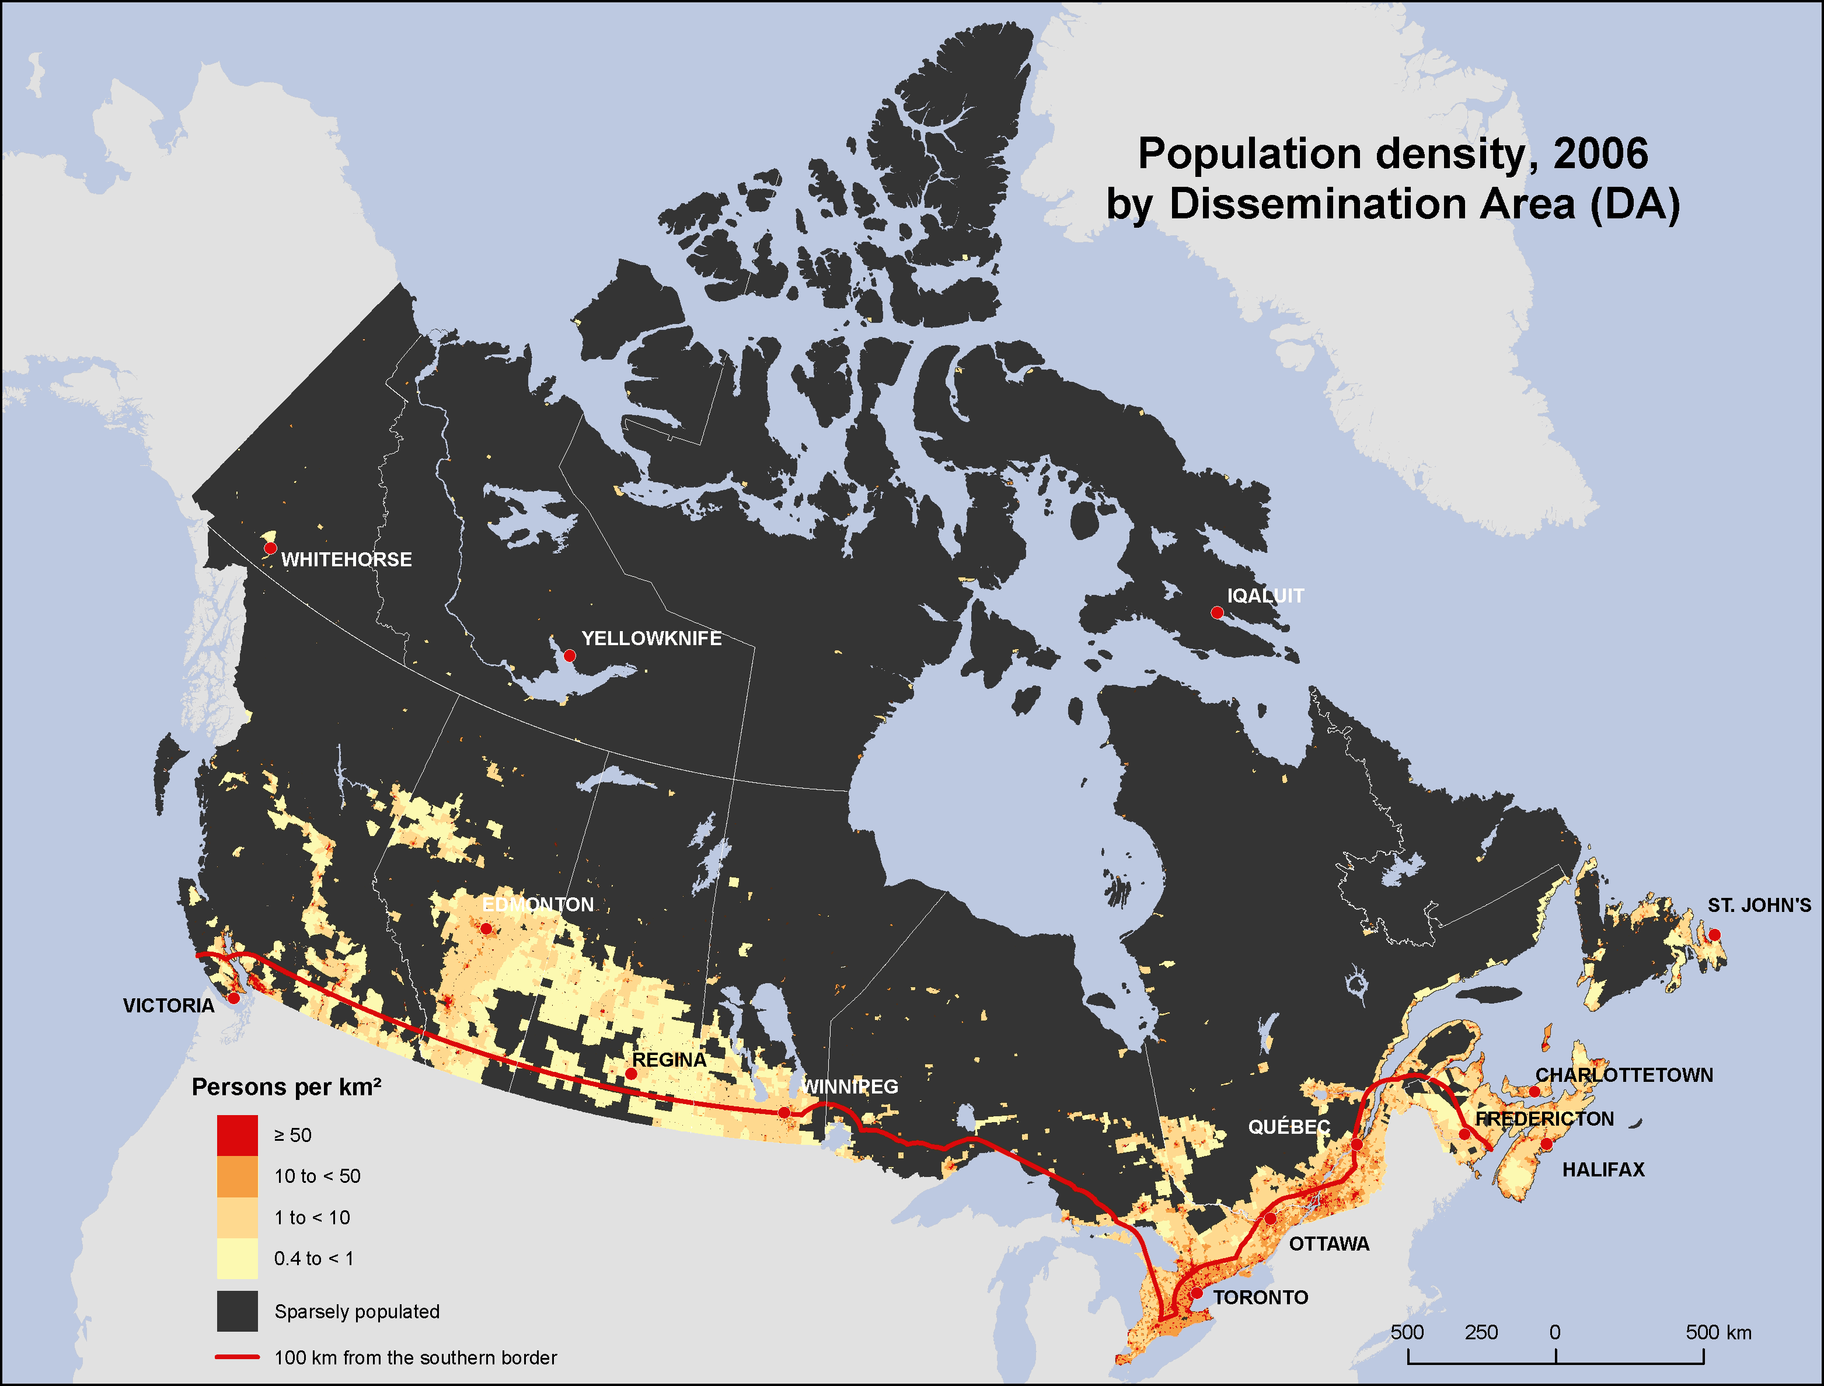
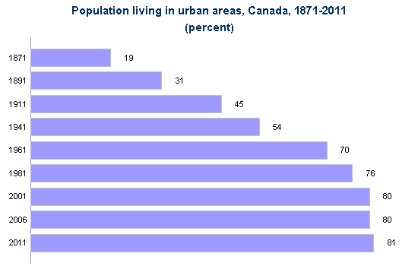
Population Distribution
An urban area is defined as an area with a population of at least 1,000 and with no fewer than 400 persons per square kilometre
Urbanization: The building up of populations in cities or urban areas
The portion of the population in Canada that lives in urban areas is increasing

Slide 47
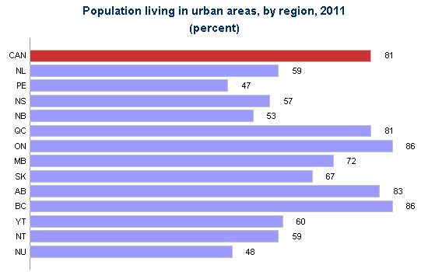
Population Distribution
Urban population varies depending on province
The provinces with the highest percentage living in urban areas are ON, BC, AB, QC
Notes:
Source: HRSDC calculation based on Statistics canada. Population and Dwelling Count Highlight Tables, 2011 Census. Available from: 2011 Census (accessed March 12, 2012).

Slide 48
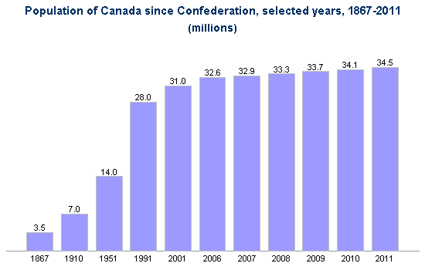
Note: The 1867 figure applies to April 1 of that year. From 1902 to 1970, the

Slide 49
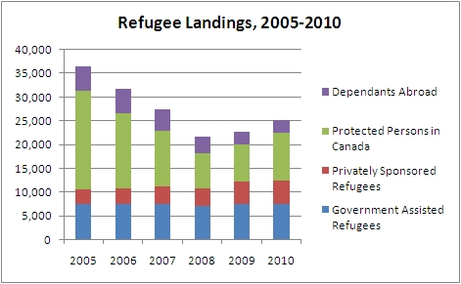
Arrival Refugees

Slide 50
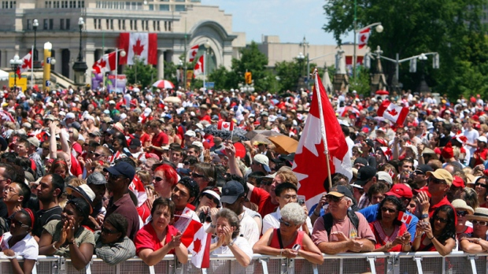
Canada’s Diversity
There were 5.6 million foreign born in Canada in 2001, representing 19 percent of the total population
The majority (41 percent) of all immigrants in Canada are from Europe
Over one-third of all immigrants in Canada are from Asia
Compared to the United states Canada has a higher percentage of
Immigrants from Africa

Slide 51
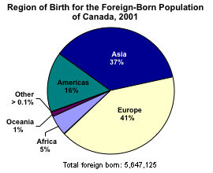

Slide 52
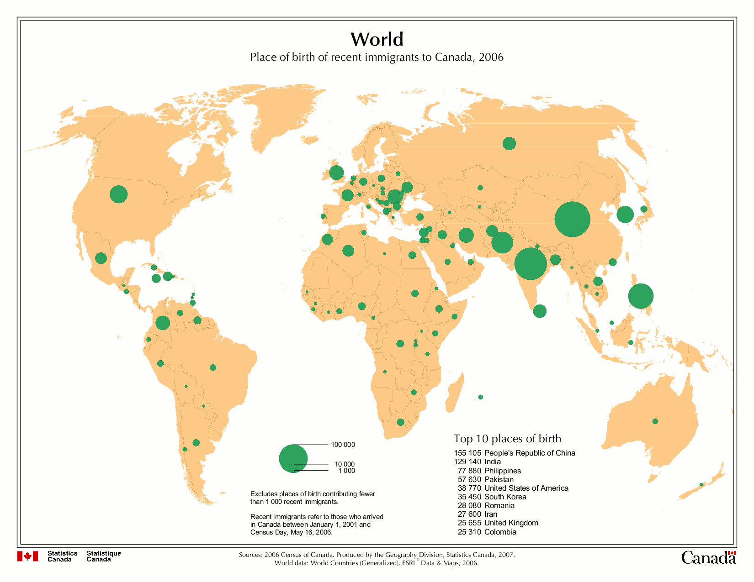

Slide 53
