Slide 2
Mining
Canada is known for its mineral wealth. For example, Canada produces more potash than any other country in the world, and 95% of it is mined in Saskatchewan.
Potash is rich in potassium, one of the three important nutrients needed for plant growth, so almost all the potash is used to make fertilizer. Potash is also used to make soap, animal food, medicines, and water softener.

Slide 3
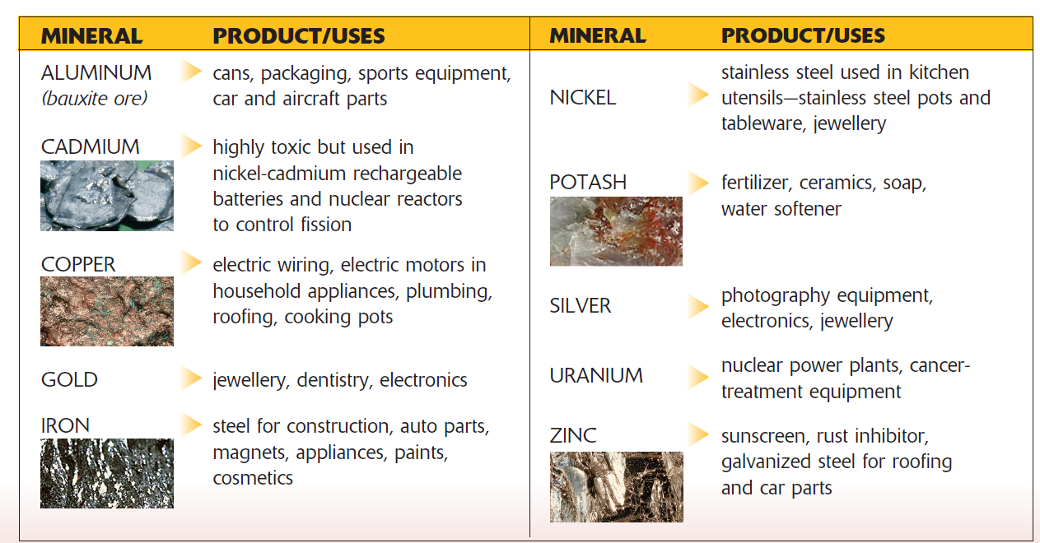
Types of Minerals
non-metallic minerals - a mineral, such as salt or potash, that is not a metal
metallic minerals - which are minerals that provide us with metals such as iron, nickel, and copper.

Slide 4
How do we find minerals?
All rocks contain minerals, but there are only a few places where the concentration of minerals is high enough to justify digging a mine.
Mining has become a knowledge-based industry that uses high-tech computer and satellite technology to explore and find the location of ore bodies, which are rocks that contain enough of a particular type of mineral to be worth developing a mine.
Magnetometers are carried by helicopter over potential mineral-bearing land to find small anomalies, or rock conditions that are different from the surrounding rock.

Slide 5
In the field
Despite all the high-technology equipment used to find minerals, prospectors and geologists must still go out “in the field” to:
  study maps and air photos
  collect rock and soil samples
  drill holes into the bedrock to bring up cores of rock, which are then examined to determine the amount of minerals in the ore
When looking for minerals, geologists need to know where certain types of rocks occur. They understand, for example, that metallic minerals are found in the igneous rocks of the Canadian Shield, while fossil fuel minerals, such as coal, oil, and natural gas, are found in the sedimentary rocks of western and Atlantic Canada.

Slide 6
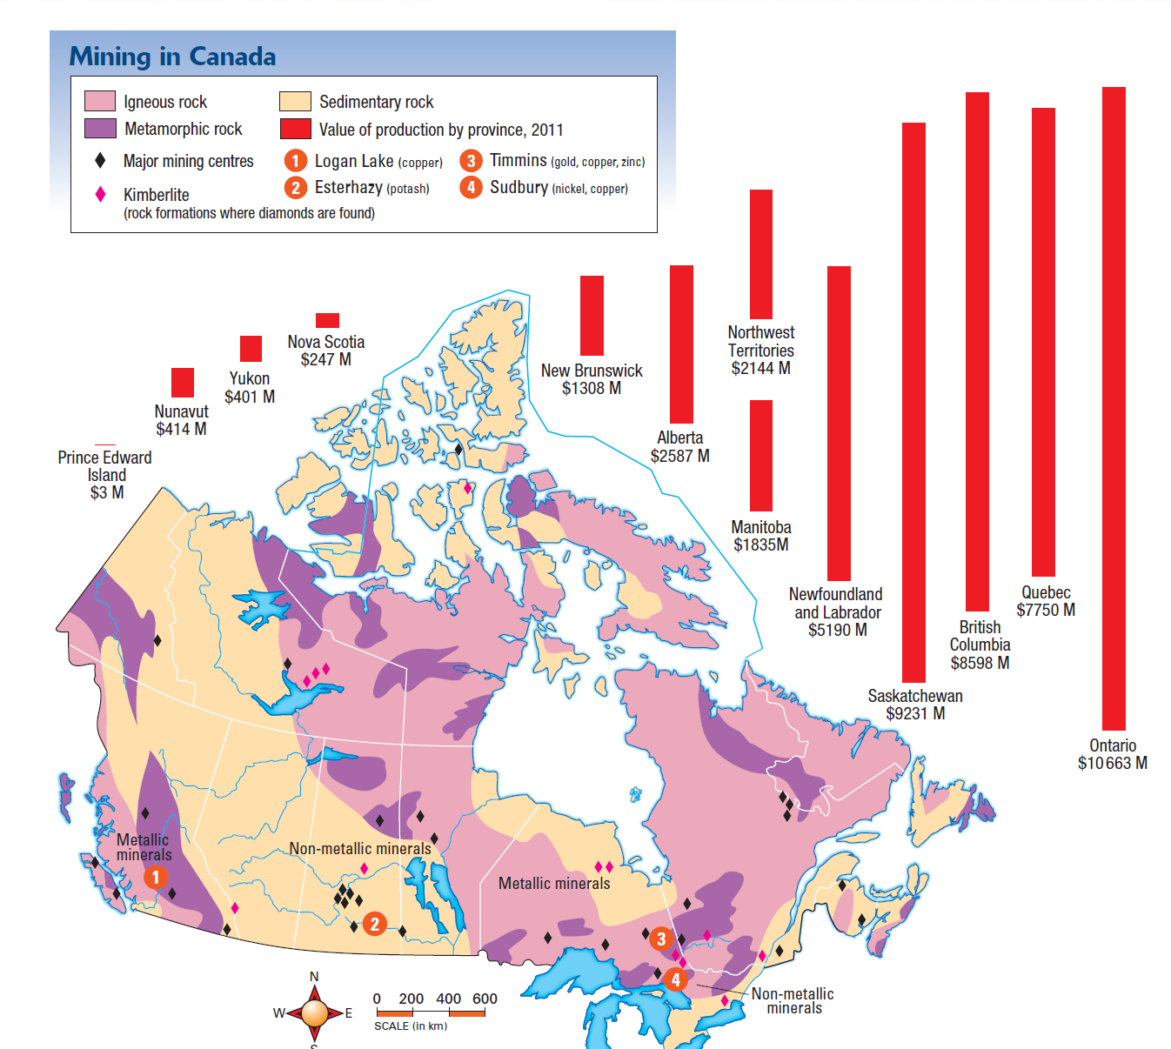

Slide 7
Mining Towns
The distribution of minerals across Canada has given rise to a number of single-industry resource towns such as Logan Lake, British Columbia. These towns are built primarily to provide workers who operate the mine with a place to live and with the services they need on a regular basis.
As long as the ore lasts or there is a boom in world markets, the town will thrive. Once the ore runs out, or the price of the mineral is too low to continue mining, the mine will close. This leaves the town with no economic base unless it diversifies its economy by encouraging other types of businesses.

Slide 8
Mining and the Economy
The four provinces of Ontario, Saskatchewan, British Columbia, and Quebec produce about 80% of the total value of Canada’s minerals. The mining industry plays an important role in the economy of Newfoundland and Labrador, representing 8.6% of the province’s total GDP. Nunavut, with its vast territory of Canadian Shield rock, is a prime location for future exploration and development of gold, base metals, and diamond mines.
Canada is a big player on world mineral markets. It leads in the production of uranium and is one of the top five countries in the production of gold, aluminum, zinc, platinum, and salt, among others.
Mining generates about $80 billion a year for Canada.

Slide 9
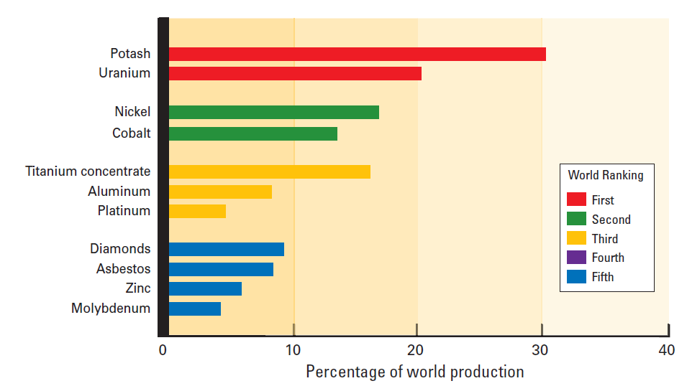
Balance of Trade
In 2010, Canada exported $85 billion worth of minerals and primary metals to 130 different countries. Canada also imports many minerals and mineral products. In 2010, Canada’s mineral imports totalled $67 billion. The difference between imports and exports is called the balance of trade.

Slide 10
Environmental Impact
Although mining occurs on less than 0.03% of Canada’s land area, the mining industry has a big ecological footprint.
The mining industry uses a great deal of energy. Fossil fuels are burned to run machinery and transportation equipment, and a great deal of electricity is needed to mill and refine minerals. These processes have far-reaching effects on air and water quality, and they contribute to greenhouse gas emissions.

Slide 11
What are we doing to lessen the impact?
Sometimes a mining company will work with a local community to re-establish wildlife habitat or to develop golf courses, recreational lakes, and parklands on closed mine sites.
Governments are responsible for enforcing environmental laws and ensuring that landscapes and ecosystems that have been affected by mining are restored.

Slide 12
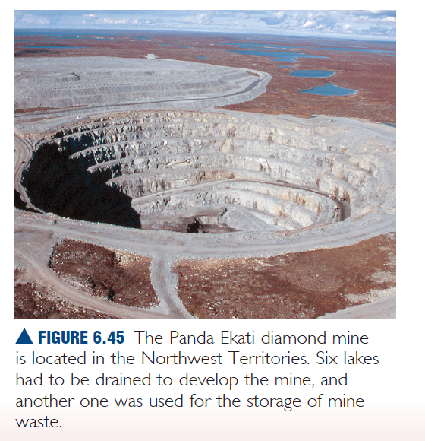
How about this for Impact?

Slide 13
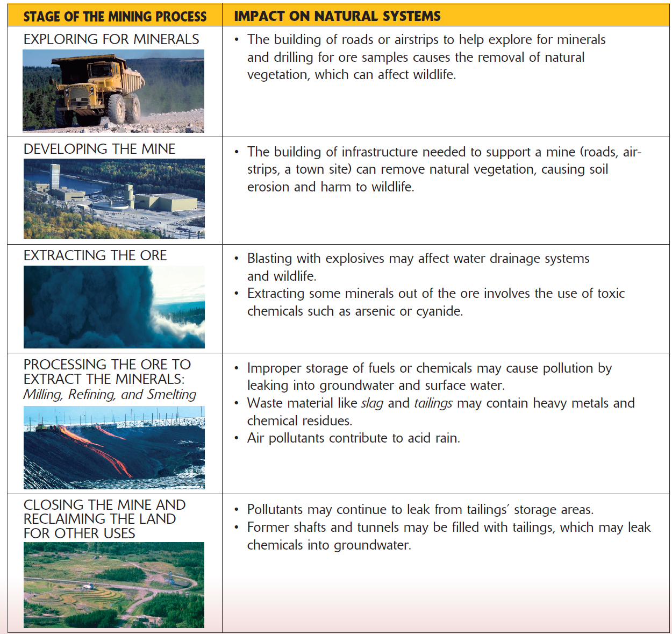
Impact at a glance….

Slide 14
Acid Rain
Acid precipitation, commonly known as acid rain, includes rain, fog, and snow that is highly acidic and a threat to the forests, lakes, fish, and the shallow soils of the Canadian Shield. Acid rain is a problem in Atlantic Canada because many water and soil systems lack natural alkalinity and cannot neutralize acid.
Most acid rain is caused by human activities that produce particles and gases of sulphur and nitrogen oxide. The burning of coal or oil in electrical generating plants and the burning of gasoline in transportation vehicles are the main causes of acid rain.
  The biggest producers of these pollutants are the refining and smelting industries, which separate metallic minerals, such as nickel, lead, and zinc from the rock in which they are found.

Slide 15
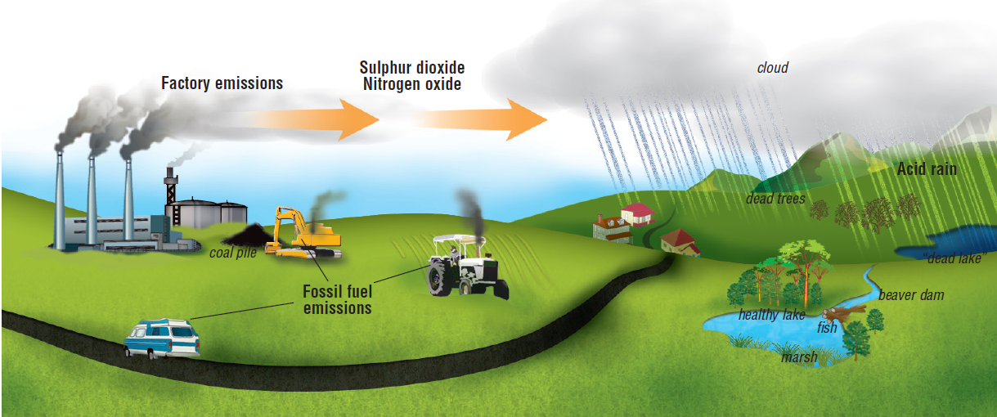
Not all the acid rain is produced in Canada. prevailing westerly winds carry emissions into Canada from power plants and industries located in the midwestern United States. The eastern United States, in turn, suffers from acid rain produced by industries in Canada.

Slide 16
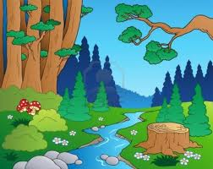
Forestry
Canadian Geography
Pages 284-295

Slide 17

Why do we cut down trees?
More than 300 communities in Canada depend on forestry – paper, building materials, heating, scenic beauty, syrup, wine etc…
Canada’s forest resources make a
significant contribution to the economy.
It provides jobs for people – logging, paper mills, silviculture, tapping

Slide 18
Types of Forestry
Clear-cutting: A logging method that involves clearing an area of all its trees at one time. It is often done in large patches. Clear-cutting is the least expensive and is a safer method for loggers
Strip logging: a form of clear-cutting in which long strip of land are cleared of trees, leaving some islands of forests intact. This method reduces soil erosion, is less disruptive to some wildlife (birds, moose), and allows natural reseeding to take place.
Shelter wood cutting: used in an area of trees that are all generally the same age. Once the trees have regenerated , the rest of the mature trees are cut again.
Selection cutting: used where there are different types
of various ages. It is also used to remove diseases in
trees. Selective cutting is the most dangerous and, most
expensive because we have to build roads to get to these
trees.

Slide 19
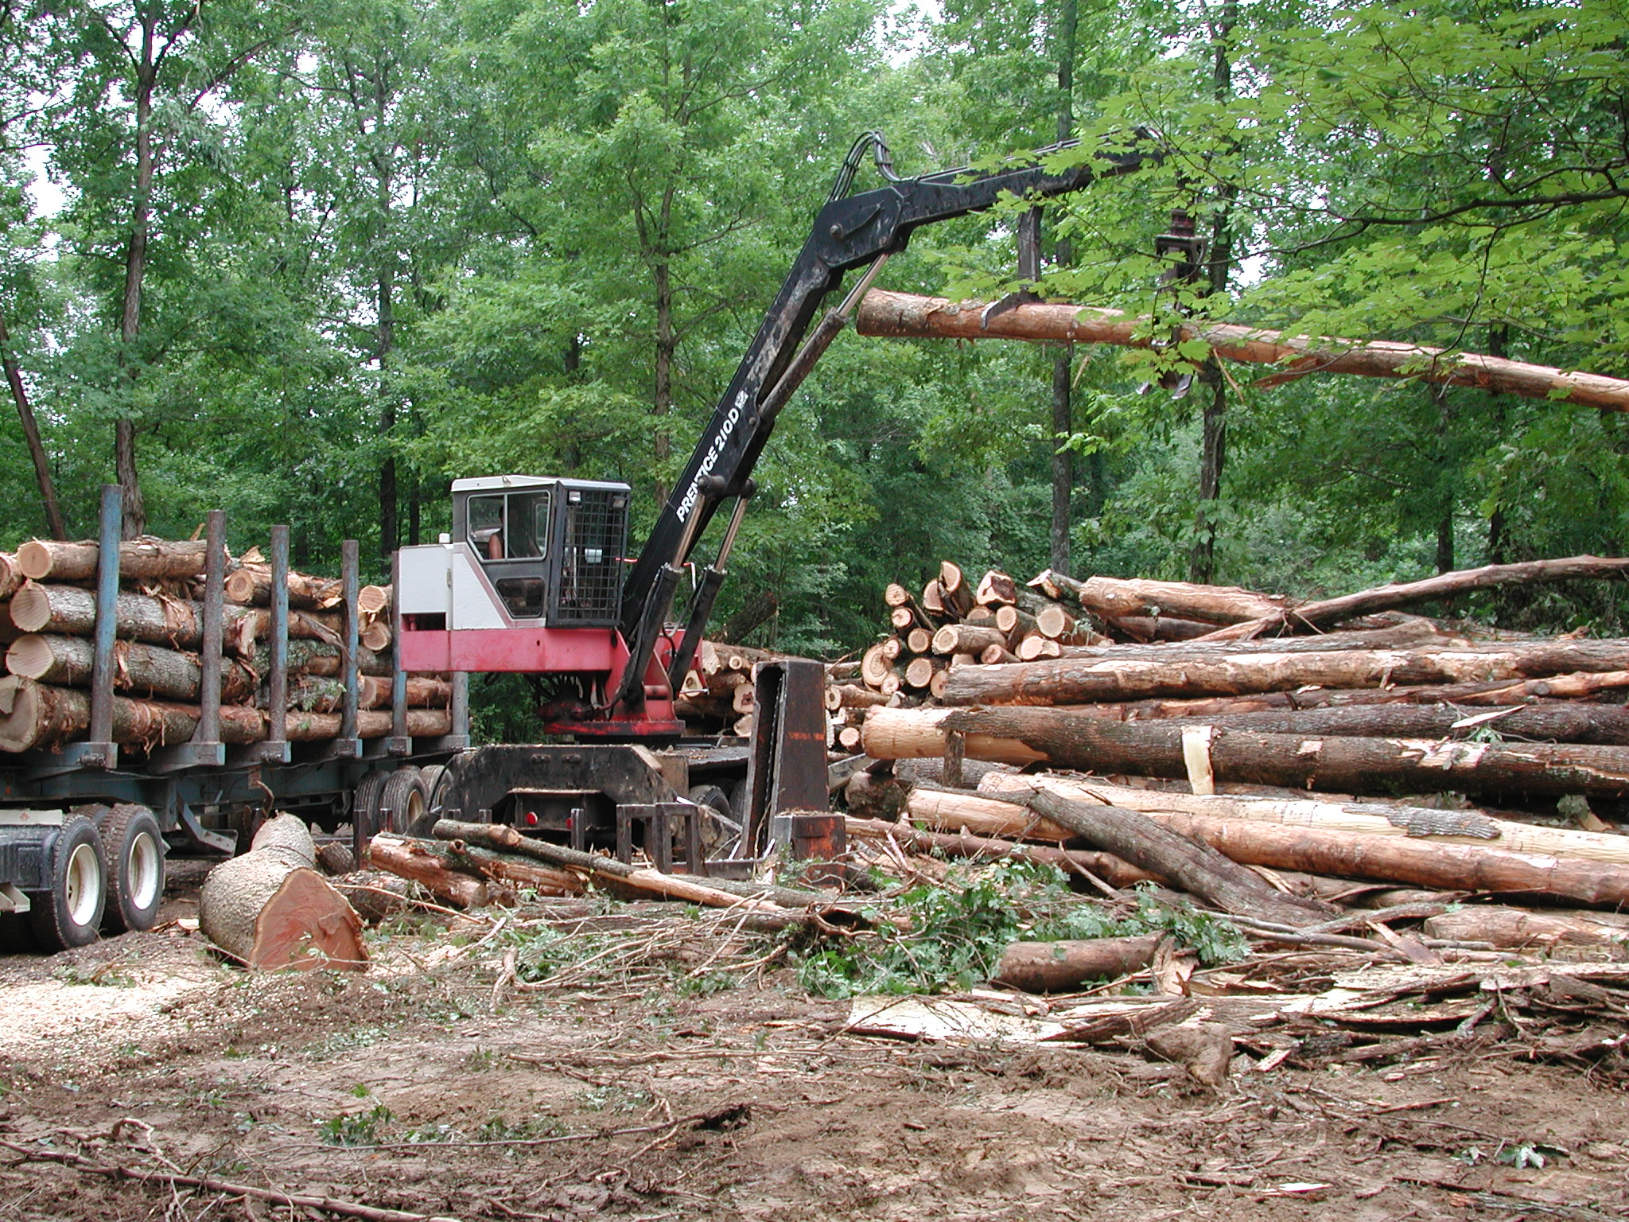
Forest Resources

Slide 20
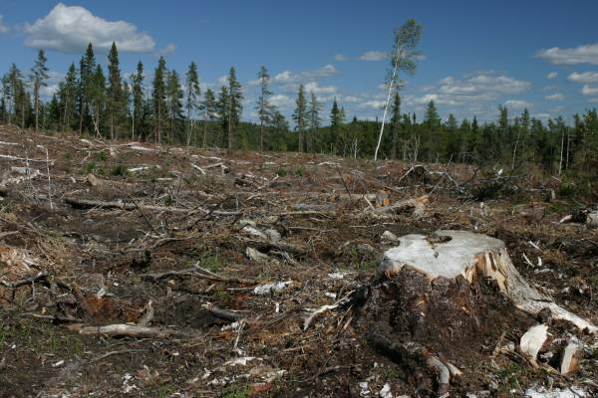
Tree Harvesting - 1. Clear Cutting
forest harvesting that removes all trees from an area.
Includes desirable AND undesirable species
the land is left uncovered.

Slide 21
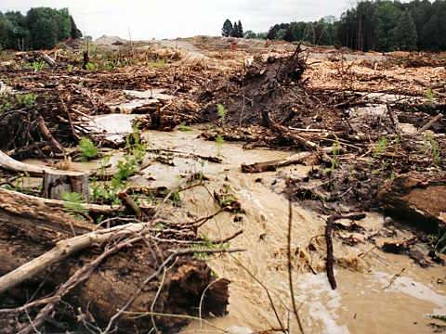
Clear Cutting
Advantages
  Most rapid
  economical
  and least dangerous form of harvesting.
  Disadvantages
  Leaves behind a poor looking landscape.
  Ecosystem has a very difficult time recovering.
  Soil is defenseless to erosion. Especially sloped land
  Wildlife habitats are disturbed.

Slide 22
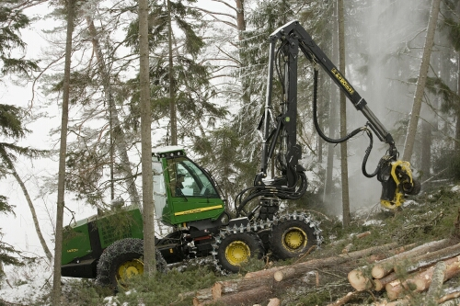
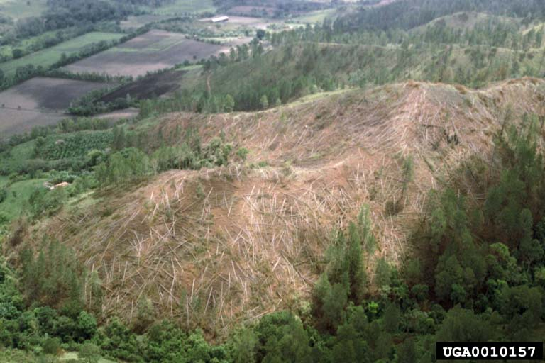
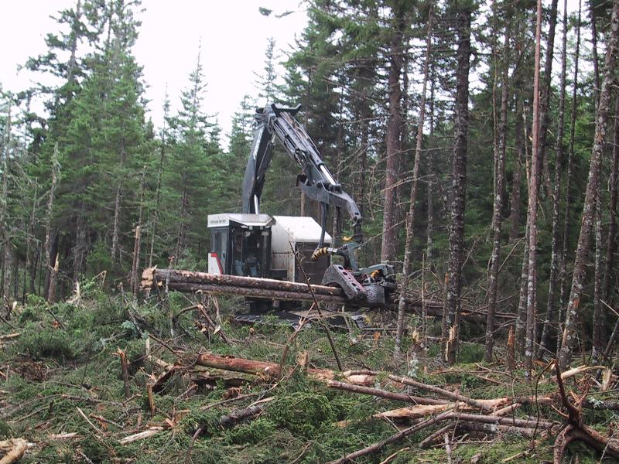
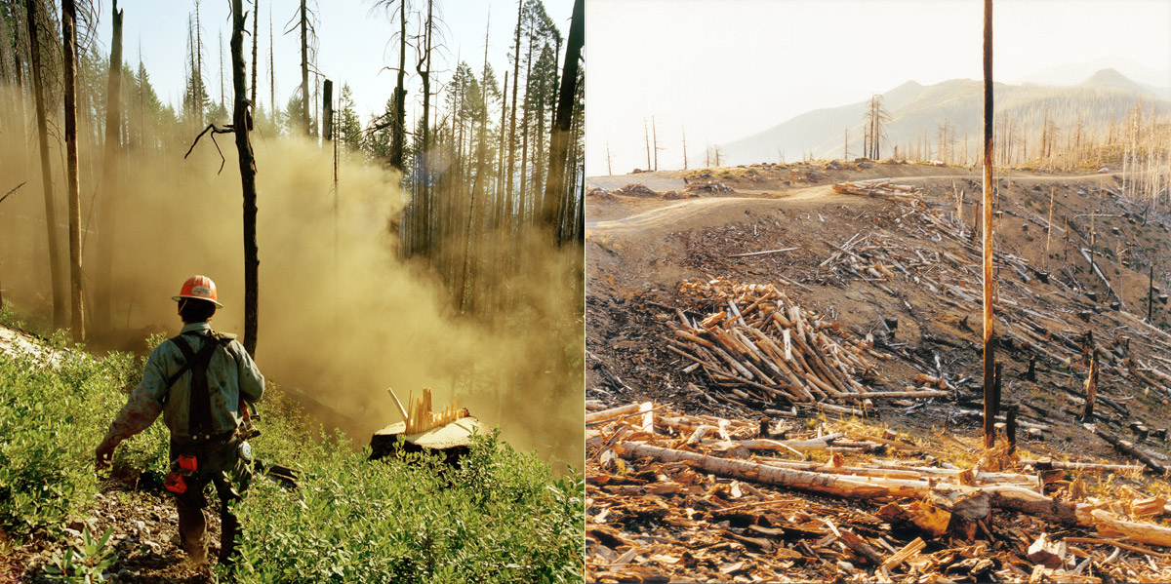
Tree Harvesting –Clear Cutting

Slide 23
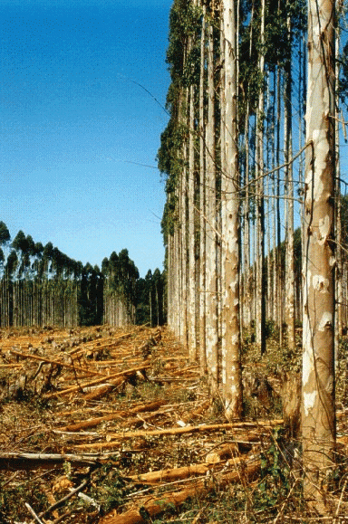
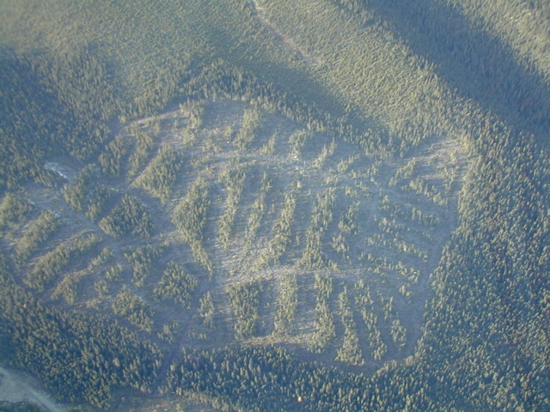
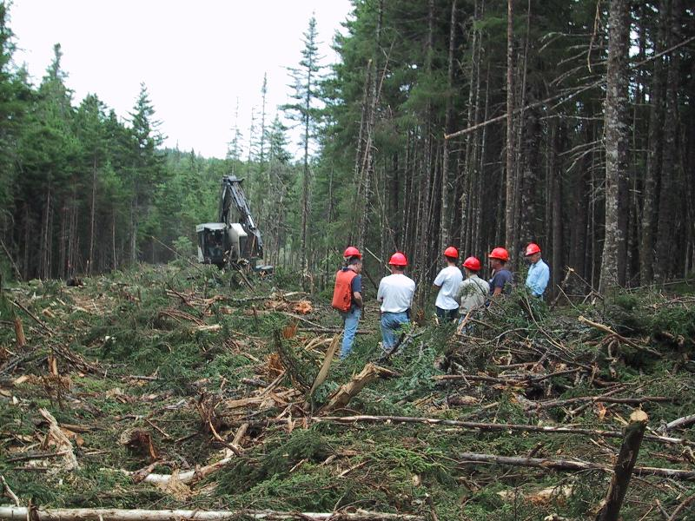
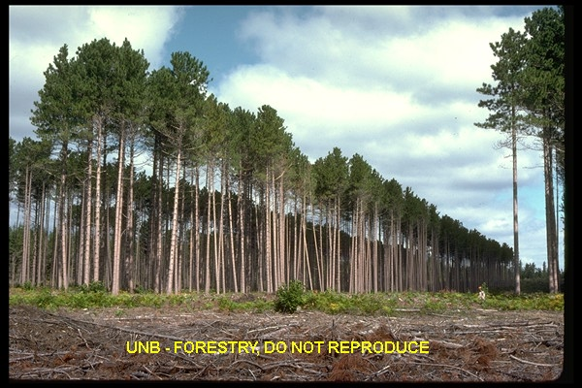
Tree Harvesting –Strip Cutting
a variation on clear cutting where strips of forest about 1 or 2 ha are left between the clear cut areas.

Slide 24
Strip Cutting
Advantages
  Less ecological disruption than clear cutting.
  Soil erosion is less severe.
  Forest can regenerate naturally without human help.
Disadvantages
  Requires a larger section of forest to produce the same amount of yield.
  More disruption to the ecosystem. Ex: extra roads.

Slide 25
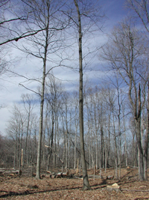
Tree Harvesting –Selective Cutting
forest harvesting that removes only mature trees and leaves the other trees in place.
Immature trees, undesired species and underbrush is all left intact.

Slide 26
Selective Cutting
Clear cutting has the advantage of being economical and safe whereas selective cutting has the advantage of leaving the ecosystem intact.
Selective cutting is the most expensive method of cutting for companies.
Proves to be the most dangerous as well.

Slide 27
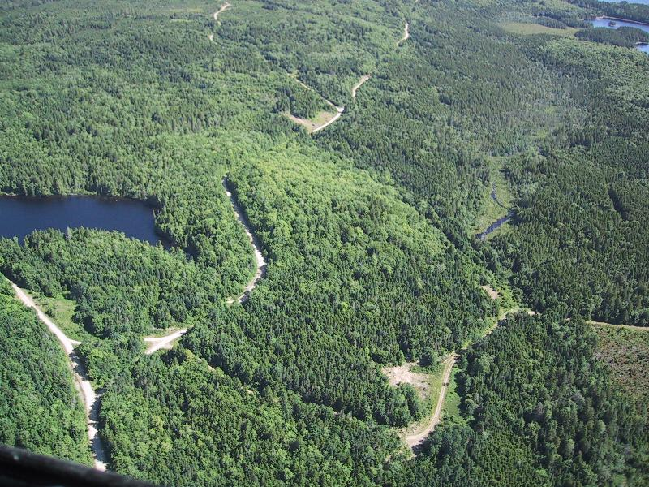
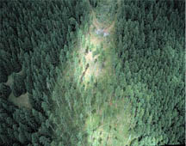
3. Selective Cutting
Advantages
  Leaves the biggest portion of the forest intact.
  Causes the least ecological disruption.
Disadvantages
  Most expensive method.
  Yields are lower.
  Care must be taken to avoid damaging unharvested trees.
  Roads must be maintained longer to keep harvesting mature trees.

Slide 28
Importance of the Forests
Forests prevent soil erosion through the use of their roots (roots hold the soil together).
Prevent flooding… Trees take up much of the water.
Prevent soil from drying up… SHADE soil and forest floor from warm temps.
Wind break that prevents wind erosion… Wind would blow the soil away…epsecially dry soil.

Slide 29
Importance of the Forests
Forests also add decaying material to the soil (humus content) otherwise the soil would have less to no nutrients.
Help filtrate the water.
Recycles air…CO₂ into O_{2.}
Base of the food chain for many ecosystems.

Slide 30
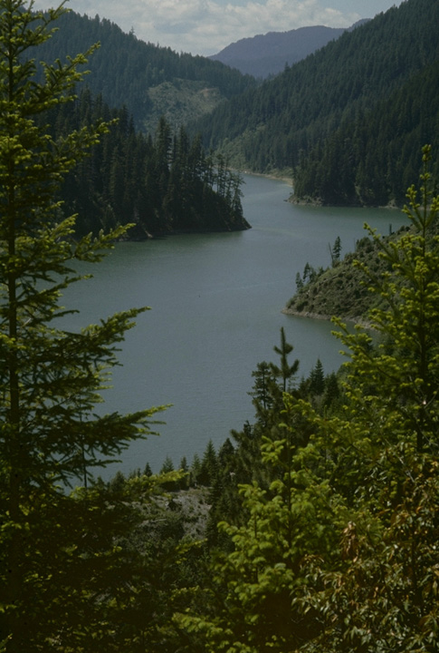
Sustainable Forestry
Sustainable means to manage or maintain something so that it remains and provides benefits over the LONG term.
Sustainable forestry… is a method of harvesting AND using the forests so that the resource is not depleted or permanently damaged.
FACT
If we cut trees faster than they grow back, we will run out of trees... NO KIDDING!!!

Slide 31
Jeopardizing “Sustainable forests!”
WORLD POPULATION INCREASES CAUSES:
The demand for forestry products increases (It is a RESOURCE with value)
the demand for forestry land to be converted to other uses…housing, mining, and hydro-electricity projects, etc..

Slide 32
Sustainable Forestry…HOW??
Improve what we input into forestry (replanting & seeds)
Improve processes like:
  road construction
  harvesting techniques
  environmental protection actions
  reducing losses (use all of the tree)
Reduce the need of output product Or even Maximize use.
  Recycle, use all parts, reduce wastage etc..
  Use of alternate building materials

Slide 33

Concerns of the forest:
People are overusing our forests which is a major concern for their sustainability. If we cut down all our trees, were driving animals out of their natural habitats which will probably result in them dying out. Canada’s forests are home to thousands of different species, and mistreatment of land causes these animals to migrate to unknown areas.
If there is no forestry people will get laid off and have to find new jobs. People will lose jobs in forestry, hunting, farming, etc... People over use our trees and it is putting stress on the environment to support our breathing needs and needs of the forestry economy.
If people keep cutting trees at the rate they are now, there will be more concentration of carbon dioxide in the atmosphere, as trees filter the carbon dioxide and produce oxygen for humans and animals. People are tearing up natural pieces of land for city construction, polluting the air.

Slide 34
Important terms involving forestry:
Boom/Bust cycles: when times are good, more houses are built and more books are sold creating more jobs. In times of recession people are laid off and jobs decreases.
Commercial forest: Forested land that is capable of producing marketable, such as timber.
Timber: the wood that has been prepared for use as a building material.
Carbon Sink: a natural storage of carbon in forests, soil, or the ocean that would otherwise be in the atmosphere.
Forest Management Plan: a plan of long-term goals for an area to be logged that is required by law in Ontario.
Model Forests: a new approach to sustainable management of small areas of local forest that involves input from all stakeholders who work together as a team.

Slide 35

Looking back…
List and describe reasons why people cut down trees and what they use them for?
Do you think there’s one or more type of pollution affecting trees? Explain.
How important are forest in your life? How might your view of forests be different from that of a logger?
Imagine that you are the owner of a large forest woodlot. Which method of cutting would you use to cut down trees? Explain why would you use this method.
Notes:
asxsww

Slide 36
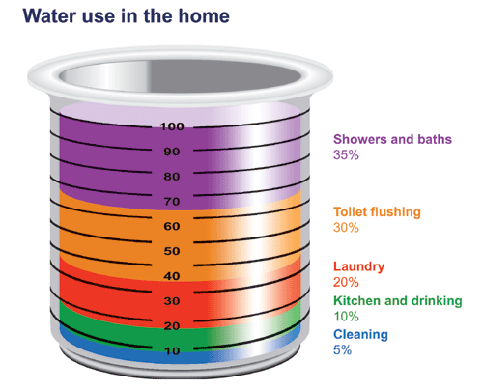
Statistics
-An average person uses approximately 343 liters of water per day, making it one of the highest consumers of water in the world.
-The majority of Canada’s fresh water is found in the form of rivers, lakes, groundwater, ice and snow.
-Canada has 20% of the fresh water
in the world.

Slide 37
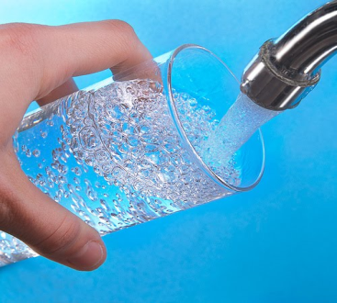
Importance of Water
Water is very important in our everyday lives. Our body is composed mostly with water around 60-70% and even while getting ready in the mornings we shower, brush our teeth or even drink it.
To farmers water is also very helpful, water is used to grow crops or water their gardens.
Without water, many people wouldn’t have jobs. Jobs such as skippers, marine engineers, fishermen, and even cooks rely on water for a source of capital.
About 40 million people in Canada and the United States depend on the largest fresh water system in the world known as the Great Lakes for water.
Some people think water is not a natural resource, it’s a basic human right. I agree with this because even though it comes from nature you can’t survive without it. Water is not just a essential part of life for humans but for animals such as fish especially.

Slide 38
Acid rain and its affect in our water
The ecological effects of acid rain are most clearly seen in the aquatic environments, such as streams, lakes, and marshes.
Acid rain flows into these bodies of water after falling on forests, fields, buildings, and roads. Acid rain also falls directly on aquatic habitats.
Acid rain primarily affects sensitive bodies of water, which are located in watersheds. It can also occur in the form of snow, fog, and tiny bits of dry material that settle to Earth. When humans burn fossil fuels, they are released into the atmosphere.
These chemical gases react with water, oxygen, and other substances to form mild solutions.
Acid rain has many ecological effects, but none is greater than its impact on lakes, streams, wetlands, and other aquatic environments. Acid rain makes waters acidic and causes them to absorb the aluminum that makes its way from soil into lakes and streams.

Slide 39
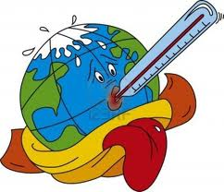
Global Warming and its affects on our Water Systems
Ocean currents are partially responsible for distributing heat around the Earth. As global temperatures rise, Arctic ice melts and massive amounts of fresh water pour into the North Atlantic and slow the Gulf Stream down.
By slowing or stopping this ocean current, global warming actually would cool Europe down dramatically. If other ocean currents were disrupted, the entire planet could experience the same cooling effect and cause an ice age.
The increase in the waters temperatures can also harm the species of animals that live in water or depend on water for survival.

Slide 40
Canada’s wetlands
Canada has 25% of the worlds total wetlands.
Provide food such as cranberries, wild rice, and fish, as well as important wildlife habitat.
Play an important role in protecting local water quality. Wetland plants clean water by filtering out sediments and pollution-even toxic chemicals.
Wetlands can be defined as water in a marsh, swamp, or fen (an area of low land covered with shallow water) that is fresh or salty, standing or flowing, and two to six metres in depth.
Are there any wetlands close to where you live?

Slide 41
Organisms In Water
Water is host to many microscopic living organisms like bacteria, viruses and parasites. A lot of these organisms are harmless, but the ones that cause diseases are called pathogens. In general, those organisms that are potential disease-producers are of primary concern. These are five types of organisms:
-bacteria,
-protozoa,
-worms,
-viruses,
-fungi
The presence of certain organisms of these many types can lead to infectious diseases such as jaundice, hepatitis, typhoid fever, cholera, as well as other diseases spread through drinking unsafe water. Tremendous strides have been made in the control of these diseases within recent years. Most of the credit has to go to sanitary engineers for their careful, consistent control of public water supplies. As proof, outbreaks of typhoid fever in either this country or Canada are rare. Natural disasters can play havoc with water supplies, but under routine conditions typhoid is no longer a serious threat. For now whole generations have grown up without the opportunity to develop a natural immunity to such diseases. Thus a failure in the protective system could result in far more people succumbing to the disease than in the past.

Slide 42
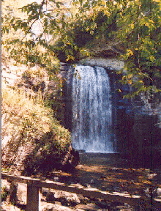
Water Erosion
Erosion: The process of water slowly degrading the soil quality.
When erosion occurs, the primary concern that it causes is washing away the top soil and making it more difficult for plant life to grow.
After a long period of time, erosion will make the farmland useless
due to the loss of fertile soil
Erosion will also cause habitat loss if the water lasts long enough
In that area.
Erosion is dangerous to farmers because of the effect of ruining
soil, if erosion occurs close to crops, farmers will have to replace
the soil, costing them more money and lowering their profit.

Slide 43
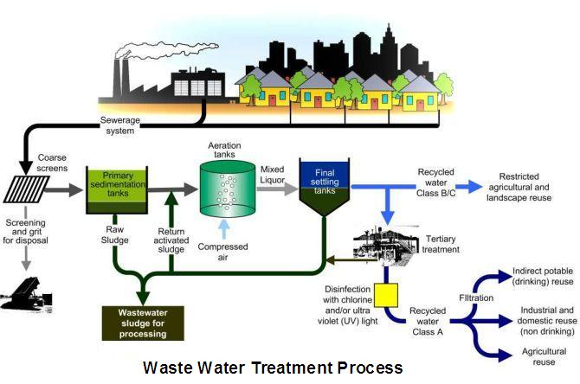
Sewage
People living in rural areas send their waste water to a septic system that must be approved by the local Municipal Government.
Most people in Canada live in communities with a municipal sewer system underground.
When the water is flushed down the drain it needs to be treated before being released back into the lakes and rivers.

Slide 44
Water Pollution
Water is used by many people around the world, but with use comes pollution and the water needs to be treated in treatment plants to remove the sewage from the dirty water.
Water is treated to kill pathogens and THM’s that cause health problems before we can drink it
It is also a big problem due to people polluting natural water sources such as ponds/lakes with garbage
This devastating in a world with a water shortage
Any chemicals that go down grounds lead to ground water contamination
Can be caused from oil spills and industrial development
Factories also play a huge role water pollution
R.R.

Slide 45
Key Terms
Water Ethics: A set of moral principles or beliefs about what is right and wrong when considering the use of water.
Commons: The natural resources such as the ocean or the atmosphere that belong to everyone.
Commodity: An economic resource such as a raw material or agriculture product that is exchanged for money.
Wetlands: A place where the water table is at ground level. (e.g, bog, swamp and marsh)
Water Diversion: The rerouting of water from one drainage basin to another.
Privatization: Changing ownership of a property or resource from public ownership by government to private ownership by an individual or business.

Slide 46
.. Key terms
Groundwater: Water found beneath the Earth’s surface in the spaces in soil and bedrock.
Fen: An area of low land covered with shallow water.
Algal Blooms: A rapid increase or accumulation in the population of algae (typically microscopic) in an aquatic system.
Septic System: A system that help clean the water that is deposited down the drains.
International Joint Commission (IJC): An organization created by a Canada-US treaty to prevent and resolve disputes over shared water and to approve water projects affecting both countries.

Slide 47
Water Sustainability
How can we sustain our water resource? In Canada, if we had control over all of our water resources would we be able to sustain it? Would we keep it all for our selves or export some to other countries who needed it? A good question to ask is:
Who controls Canada’s Water?
As part of the global marketplace, Canada is involved in the worldwide trend toward privatization (changing ownership of a resource from public ownership by government to private ownership by an individual or a business) of water supplies. This means the water is owned by a corporation and not the Canadian public. The main goal of any corporation is to make as much profit as possible. This would mean that they have little reason to conserve, and, in fact, consumption is encouraged. Would this effect water sustainability?
Several organizations in Canada are fighting against water privatization in order to protect water sources for the future to help keep it sustained. So far, Canada has not given permission for bulk fresh water exports, although bottled water exports are allowed.

Slide 48
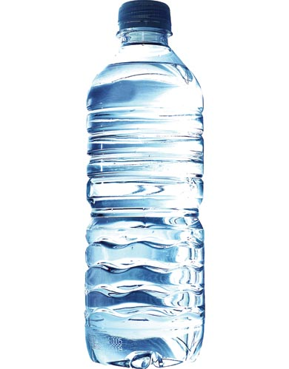
Journal Entry
Many counties have asked Canada to begin exporting bottled water to countries where there are water shortages. What advantages and disadvantages would result if Canada did start exporting water? If we don't?
Canada has more than enough water to meet the needs of its population. This has led to people taking this resource for granted. How would you rate the water usage in your community and why?
OR

