Slide 1
Water – The Essence of Life

Slide 3
Water – More than just a Natural Resource?
No one can live without water, but opinions differ on how to use it and the value of it.
Water Ethics – moral principles and beliefs about what is right and wrong when considering the use of water.
Question: Who should own water?

Slide 4
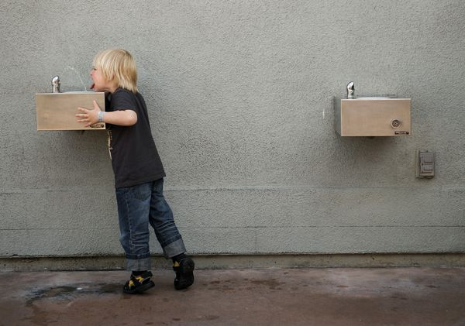
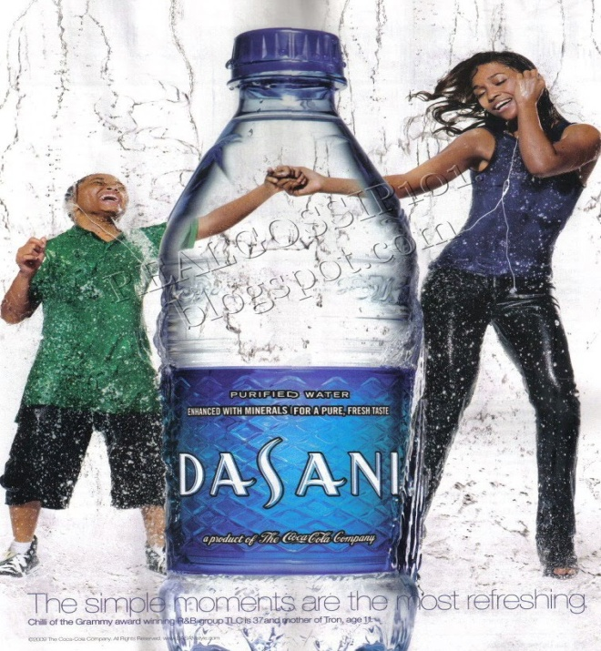
Views on Water
viewpoints vary re: the ownership of water:
The Commons: water belongs to everyone and should be protected by people and government.
We are not the only species that depend on water.
A Commodity: water may be owned privately and sold for a profit.

Slide 5
Where is Canada’s Water?
Canada has 20% of world’s fresh water, but much is unavailable for our use:
Water is too deep underground or in remote parts of Canada.
50% of this water flows into the Arctic Ocean, thus unavailable for densely populated areas of southern Canada.

Slide 6
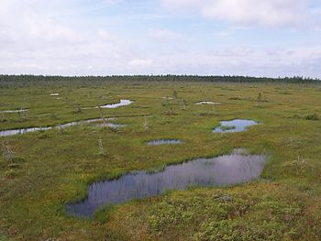
Wetlands
Canada has 25% of world’s wetlands.
Wetlands – water in a marsh, swamp, or fen, that is fresh or salty, standing or flowing and two to six metres in depth.

Slide 7
Importance of wetlands:
Crucial natural system and wildlife habitat
Protect local water quality
Have an economic, ecological, cultural, recreational, and scientific value.
As wetlands are drained to develop other land uses, water is affected.

Slide 8
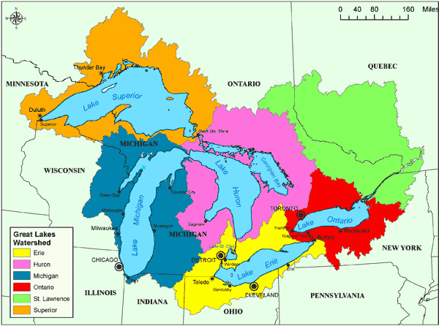
The Great Lakes Watershed
largest freshwater system in the world
About 40 million people (from Canada and US) depend on the Great Lakes watershed .
Each year, only 1 % of Great Lakes water replenished through precipitation and rivers

Slide 9
Pressure on Great lakes increasing as cities, industries and agriculture continue to expand and develop.
Great Lakes are shared between Canada and US
international cooperation is needed to protect the watershed.
The International Joint Commission (IJC) created by a Canada-US Treaty
prevent and resolve disputes over shared water and to approve projects affecting both countries.
Concerns include pollution, declining lake levels, and the impact of climate change.

Slide 10
Diverting Water
many US communities often have critical water shortages
Businesses have proposed Water Diversion
rerouting water from one drainage basin to another.
Ontario and Quebec and 8 American states signed agreement to ban large water diversions
but economic growth places more pressure on the Great Lakes.

Slide 11
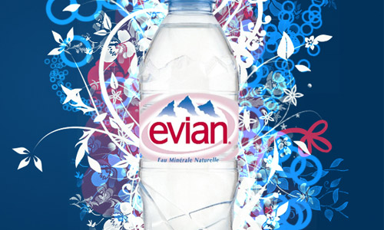
Who Controls Our Water?
Canada is part of worldwide trend towards the privatization of water supplies.
Private water supply – Owned by private companies and not the Canadian people.
company’s main goal is profit
This gives little reason to conserve water.

Slide 12
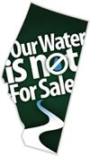
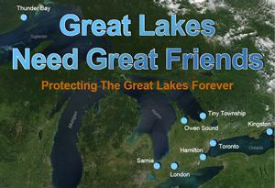
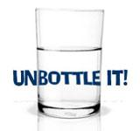
Several organizations in Canada are fighting against privatization of water in order to protect water sources for the future.

Slide 13
Protecting Our Water Resources
larger municipal water supplies are generally safe.
many factors can contaminate water, making it unsafe to drink.
Logging and mining operations produce contaminants
Small communities can’t afford expensive water treatment systems.

Slide 14
boil orders needed in rural communities often needed to ensure safety of drinking water
All provincial governments have declared safe drinking water a priority.
Strict laws and policies are put in place such as the Safe Drinking Water Act which sets out requirements for testing and treating municipal water.

Slide 15
Canadian Drinking Water Advisories
http://www.watertoday.ca/maptest4.asp?province=13
1838 Canadian Water Advisories in
http://www.ctvnews.ca/health/at-least-1-838-drinking-water-advisories-across-canada-report-1.2278160

Slide 16
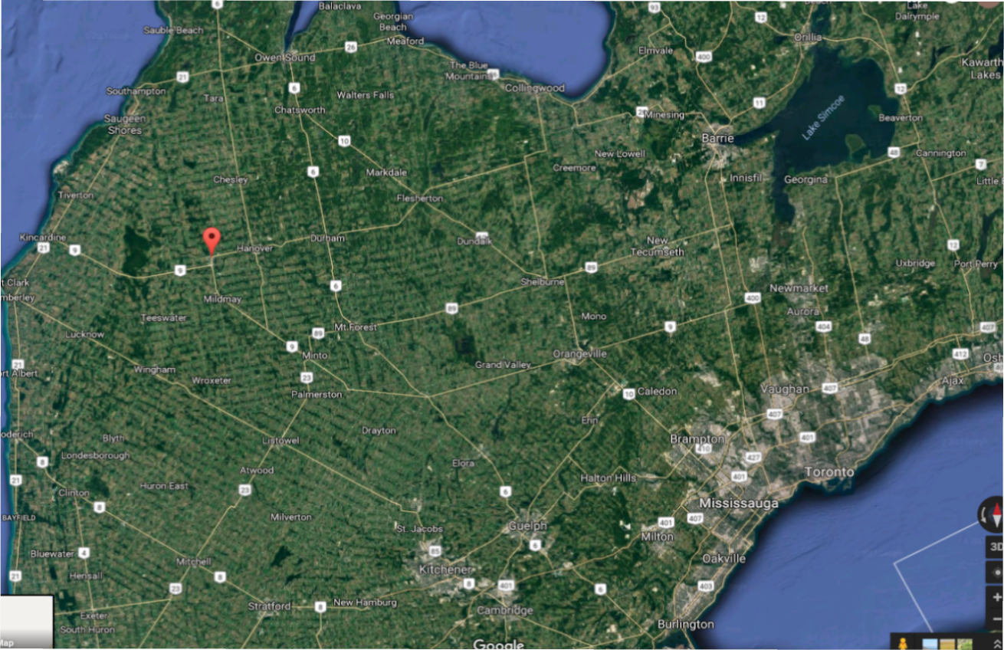
Walkerton, ON
5,000 residents of Walkerton, Ont. Their town's water supply was contaminated by a deadly strain of E. coli bacteria. By week's end, the outbreak in the picturesque farming community, 150 km northwest of Toronto, had killed five, put dozens in the hospital and stricken more than 1,000 with nausea, severe cramps and bloody diarrhea.

Slide 17
Groundwater Contamination
Groundwater – held in soil and rocks under surface of the earth
is naturally filtered by several layers of sand and gravel.
Industrial spills, pipeline and chemical tank leaks, and agricultural wastes seep into ground water source and eventually into lakes and rivers

Slide 18
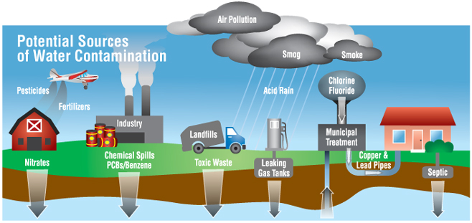

Slide 19
Treating you Drinking Water
we treat water and kill pathogens (bacteria or viruses) that make people sick.
Chlorine often used because it is inexpensive.
However, studies show a combination of chlorine and organic material in water can cause health problems and even cancer.
Ozonation and UV light are also good at killing pathogens and treating water.

Slide 20
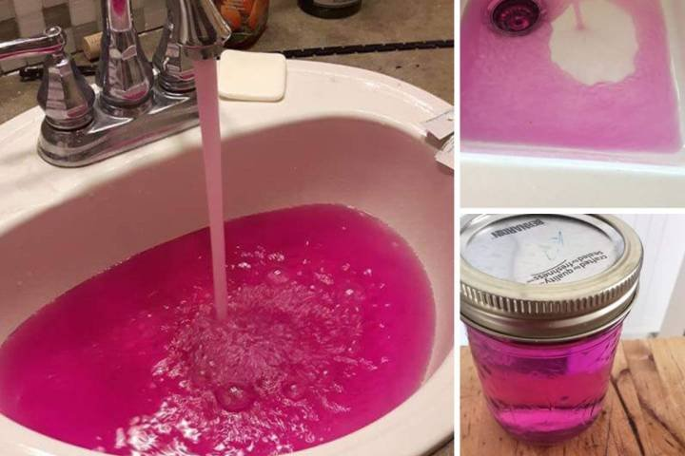

Slide 21
Treating your Sewage
Rural communities send waste to a septic system, which is approved by their local municipal government.
Many communities live in an area where there is a municipal sewer system underground
The water drained into the sewers must be treated before it is released into lakes and rivers.

